Slide 1
E-Commerce Analysis
Created by Shweta Purushothaman
Batch no.: WS103806

Slide 2
Outline
Introduction
Data Overview
Data Cleaning and Preprocessing
Feature Engineering
Exploratory Data Analysis (EDA)
Modelling Approach
Model Performance
Insights and Findings
Recommendations
Challenges and Limitations
Future Work
Conclusion
Appendix
References

Slide 3
Introduction
Project background and context
An international e-commerce company which sells electronic products wants to discover key insights from their customer database. They want to use some of the most advanced machine learning techniques to study their customers.
Problems we want to find answers
What was Customer Rating? And was the product delivered on time?
Is Customer query is being answered if product importance is high, having highest customer rating or being delivered on time?

Slide 4
Data Overview
The dataset used for model building contained 10999 observations of 12 variables.
The data contains the following information:
ID: ID Number of Customers.
Warehouse block: The Company have big Warehouse which is divided in to block such as A,B,C,D,E.
Mode of shipment: The Company Ships the products in multiple way such as Ship, Flight and Road.
Customer care calls: The number of calls made from enquiry for enquiry of the shipment.
Customer rating: The company has rated from every customer. 1 is the lowest (Worst), 5 is the highest (Best).
Cost of the product: Cost of the Product in US Dollars.
Prior purchases: The Number of Prior Purchase.
Product importance: The company has categorized the product in the various parameter such as low, medium, high.
Gender: Male and Female.
Discount offered: Discount offered on that specific product.
Weight in grams: It is the weight in grams.
Reached on time: It is the target variable, where 1 Indicates that the product has NOT reached on time and 0 indicates it has reached on time.

Slide 5
Data Cleaning and Preprocessing
Data Collection
Customer database of an electronic products selling e-commerce international company.
File source: .csv file
Data Inspection
Shape of the dataset: 10999(rows), 12 (columns)
No. of duplicate records: 0
Data types: int64(continuous data) and object(categorical data)
Continuous data variables: ID, Customer_care_calls, Customer_rating, Cost_of_the_Product, Prior_purchases, Discount_offered, Weight_in_gms, Reached.on.Time_Y.N
Categorical data variables: Warehouse_block, Mode_of_Shipment, Product_importance, Gender
Handling Missing Data
No. of missing values: 0

Slide 6
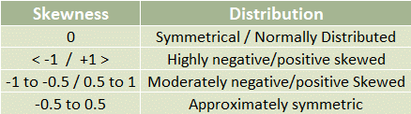
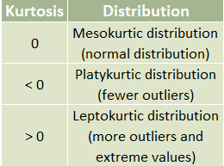
Data Cleaning and Preprocessing
Outlier Detection
Skewness: it tells us the direction of potential outliers. Skewness
is the spreadness of the Distribution.
Kurtosis: It helps identify whether the data has heavy tails (outliers) or is
more concentrated around the mean (light tails) compared to a normal
distribution. Kurtosis is a measure of tailedness of a distribution.
No. of outliers detected: 2 (Prior_purchases and Discount_offered)

Slide 7
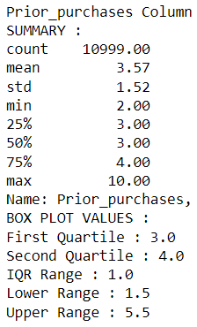
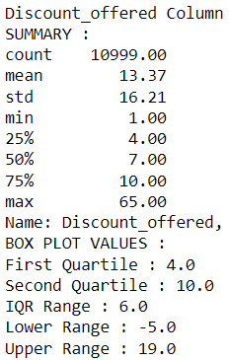


Data Cleaning and Preprocessing
Outlier Detection: we used Box Plot (it is the non-parametric method) technique
Outlier Treatment: Remove the outlier from the dataset based on Upper and Lower Range respectively

Slide 8


Feature Engineering
Feature Selection
Recursive Feature Elimination: removing the least important features based on model performance. Gender and ID columns which give us no relevant information for analysis. Hence we can drop them.
Feature Extraction
Categorical Data: Encoding categorical variables into numerical format
(Warehouse_block, Mode_of_Shipment, Product_importance)

Slide 9
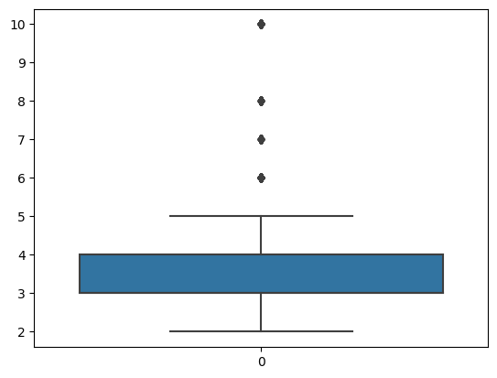
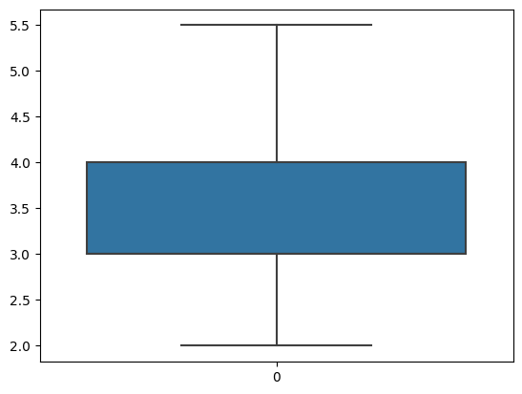
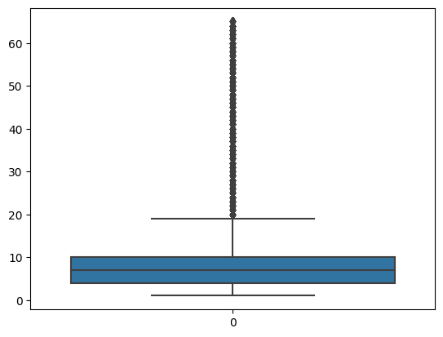
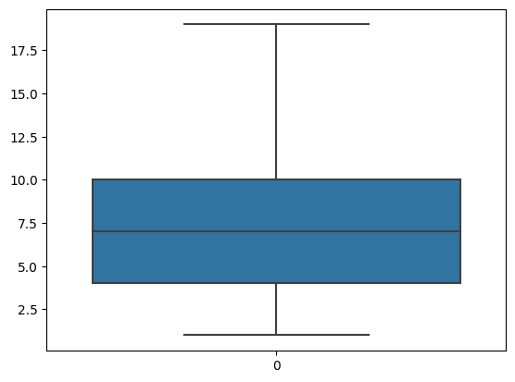
Exploratory Data Analysis (EDA)
Prior_purchases Column
(Boxplot of before and after treatment)
Discount_offered
Column (Boxplot of before and after treatment)
Visualising the Outlier Treatment

Slide 10
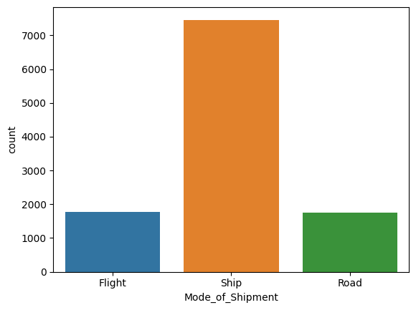
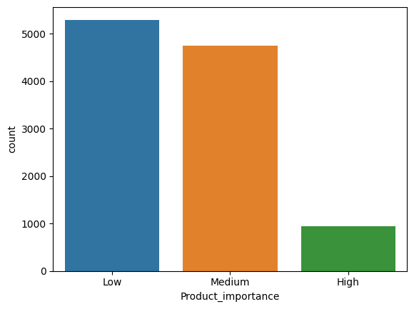
Exploratory Data Analysis (EDA)
Visualizing the mode of shipments
Visualizing the product importance
The maximum shipment was made using ships, secondly for flight and the minimum mode is for road
The maximum count is for low, secondly for medium and the minimum count is for high importance

Slide 11
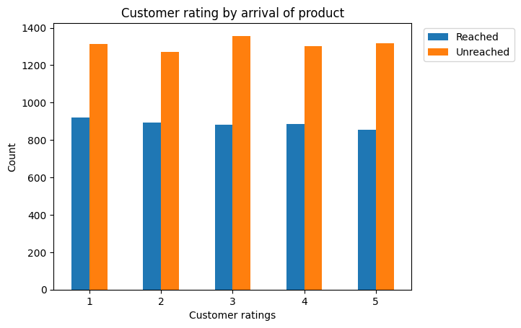
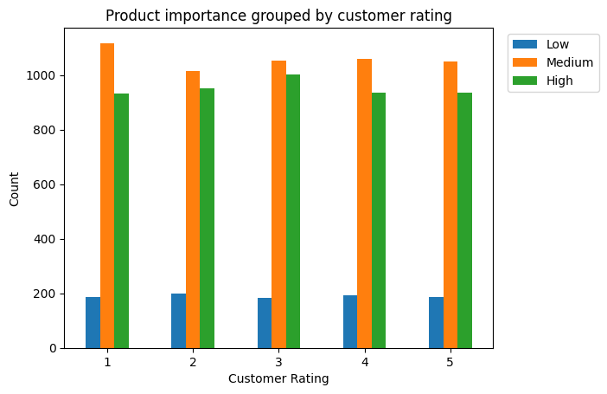
Exploratory Data Analysis (EDA)
Visualizing the Customer Rating against product reached on time
Visualizing different product importance grouped by customer ratings
For all the ratings the unreached counts is between 1200-1400 and the reached counts is between 800-1000
The highest unreached items had the rating as 3
The highest reached items had the rating as 1
In a majority products with medium importance are more and the rating is 1
Products with highest importance has maximum rating as 3 and with lowest importance has maximum rating as 1

Slide 12
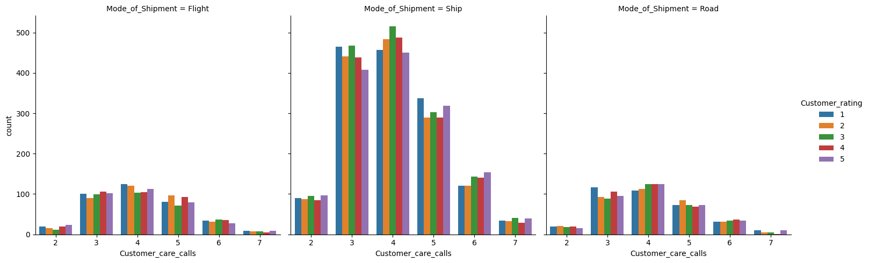
Exploratory Data Analysis (EDA)
Visualizing each mode of shipment with number of calls made to the customer service and their customer ratings
for all the modes of shipment the majority of number of calls made to the customer service was 3,4,5.
for Flight shipment the frequency of high no. of call was 4 and the highest ratings given was 1.
for Ship shipment the frequency of high no. of call was 4 and the highest ratings given was 3.
for Road shipment the frequency of high no. of call was 4 and the highest ratings given was 3, 4, 5.

Slide 13
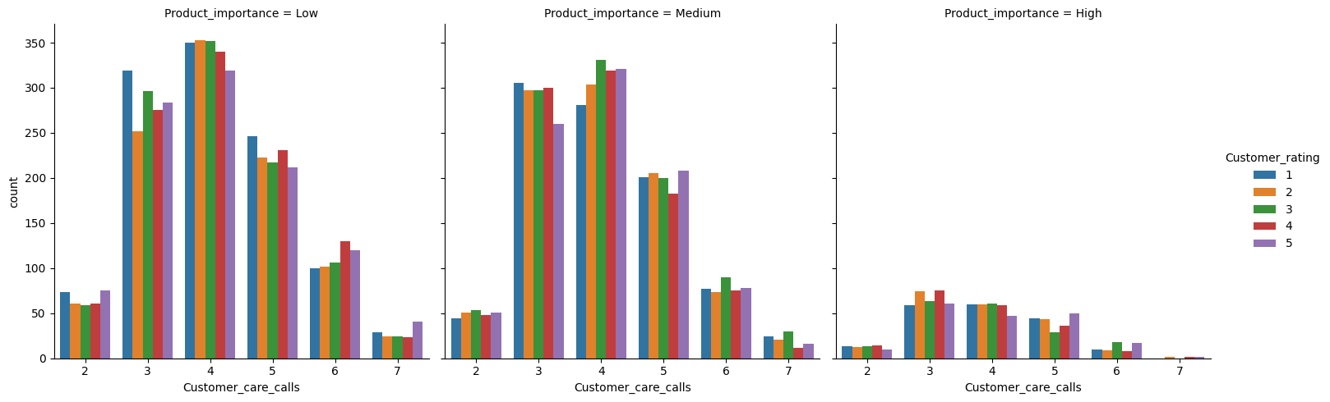
Exploratory Data Analysis (EDA)
Visualizing each product importance with their customer ratings and no. of calls made to the customer service
for all the product importance entities the majority of number of calls made to the customer service was 3,4.
for low importance items the frequency of high no. of call was 4 and the highest ratings given was 2.
for medium importance items the frequency of high no. of call was 4 and the highest ratings given was 3.
for high importance items the frequency of high no. of call was 3 and the highest ratings given was 4.

Slide 14
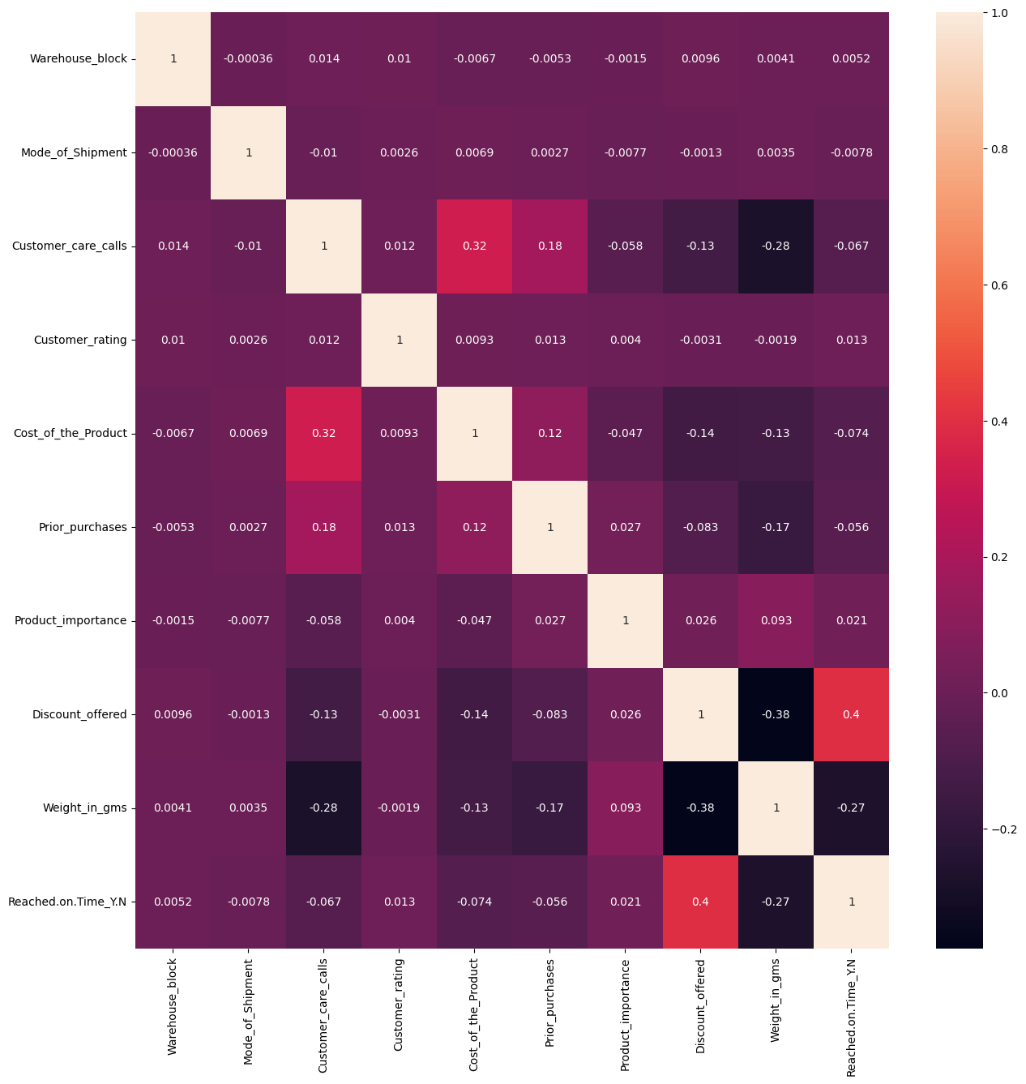
Exploratory Data Analysis (EDA)
Visualizing the correlation of different variables to check multi- collinearity
There is a high correlation between:
Weight_in_gms & Discount_offered
Weight_in_gms & Customer_care_calls
Weight_in_gms & Reached.on.Time_Y.N
Weight_in_gms & Prior_purchases

Slide 15
Modelling Approach
For the dataset, dependent variable (y = output variable) is 'Reached.on.Time_Y.N' column and rest of the columns are independent variables (X = input variable)
The target variable is dichotomous in nature (0/1). Hence, we will consider Binary classification for model building
Binary classification is a supervised learning algorithm that categorizes new observations into one of two classes.
There are several machine learning techniques which depends on factors such as the size and quality of your dataset, the complexity of the problem, and the computational resources.
Few common techniques I have used to identify the best fit model for the dataset by comparing their results. Below are the techniques which I have used:
Naive Bayes Model (Bernoulli Naive Bayes)
Logistic Regression
K-Nearest Neighbors (KNN)
Support Vector Machines (SVM)
Decision Tree
Boosted Decision Tree
Bagging Decision Tree
Random Forest Algorithm

Slide 16
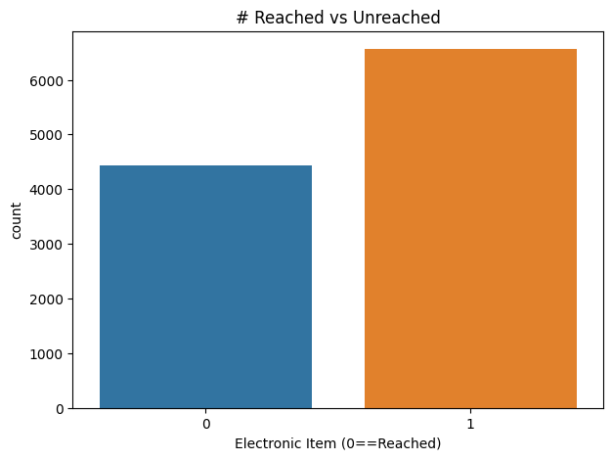
Modelling Approach
Divide data into Input and Output
X as Input(Independent variables) and y as Output(Dependent variable).
Split data into two parts train and test
Divide the dataset in 2 parts : Training data(80%) and Testing data(20%)
X and y will have XTraining, XTesting and yTraining, yTesting
Performance Testing
Training and test score
Receiver Operating Characteristic Area Under the Curve (ROC-AUC) score
The Root Mean Square Error (RMSE) value
Cross-validation
Confusion Matrix (Correct and Incorrect predictions)
Classification Report (Precision and recall – refer the Jupyter notebook)

Slide 17
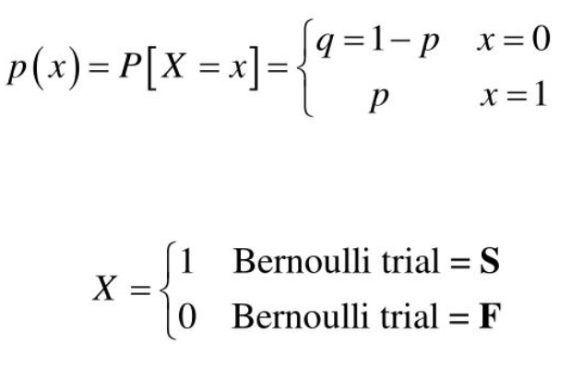
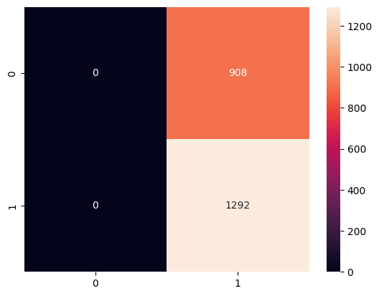
Model Performance
Naive Bayes Model (Bernoulli Naive Bayes)
Bernoulli Naive Bayes is a part of the Naive Bayes family.
Based on the Bernoulli Distribution and accepts only binary values, i.e., 0 or 1.
Success: p and Failure: q
q = 1 - (probability of Success) = 1 - p
Result:
Did not correctly identify any positive cases (TP = 0).
Did not incorrectly classify any positive cases as negative (FN = 0).
Model is not sensitive enough to the positive class
Failing to recognize positive instances.
Evaluation metrics: Defined model name and metrics
bnb

Slide 18
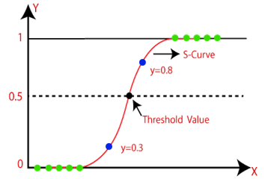

Model Performance
Logistic Regression
It uses the concept of threshold value
Values > threshold ~ 1 and values < threshold ~ 0
The S-form curve is called the Sigmoid/logistic function used to map the predicted values to probabilities
Evaluation metrics: Defined model name and metrics
lr
model1
After Standardization (by using StandardScaler)

Slide 19
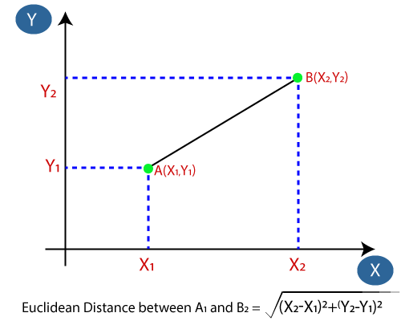
Model Performance
K-Nearest Neighbors (KNN):
Classifies data points based on the majority class among their k nearest neighbors in the feature space.
When new data appears, it can be easily classified into a well suite category by calculating the distance between the data points for all the training samples.
Evaluation metrics: Defined model name and metrics
model (k=3)
knn (k=48)
After selecting best k-value (by using GridSearchCV)

Slide 20

Model Performance
Support Vector Machines (SVM):
It creates the best line or decision boundary that can segregate n-dimensional space into classes in order to put the new data point in the correct category in the future.
SVMs aim is to find the best decision boundary which is called a hyperplane.
Evaluation metrics: Defined model name and metrics
classifier
SVMclassifier
After Standardization (by using StandardScaler)

Slide 21
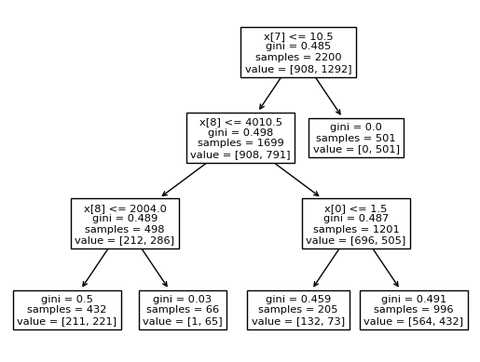
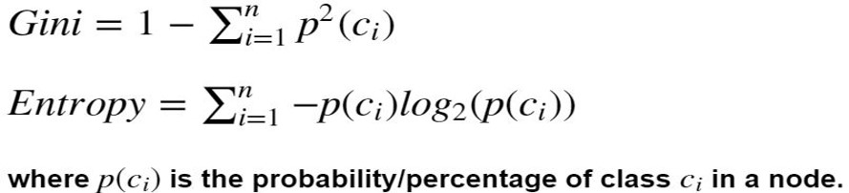
Model Performance
Decision Tree:
It’s is a flowchart-like tree structure where an internal node represents a feature, branch represents a decision rule, and each leaf node represents the outcome.
Topmost node is the root node. It partitions the tree in a recursive manner called recursive partitioning.
clf(1)
clf(2)
After adding tuning parameters (criterion="entropy/gini", max_depth=3)

Slide 22
Model Performance
Ensemble algorithms in order to improve the accuracy with base model as Decision Tree
It helps improve machine learning results by combining several models.
This approach allows the production of better predictive performance compared to a single model.
The most common Ensemble learning which we have used are as follow:
Boosting (AdaBoost)
AdaBoost is a good choice when you have a weak base learner and want to boost its performance.
It can work well in binary classification, particularly when you have a diverse set of weak learners.
Bagging
Bagging can be a good choice when you want to reduce variance and overfitting in your base model.
It's a simple yet effective ensemble technique.
Random Forest
Random Forest is a versatile and robust ensemble method that works well in a wide range of situations.
It can handle both numerical and categorical data, is less prone to overfitting, and typically doesn't require extensive hyperparameter tuning.

Slide 23
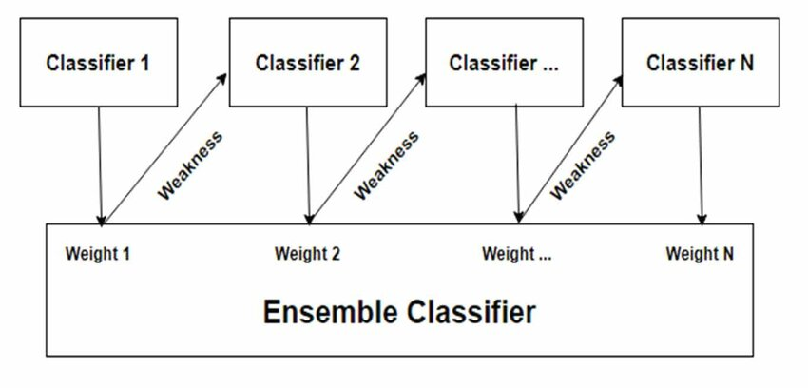
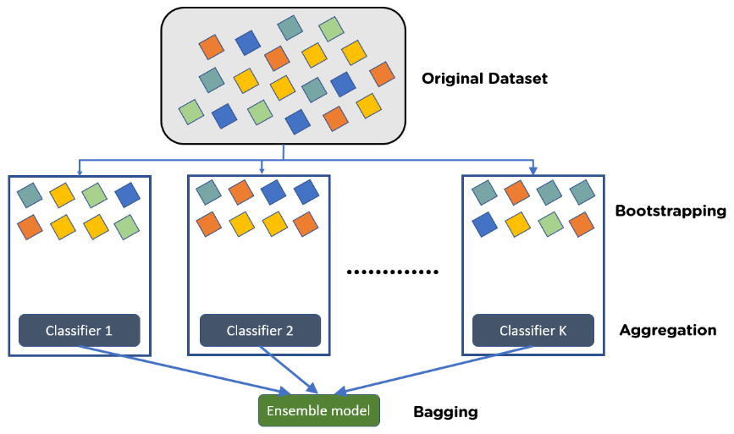
Model Performance
Adaptive boosting algorithm (AdaBoost)
It involves using very short (one-level) decision trees that are added sequentially to the ensemble which attempts to correct the predictions made by the model.
This is achieved by weighing the training dataset, focusing on training examples on which prior models had prediction errors.
After adding parameters still the model had under-fitting problem
boost_model
Bagging Algorithm (Bootstrap Aggregating)
Bootstrapping is the method of randomly creating samples of data out of a population with replacement to estimate a population parameter.
bag_
model

Slide 24
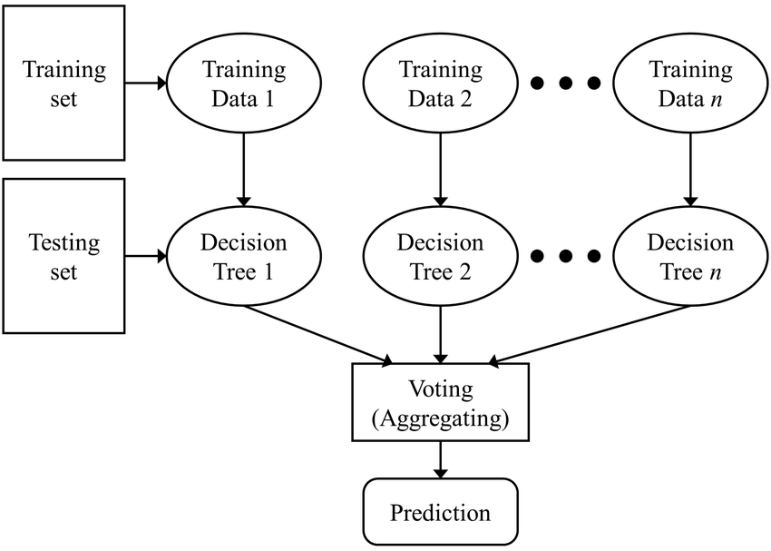
Model Performance
Random Forest Algorithm:
It combines the predictions of multiple decision trees to improve accuracy and generalization.
The greater number of trees in the forest leads to higher accuracy and prevents the problem of overfitting.
Evaluation metrics: Defined model name and metrics
rfc
Rfclassifier
After adding tuning parameters by using Gridsearch

Slide 25
Insights and Findings
Summarizing the key findings
Five classification machine learning models were implemented.
Out of all Decision Tree gave the best results.
Three ensemble learning algorithm was implemented with base model as Decision Tree.
Out of all ensemble algorithm, Random Forest algorithm gave the best result.
Actionable insights derived from the data
In the first phase of classification models underwent issues like,
Overfitting problem
Underfitting problem
To overcome the issues we used Standardization, GridSearch for identifying the best tuning parameters, hyper-tuning

Slide 26
Recommendations
In Output variable ‘0’ indicates order/item reached on time and ‘1’ indicates not reached on time.
Count for ‘0’ is 4436 and for ‘1’ is 6563.
Increase the count of items reached on time. It can be done by following ways:
Capacity Planning: determine the maximum number of items that can be processed within a given timeframe.
Demand Forecasting: anticipate future demand which can help to plan and allocate resources more effectively.
Efficient Processes: Optimize your production or service processes to maximize throughput.
Inventory Management: Maintain optimal level of inventory to meet demand without overstocking/understocking.
Resource Allocation: Ensure to have the right mix of resources, labor, equipment, materials, to meet service goals.
Monitoring and Reporting: Implement real-time monitoring systems to track service progress and identify issues.
Supply Chain Management: Collaborate closely with suppliers and logistic partners for smooth & timely supply chain.
Scenario Planning: Develop scenarios & contingency plans allowing to respond quickly to changing market conditions.
Collaboration and Communication: Foster open communication and collaboration among teams and departments to ensure everyone is aligned with production or service goals and can adapt to changing circumstances.

Slide 27
Challenges and Limitations
Challenges
Selection of Machine learning models.
Finding the issues and rectifying the results.
Noisy data, skewness and kurtosis.
Changing categorical data into numerical data
Limitations
Applied standardization at the start during EDA.
Weight_in_gms, Cost_of_the_Product and Discount_offered have greater values which can be standardized.
More columns could have been eliminated which doesn’t provide any insights for result.

Slide 28
Future Work
Analysis can be extended by splitting the data in different ratio. And then compare the results.
Implementing more machine learning techniques by including deep learning too.
Visualizing every possible scenarios.
Analysis can be improved by using GridSearch algorithm for choosing the best parameter for hyper-tuning at the start of each machine learning models.
Using stacking ensembled learning algorithm.

Slide 29
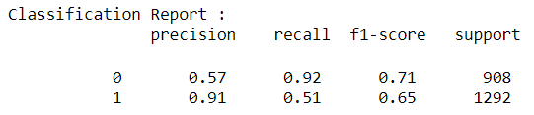
Conclusion
After analyzing all the models, we can conclude:
Out of all the models the Random Forest algorithm with base model as Decision tree gives the best result.
The accuracy is optimized.
Better and clearer predictions with highest precision, recall and f1-score.
Greater correct predictions and lesser incorrect predictions
Minimum RMSE value
High Cross Validation score

Slide 30
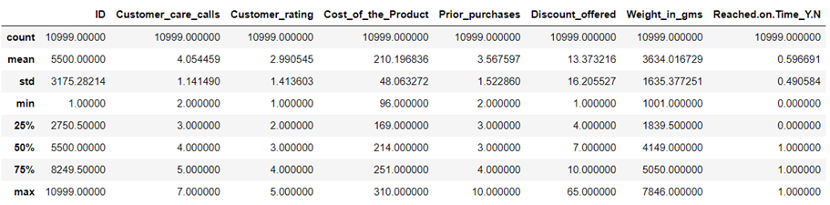
Appendix
Ecommerce dataset
Statistical Data

Slide 31
References
Machine learning models are implemented in Jupyter Notebooks
The flowcharts are downloaded from
www.javatpoint.com
www.datacamp.com
www.kaggle.com
The Dashboard is implemented in Tableau. Below is the link for accessing the responsive E-commerce Analysis Dashboard,
https://public.tableau.com/app/profile/shweta.purushothaman/viz/ShwetaPurushothaman_E-commerce_Capstone/Dashboard1?publish=yes

Slide 32
Thank you !!!

