Slide 1

MSPM’S Deogiri Institute of Engineering and Management Studies, Aurangabad Department of Computer Science and Engineering
Subject:- Theory of Computation Topic:- Pattern searching using naïve method
Submitted by Raviraj Sundararo Bondar(36161)
Shweta Duragadas Rajurkar(36162)
Under the Guidance of Prof. Sarika Chavan Asst.Prof.Department of CSE (Deogiri Institute Engineering and Management Studies) 2019-2020

Slide 2
Content
Problem Statement
Introduction
Method
Approach
Algorithm
Program
Output
Application
Conclusion

Slide 3
Problem Statement
Pattern searching using naïve method

Slide 4
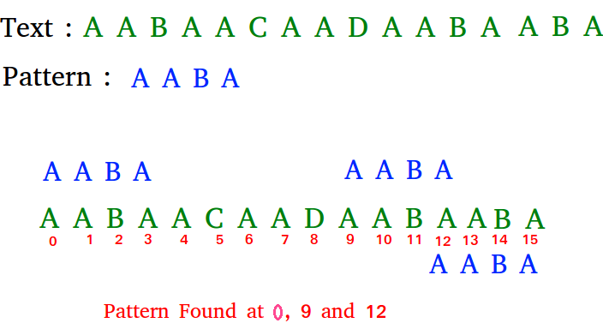
Introduction
The Pattern Searching algorithms are sometimes also referred to as String Searching Algorithms and are considered as a part of the String algorithms. These algorithms are useful in the case of searching a string within another string.

Slide 5
Method
Naïve pattern searching is the simplest method among other pattern searching algorithms. It checks for all character of the main string to the pattern. This algorithm is helpful for smaller texts.
The time complexity of Naïve Pattern Search method is O(m*n). The m is the size of pattern and n is the size of the main string.

Slide 6
Approach
We are using naive string search algorithm in this program.
We create a function match which receives two character arrays and returns the position if matching occurs otherwise returns -1.

Slide 7
Algorithm
naivePatternSearch(pattern, text)
Input: The text and the pattern
Output: location, where patterns are present in the text
Begin
patLen := pattern Size
strLen := string size
for i := 0 to (strLen - patLen), do
for j := 0 to patLen, do
If text[i+j] ≠ pattern[j], then
break the loop
done
if j == patLen, then
display the position i, as there pattern found
done
End

Slide 8
Program
def search(pat, txt):
M = len(pat)
N = len(txt)
# A loop to slide pat[] one by one */
for i in range(N - M + 1):
j = 0
# For current index i, check
# for pattern match */
while(j < M):
if (txt[i + j] != pat[j]):
break
j += 1
if (j == M):
print("Pattern found at index ", i)
# Driver Code
if __name__ == '__main__':
txt = (input("Enter the String : "))
pat = (input("Enter the Pattern : "))
search(pat, txt)

Slide 9
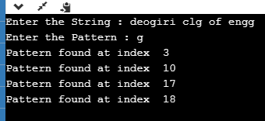
Output

Slide 10
Application
Web search engine
Spam filters
Parser
Digital library
Word processor
Screen scrapers
Natural language processing
Computational molecular biology

Slide 11
Conclusion
Hence we have to implemented pattern searching using naïve method using python programming language.

Slide 12
THANK YOU!!

