Slide 1
Predicting Repeated Customers based on the purchase behavior using Customer Segmentation
Presented by :
Shweta Tatiya

Slide 2
Problem Statement
In today’s business world it is difficult to build loyal relationships with customers, where customer retention is a major issue. It is generally believed that loyalty and customer satisfaction is a key factor in repurchasing
Predicting the ‘Repeat Purchase’ behavior of an existing customer using customer segmentation and RFM analysis model.
We use geographical segmentation data of customers for over a year to predict ‘Loyal Customers’ , ‘Best Customers’ , ‘Lost Customers’ by finding the recency frequency and monetary values .

Slide 3
Customer Segmentation
Customer segmentation relies on identifying key differentiators that divide customers into groups that can be targeted. Information such as a customers' demographics (age, race, religion, gender, family size, ethnicity, income, education level), geography (where they live and work), psychographic (social class, lifestyle and personality characteristics) and behavioral (spending, consumption, usage and desired benefits) tendencies are taken into account when determining customer segmentation practices.
In ecommerce companies like online retails, customer segmentation is necessary in order to understand customers behaviors.
It leverages acquired customer data , transactions data in order to divide customers into groups. Our goal is to cluster our customers to get insights in
Increasing revenue (Knowing customers who present most of our revenue)
Increasing customer retention
Discovering Trends and pattern
Defining customers at risk

Slide 4
RFM Model Analysis
RFM (Recency, Frequency, Monetary) analysis is a customer segmentation technique that uses past purchase behaviour to divide customers into groups.
RFM helps divide customers into various categories or clusters to identify customers who are more likely to respond to promotions and also for future personalization services.-
RECENCY (R): Days since last purchase
FREQUENCY (F): How many times a customer purchased from us
MONETARY VALUE (M): Total money this customer spent.
RFM Analysis answers these questions:-
Who are our best customers?
Who has the potential to be converted in more profitable customers?
Which customers we must retain?
Which group of customers is most likely to respond to our current campaign?

Slide 5
Contd …

Slide 6
Pareto Principle
Commonly referred to as the 80-20 rule on our dataset by applying it to our RFM variables.
Pareto’s rule says 80% of the results come from 20% of the causes.
Similarly, 20% customers contribute to 80% of your total revenue.
Notes:
Based on the rank 20% top customers are predicted and are given RFM score based on

Slide 7
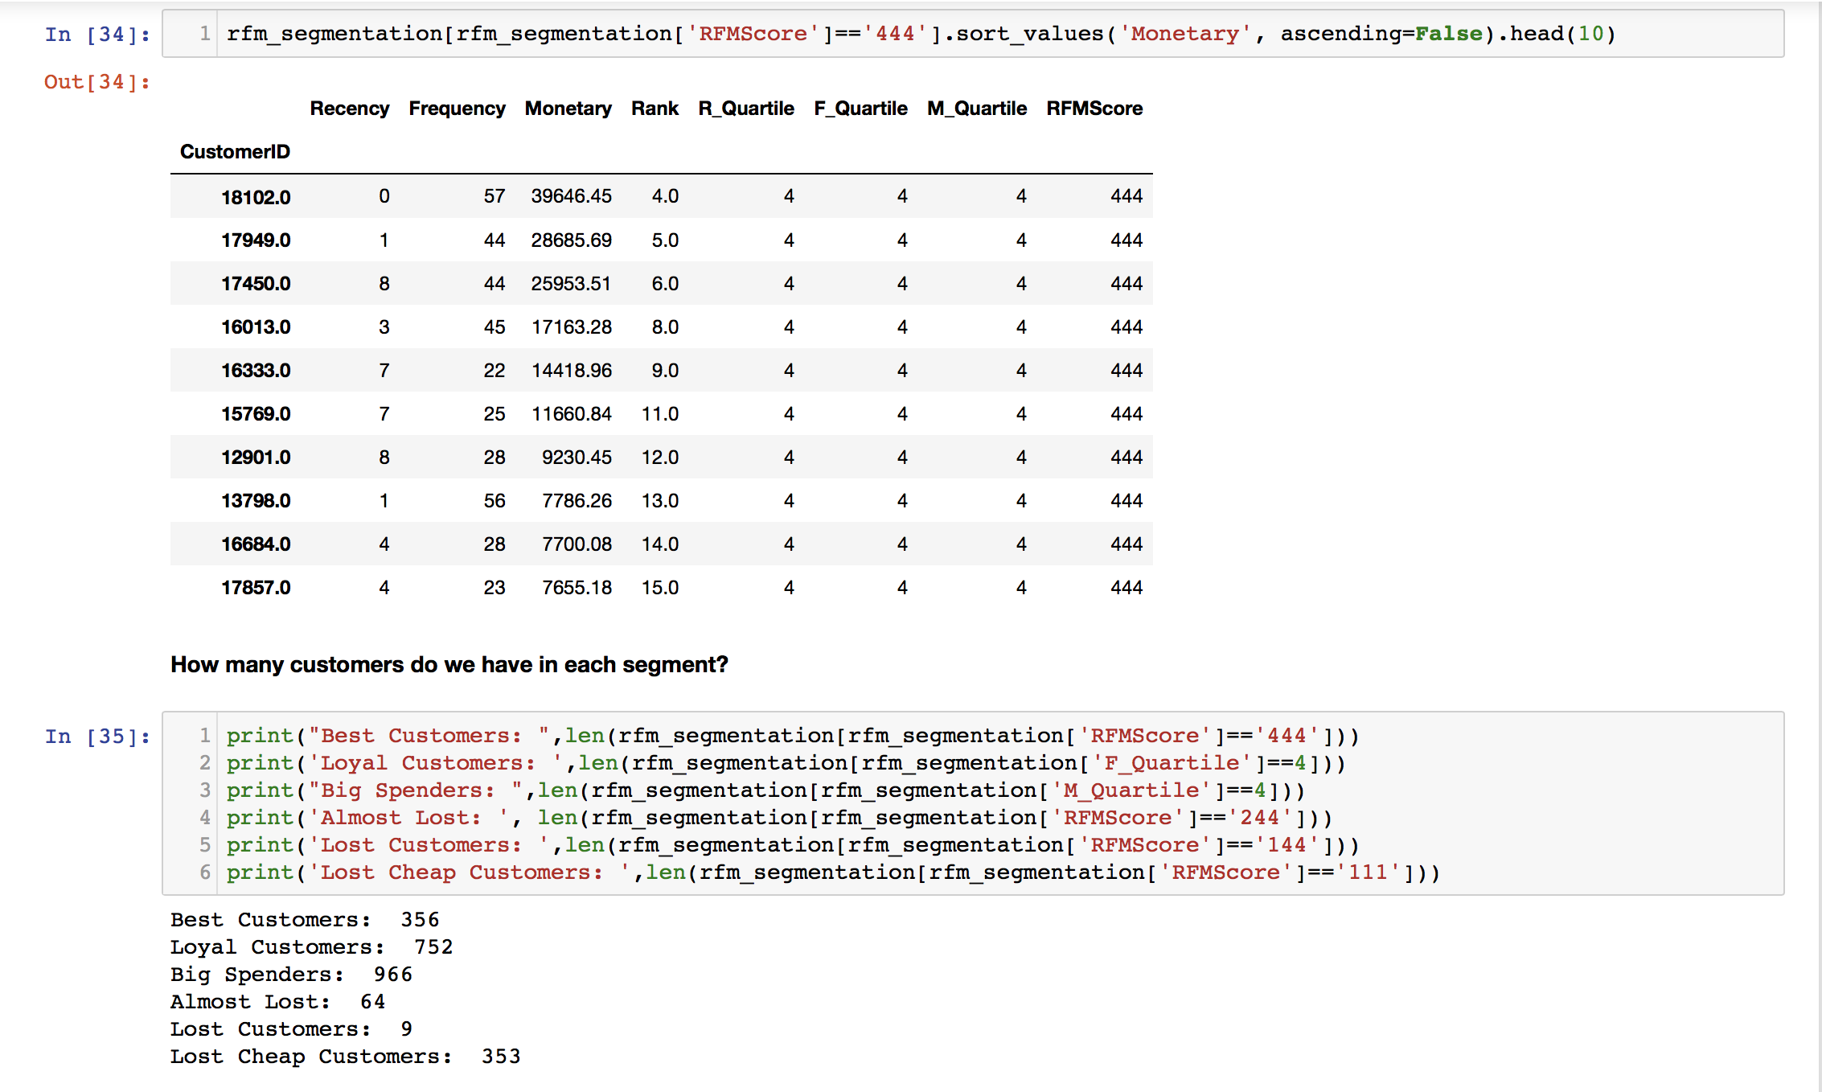
Creation of RFM segmentation table
Notes:
Best Recency score = 4: most recently purchased.
Best Frequency score = 4: most quantity purchase.
Best Monetary score = 4: spent the most.
**Best Customers - Champions**: Reward them. They can be early adopters to new products. Suggest them "Refer a friend".
**At Risk**: Send them personalized emails to encourage them to shop.

Slide 8
Future Work

Slide 9
Relevant Research papers
The evolution of direct, data and digital marketing, Richard Webber, Journal of Direct, Data and Digital Marketing Practice (2013) 14, 291â€“309.
Clustering Experiments on Big Transaction Data for Market Segmentation, Ashishkumar Singh, Grace Rumantir, Annie South, Blair Bethwaite, Proceedings of the 2014 International Conference on Big Data Science and Computing.
A decision-making framework for precision marketing, Zhen You, Yain-Whar Si, Defu Zhang, XiangXiang Zeng, Stephen C.H. Leung c, Tao Li, Expert Systems with Applications, 42 (2015) 3357â€“3367.

Slide 10
Thank you

