Slide 1
Airport_Data_Analysis(Dashboard)
File created on: 2/20/2022 7:30:34 AM

Slide 2
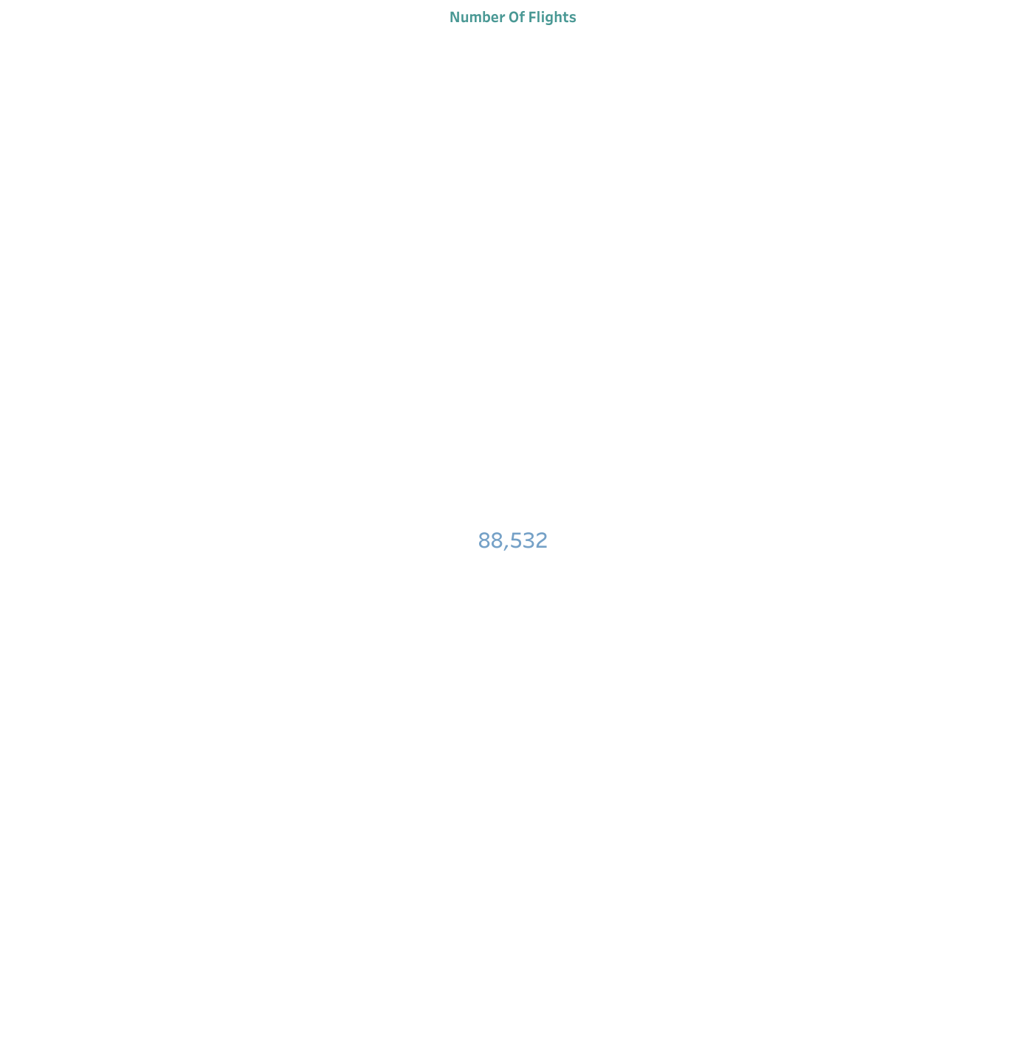

Slide 3
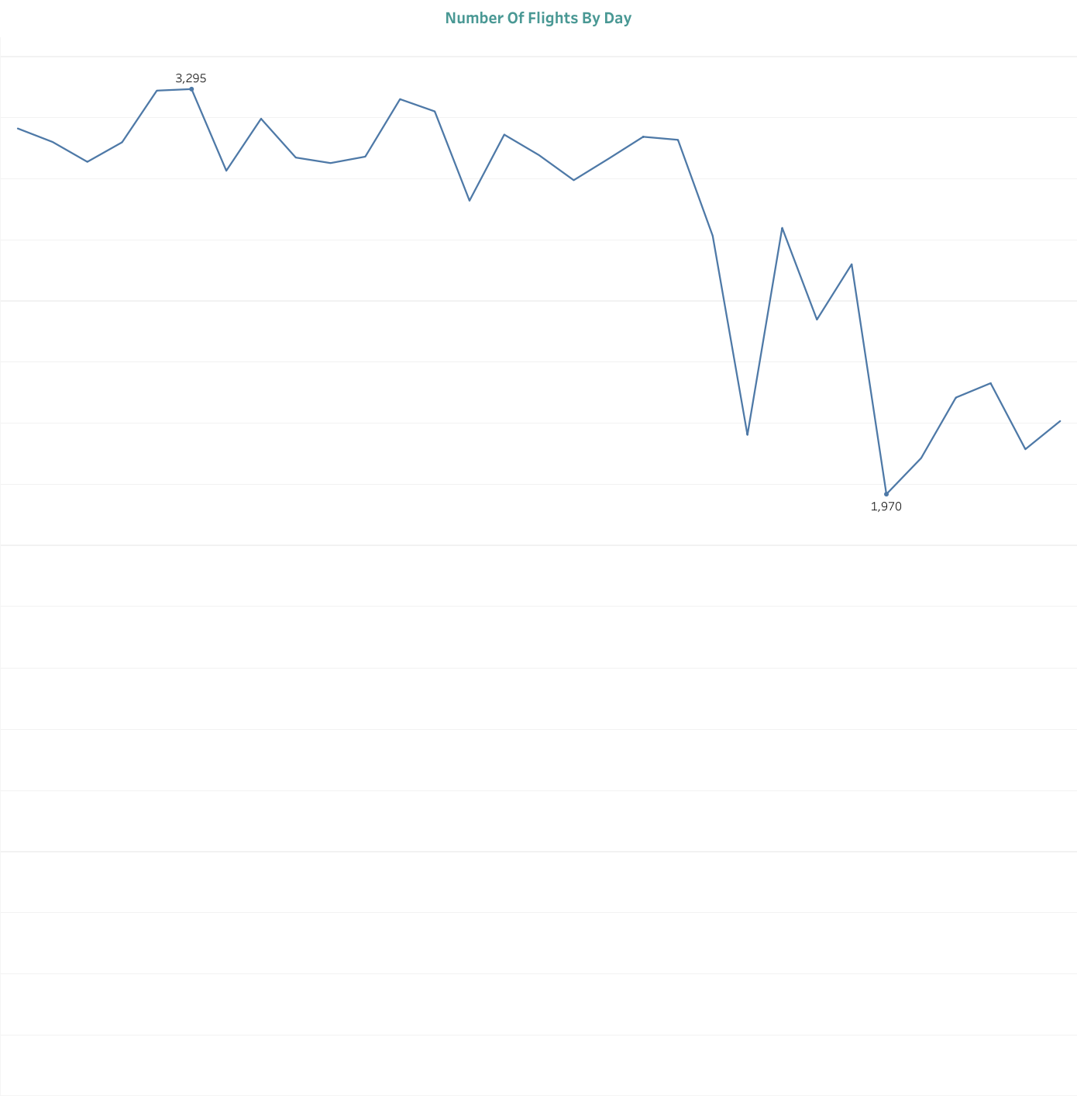

Slide 4
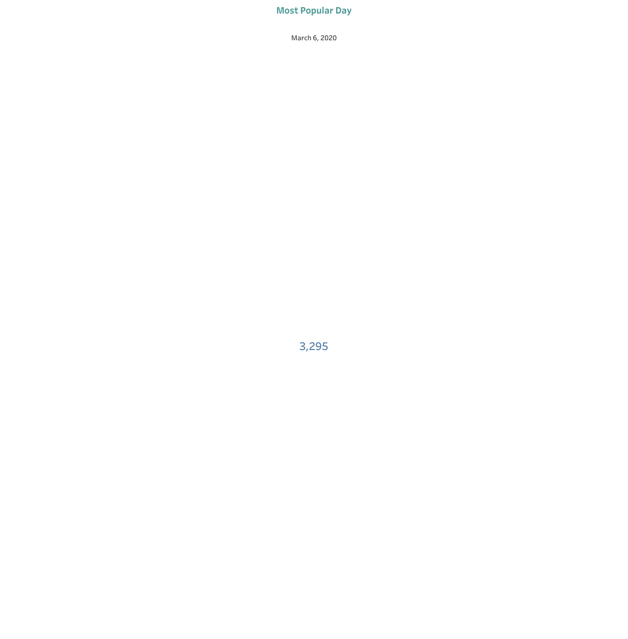

Slide 5


Slide 6


Slide 7
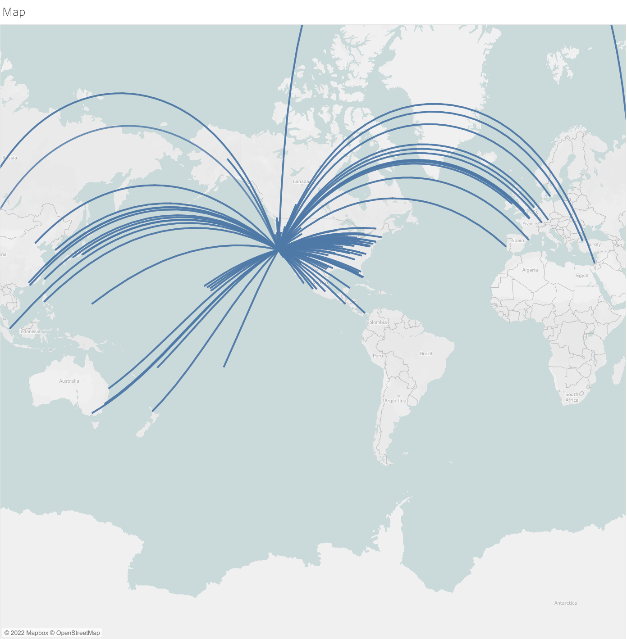

Slide 8
