Slide 1

Amazon EBS

Slide 2
Amazon EBS
Introduction to Amazon EBS
EBS Size and Capacity
EBS Benefits
Use Cases
Volume Types
EBS Snapshots
EBS Features
Pricing
Instance Store-backed Instances
EBS-backed Instances
Lab Exercise

Slide 3
Amazon EBS
Amazon EBS
Amazon Elastic Block Store (Amazon EBS) provides persistent storage volumes for Amazon EC2 instances that can be attached to a running instance.
Each Amazon EBS volume is automatically replicated within its Availability Zone to protect you from component failure, offering high availability and durability.
With Amazon EBS, you can scale your usage up or down within minutes – all while paying a low price for only what you provision

Slide 4
Amazon EBS
EBS Size and Capacity
AWS offers a 30 GB of EBS(any combination of General Purpose(SSD) or Magnetic), 2,000,000 I/Os (with EBS magnetic) and 20 GB for backups in free tier.
We can create Amazon EBS volumes that can store up to 16 TB, and process up to 20,000 input/output operations per second (IOPS).
We can also create Amazon EBS General Purpose solid state drive (SSD) volumes that can store up to 16 TB, and process up to 10,000 IOPS. These volumes are designed for five 9s of availability and up to 320 mbps second of throughput when attached to EBS optimized instances.
These performance improvements make it even easier to run applications requiring high performance or high amounts of storage, such as large transactional databases, big data analytics, and log processing systems.
Larger and faster volumes are available now in all commercial AWS regions and in AWS GovCloud (US).

Slide 5
Amazon EBS
Benefits:
Reliable, secure storage
Each Amazon EBS volume is automatically replicated within its Availability Zone to protect you from component failure.
Amazon EBS encryption provides security between EC2 instances and EBS volumes.
Consistent and low-latency performance
Amazon EBS General Purpose (SSD) volumes and Amazon EBS Provisioned IOPS (SSD) volumes deliver low-latency through SSD technology and consistent I/O performance.
Backup and restore,
Backup your data by taking point-in-time snapshots of your Amazon EBS volumes.
Restore business by implementing EBS snapshots into EC2 instances.
Quickly scale up, easily scale down
Increase or decrease the storage and performance within minutes.
Geographic flexibility
Amazon EBS provides the ability to copy snapshots across AWS regions, enabling geographical expansion, data center migration, and disaster recovery.

Slide 6
Amazon EBS
EBS Use Cases
Relational databases
Amazon EBS supports millions of gaming customers or billions of e-commerce transaction databases such as Oracle, Microsoft SQL Server, MySQL and PostgreSQL.
Enterprise applications
Amazon EBS provides an environment for mission-critical applications such as SAP and Microsoft SharePoint.
File workloads
Amazon EBS can store files and applications securely and supports distributed file sharing.
Ex: NASA/JPL uses GlusterFS on Amazon EBS

Slide 7
Amazon EBS
EBS Volume Types
Amazon EBS allows you to create storage volumes and attach them to Amazon EC2 instances.
Amazon EBS volumes are placed in a specific Availability Zone and automatically replicated to protect from the failure of a single component.
Amazon EBS provides three volume types based on performance and cost
General Purpose (SSD),
Provisioned IOPS (SSD),
Magnetic.
All EBS volume types offer the same durable snapshot capabilities and are designed for 99.999% availability

Slide 8
Amazon EBS
Amazon EBS General Purpose (SSD) Volumes
General Purpose (SSD) volumes are the default EBS volume type for Amazon EC2 instances.
General Purpose (SSD) volumes are backed by Solid-State Drives (SSDs) and are suitable for small to medium-sized databases, development and test environments.
General Purpose (SSD) volumes offer consistent baseline performance of 3 IOPS/GB to a maximum of 10,000 IOPS, and provide up to 160 Mbps of throughput per volume.

Slide 9
Amazon EBS
Amazon EBS Provisioned IOPS (SSD) Volumes
Provisioned IOPS (SSD) volumes are backed by Solid-State Drives (SSDs) and suitable for applications with I/O-intensive workloads.
Provisioned IOPS (SSD) volumes offer consistent baseline performance of up to 30 IOPS/GB to a maximum of 20,000 IOPS, and provide up to 320 Mbps of throughput per volume.
Amazon EBS Magnetic Volumes
Magnetic volumes provide the lowest cost per GB of all EBS volume types.
Magnetic volumes are backed by magnetic drives and are ideal for infrequent data access and for low storage cost.
Magnetic volumes provide approximately 100 IOPS on average, with an ability to burst to hundreds of IOPS.

Slide 10
Amazon EBS
Amazon EBS Snapshots
You can back up the data on your EBS volumes to Amazon S3 by taking point-in-time snapshots.
Snapshots are incremental backups, which means that only the blocks on the device that have changed after your most recent snapshot are saved.
If you are dealing with snapshots of sensitive data, you should consider encrypting your data manually before taking the snapshot. Snapshots of encrypted volumes are automatically encrypted.
When you create an EBS volume, you can create it based on an existing snapshot.
If you access a piece of data that hasn't been loaded yet, the volume immediately downloads the requested data from Amazon S3, and then continues loading the rest of the volume's data in the background.
Snapshots are constrained to the region in which they are created.

Slide 11
Amazon EBS
EBS Features
Key features of Amazon EBS Snapshots:
Immediate access to Amazon EBS volume data - After a volume is created from a snapshot, there is no need to wait for all of the data to transfer from Amazon S3 to your Amazon EBS volume. We can start accessing the volume.
Resizing Amazon EBS volumes - When you create a new Amazon EBS volume based on a snapshot, you may specify a larger size for the new volume.
Sharing Amazon EBS Snapshots - Amazon EBS Snapshots’ share-ability makes it easy for you to share data with your co-workers or others in the AWS community.
Copying Amazon EBS Snapshots across AWS regions - Amazon EBS’s ability to copy snapshots across AWS regions makes it easier to leverage multiple AWS regions for geographical expansion, data center migration and disaster recovery. You can copy any snapshot accessible to you: snapshots you created; snapshots shared with you; and snapshots from the AWS Marketplace, VM Import/Export, and AWS Storage Gateway.

Slide 12
Amazon EBS
Amazon EBS-Optimized Instances
EBS-optimized instances enable EC2 instances to fully use the IOPS provisioned on an EBS volume. It allows dedicated throughput between Amazon EC2 and Amazon EBS.
Amazon EBS Availability and Durability
Amazon EBS volumes are designed to be highly available and reliable at no additional charge.
Amazon EBS volume data is replicated across multiple servers in an Availability Zone to prevent the loss of data from the failure of any single component
Amazon EBS Encryption and AWS Identity and Access Management
Amazon EBS encryption offers encryption of EBS data volumes and snapshots.
EBS encryption enables data security by encrypting your data volumes and snapshots using Amazon-managed keys or keys you create and manage using the AWS Key Management Service (KMS).
Access to Amazon EBS volumes is integrated with AWS Identity and Access Management (IAM). IAM enables access control to your Amazon EBS volumes

Slide 13
Amazon EBS
Pricing
Region:US East (N. Virginia)
Amazon EBS General Purpose (SSD) volumes
$0.10 per GB-month of provisioned storage
Amazon EBS Provisioned IOPS (SSD) volumes
$0.125 per GB-month of provisioned storage
$0.065 per provisioned IOPS-month
Amazon EBS Magnetic volumes
$0.05 per GB-month of provisioned storage
$0.05 per 1 million I/O requests
Amazon EBS Snapshots to Amazon S3
$0.095 per GB-month of data stored

Slide 14
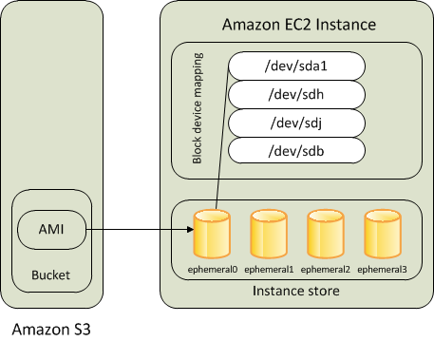
Amazon EBS
Instance Store-backed Instances
Instances that use instance stores for the root device automatically have instance store volumes available, with one serving as the root device volume. When an instance is launched, the image that is used to boot the instance is copied to the root volume (typicallysda1). Any data on the instance store volumes persists as long as the instance is running, but this data is deleted when the instance is terminated

Slide 15
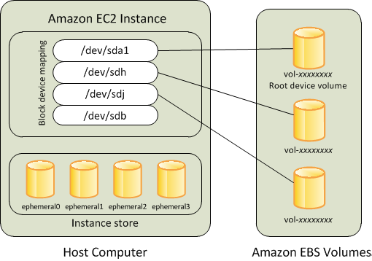
Amazon EBS
Amazon EBS-backed Instances
Instances that use Amazon EBS for the root device automatically have an Amazon EBS volume attached. When you launch an Amazon EBS-backed instance, we create an Amazon EBS volume for each Amazon EBS snapshot referenced by the AMI you use. You can optionally use other Amazon EBS volumes or instance store volumes

Slide 16
Amazon EBS
tart, Reboot, Terminate EC2 Instance
Stop/Start, Reboot, Terminate EC2 Instance
Things that change when you stop/start include:
New internal IP address, though could randomly be the same. [VPC instances keep same internal IP addresses through stop/start.]
New external IP address (though could randomly be the same).
If an Elastic IP address was associated with the instance before it was stopped, then you’ll need to re-associate it after the start. [VPC instances keep Elastic IP addresses associated through stop/start.]
You can leave an instance stopped for as long as you like and not get charged for run time (though you do get charged at a much lower rate for the EBS volume storage). See the next point.
A fresh billing hour is started for the instance when you start it again. E.g., if you start a new instance and then stop/start it 3 times within the first 60 minutes, you’ll get charged for 4 hours instead of 1.
There is a small chance that EC2 will not have available slots of the correct instance type to run your instance when you want to start it again. I’ve had this happen and temporarily switched to a different, available instance type to get it running again.

Slide 17
Amazon EBS
Lab Exercise:
Create Instance, add storage while launching and then mount in instance
Create, Attach, Detach Volume
Take Snapshot
Restore an EBS volume from a snapshot
Attach the newly created Volume to instance
Modify existing volume (extend)

Slide 18
Amazon EBS
Thank You

