Slide 1
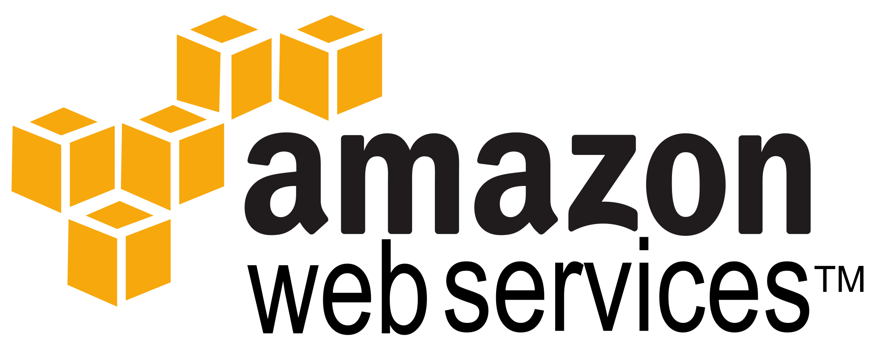
AWS Introduction and Architecture

Slide 2
AWS Introduction and Architecture
Introduction to Amazon Web Services
AWS and other Cloud Service Providers
Accessing AWS
AWS Architecture
AWS Services and Products
AWS Management Console

Slide 3
AWS Introduction and Architecture
Amazon Web Services (AWS) provides on-demand computing resources and services in the cloud, with pay-as-you-go pricing.
For example, you can run a server on AWS that you can log on to, configure, secure, and run just as you would a server that's sitting in front of you
Using AWS resources instead of your own is like purchasing electricity from a power company instead of running your own generator
It provides many of the same benefits:
Capacity exactly matches your need,
You pay only for what you use,
Economies of scale result in lower costs, and
The service is provided by a vendor experienced in running large-scale networks

Slide 4
AWS Introduction and Architecture
Verizon Cloud - Almost perfect, except support sucks, just like PWSRN.
Joyent - networking just not flexible enough
Microsoft Azure - Almost perfect. Lack of 'certified' Debian image unfortunate. Cost for advanced router is too high.
Rackspace - no static IP's a blocker, just like Joyent and Google Cloud
Century Link - no private network choice unfortunate but not blocker. Very helpful and responsive support.
IBM/SoftLayer - Strong backend network infrastructure/DC. Still evaluating.

Slide 5
AWS Introduction and Architecture
How Do I Access AWS?
AWS provides several ways to create and manage resources.
1. AWS Management Console - A web interface.
2. AWS Command Line Interface (AWS CLI) Commands for a broad set of AWS products.
3. Command Line Tools - Commands for individual AWS products.
4. Query APIs - Low-level APIs(SOAP) that you access using HTTP requests.

Slide 6
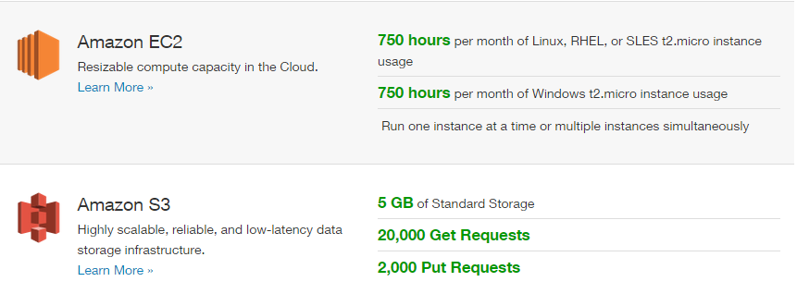
AWS Introduction and Architecture
Pricing
AWS can offer significant cost savings compared to the equivalent on-premises infrastructure.
You can use the AWS Simple Monthly Calculator to estimate what it would cost to use AWS.
Note that if you created your AWS account within the last 12 months, you are eligible for the AWS Free Tier.

Slide 7
AWS Introduction and Architecture
Amazon has data centers in different areas of the world (for example, North America, Europe, and Asia). Correspondingly, AWS products are available to use in different regions. By placing resources in separate regions, you can design your website or app to be closer to specific customers or to meet legal or other requirements. Note that prices for AWS usage vary by region.
Each region contains multiple distinct locations called Availability Zones. Each Availability Zone is engineered to be isolated from failures in other Availability Zones, and to provide inexpensive, low-latency network connectivity to other zones in the same region. By placing resources in separate Availability Zones, you can protect your website or app from the failure of a single location.
AWS resources can be tied to a region or tied to an Availability Zone. Not every region or Availability Zone supports every AWS resource. When you view your resources, you'll only see the resources tied to the region you've specified. This is because regions are isolated from each other, and we don't replicate resources across regions automatically

Slide 8
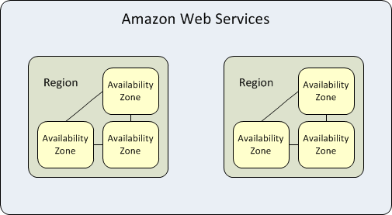
AWS Introduction and Architecture
Each region is completely independent.
Each Availability Zone is isolated, but the Availability Zones in a region are connected through low-latency links.
The following diagram illustrates the relationship between regions and Availability Zones

Slide 9
AWS Introduction and Architecture
Name | Region Code
Asia Pacific (Tokyo) | ap-northeast-1
Asia Pacific (Singapore) | ap-southeast-1
Asia Pacific (Sydney) | ap-southeast-2
EU (Frankfurt) | eu-central-1
EU (Ireland) | eu-west-1
South America (Sao Paulo) | sa-east-1
US East (N. Virginia) | us-east-1
US West (N. California) | us-west-1
US West (Oregon) | us-west-2
Regions
Each Amazon EC2 region is designed to be completely isolated from the other Amazon EC2 regions. This achieves the greatest possible fault tolerance and stability.
Amazon EC2 provides multiple regions so that you can launch Amazon EC2 instances in locations that meet your requirements. For example, you might want to launch instances in Europe to be closer to your European customers or to meet legal requirements

Slide 10
AWS Introduction and Architecture
When you view your resources, you'll only see the resources tied to the region you've specified. This is because regions are isolated from each other, and we don't replicate resources across regions automatically.
When you work with an instance using the command line interface or API actions, you must specify its regional endpoint.
When you launch an instance, you must select an AMI that's in the same region.
If the AMI is in another region, you can copy the AMI to the region you're using.
All communications between regions is across the public Internet.
Therefore, you should use the appropriate encryption methods to protect your data.
Data transfer between regions is charged at the Internet data transfer rate for both the sending and the receiving instance.

Slide 11
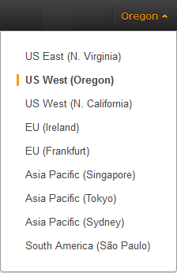
AWS Introduction and Architecture
Describing Your Regions and Availability Zones
You can use the AWS Management Console or the command line interface to determine which regions and Availability Zones are available for your use.
To find your regions and Availability Zones using the AWS Management Console
Open the AWS Management Console.
From the navigation bar, view the options in the region selector.
Open the Amazon EC2 console.

Slide 12
Compute and Networking Services 1. Amazon EC2 2. Auto Scaling 3. Elastic Load Balancing (ELB) 4. Amazon VPC 5. Amazon Route 53 Storage and Content Delivery Services 1. Amazon EBS 2. Amazon S3 3. Amazon Glacier 4. Amazon CloudFront 5. Amazon Import/Export 6. Amazon Storage Gateway Database Services 1. Amazon RDS 2. Amazon DynamoDB 3. Amazon ElasticCache 4. Amazon Redshift
AWS Introduction and Architecture

Slide 13
AWS Introduction and Architecture
Logging in to AWS Management Console
Step 1: Open the Amazon Web Service at http://aws.amazon.com.
Step 2: Select AWS Management Console from the My Account/Console dropdown list box.
Step 3: Enter the email address you specified when signing up for AWS Management Console.
Verify that you have signed up. If not, follow the steps below to sign up:
Go to http://aws.amazon.com, and click Sign up Now .
Follow the on-screen instructions to finish signing up.
Step 4: Select the I am a returning user and my password is radio button and enter your password.
Step 5: Click Sign in using our secure server to proceed. The AWS Management Console home page appears.

Slide 14
Thank You
AWS Introduction and Architecture

Slide 15
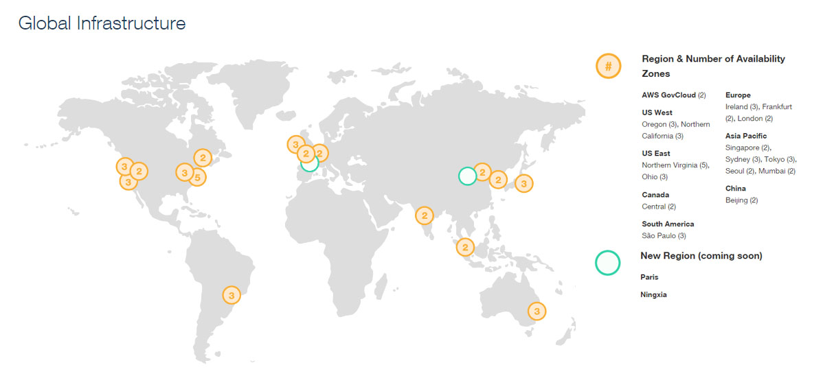

Slide 16
