Slide 1

SMART INDIA HACKATHON 2026
TITLE PAGE
  Problem Statement ID –SIH26218
  Problem Statement Title-Title-Communication Aware Search Rover for Firefighters (FIRE-X).
  Theme-Robotics and Drones
PS Category- Hardware
  Team ID-143949
Team Name-DEEPNEX

Slide 2

DEEPNEX
FIRE-X: Communication-Aware Search
Rover for Firefighters
Proposed Solution
The Core Problem
Proposed Solution | How it Addresses Problem | Innovation & Uniqueness
Search-First Autonomous Rover | Eliminates direct human exposure during initial site entry. | Lightweight reconnaissance platform engineered for continuous 1-hour operation without rescue bulk.
Hybrid Thermal Armor | Prevents internal electronics failure from heat soak and flames. | Combines passive ceramic/aerogel barriers with an external evaporative water-mist cooling loop.
Dual-Link Mesh Network | Maintains reliable data transmission through concrete and debris. | Sub-GHz LoRa mesh fallback paired with an RF-transparent window for sealed WebRTC video streaming.
Edge AI Detection & SLAM | Maps collapsed layouts and locates victims automatically. | On-board Jetson inference sends instant text alerts over LoRa if video bandwidth drops.
Zero-Visibility & Toxic Gas
Firefighters enter blinding smoke and lethal environments without prior visibility.
Communication Blackouts
Concrete walls, metal corridors, and rubble cause severe signal loss.
Thermal Breakdown
Extreme radiant heat rapidly destroys conventional reconnaissance electronics.
Delayed Scene Intelligence
Manual scouting is slow and exposes personnel before hazards are identified.
2

Slide 3
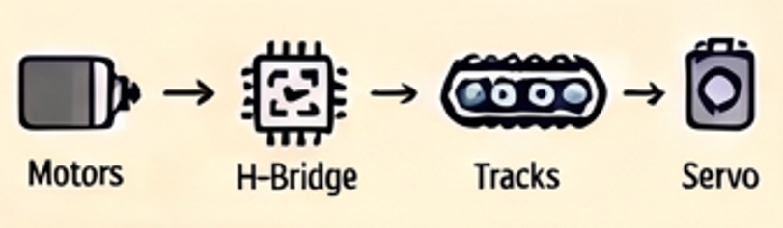
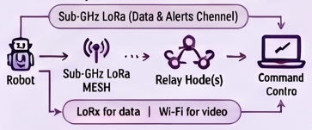
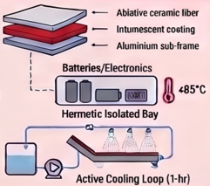
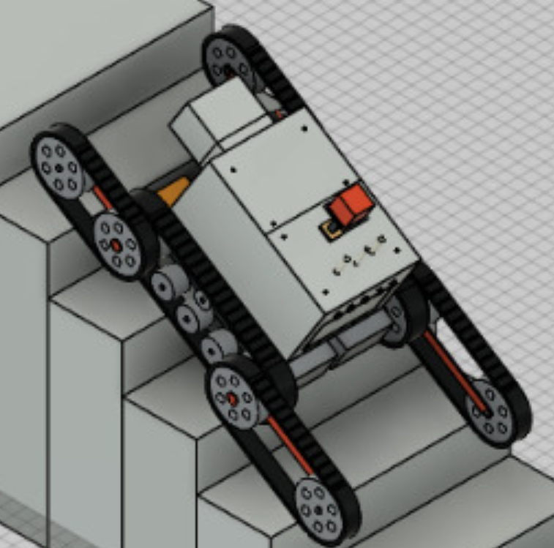
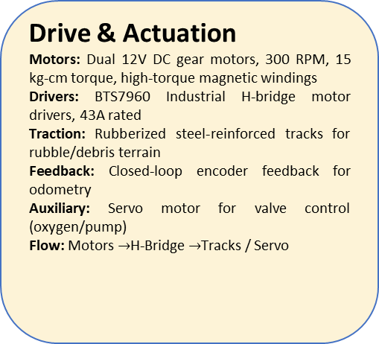
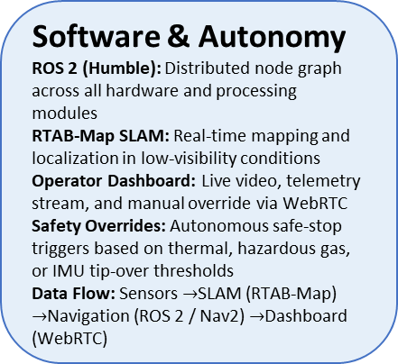
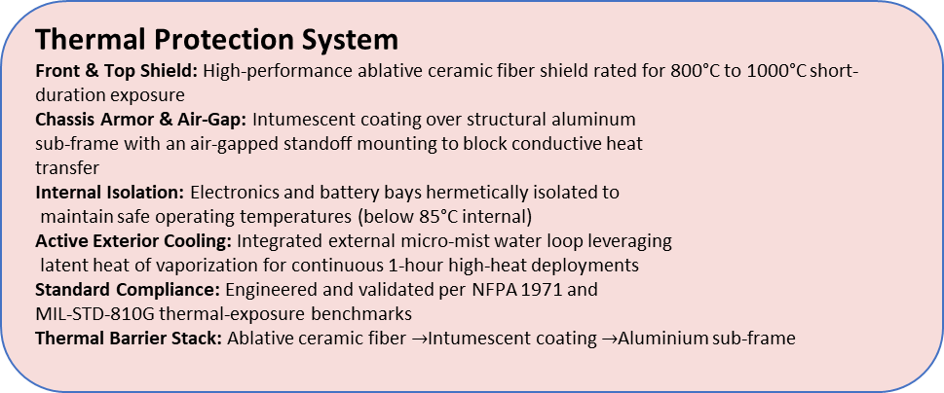
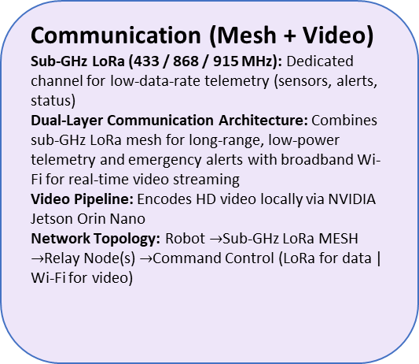
DEEPNEX
FIREFIGHTER COMMUNICATION-AWARE SEARCH ROVER -SYSTEM ARCHITECTURE
Sub-GHz LoRa Mesh Communication | Safe & Reliable Rescue Operations
Sensing Suite
FLIR Lepton 3.5 thermal camera: 160×120 px, -10°C to 400°C, high-temp housing
Intel RealSense D435i stereo depth camera: RGB-D, obstacle detection
Industrial gas sensors: MQ-2 / MQ-7 (LPG, smoke, methane), BME680 (temperature, humidity, air quality)
Ranging sensors: 3× waterproof ultrasonic (JSN-SR04T) + VL53L1X (ToF for obstacle ranging)
Bosch BNO055 9-DoF IMU: pitch / roll / yaw detection
RD-03D RADAR SENSOR
RD-03D:24GHZ FMCW radar for human target detection and tracking
Non-visual sensing:Operates when smoke/darkness limits camera visibility
Target data:Distance,position,angle and motion and multi rarcks multiple targets in
the sensing area
Interface: UART→STM32
Purpose: Possible victim detection and communication decision support
Drive & Actuation
Motors: Dual 12V DC gear motors, 300 RPM, 15 kg-cm torque, high-torque magnetic windings
Drivers: BTS7960 Industrial H-bridge motor drivers, 43A rated
Traction: Rubberized steel-reinforced tracks for rubble/debris terrain
Feedback: Closed-loop encoder feedback for odometry
Auxiliary: Servo motor for valve control (oxygen/pump)
Flow: Motors $→$H-Bridge $→$Tracks / Servo
Communication (Mesh + Video)
Sub-GHz LoRa (433 / 868 / 915 MHz): Dedicated channel for low-data-rate telemetry (sensors, alerts, status)
Dual-Layer Communication Architecture: Combines sub-GHz LoRa mesh for long-range, low-power telemetry and emergency alerts with broadband Wi-Fi for real-time video streaming
Video Pipeline: Encodes HD video locally via NVIDIA Jetson Orin Nano
Network Topology: Robot $→$Sub-GHz LoRa MESH $→$Relay Node(s) $→$Command Control (LoRa for data | Wi-Fi for video)
Thermal Protection System
Front & Top Shield: High-performance ablative ceramic fiber shield rated for 800°C to 1000°C short-duration exposure
Chassis Armor & Air-Gap: Intumescent coating over structural aluminum
sub-frame with an air-gapped standoff mounting to block conductive heat
transfer
Internal Isolation: Electronics and battery bays hermetically isolated to
maintain safe operating temperatures (below 85°C internal)
Active Exterior Cooling: Integrated external micro-mist water loop leveraging
latent heat of vaporization for continuous 1-hour high-heat deployments
Standard Compliance: Engineered and validated per NFPA 1971 and
MIL-STD-810G thermal-exposure benchmarks
Thermal Barrier Stack: Ablative ceramic fiber $→$Intumescent coating $→$Aluminium sub-frame
Chassis & Enclosure
Rating: IP67-rated aluminium-ABS composite outer enclosure
Ruggedization: Vibration-dampened mounts, MIL-STD-810G inspired ruggedization
Underbody: Reinforced belly plate for rubble and collapsed-structure terrain
Modularity: Field-serviceable panels for rapid sensor/battery swap.
Software & Autonomy
ROS 2 (Humble): Distributed node graph across all hardware and processing modules
RTAB-Map SLAM: Real-time mapping and localization in low-visibility conditions
Operator Dashboard: Live video, telemetry stream, and manual override via WebRTC
Safety Overrides: Autonomous safe-stop triggers based on thermal, hazardous gas, or IMU tip-over thresholds
Data Flow: Sensors $→$SLAM (RTAB-Map) $→$Navigation (ROS 2 / Nav2) $→$Dashboard (WebRTC)
3

Slide 4
DEEPNEX
ROVER DESIGN: RISK MITIGATION & SYSTEM CONSTRAINTS
1. Thermal & Environmental Constraints
2. Mobility & Mechanical Hazards
PROBLEM
ENGINEERING SOLUTION
PROBLEM
ENGINEERING SOLUTION
Cooling Depletion: 1-hr active mist loop runs dry during extended rescue; internal temp risks exceeding 85°C limit.
ROS 2 autonomous Return to Base (RTL) override triggers instantly when mist reservoir hits 20% capacity.
Debris Jamming: Wheels and rocker-bogie linkages tangle in rebar, structural wire, or melted plastics.
Current-spike monitoring on BTS7960 drivers; auto-executes low-speed reverse-and-wiggle on stall.
Armor Degradation: Ablative ceramic fiber & intumescent coatings off-gas/degrade after 800°C+ flame exposure.
Quick-release, field-replaceable modular shell plates; log heat-exposure hours for maintenance.
High-Centering / Rollover: Climbing rubble exceeding rocker-bogie articulation limits risks tip-over.
Bosch BNO055 IMU pitch/roll monitoring; hard stop & operator alert if tilt exceeds critical threshold (>35°).
3. Communication & Telemetry Drops
4. Sensor Blindness & AI Degradation
PROBLEM
ENGINEERING SOLUTION
PROBLEM
ENGINEERING SOLUTION
Wi-Fi Loss: High-bandwidth video fails inside steel/concrete structures due to Faraday cage attenuation.
Fallback to Sub-GHz LoRa mesh; sends telemetry & compressed YOLOv8 human detection bounding-box snapshots.
Soot Obscuration: Optical & thermal lenses coated in soot, blinding edge AI person detection.
Recess cameras in housing + integrate CO2 cartridge pressurized air-purge nozzle for periodic lens clearing.
Mesh Fragmentation: Distance to base stretches beyond signal penetration limits.
Auto-deploy physical LoRa relay nodes ("breadcrumbs") onto ground when RSSI drops below safe threshold.
Depth Camera Failure: Smoke scatters IR dots on RealSense D435i, causing "phantom" walls.
Lower optical depth trust weight when MQ-7/BME680 detect dense smoke; rely on ultrasonic sensors.
4

Slide 5
DEEPNEX
IMPACT AND BENEFITS
Aspect
Before
After (Solution)
Societal and Economic Benefit
Scalability & Impact
IMPACT AND BENEFITS
• Improves firefighter safety by providing advance hazard information.
• Supports faster and safer victim identification.
• Provides an affordable guidance system for fire service
• Normal Telemetry: Target ≥95% packet delivery (≤5% loss).
• Critical Data: Target 98–99% effective delivery using ACK + retransmission.
• Scalable Coverage: Add relay nodes as building size and obstruction increase.
Firefighters enter hazardous
areas without prior visibility.
Remote robot checks dangerous
areas before crew entry.
Crew Safety
Communication
Radio contact may be lost in
bad zones.
Hazard information reaches
command from affected areas.
Feasibility & Viability
Potential Challenges & Risks
Hazard Detection
Gas and collapse risks are
identified manually.
Robot provides early hazard
information before entry.
• Long-Range Communication: LoRaWAN can exceed 2 miles in suitable urban conditions; building range depends on obstacles
• Fire-Bot Range Target: 200–500 m per reliable hop inside the building; add relay nodes when link quality drops.
• Packet Loss: Published dense-urban trial 26.93–37.75% first-transmission success = 2.27–3.77% loss.
• Fire-Building Risk: Concrete, steel and debris can increase path loss and packet errors.
• No Fixed Loss Value: Actual loss must be measured using RSSI, SNR and packet-delivery tests.
Victim Identification
Manual search is slow and
uncertain.
AI-assisted detection helps
identify victims faster.
Operational Efficiency
Security Benefit
Resource Deployment
Crews are deployed without
complete scene information.
Teams are deployed based on
information collected by the robot.
• Automates the initial search
• and assessment phase.
• Helps command prioritize
• where rescue teams should enter
• Protects data and communication
• from unauthorized access and
• cyber threats.
• Ensures secure transmission
• of fire-scene information
Target: ≥95% secure data
transmission reliability
5

Slide 6
DEEPNEX
RESEARCH AND REFERENCES
Market Analysis
TAM
SAM
AS
SOM
TOTAL ADDRESSABLE MARKET
(TAM)
₹3,500 Crores
Represents the overall Indian Firefighting, Disaster Rescue & Industrial Hazard modernization budget.
SERVICEABLE AVAILABLE MARKET
(SAM)
₹500 Crores
Targeting ~1,500 major fire stations, NDRF/SDRF units, and heavy industrial plants across India.
SERVICEABLE OBTAINABLE MARKET
(SOM)
₹15 Crores
1-year initial pilot program capturing 5% of SAM (deploying 75 units at ₹20 Lakhs each).
REFERENCES
LINKS
The Indian Express (30 June 2026) – "Drones, AI, auto-alerts: Delhi's firefighting plan for the next 25 years"
The Indian Express (23 March 2026) – "Inflammable material in basement, traffic, repair work: Report highlights problems..."
The Indian Express (19 March 2026) – "Single entrance, 'malfunctioning' hydraulic crane, absence of ventilation..."
Li et al. (2019) — Fire Reconnaissance Robot Based on SLAM, Thermal Imaging and AR Display, Sensors, 19(22), 5036.
Gelfert (2023) — A Sensor Review for Human Detection with Robotic Systems in Regular and Smoky Environments.
Project Repository & Documentation:
https://github.com/Shwetank-Sinha/TEAM-DEEPNEX-SIH
6

