Slide 1


INSTITUTE FOR ADVANCED COMPUTING AND SOFTWARE DEVELOPMENT
PG-DAC FEB 2020
A TECHNICAL PRESENTATION ON
“ Online Mobile Shopping System ”
PRESENTED TO -
MRS. Vaishali Mam
PRESENTED BY-
SHUBHAM KADAM 1202
SHWETANK SINGH YADAV 1206

Slide 2
Contents
Introduction
Need of Online Shopping
Modules
Customer
Seller
Diagrams
Pros and Cons
Future scope
Conclusion
References

Slide 3
Introduction
Online Shopping is a form of electronic commerce which allows consumer to buy directly goods and services from seller over the web browser through internet connection.
The Online Mobile Shopping System is a web application is intended to provide complete solutions for vendors as well as customers through a single get way using the internet. It will enable vendors to sell their products, customer to browse through the shop and purchase them online without having to visiting the shop physically.

Slide 4
Need of online shopping
In current scenario it is not possible to everyone to go to store for buying mobile due to their constraints. So this system allows them to shop them at ease of their house.
Also for seller point of view if this system is implemented it will increase their customers and reduction in overheads like rent , light bill etc. as it will remove the need of having shop.

Slide 5
Module
In our project we have two three modules:
Customer
Seller

Slide 6
Customer
Register/ Login(New user can register to have our service.)
View mobiles (sorted/ according to their search)
Add to Cart/View cart
Make payment
Add review
Update personal info

Slide 7
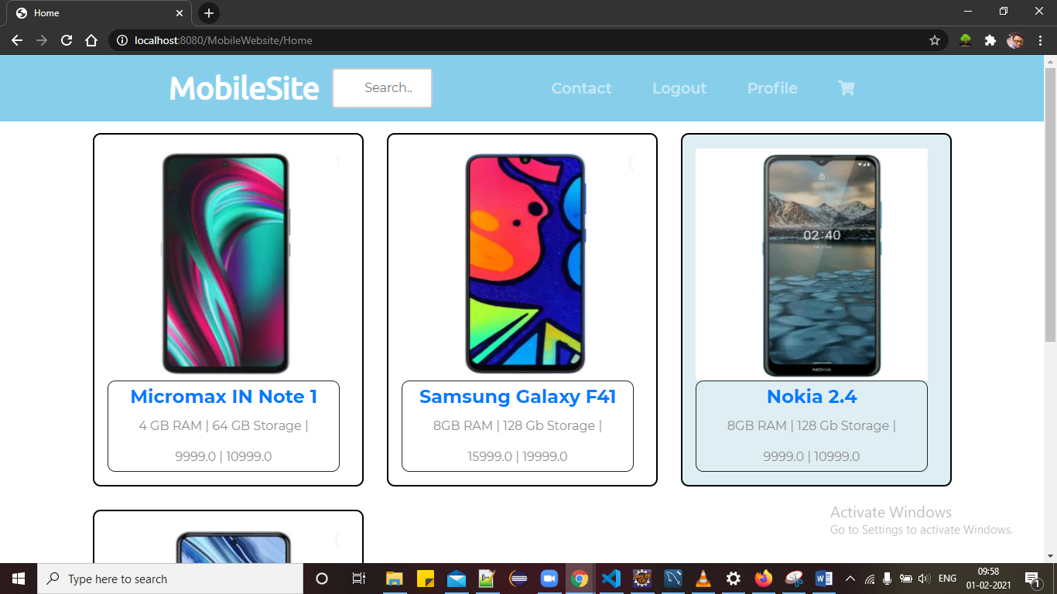
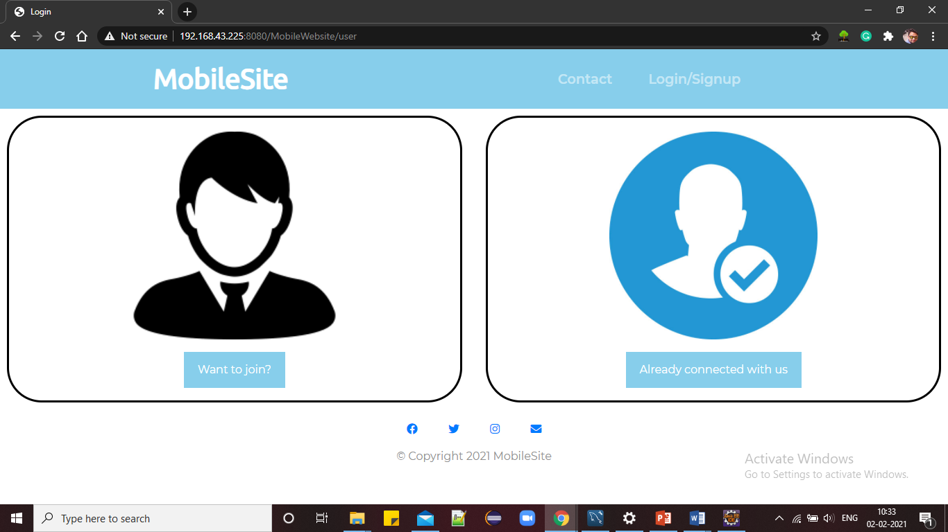
Customer Module
Home page for Customers
Register/ Login page

Slide 8
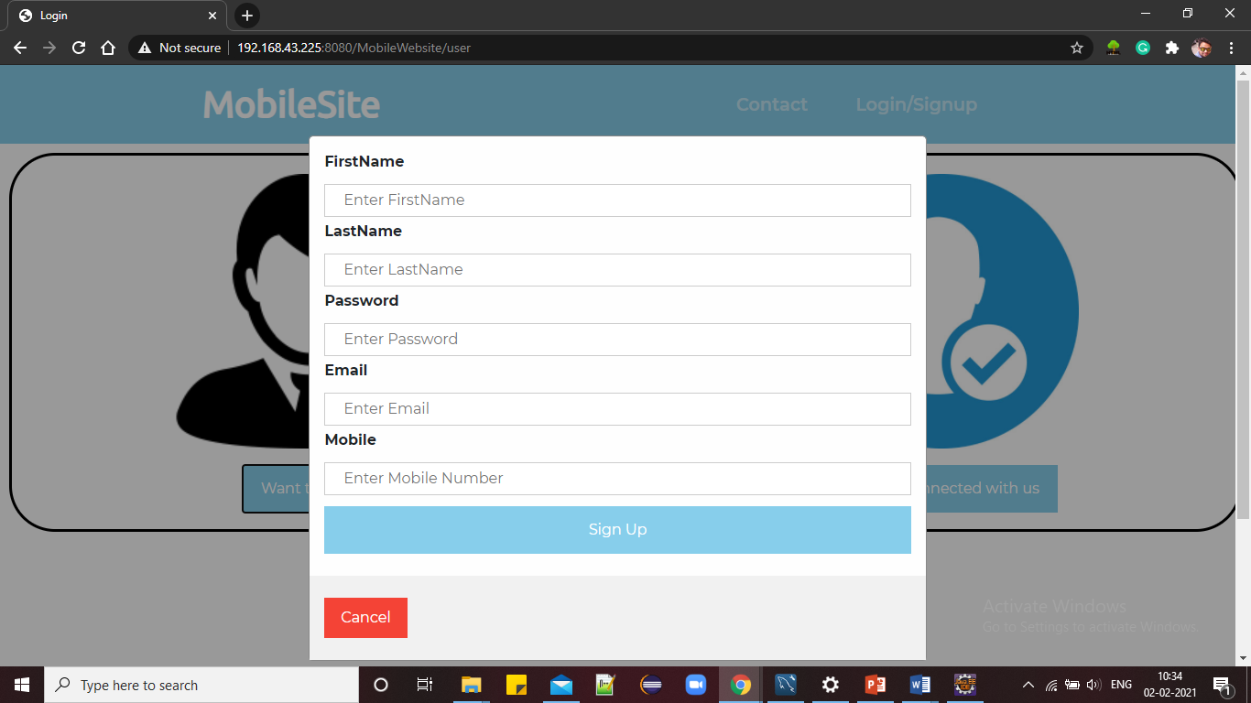
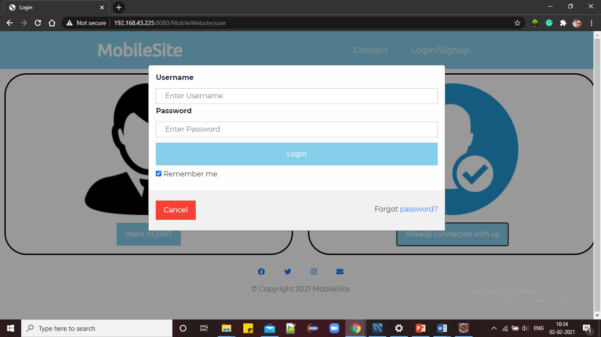
Customer Module
Signup page
Login page

Slide 9
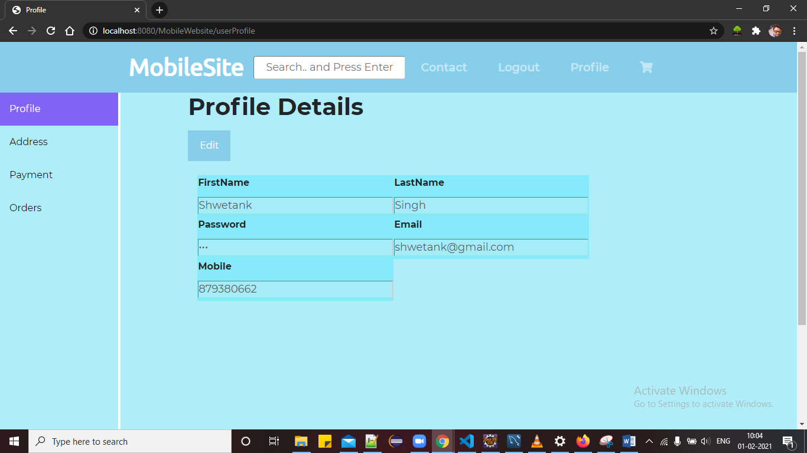
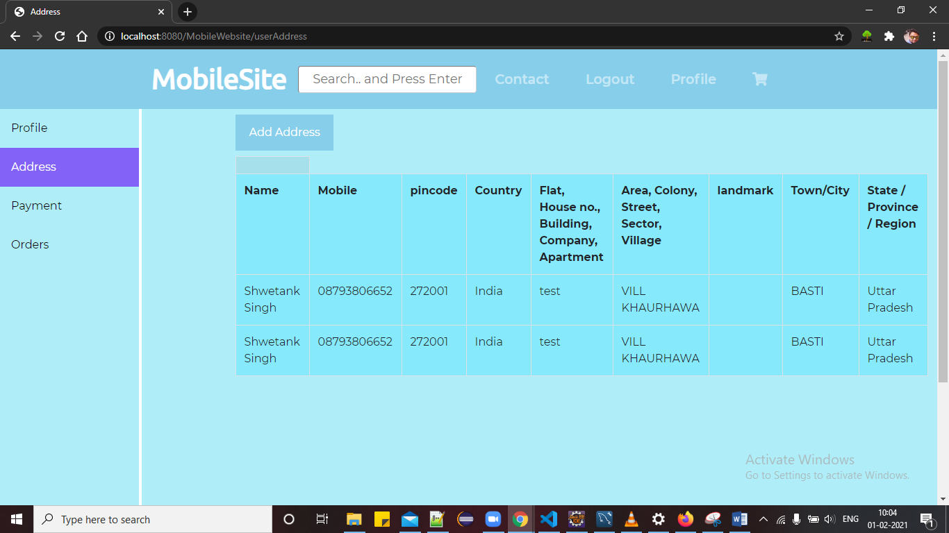
Customer Module
View/ Update Info
Address page to add new address

Slide 10
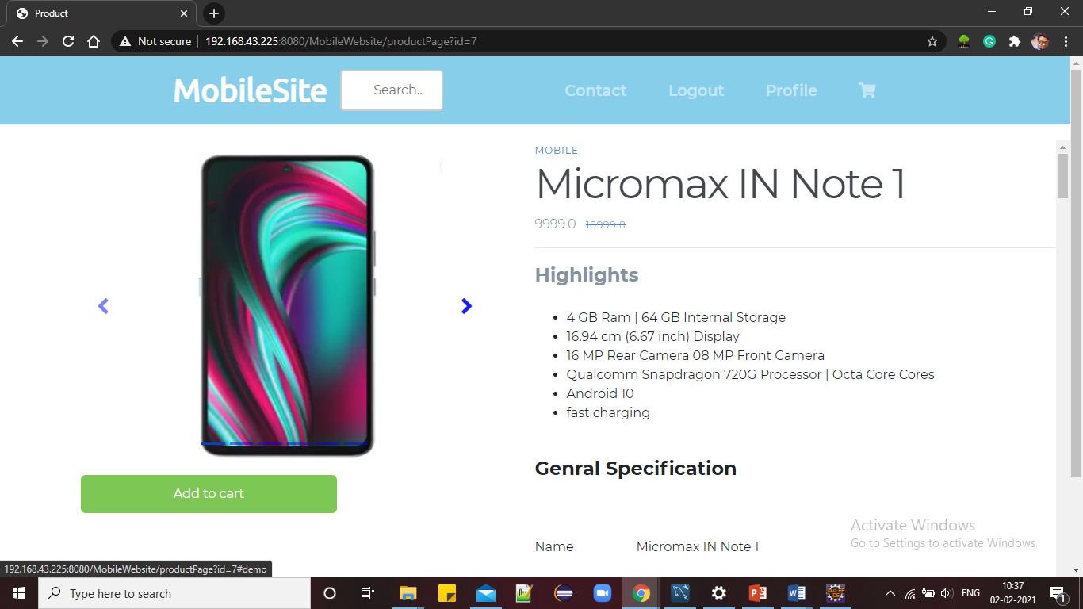
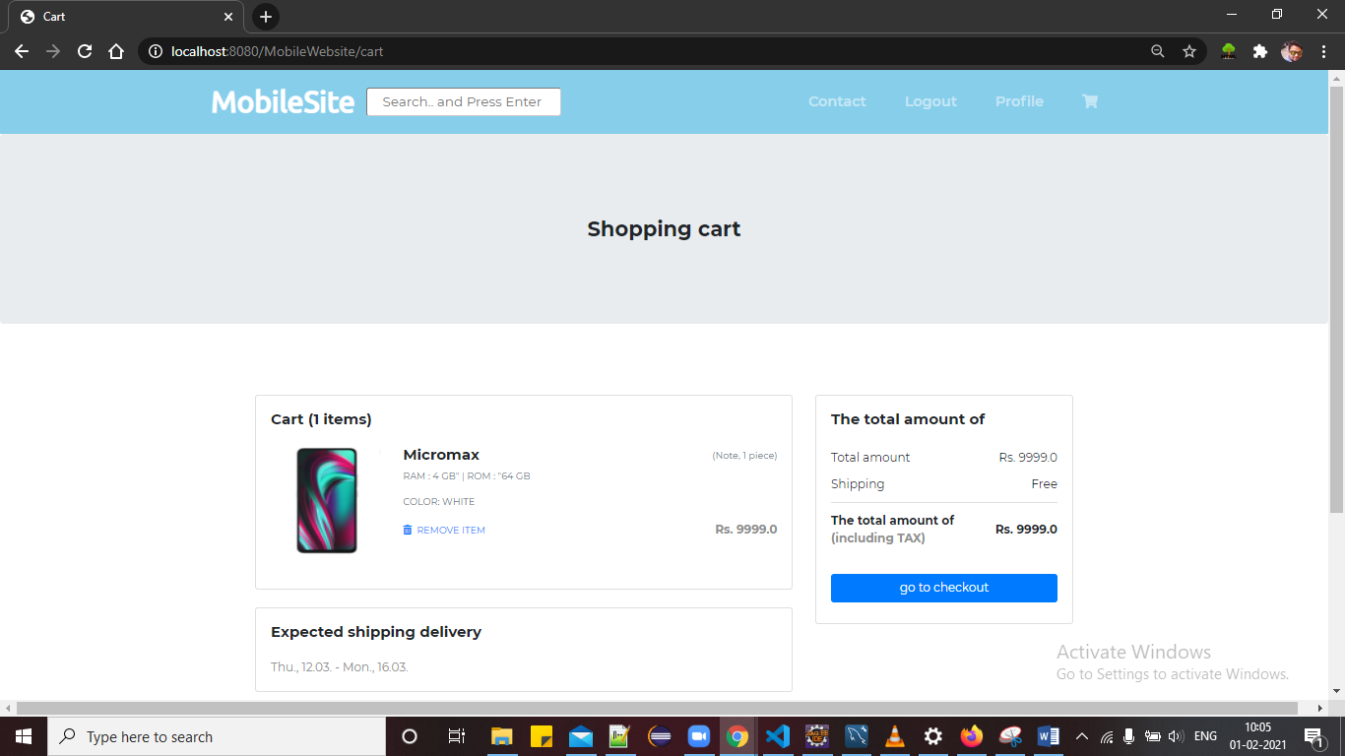
Customer Module
View product page
Cart page

Slide 11
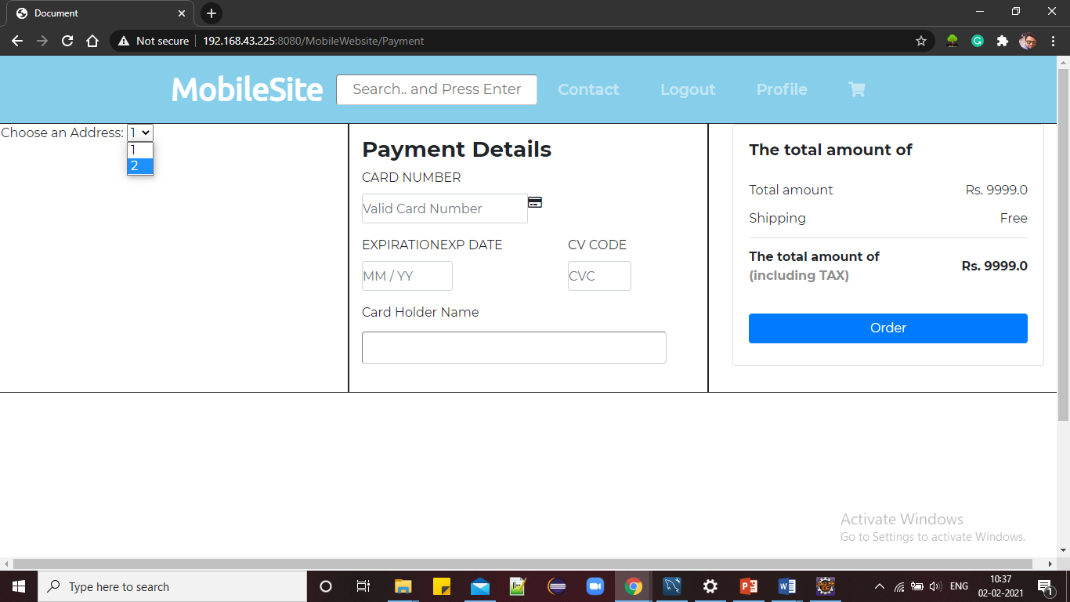
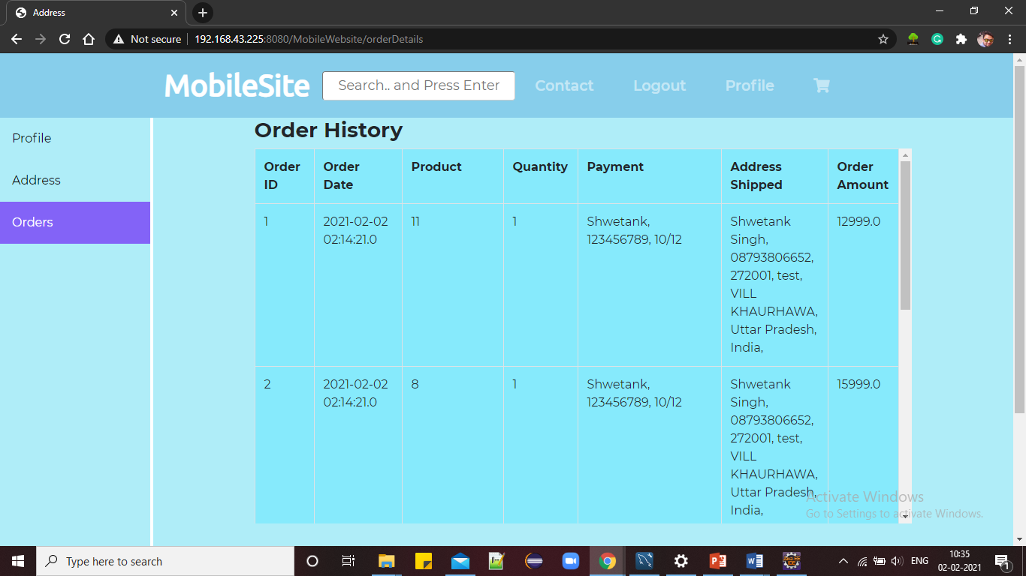
Customer Module
Payment page
Order history of customer

Slide 12
Seller
Register/ Login
Add mobiles for sale
View added mobiles
Remove mobiles
Update / view Info
Generate order reports

Slide 13

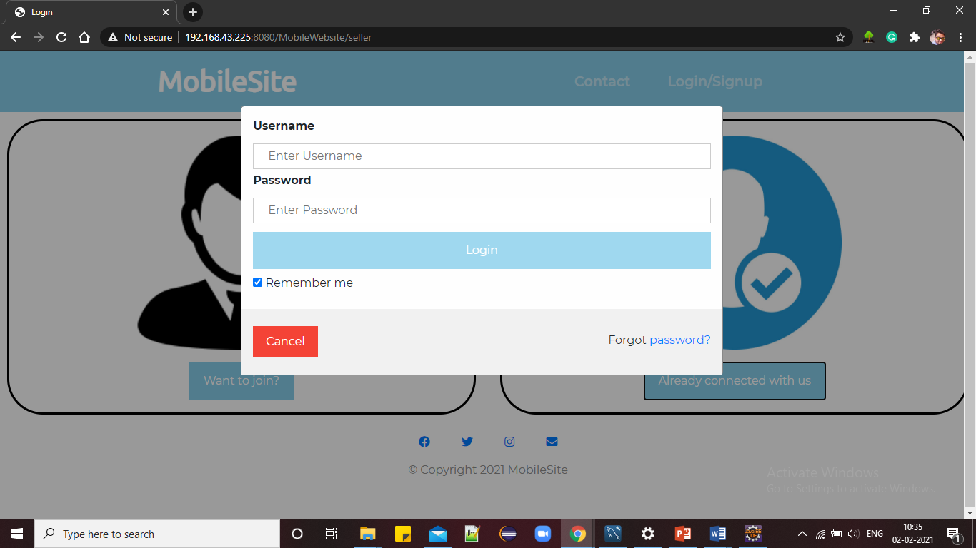
Seller Module
Register and login page for seller
Login page for seller

Slide 14
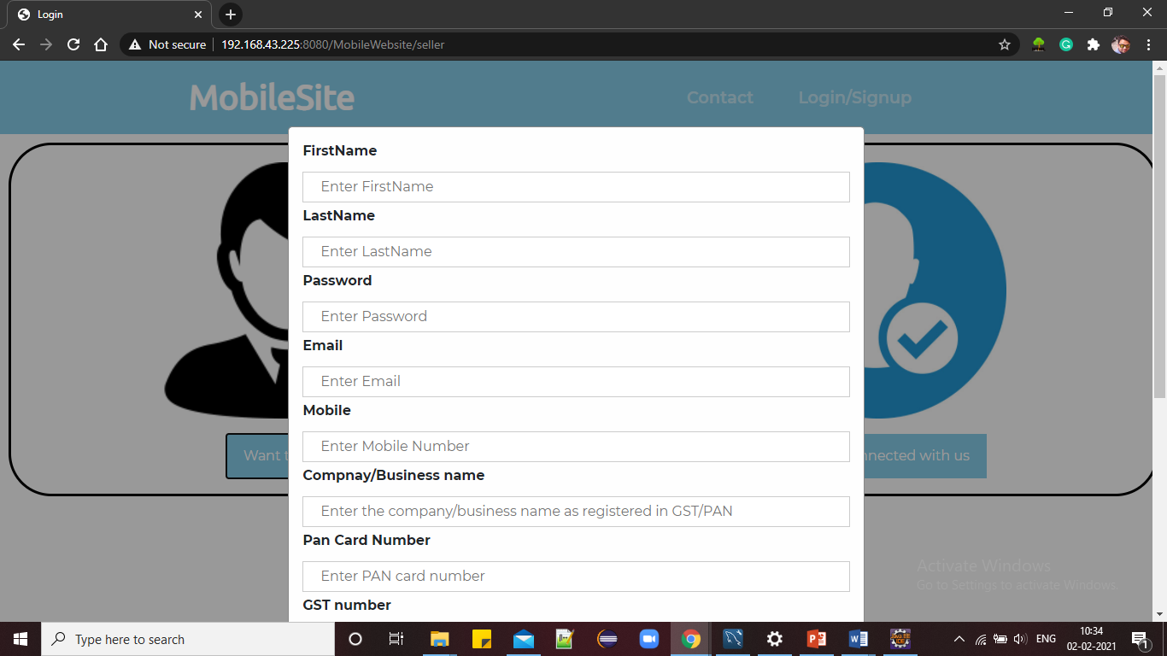
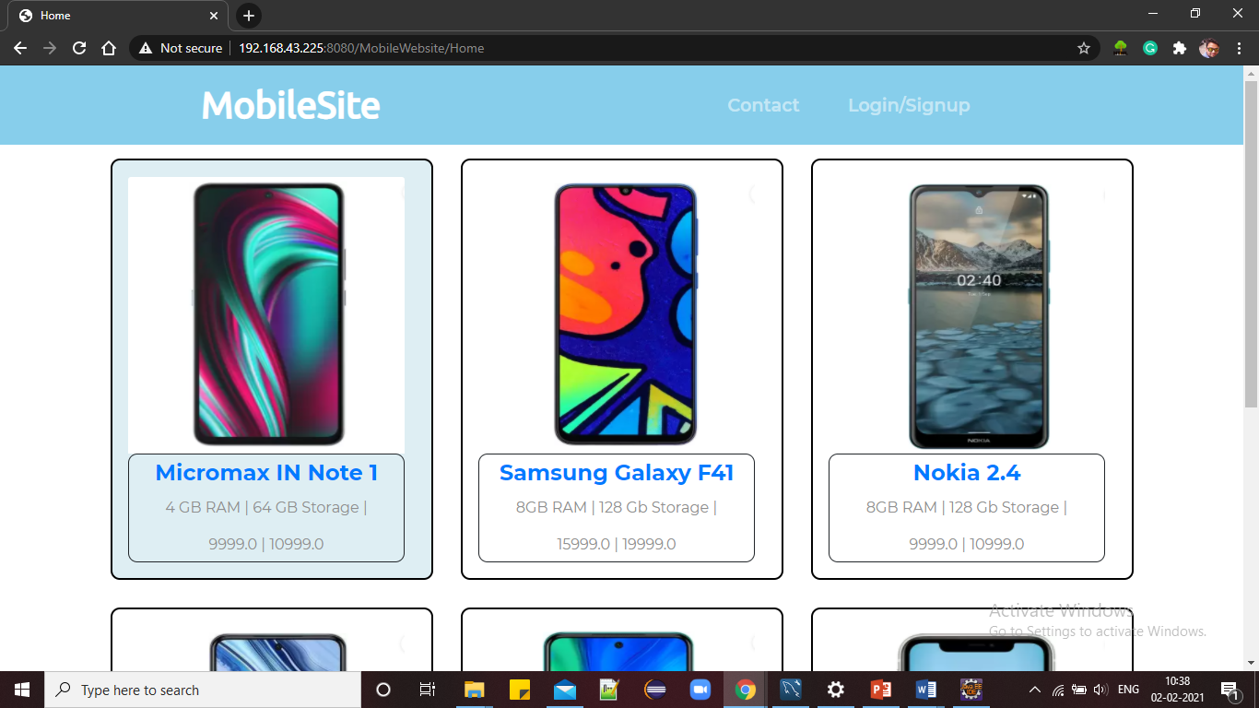
Seller Module
Seller registration page
Seller homepage

Slide 15
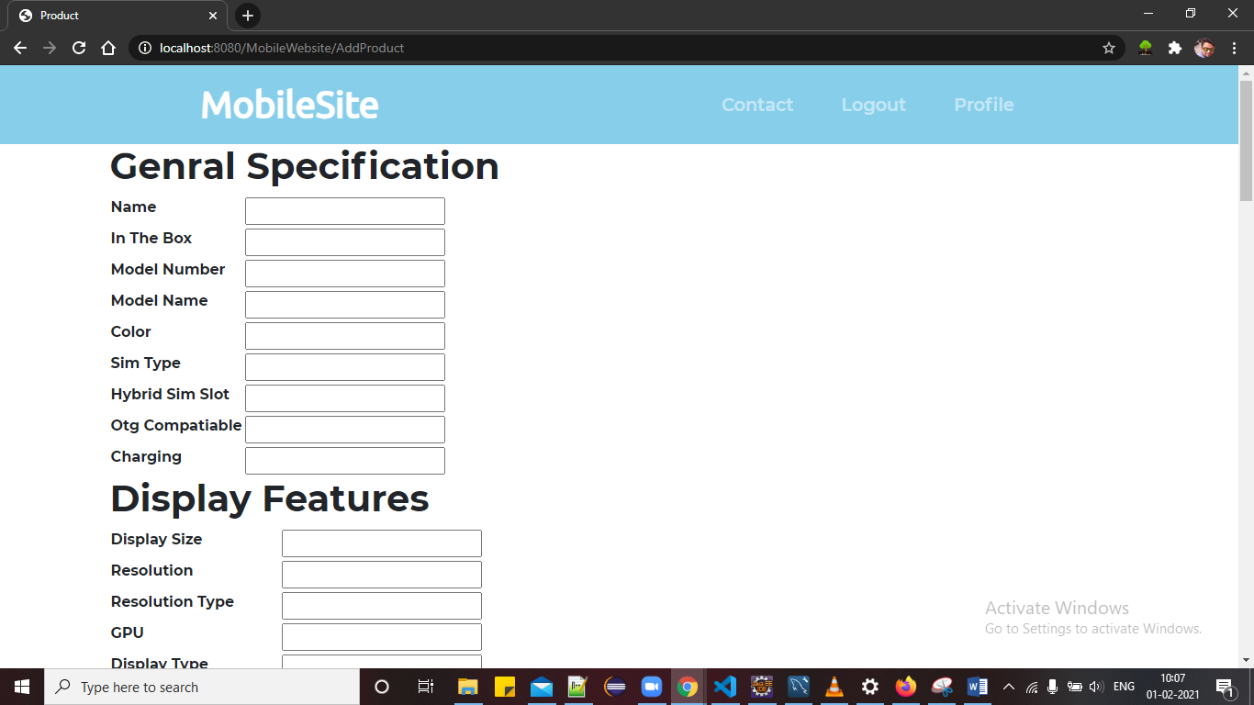
Seller Module
Addition of new product by seller
Update info for seller

Slide 16
diagrams

Slide 17
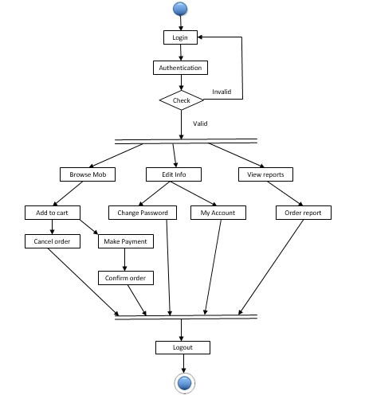
Fig 1. Activity diagram for Customer

Slide 18
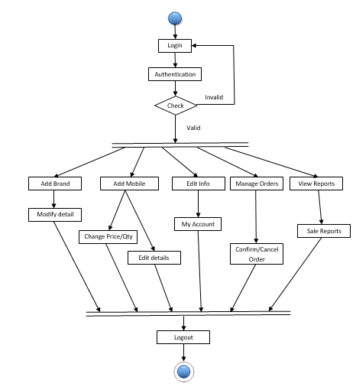
Fig 2. Activity diagram for Seller

Slide 19
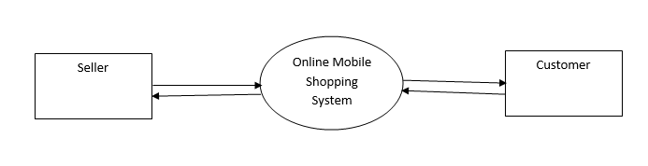
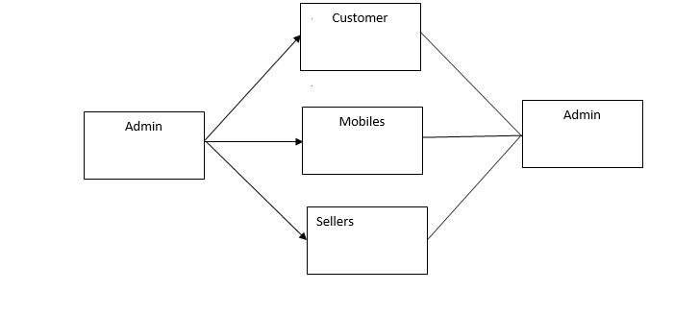
Fig 3. Level 0 Data flow diagram
Fig 4. Level 1 Data flow diagram

Slide 20
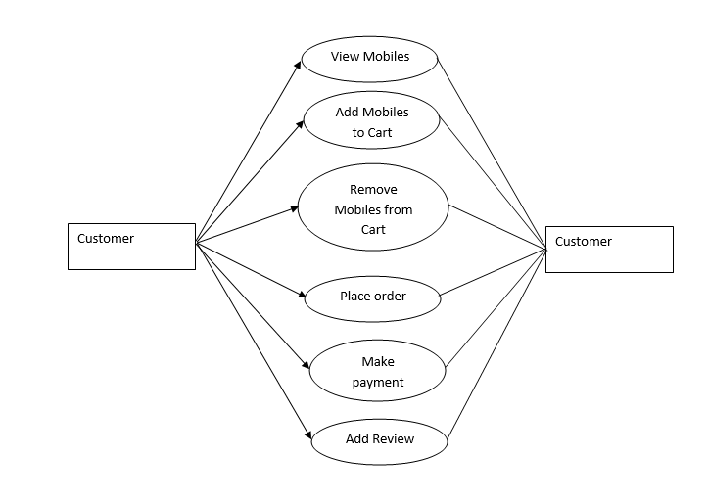
Fig 5. Level 2 Data flow diagram for Customer

Slide 21
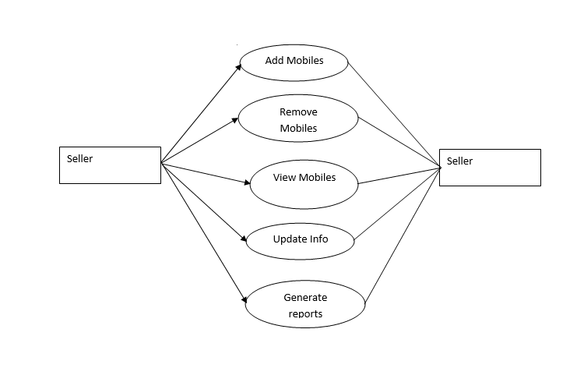
Fig 6. Level 2 Data flow diagram for Seller

Slide 22
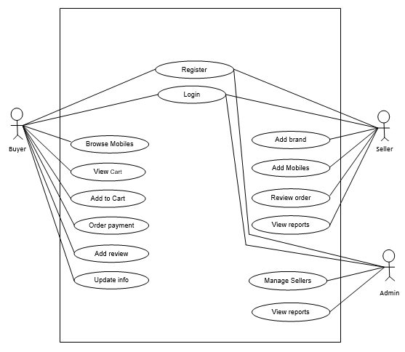
Fig 7. Use-Case diagram for Online Mobile Shopping

Slide 23
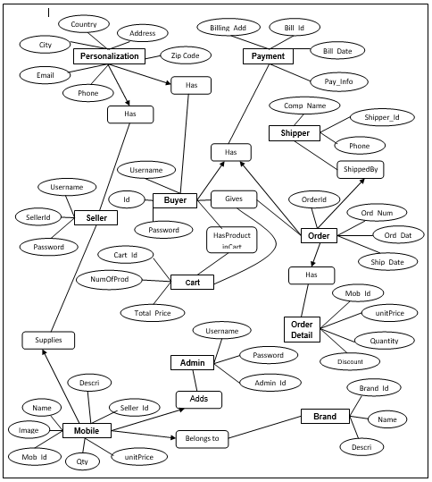
Fig 8. E-R diagram for Online Mobile Shopping System

Slide 24
Technology used
Java j2ee for backend
Html, CSS, Bootstrap and JavaScript for frontend
MySQL Database

Slide 25
Pros
Can shop for 24*7
No need to carry cash
A lots of store within click away
Comparison is easy
No queue to wait.
Shopping privacy

Slide 26
Cons
Not able to inspect mobile physically
Time consuming if connection is weak
Return process takes time in case of any damage
Actual product may differ.

Slide 27
Future Scope
This project can be further enhanced for better experience of customers and sellers. We can also implement multiple payment gateway, real-time tracking of your orders. The software is flexible enough to be modified and implemented as per future requirements. We have tried our best to present this free and user–friendly website.

Slide 28
Conclusion
User friendly application promotes purchase and shopping faster.
Being able to buy anytime any where.
You don’t need to travel to shop for purchasing.

Slide 29
Thank you…..

