Slide 1


Heart Disease
- Shinde Shweta

Slide 2
About me
NAME : Shinde Shweta
Academic Qualification: MSC (Computer Science)

Slide 3
Introduction
It is difficult to identify heart disease because of several contributory risk such as diabetes, high blood pressure, high cholesterol, abnormal pulse rate and many other factors and heart disease remains one of the leading causes of mortality worldwide, emphasizing the critical need for effective early detection and intervention strategies.
Among various life threating disease, heart disease has generated a great deal of attention in medical research.
The diagnosis of heart disease is a challenging task, which can offer automated prediction about the heart condition of patient so that further treatment can be made effective, the diagnosis of heart disease is usually based on signs, symptoms of the patient.
The severity of the disease is classified based on various methods like KNN (K-nearest neighbor) algorithm, SVC (Support Vector Classifier) and Logistic Regression.
Through the various experimentation and analysis, the project aims to identify the most accurate and reliable models for heart disease classification.

Slide 4
Problem Statement
This project aims to develop a machine learning classification model to predict heart disease risk based on patient health data.
By using various machine learning algorithms trying to find out the best to predict the presence or absence or heart disease.

Slide 5
Objective
The main objective of this project is to develop a heart prediction system, the system can discover and extract hidden knowledge associated with a disease from the data set.
Heart disease prediction using machine learning utilizes algorithms to analyze medical data like age, blood pressure, and cholesterol levels, aiding in early detection and prevention.
This system aims to exploit machine learning techniques on a medical data to assist in the prediction of heart disease and to contribute to the early detection and management of heart-related conditions, thereby improving patient outcomes and healthcare delivery.

Slide 6
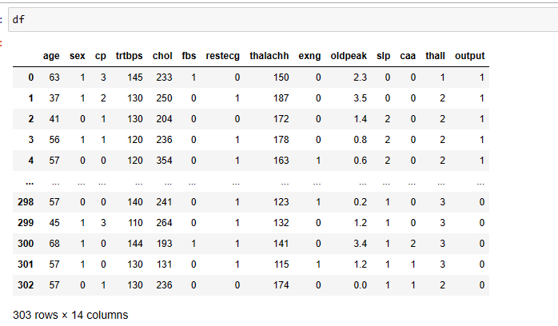
Load the Data
The dataset is sourced from Kaggle, the dataset's binary classification target denotes the presence (1) or absence (0) of heart disease. this dataset provide a throughout foundation for clinical markers.

Slide 7
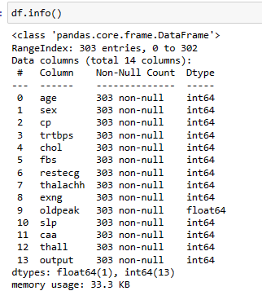
Simple EDA:
The dataset contains 4,242 data points with 14 feature variables like age, sex, cp, trtbps , chol, fbs, restecg, thalachh, exng, oldpeak, slp, caa, thall, output. The class variable being Output category.
The dataset doesn’t contain any null values but contain few outliers. In this dataset it contains Numerical columns like age, sex, cp, trtbps , chol, fbs, restecg, thalachh, exng, oldpeak, slp, caa, thall, output.

Slide 8
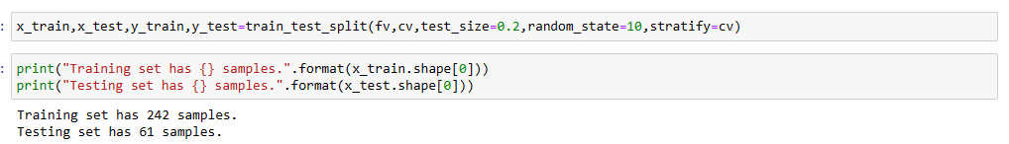
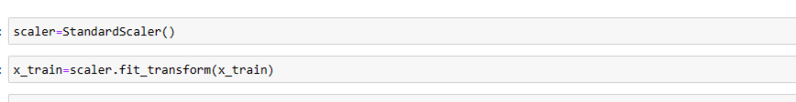
Data Preprocessing:
- Handling missing values
- Feature scaling
- Splitting into training and testing sets
- Data is divided into training and testing sets to assess model performance on unseen data and prevent overfitting.
- StandardScaler ensures that all features contribute equally to the model training process, preventing features with larger scales from dominating the learning algorithm and also help to learn from the data and produce reliable predictions.

Slide 9
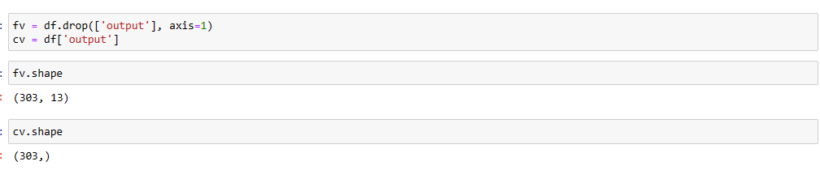
Model Building
- Model building refers to the process of creating a structure that can capture patterns, relationships, or trends within data.
- I have first divided the dataset into several subsets in order to guard against data leaking and guarantee the accuracy of our research. By keeping our training and testing data independent from one another, we were able to prevent any unintentional information contamination.

Slide 10
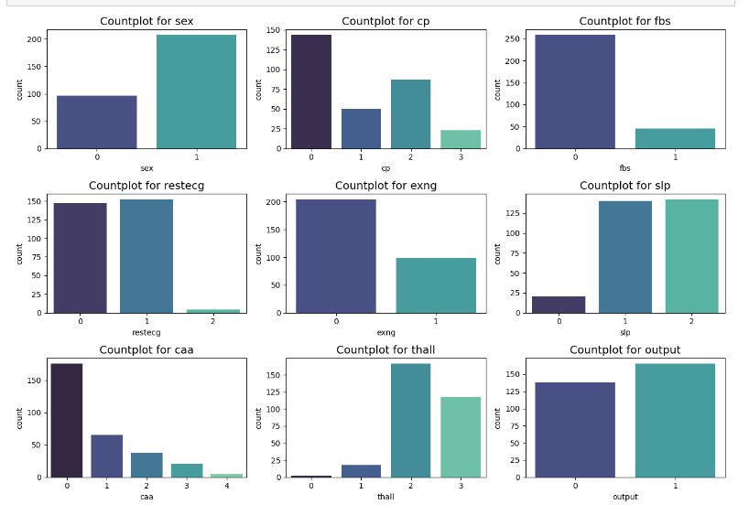
Exploratory Data Analysis
insights: Most of the categorical features are imbalanced, in Countplot of sex it is showing the count of 0-female and 1-male same for the Countplot of cp represent the count of 0: Typical angina, 1: Atypical angina ,2: Non-anginal pain ,3: Asymptomatic.

Slide 11
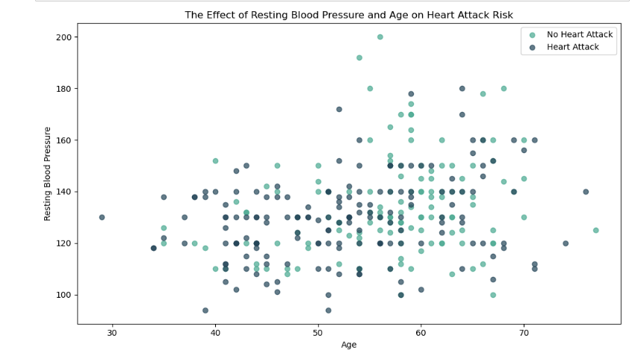
Insights: The scatter plot shows a positive correlation between age and resting blood pressure, with older people having higher resting blood pressure, potentially increasing their risk of heart attacks.

Slide 12
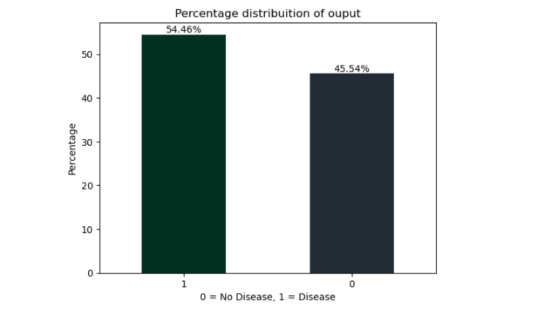
Insights:
- The plot showcases the distribution of classes (0 and 1) in the target variable, indicating the prevalence of heart disease within the dataset. Each bar represents the percentage of data points belonging to a specific class.
Clear labeling (0 = No Disease, 1 = Disease) helps interpret the meaning of each class, essential for assessing predictive performance. - the observation reveals that the "Disease" class comprises 54.46% of the dataset, while the "No Disease" class accounts for 45.54%.

Slide 13
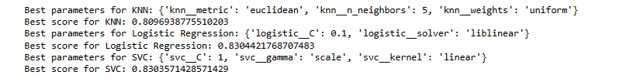
Model Training:
The model is trained using 3 classification algorithms: KNN classifier, Logistic Regression and Support vector Classifier and performance of the model is verified using all the classification metrics like accuracy, f1 score and roc_auc score. KNN algorithm is doing good at n=5, Logistic regression’s best parameters with solver as liblinear and SVC is doing good at C=1 with Linear kernel. The accuracy for KNN is 80.9%, Logistic Regression is 83.04% and SVM is 83.03%.

Slide 14
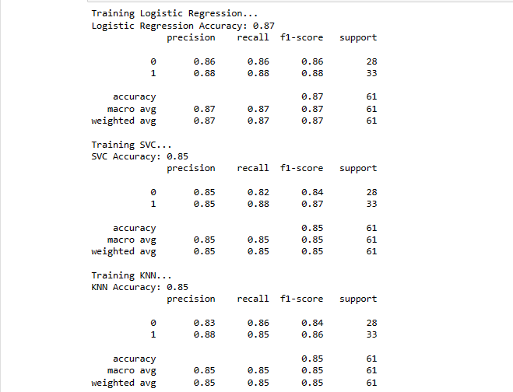
Model Evaluation:
Out of all the 3 models, as Logistic Regression is doing better than the other 2 models, it is chose as the Final model to classify the output column. The generalized accuracy achieved for Logistic Regression is 87%, generalized f1_score is 0.0.86 and roc-auc score is 0.88.

Slide 15
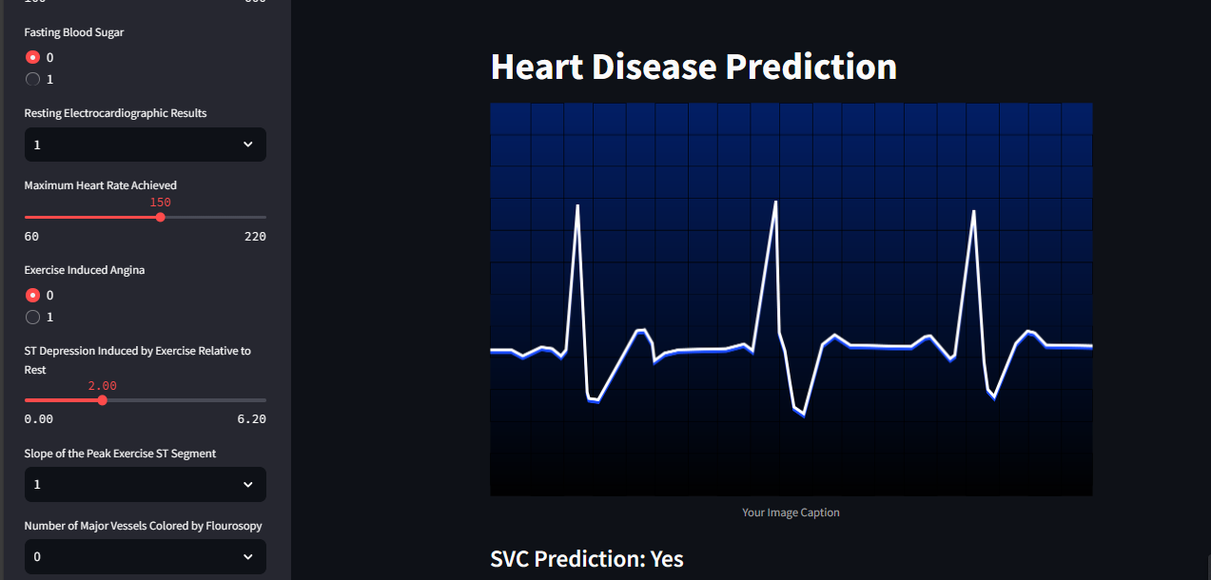
Model Deployment:
The finalized model is then deployed on Streamlit

Slide 16

THANK YOU

