Slide 1


Paris Housing Price Prediction
- Shinde Shweta

Slide 2
About me:
NAME : Shinde Shweta
Academic Qualification: MSC (Computer Science)

Slide 3
Problem Statement:
Predicting house prices accurately aids homebuyers in making informed decisions about their investments
It provide stakeholders with actionable insights for informed decision-making in property transactions, , ultimately enhancing market efficiency and transparency.

Slide 4
Objective
The objective of this project is to develop a robust and accurate model for predicting housing prices in Paris using various machine learning algorithms.
Gathering and cleaning relevant data on Paris housing prices to ensure the dataset is suitable for training machine learning models.
Analyzing the results to draw insights into the key factors affecting housing prices in Paris and providing actionable recommendations based on the model's predictions.
This project aims to leverage advanced machine learning techniques to achieve high prediction accuracy, thereby providing valuable insights for stakeholders such as real estate investors, buyers, and policy makers.

Slide 5
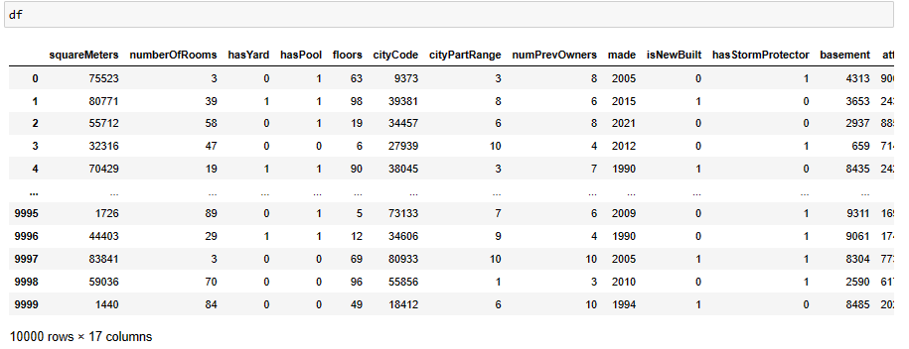
Data Collection:
The source of the data is Kaggle.

Slide 6
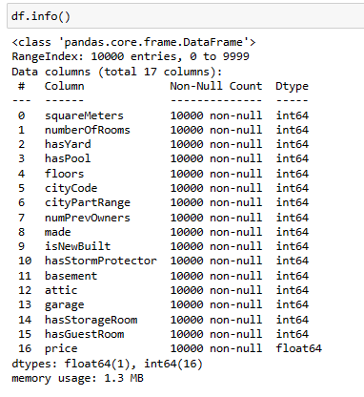
Simple EDA:
The dataset contains 17,000 data points with 17 feature variables like squareMeters, numberOfRooms, hasYard, hasPool, floors, cityCode , cityPartRange, numPrevOwners, made, isNewBuilt, hasStormProtector, basement, attic, garage, hasStorageRoom, hasGuestRooms, Price. The class variable being Price category.

Slide 7
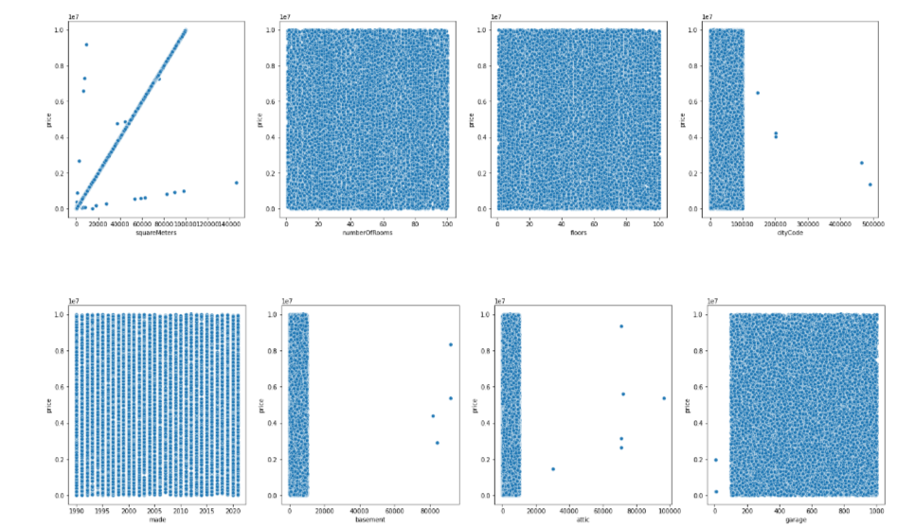
- The relationship depicted in the rugplot suggests a positive correlation between the square meters of house area, Numberofrooms, floors, citycode, made, basement, attic and garage with the corresponding price. As the square meterage increases, the price tends to rise as well .
- The discovery highlights that how house size determining property values in Paris real estate market. it is hard to define the effect of number of rooms on the price, it seems like number of room does not have any effect on price Other seems to be uniformly distributed.

Slide 8
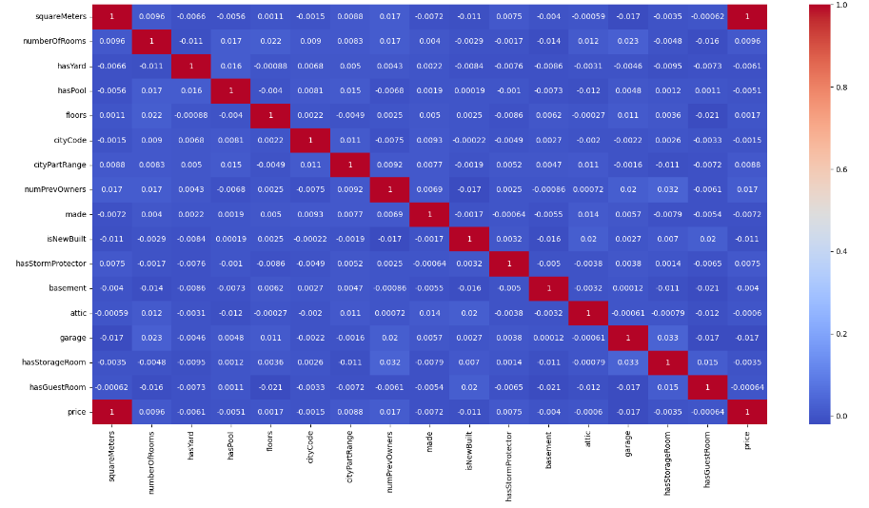
Insights:- The above heatmap represents the correlation between the different factors of the dataset. We can conclude that there is high correlation between price and squremeters and some great features such as having a pool, a garage, a basement or a guestroom have a little but negative correlation with price.

Slide 9
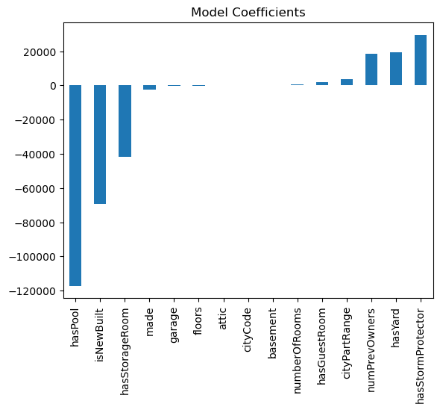
Insights: hasPool shows a high negative coefficient followed by isNewBuilt and made, and hasStormProtector shows a small positive coefficient, and the hasYard shows the second highest positive coefficient.

Slide 10
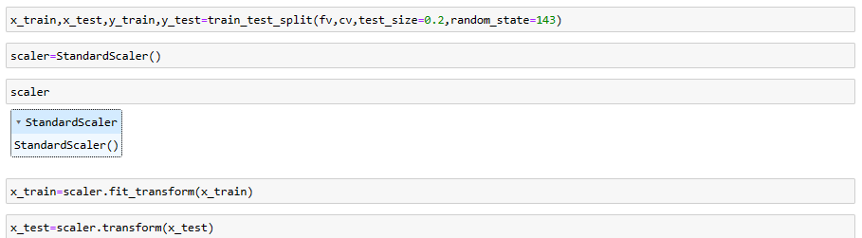
Pre-Processing:
Completed a Pre-Processing task such as Splitting the data into training and testing sets
dividing the dataset Into testing and training sets to make sure our machine learning regression model for forecasting Parisian home prices is reliable and accurate. Also used a Standard scalar technique which ensure that all features contributing equally to model training process.

Slide 11
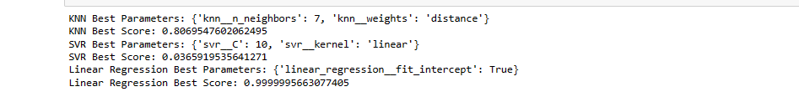
Model Training:
The model is trained using 3 Regression algorithms: KNN , Logistic Regression and Support vector Regression and performance of the model is verified using all the Regression metrics R2_Score. KNN algorithm is doing good at n=7, Logistic regression’s best parameters linear_regression__fit_interceptand SVR is doing good at C=10 with Linear kernel. The accuracy for KNN is 80%, Logistic Regression is 99% and SVR is 0.36%.

Slide 12
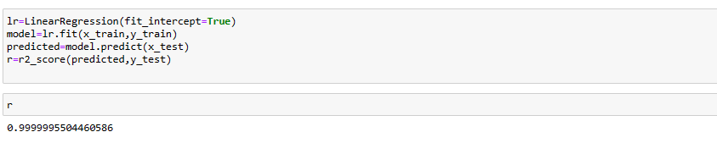
Model Evaluation:
Out of all the 3 models, as Logistic Regression is doing better than the other 2 models, it is chose as the Final model to classify the output column. The r2_Score achieved for Logistic Regression is 99.

Slide 13
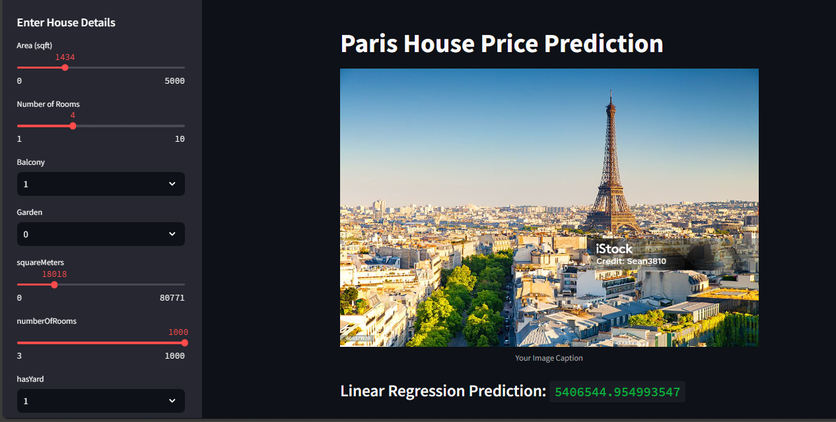
Model Deployment:
The finalized model is then deployed on Streamlit

Slide 14

THANK YOU

