Slide 1
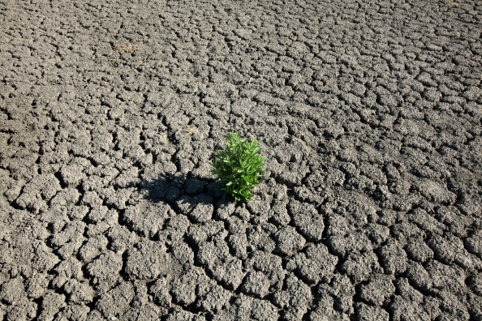
UTSA Data Analytics Boot Camp (August-2022)
A Review of the Effectiveness of the San Antonio Water System (SAWS) Water Restrictions Policies
Presented by :-
Sierra Quevedo, Jessica Ermovick, Matthew Belcher, Gino Hernandez, Shwet ‘Sunny’ Bhatt

Slide 2

Project Information
Project Team (Group 1):
Sierra Quevedo, Jessica Ermovick, Matthew Belcher, Gino Hernandez, Shwet ‘Sunny’ Bhatt
List of variables analyzed:
Water Level (J17)
Temperature
Humidity and Precipitation
Change in Water Level by year (J17)
Drought Levels for water restriction (Stage 1, Stage 2, Stage 3)
Project Scope:
As a team we decided to extract historical data from sources such as Wunderground, Edwards Aquifer and Drought Monitor to analyze and review the Effectiveness of the San Antonio Water System (SAWS) Water Restrictions Policies implemented for Bexar county. We have used various tools such as…….

Slide 3
Questions
Which variables help us establish a strong correlation with drop in water levels for well J17?
Did overall consumption of water increase in Bexar county over last 5 years resulting in decrease of water levels?
Did overall the overall Humidity and precipitation affect water levels?
Did the overall temperature change in last 5 years affect the water levels?
How does San Antonio Water Systems implement drought restrictions. Based on recent data, are current restrictions effective in maintaining and/or replenishing water level in well J17?
How do we look at this issue as a group based on available data?
Graphically we represented our data in scatter plots and bar charts…….
Correlation/P-value, chi value.
We found multiple sources of data and the main challenge was to clean and merge dataframes……

Slide 4
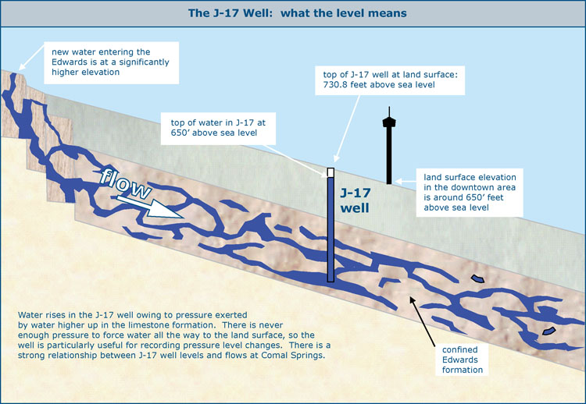
Project Data Sources
.csv data:

Slide 5
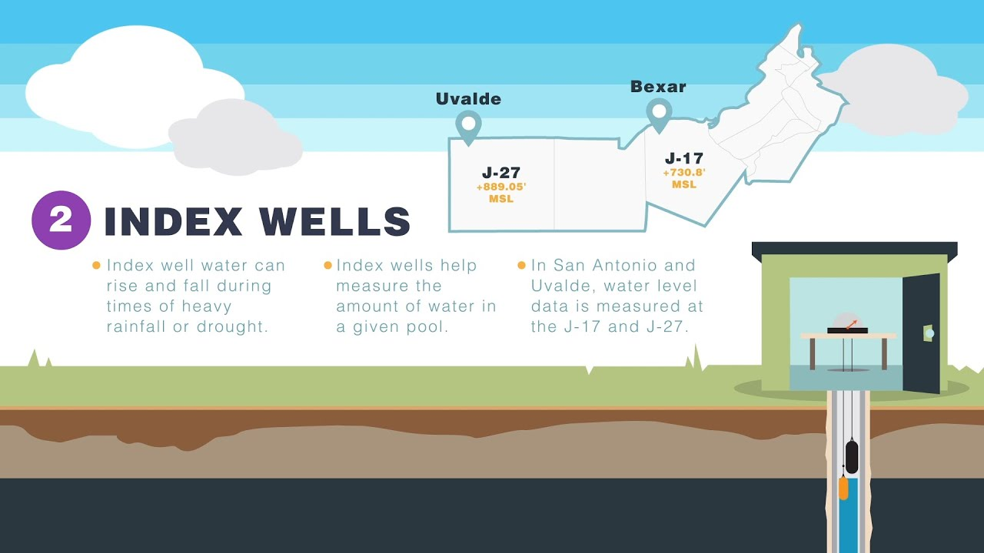
Project Variables
Weather Historical Data
J17WL Well Historical Data
Drought Conditions

Slide 6
Data Cleanup

Slide 7
Changes in Water level

Slide 8
Temperature

Slide 9
Humidity and Precipitation

Slide 10
Water level restrictions

Slide 11
Temperature versus Water level

Slide 12
Humidity vs Water level

Slide 13
Precipitation vs Water level

Slide 14
P-Value and Null vs Alternate Hypothesis

Slide 15
Total P-Value data

Slide 16
Limitations

Slide 17
Conclusion

