Slide 1
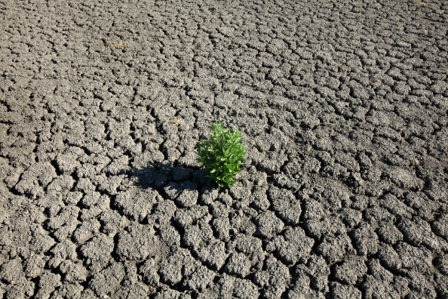
UTSA Data Analytics Boot Camp (August-2022)
A Review of the Effectiveness of the San Antonio Water System (SAWS) Water Restrictions Policies
Presented by :-
Sierra Quevedo, Jessica Ermovick, Matthew Belcher, Gino Hernandez, Shwet ‘Sunny’ Bhatt

Slide 2

Project Information
Project Team (Group 1):
Sierra Quevedo, Jessica Ermovick, Matthew Belcher, Gino Hernandez, Shwet ‘Sunny’ Bhatt
List of variables analyzed:
Water Level (J17)
Temperature
Humidity and Precipitation
Change in Water Level by year (J17)
Drought Levels for water restriction (Stage 1, Stage 2, Stage 3)
Project Scope:
As a team we decided to extract historical data from sources such as Wunderground, Edwards Aquifer and Drought Monitor to analyze and review the Effectiveness of the San Antonio Water System (SAWS) Water Restrictions Policies implemented for Bexar county.

Slide 3
Questions
Which variables help us establish a strong correlation with drop in water levels for well J17?
Did overall consumption of water increase in Bexar county over last 5 years resulting in decrease of water levels?
Did the overall Humidity and precipitation affect water levels?
Did the overall temperature change in last 5 years affect the water levels?
How does San Antonio Water Systems implement drought restrictions. Based on recent data, are current restrictions effective in maintaining and/or replenishing water level in well J17?
How do we look at this issue as a group based on available data?
Graphically we represented our data in scatter plots, line charts, whisker plot. In addition to this we worked on a predictive analysis model that helped us establish if there was any correlation between temperature and J17 water levels.
P-value
We found multiple sources of data and the main challenge was to clean and merge dataframes. We had limitations with…….

Slide 4
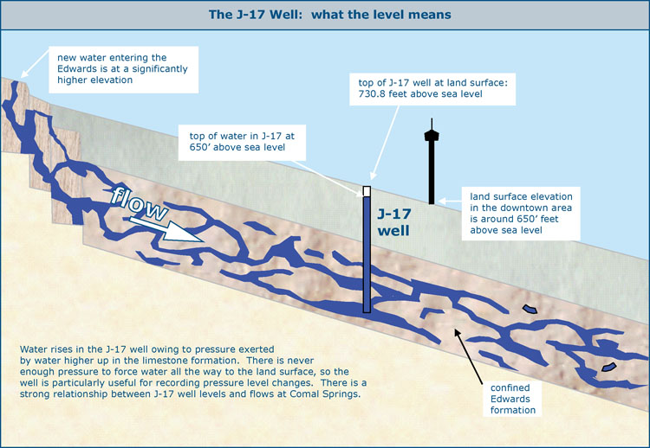
Project Data Sources
.csv data:
Weather Historical Data
https://www.wunderground.com/
J17WL Well Historical Data
https://www.edwardsaquifer.org/science-maps/aquifer-data/historical-data/
Drought Conditions
https://droughtmonitor.unl.edu/DmData/DataDownload.aspx

Slide 5
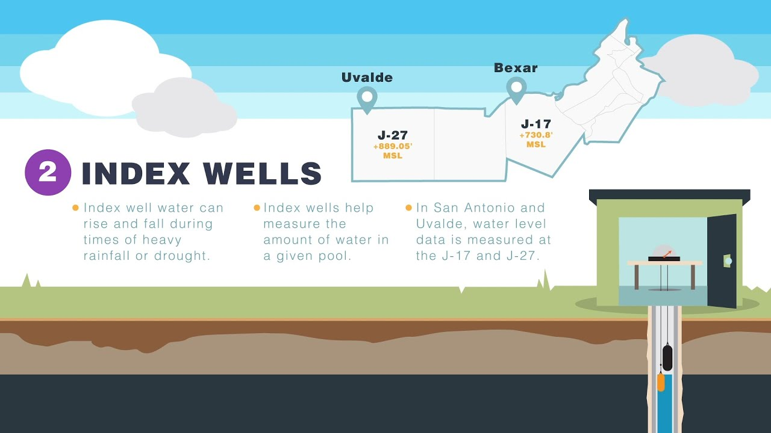
Project Variables
Water Level (J17)
Temperature
Humidity and Precipitation
Change in Water Level by year (J17)
Drought Levels for water restriction (Stage 1, Stage 2, Stage 3)

Slide 6
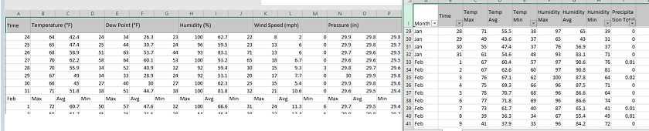

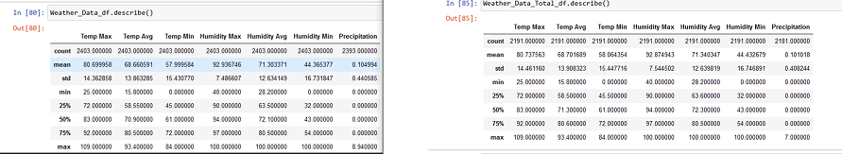
Data Cleanup
Weather Data was labor intensive- the formatting was not useable by python. Manual efforts to clean rows were performed
After Data Cleanup, the only noticeable difference in data was the counts

Slide 7
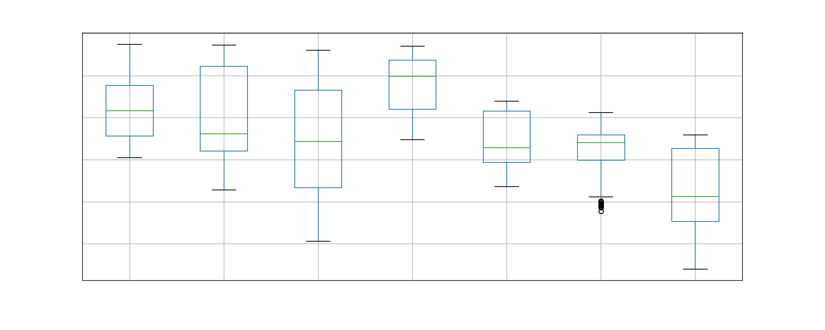
Check Data For Outliers

Slide 8
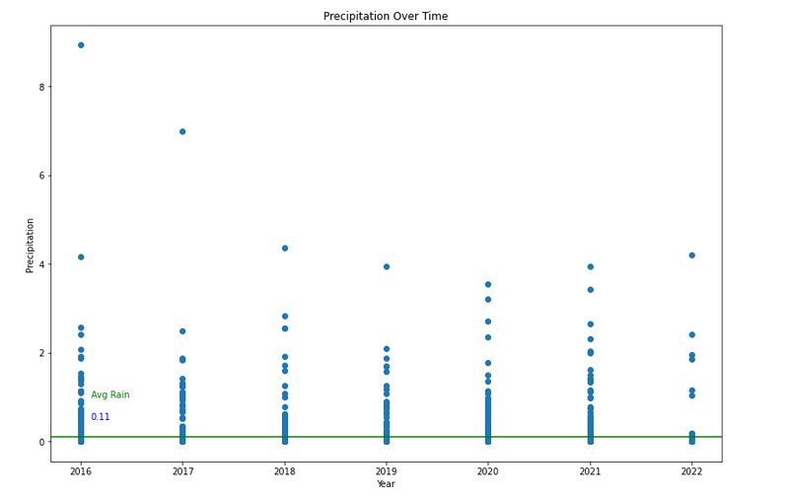
Average rainfall

Slide 9
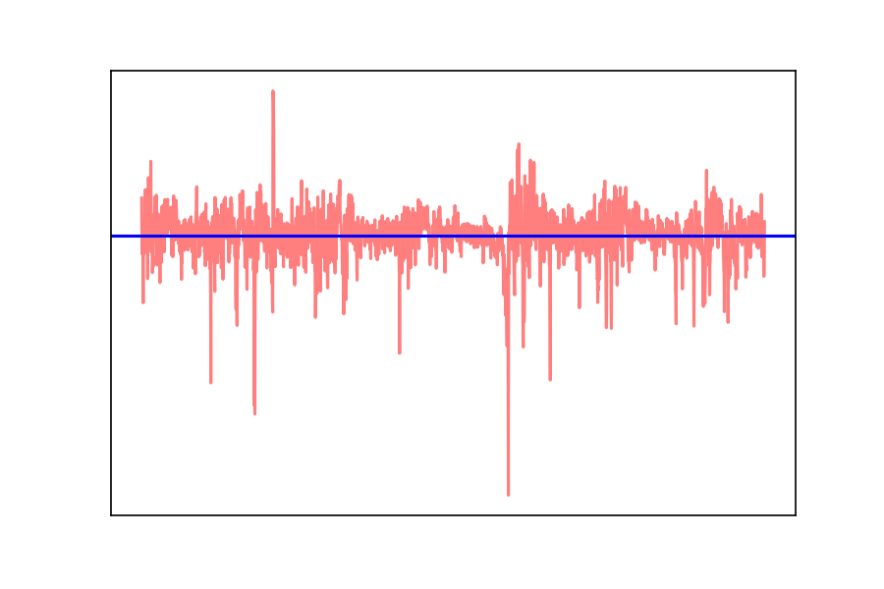
Percent decrease over time of water level

Slide 10
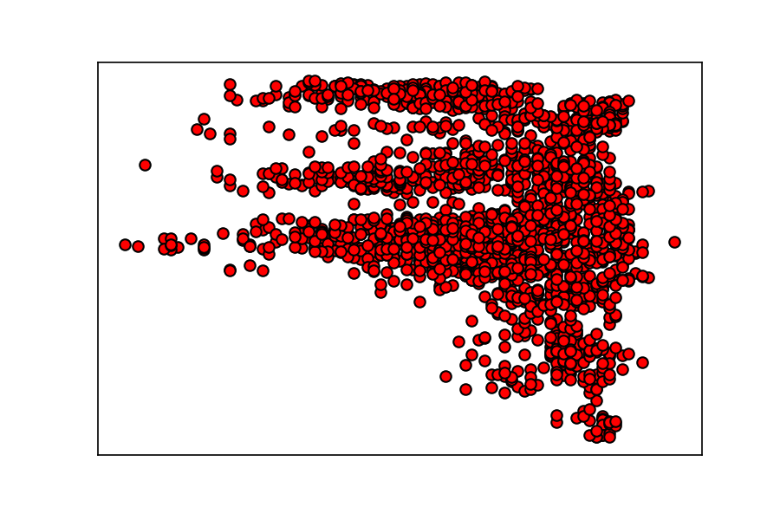
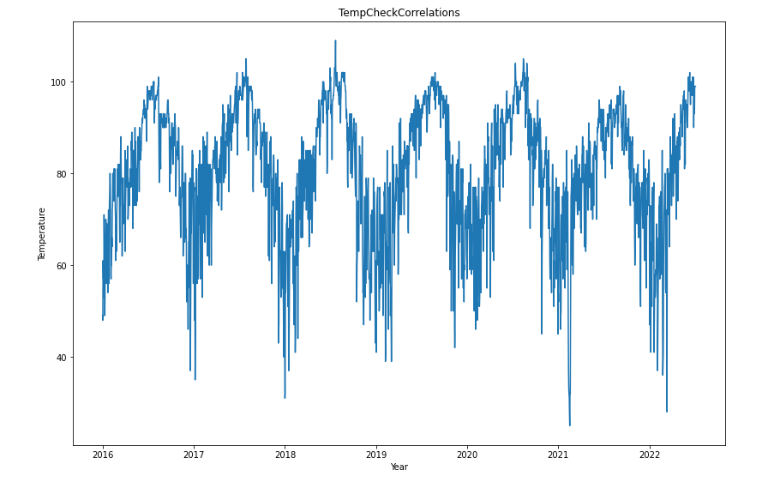
Does Temperature have anything to do with it?

Slide 11
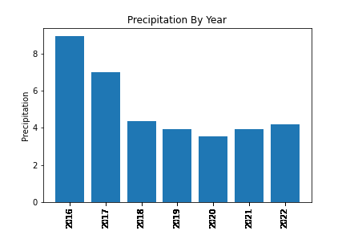
Humidity and Precipitation

Slide 12
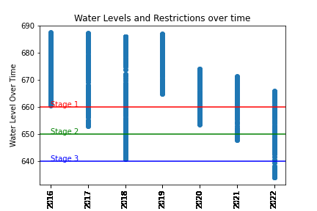
Water level restrictions

Slide 13
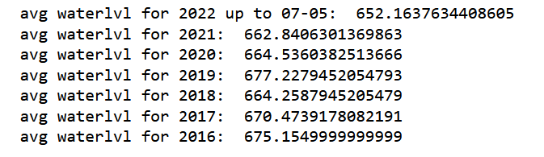

Null vs Alternate Hypothesis
When we performed the ANOVA test for the water level average each year we notice the we end up with the with the following p-value of 3.67 * 10^(-218), which is approximately zero.
Thus, we note based on this p-value the null hypothesis has been proven false and the alternative hypothesis is proven true.

Slide 14

Conclusion
Statistical tests show there is evidence to reject the null hypothesis, that there is indeed a problem with the current water restrictions being imposed by the SAWS
Box Plot shows some outliers in 2021 that might skew data
Temperature did not indicate a relationship with the water levels over the time period
Precipitation showed a slight relationship with the water levels over the time period
Dependent Variable- water levels of the J17 well at Edwards Aquifer continues to drop at a stead and alarming rate noted in 2020 and not rising meaning:
SAWS is not efficiently implementing water restrictions to mitigate the dropping water levels of the well

Slide 15
Limitations
At this point we might have an impact based on overall population increase in Bexar County which can directly affect the total usage form J17 well. In addition to that, we were not able to get historical data from SAWS.
We were not able to gather 2020 dataset for Weather and precipitation historical data. (Nov. 8th)
We did not have overall water usage for the city of San Antonio and other factors like diverting water for agricultural usage.
We don’t have complete 2022 data.

