Slide 1
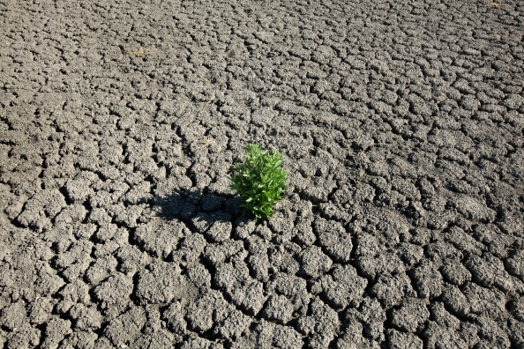
UTSA Data Analytics Boot Camp (August-2022)
A Review of the Effectiveness of the San Antonio Water System (SAWS) Water Restrictions Policies
Presented by :-
Sierra Quevedo, Jessica Ermovick, Matthew Belcher, Gino Hernandez, Shwet ‘Sunny’ Bhatt

Slide 2

Project Information
Project Team (Group 1):
Sierra Quevedo, Jessica Ermovick, Matthew Belcher, Gino Hernandez, Shwet ‘Sunny’ Bhatt
List of variables analyzed:
Water Level (J17)
Temperature
Humidity and Precipitation
Change in Water Level by year (J17)
Drought Levels for water restriction (Stage 1, Stage 2, Stage 3)
Project Scope:
As a team we decided to extract historical data from sources such as Wunderground, Edwards Aquifer and Drought Monitor to analyze and review the Effectiveness of the San Antonio Water System (SAWS) Water Restrictions Policies implemented for Bexar county. We have used various tools such as…….

Slide 3
Questions
Which variables help us establish a strong correlation with drop in water levels for well J17?
Did overall consumption of water increase in Bexar county over last 5 years resulting in decrease of water levels?
Did the overall Humidity and precipitation affect water levels?
Did the overall temperature change in last 5 years affect the water levels?
How does San Antonio Water Systems implement drought restrictions. Based on recent data, are current restrictions effective in maintaining and/or replenishing water level in well J17?
How do we look at this issue as a group based on available data?
Graphically we represented our data in scatter plots, line charts, whisker plot. In addition to this we worked on a predictive analysis model that helped us establish if there was any correlation between temperature and J17 water levels.
P-value
We found multiple sources of data and the main challenge was to clean and merge dataframes. We had limitations with…….

Slide 4
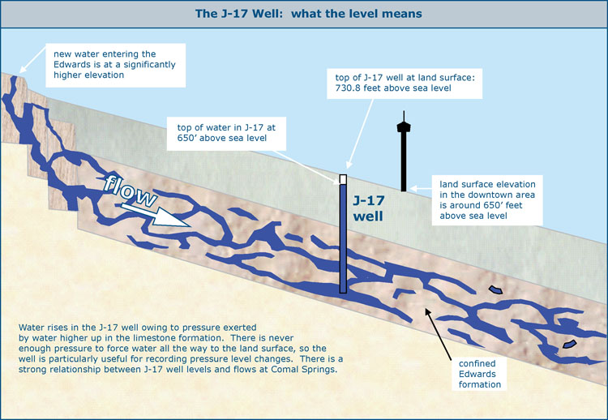
Project Data Sources
.csv data:
https://www.wunderground.com/
https://www.edwardsaquifer.org/science-maps/aquifer-data/historical-data/
https://droughtmonitor.unl.edu/DmData/DataDownload.aspx
Weather Historical Data
J17WL Well Historical Data
Drought Conditions

Slide 5
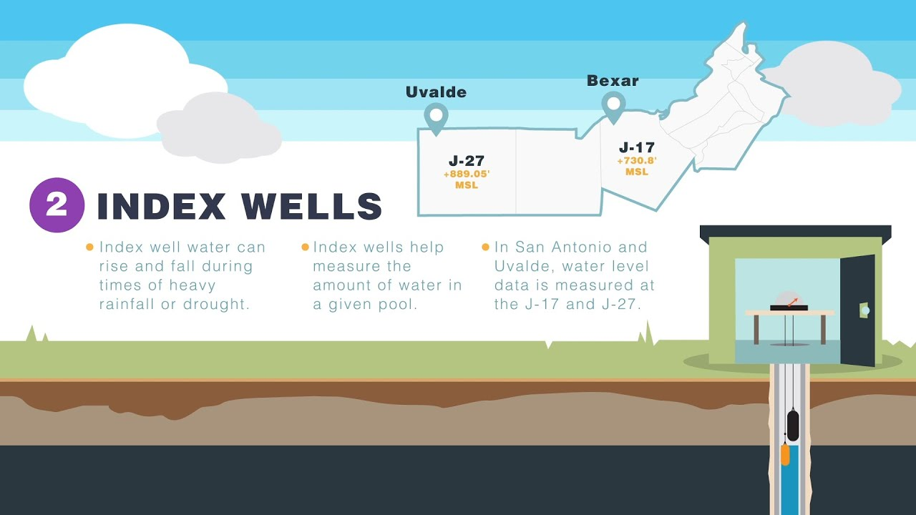
Project Variables
Water Level (J17)
Temperature
Humidity and Precipitation
Change in Water Level by year (J17)
Drought Levels for water restriction (Stage 1, Stage 2, Stage 3)

Slide 6
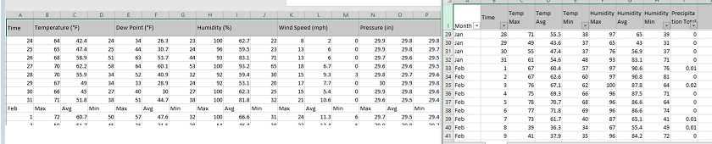
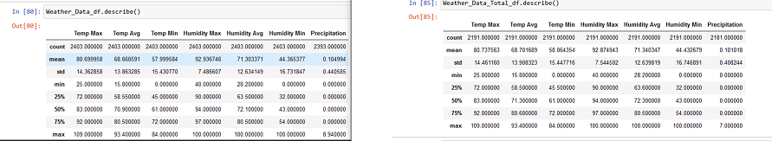
Data Cleanup
Weather Data was labor intensive- the formatting was not useable by python. Manual efforts to clean rows were performed
After Data Cleanup, the only noticeable difference in data was the counts

Slide 7
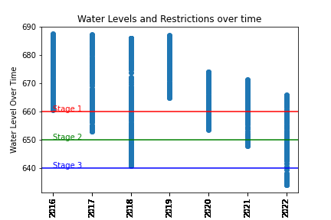
Null Hypothesis: Water Restrictions Implemented by SAWS maintain the Aquifer Level adequately

Slide 8
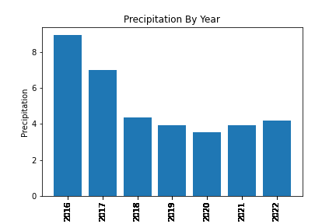
Humidity and Precipitation

Slide 9
Water level restrictions
Plots/charts explaining Time vs water levels at each point (5 years)

Slide 10
P-Value and Null vs Alternate Hypothesis

Slide 11
Total P-Value data

Slide 12
Limitations
At this point we might have an impact based on overall population increase in Bexar County which can directly affect the total usage form J17 well. In addition to that, we were not able to get historical data from SAWS.
We were not able to gather 2020 dataset for Weather and precipitation historical data. (Nov. 8^{th)}

Slide 13
Conclusion
Based on our analysis…..

