Slide 1
Capstone Project – Northwind Traders SalesAnalytics

Slide 2
Overview
The Northwind Traders Power BI project aims to create an interactive and user-friendly dashboard that presents key business insights across sales, customers, employees, and inventory.
The project helps management make data-driven decisions through powerful visualizations, trend analysis, and comparative performance metrics.

Slide 3
Problem Statement
The objective of this report is to analyze Northwind Traders’ sales performance and generate insights into customer behavior, product performance, and employee efficiency. The project focuses on:
Understanding revenue drivers and top-performing regions
Monitoring stock levels and supplier reliability
Tracking employee productivity and customer engagement
Providing a consolidated, data-driven overview of company operations

Slide 4
Data Preparation & Cleaning
Removed duplicates and blank values to ensure data consistency.
Converted text fields to date formats for OrderDate, ShippedDate, and RequiredDate.
Built table relationships in Power BI for interactive analysis.
Ensured standard naming conventions and formatted currency, numbers, and dates.

Slide 5
Exploratory Data Analysis (EDA)
Performed EDA using SQL to analyze sales, customers, orders, and employee data.
Created Total Price column in Excel Power Query and changed text to date formats for consistency.
Exported SQL outputs to Excel for tabular visualization and summary validation.
Conducted Power BI EDA to explore patterns in sales trends, customer behavior, and product performance through visuals.

Slide 6
MECE Breakdown / Project Workflow
Business Understanding – Define project objectives and key business questions
Data Understanding – Identify relevant tables, relationships, and attributes.
Data Preparation & Modeling – Clean, transform, and establish data relationships.
Analysis & Measures – Create calculated fields and DAX Measures,KPIs for performance tracking.
Visualization Design – Develop intuitive visuals for comparative insights.
Interactivity & User Experience – Add slicers, filters, and drill-through options.
Insights & Storytelling – Present findings with context for decision-making.
Deployment & Maintenance – Publish, refresh, and share dashboards.
Tools Used – Excel, SQL, and Power BI.

Slide 7
Data Dictionary – Key Analysis Areas
Analysis Type | Focus / Key Metrics | Purpose / Insights
Customer Analysis | Customer segmentation, order frequency, and revenue per customer | Identify loyal customers, understand buying behavior, and plan targeted marketing.
Order Analysis | Total orders, order volume, discounts, and shipping trends | Analyze order patterns, evaluate shipping efficiency, and track revenue contribution.
Employee Analysis | Revenue by employee, total and average orders handled | Assess performance, recognize top performers, and optimize workload distribution.
Product Analysis | Best-selling products, category trends, and stock status | Track product success, manage inventory, and ensure profitable category mix.
Supplier Analysis | Supplier contribution, stock availability, and regional supply data | Monitor supplier performance and improve procurement reliability.
Shippers Analysis | Delivery performance, and shipper utilization | Evaluate logistics partners and improve shipping cost-effectiveness.

Slide 8
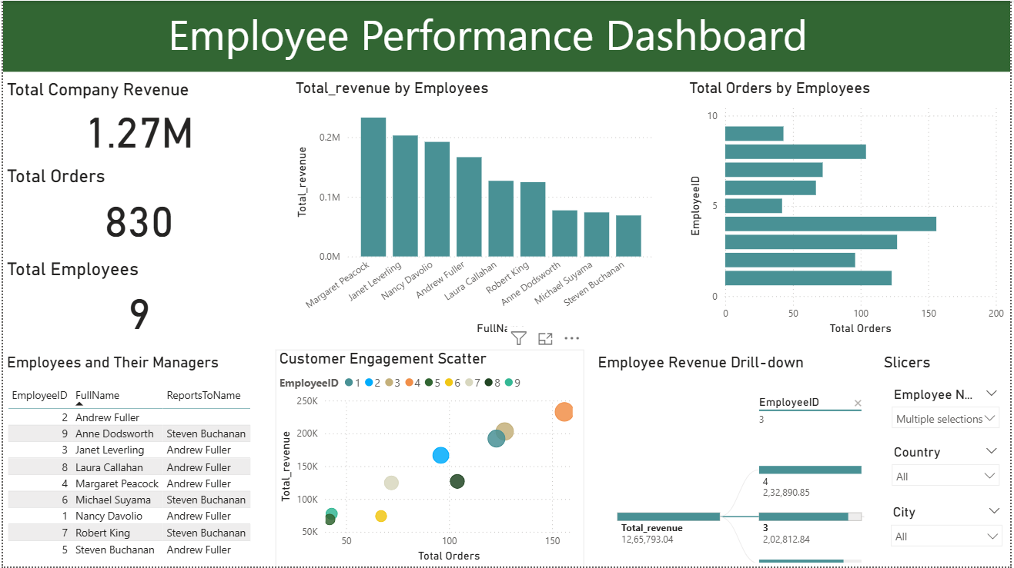

Slide 9
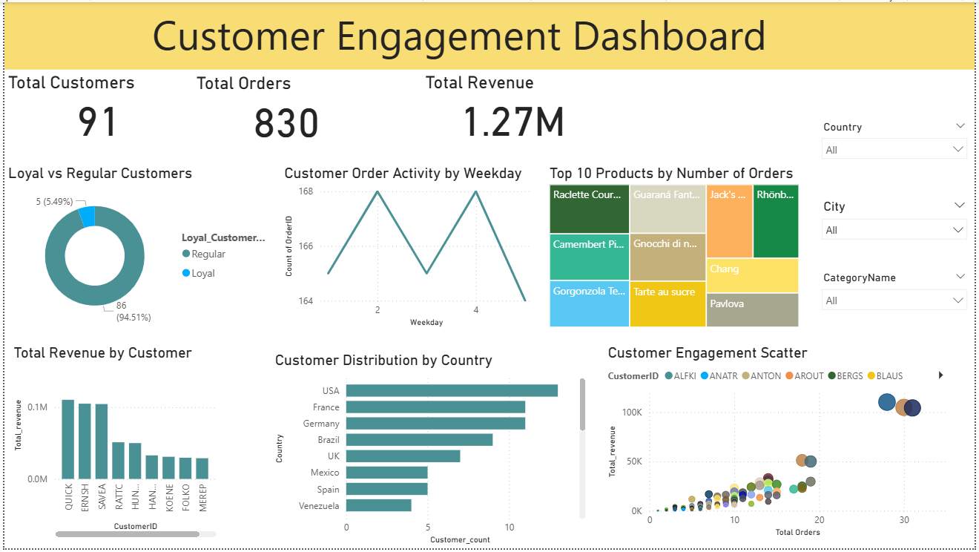

Slide 10
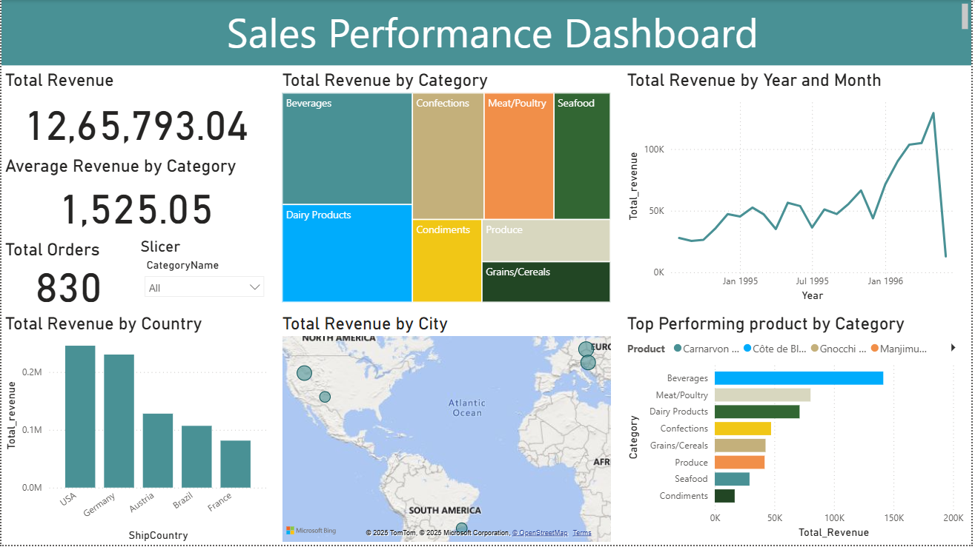

Slide 11
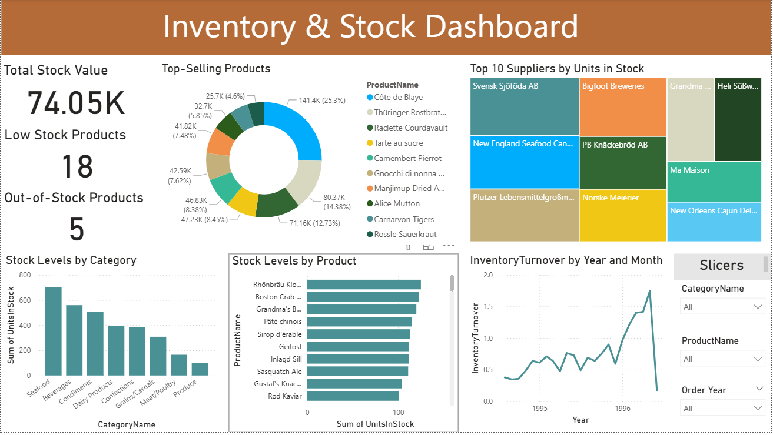

Slide 12
Insights:-
Top-performing employees were identified based on total sales and number of orders handled.
High-value customers contribute significantly to total revenue and show consistent order frequency.
Sales trends indicate seasonal fluctuations, with peak sales observed during specific months.
Top-selling products and categories drive the majority of revenue, highlighting profitable segments.
Inventory analysis revealed overstocked and low-stock items, helping in better stock management.
Supplier performance insights assist in optimizing procurement and ensuring timely deliveries.
Shipping performance analysis showed the most frequently used shippers and overall delivery efficiency.

