Slide 1

FAKE NEWS DETECTION
USING LOGISTIC REGRESSION
Shwetha Thallapelli
Notes:
3/6/2025
1
1

Slide 2
CONTENTS
Model evaluation metrics
Confused Matrics Analysis
Limitations and challenges
Conclusion
References
Introduction
Requirement specification
ML Libraries
Methodology
Logistic regression
TF-IDF Feature
Notes:
3/6/2025
2
2

Slide 3

INTRODUCTION
Fake news is also known as junk news which refers to false or misleading Information which pretends as real news
It is becoming increasingly difficult for us to know how to identify fake news.
Fake news detection is a natural language processing task that involves identifying and classifying news articles or other type of te- -xt as real or fake.
The goal of fake news detection is to develop algorithms that can automa- tically identify and flag fake news articles
Notes:
3/6/2025
3
3

Slide 4
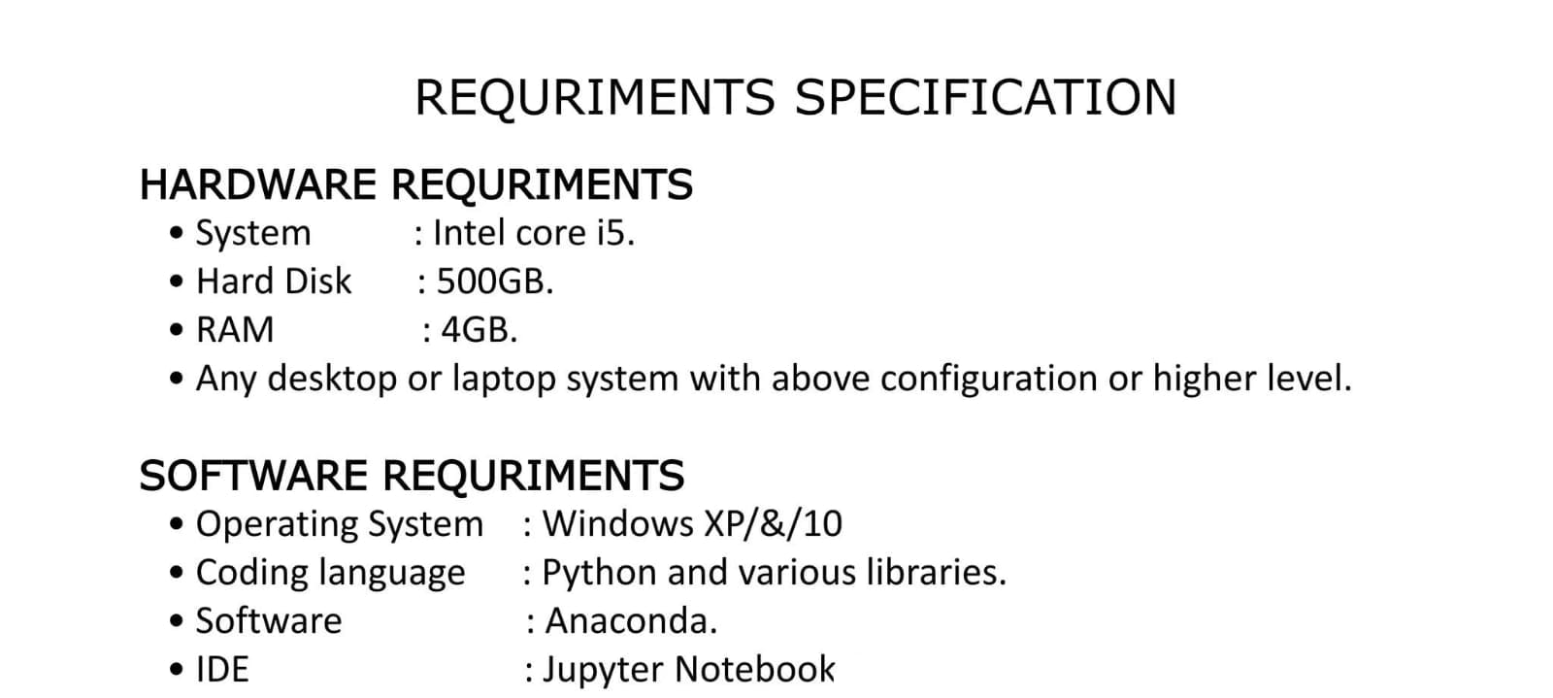
Notes:
3/6/2025
4
4

Slide 5
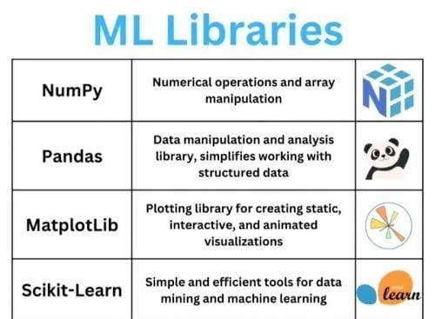

Notes:
3/6/2025
5
5

Slide 6
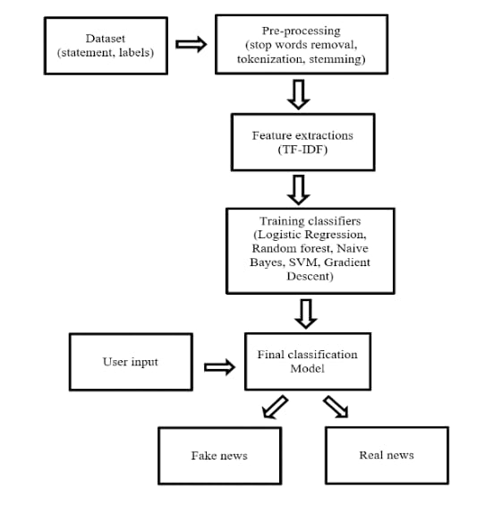
METHODOLOGY:
PROCESS FLOW OF THE SYSTEM:-
Notes:
3/6/2025
6
6

Slide 7
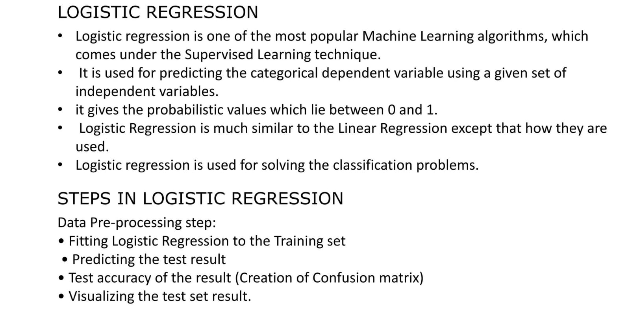
LOGISTIC REGRESSION
Notes:
3/6/2025
7
7

Slide 8
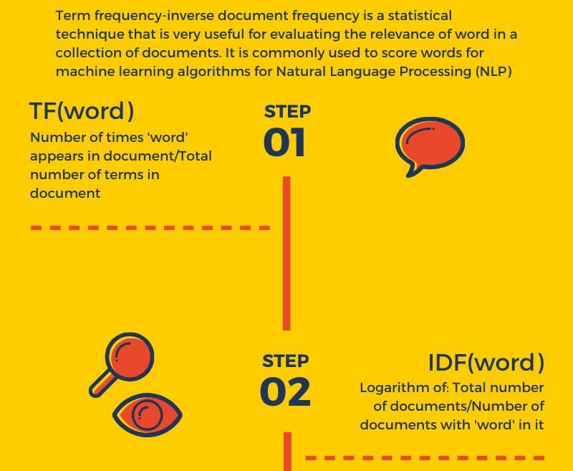
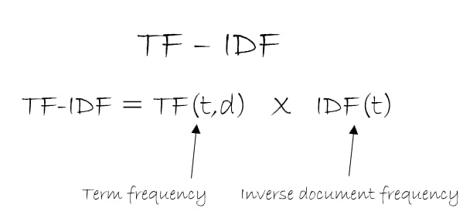
TF-IDF FEATURE
Notes:
3/6/2025
8
8

Slide 9
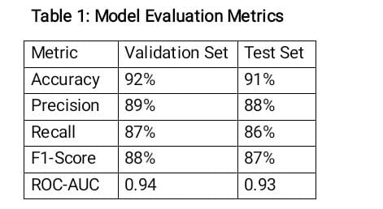
Model Evaluation Metrics
Afer training the logistic regression model ,the evaluation was conducted on both validation and test datasets
Notes:
3/6/2025
9
9

Slide 10
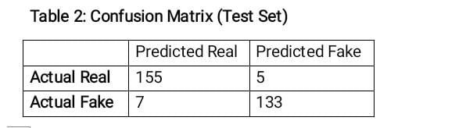
Confused Matrix Analysis
It offers a valuable visual representation of the classification performance of the logistic regression model
CC by SA, Risyad Rais
Notes:
3/6/2025
10
10

Slide 11
Limitations and challenges
EVOLVING TACTICS
DIVERSE LANGUAGES AND CONTEXTS
INTERPRETABILITY OF RESULTS
BALANCING FREEDOM OF SPEECH WITH REGULATION
Notes:
3/6/2025
11
11

Slide 12
CONCLUSION
This project has demonstrated significant potential in addressing the challenges of misinformation.
The findings reveal that the model was able to achieve promising performance metrics .
This result highlights the viability of logistic regression as a foundational method in the fight against fake news.
Notes:
3/6/2025
12
12

Slide 13
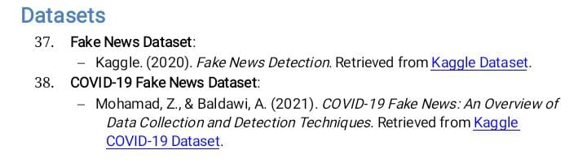
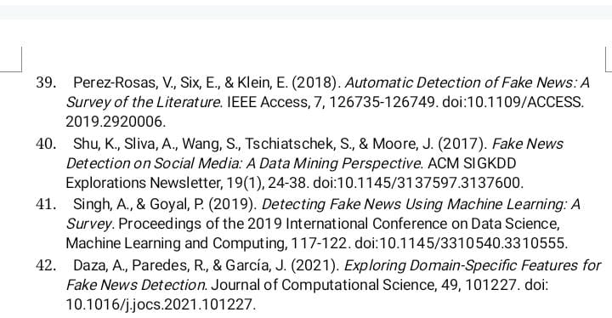
REFERENCES
RESEARCH PAPERS:
Notes:
3/6/2025
13
13

Slide 14

Notes:
3/6/2025
14
14

