Slide 1
Movie Rental Analytics Project

Slide 2
Overview
Build a Power BI dashboard using the Sakila DVD Rental Database.
Analyze customers, films, staff, and store operations
Provide insights for customer segmentation, inventory optimization, staff performance,
and revenue trends
.
Enable data-driven decisions and actionable recommendations (marketing, inventory, training).

Slide 3
Problem Statement
DVD rental business faces challenges in inventory management, customer retention, staff performance, and store revenue.
Goal: Create a Power BI dashboard to analyze and visualize key business metrics.
Outcome: Support data-driven decisions to improve marketing, optimize inventory, enhance staff efficiency, and boost overall store performance.

Slide 4
Data Preparation & Cleaning
Import & Load: 16 Sakila tables (Customer, Film, Rental, Payment, Staff, Store, etc.).
Clean: Remove duplicates, nulls; standardize dates and categorical fields.
Transform: Create calculated measures (Total Revenue, Total Rentals, Avg Rental Duration); derive time fields (Year, Month, Quarter).
Validate: Check relationships, totals, and referential integrity.

Slide 5
Exploratory Data Analysis (EDA)
Purpose: Understand the dataset, identify patterns, trends, and anomalies before building dashboards.
Tools Used: SQL for queries, Excel for quick summaries, Power BI for visualization and interactive exploration.
Approach:
Checked data quality, completeness, and consistency.
Explored relationships between tables and key metrics.
Identified insights to guide dashboard design and KPI selection

Slide 6
MECE Breakdown / Project Workflow
Business Understanding – Define project objectives and key business questions
Data Understanding – Identify relevant tables, relationships, and attributes.
Data Preparation & Modeling – Clean, transform, and establish data relationships.
Analysis & Measures – Create calculated fields and DAX Measures,KPIs for performance tracking.
Visualization Design – Develop intuitive visuals for comparative insights.
Interactivity & User Experience – Add slicers, filters, and drill-through options.
Insights & Storytelling – Present findings with context for decision-making.
Deployment & Maintenance – Publish, refresh, and share dashboards.
Tools Used – Excel, SQL, and Power BI.

Slide 7
Data Dictionary – Key Analysis Areas
Analysis Type | Focus / Metrics | Purpose / Insight
Customer Segmentation | Active vs Inactive, Total Spend, Rental Frequency | Identify key customer groups & retention opportunities
Film Performance | Rentals per Film, Avg Rental Duration, Category | Optimize film inventory & identify popular films
Staff Performance | Rentals Handled, Revenue Contribution, Avg Rental Duration | Evaluate staff efficiency & training needs
Store Revenue Analysis | Revenue per Store, Monthly/Quarterly Trends | Compare store performance & spot trends
Inventory Utilization | Stock vs Rented Copies, Availability by Category | Optimize inventory & reduce idle stock
Payment / Sales Analysis | Total Revenue, Avg Payment per Customer, Payment Methods | Monitor financial health & spending patterns

Slide 8
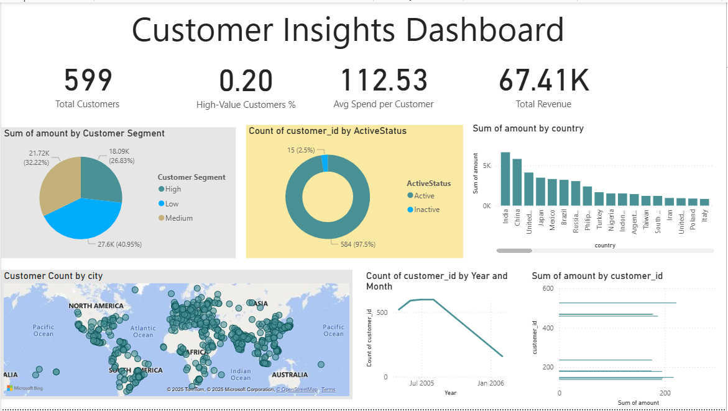

Slide 9
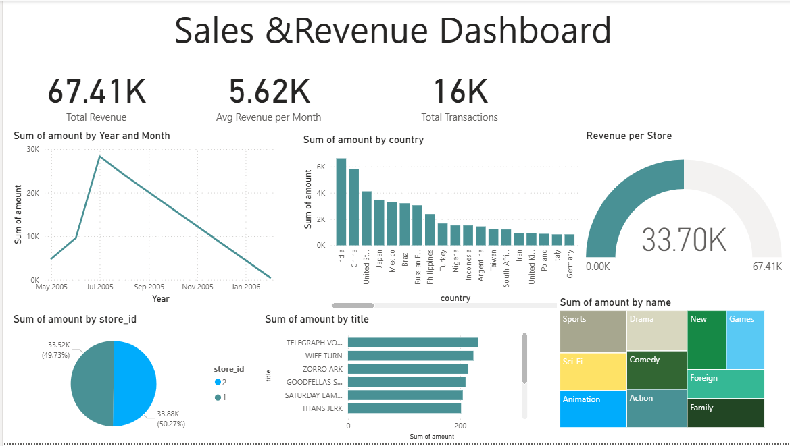

Slide 10
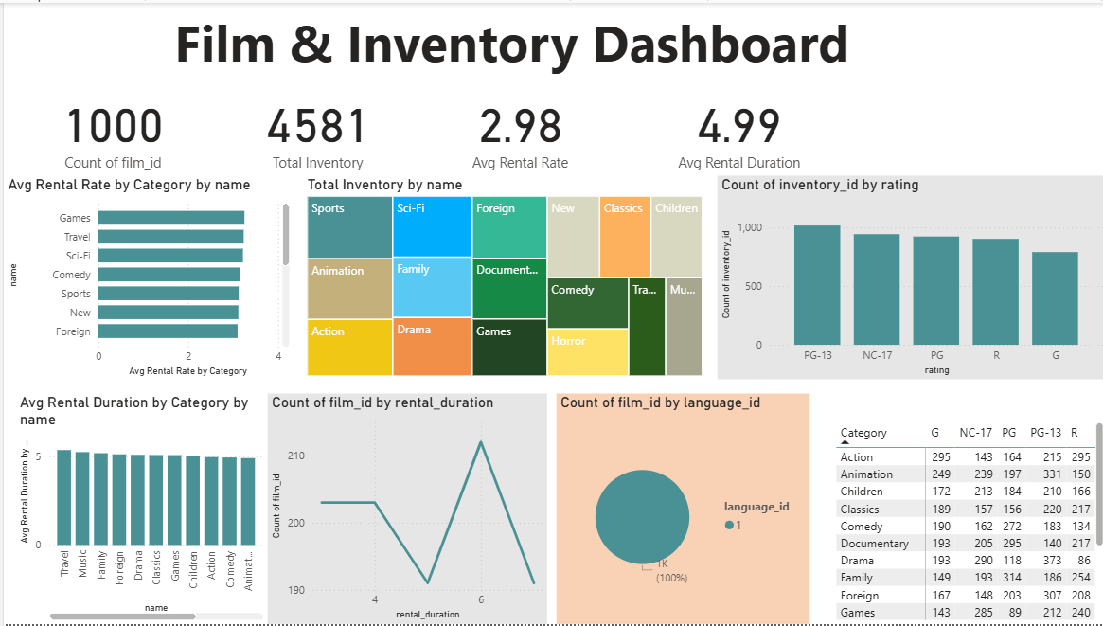

Slide 11
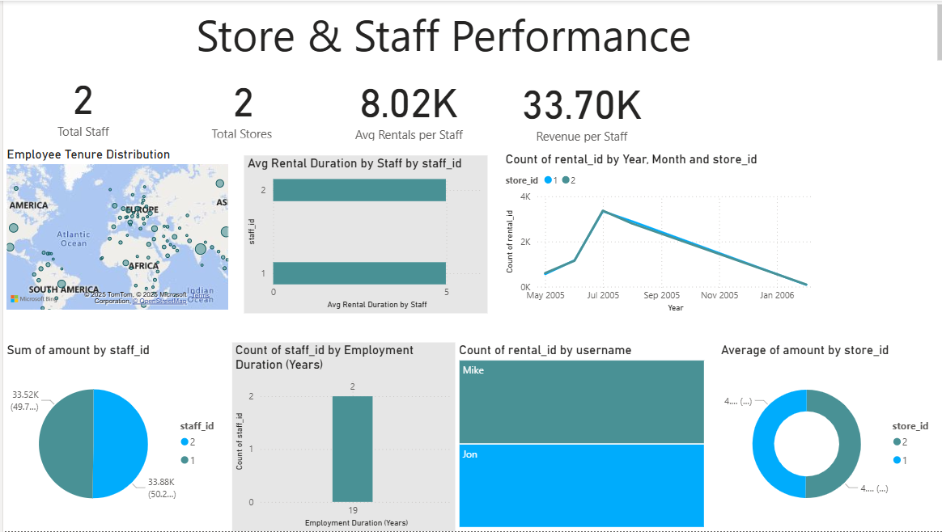

Slide 12
Insights:-
Customers: Active, high-spending customers drive most revenue; rental preferences vary by category/language.
Films & Inventory: Popular films drive demand; some inventory overstocked, others in high demand.
Staff: Performance varies; top staff handle more rentals efficiently; training opportunities exist.
Stores & Revenue: Revenue trends differ by store and season; operational efficiency varies.
Dashboards & EDA: Visualizations reveal trends, anomalies, and key KPIs to guide data-driven decisions.

