Slide 1
Analyzing the Evolution of Video Game Sales: Trends, Factors, and Future Projections
Shameema Afrin Jahir Husain
Shashikiran Sai Voruganti
Shwetha Srinivasan Natesan
Venkatesh Rakurthi
Professor. Dr. Duoduo Liao
George Mason University AIT 614-012 Big Data Essentials 10/24/2023

Slide 2
Introduction
Video game sales have increased dramatically over the last few decades, going from simple arcade games in the early 1990s to realistic multiplayer experiences in the present day. The industry's enormous economic impact, which is expected to reach $150 billion by 2021, highlights the growing need. This study focuses on identifying important aspects influencing sales, such as gaming platforms, shifting demographics, and creative business strategies. It is based on a dataset of over 16,600 video games from 1980 to 2016. The information gathered is intended to help players make educated decisions about the platforms, genres, and nations with the greatest sales. This will add significant value to the ever-changing video game business.

Slide 3
Objectives
Which gaming platform has the highest average global sales? How are the global sales of the various platforms distributed across time?
What patterns may be seen in the evolution of the global sales ranking of video games over time?
Which genres do regions tend to like more, and how does this affect overall sales rankings?
Which video games are best-selling in North America, Europe, Japan, and other countries, and how do their sales compare to those across the globe?

Slide 4
Objectives
In the top global sales rankings, which game genre is most popular, and is there a specific region where it is more popular?
Which publishers are most frequently linked to highly ranked games, and which publishers are particularly successful in genres or geographical areas?
What is the relationship between the publisher preference and the geographic sales (NA, EU, JP, Other)? Does this relationship change depending on the platform?
Is there a game in the dataset that a less well-known publisher released that has a high global sales ranking? If so, what variables made that publisher successful?

Slide 5
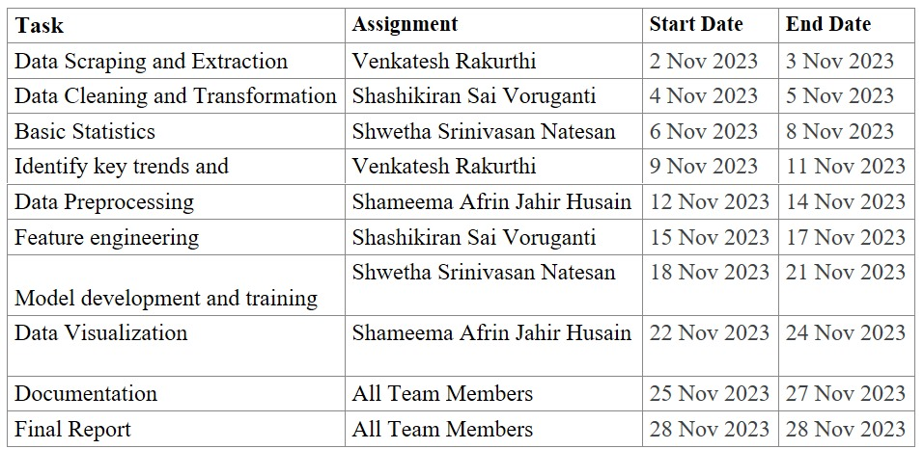
Summarized Timeline

Slide 6
Selected DataSet
Rank: Numerical representation of sales performance ranking.
Name: Textual information indicating the name of the video game.
Platform: Specifies the release platform for the games, ranging from PC to PS4 and others.
Year: Numeric data representing the game release year.
Genre: Textual information detailing the genre of the video game.
Publisher: Identifies the game publisher responsible for the title.
NA_Sales: Numeric data indicating North America sales in millions.
EU_Sales: Numeric data reflecting Europe sales in millions.
JP_Sales: Numeric data representing Japan sales in millions.
Other_Sales: Numeric data accounting for sales in the rest of the world, measured in millions.
Global_Sales: Numeric data capturing total worldwide sales.

Slide 7


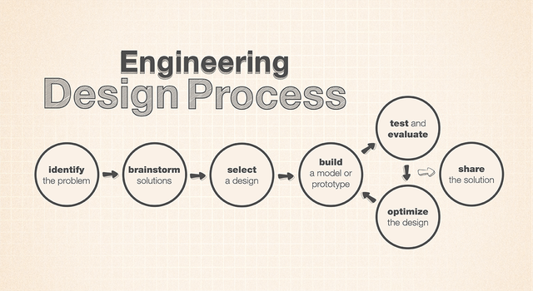
System and Tools

Slide 8
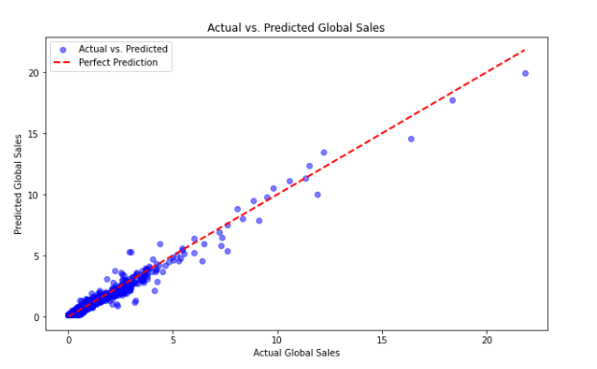
Modeling

Slide 9
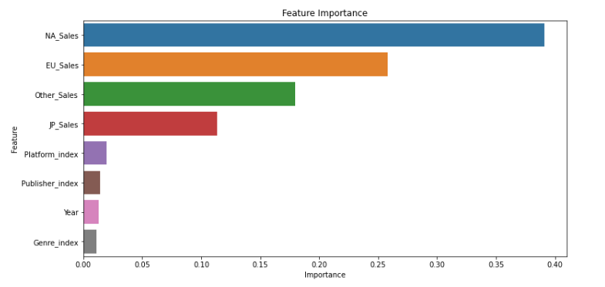
Feature selection

Slide 10
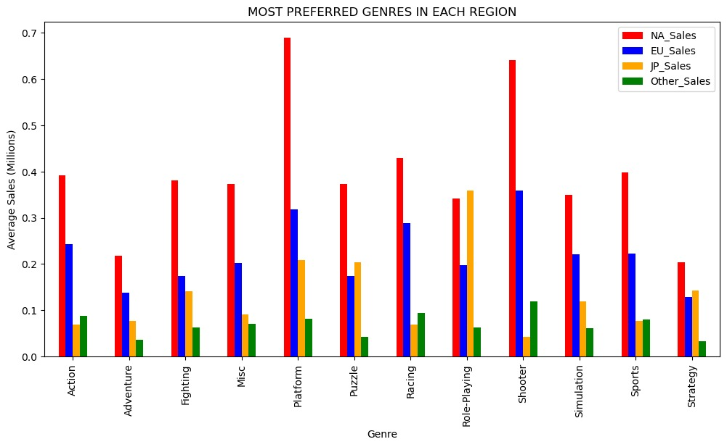
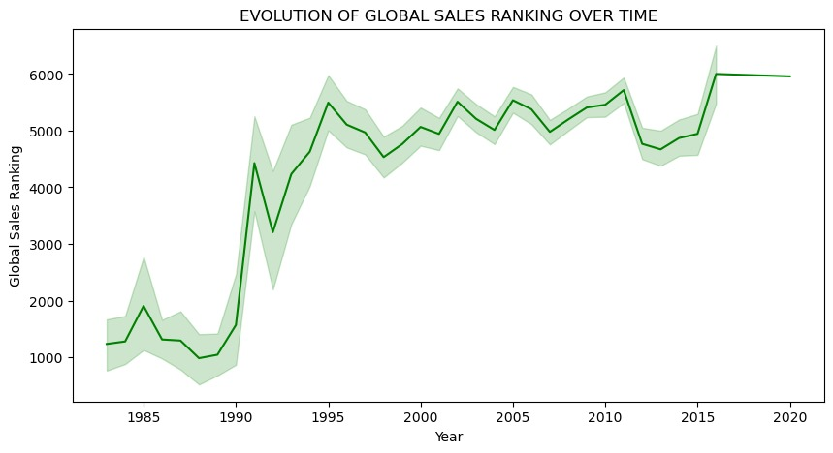
Data Visualization using Python and R

Slide 11
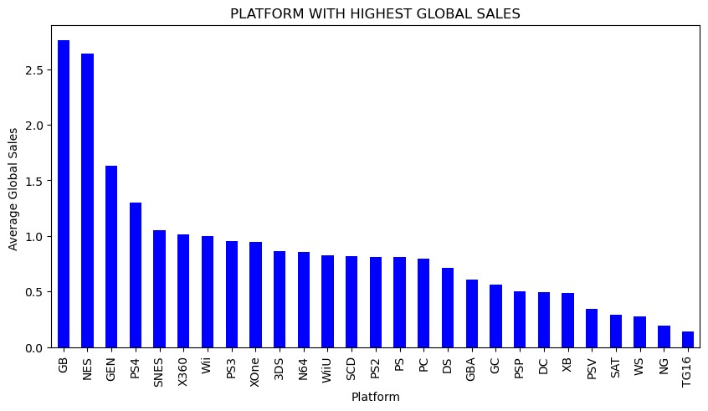
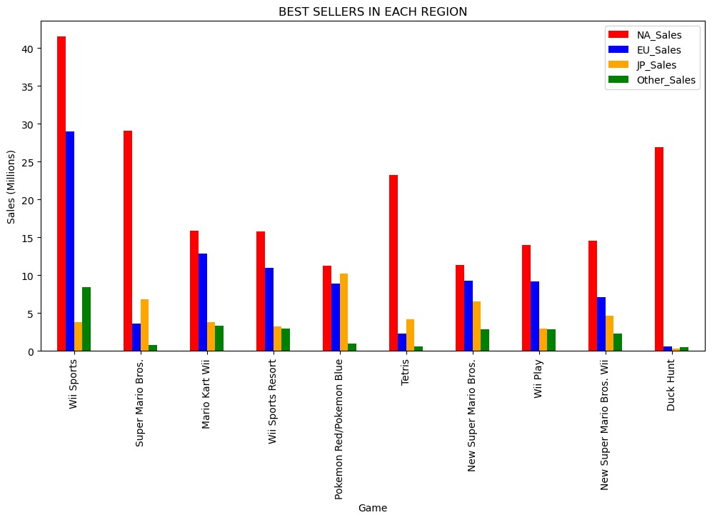

Slide 12
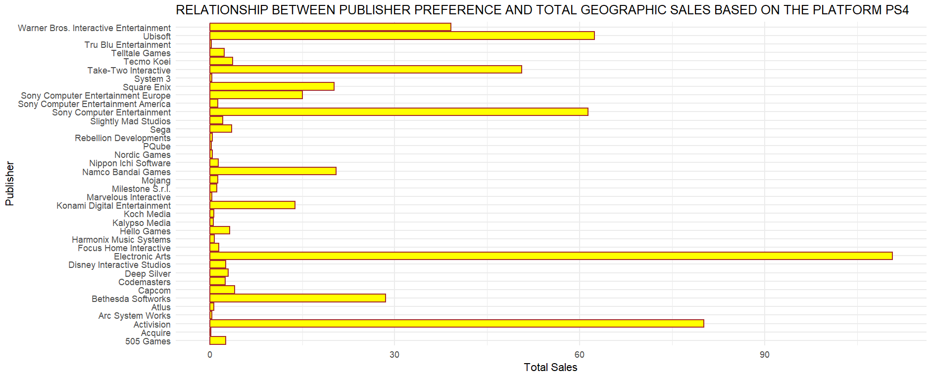
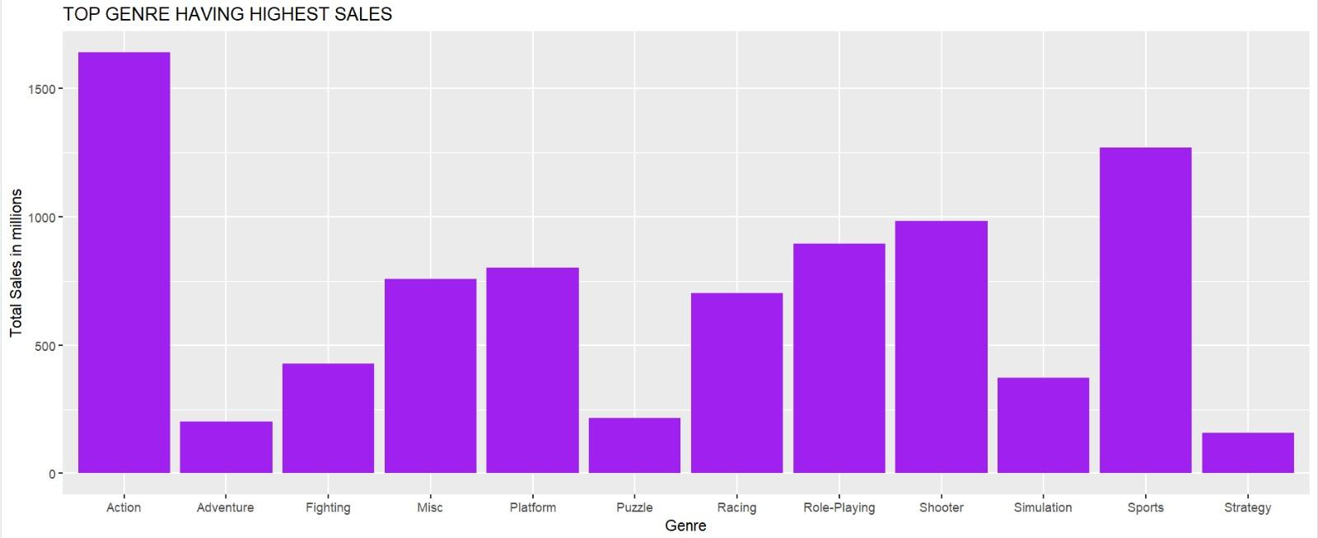

Slide 13
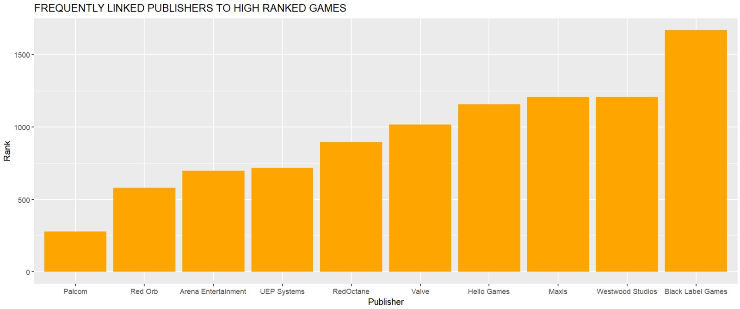
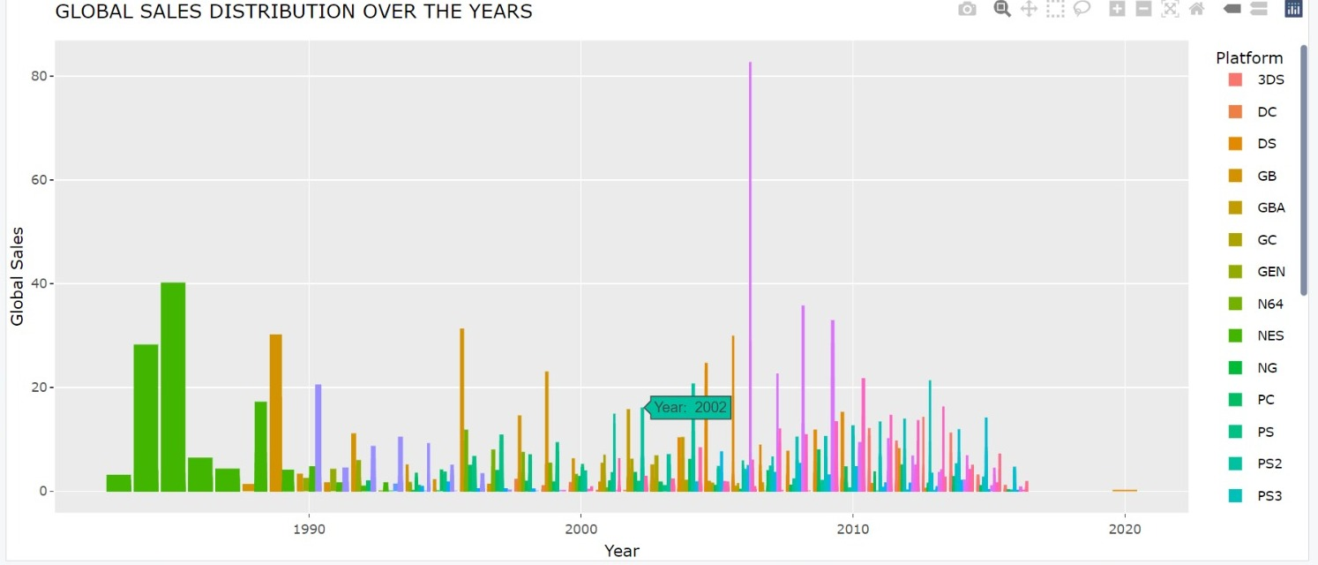

Slide 14
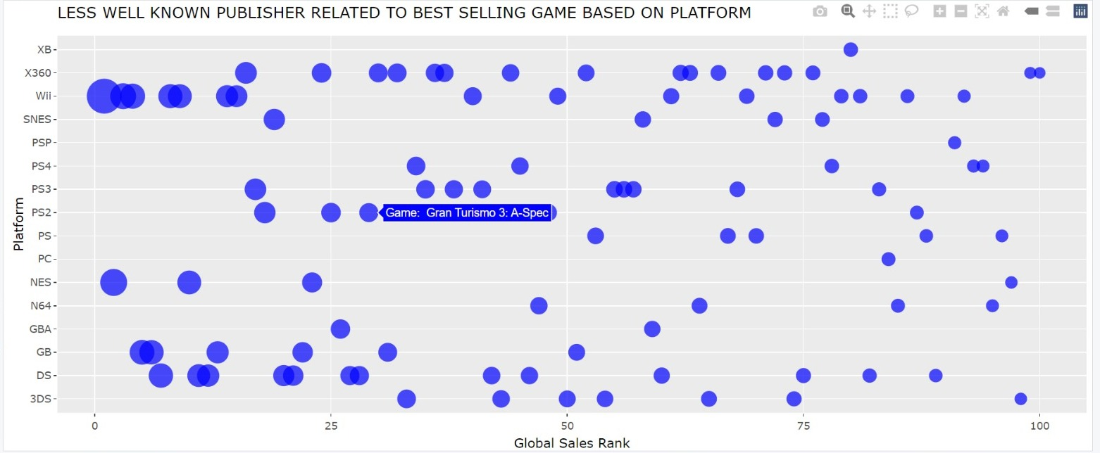

Slide 15
Conclusion
According to the data, the most popular genre on the gaming platform is Action, and GB has the greatest average global sales. The strong effectiveness of the statistical model used to predict global sales is demonstrated by its high R-squared value of 0.9693, which indicates that it accounts for around 96.93% of the variance in global sales. The low Mean Squared Error of 0.0390 further suggests precise forecasts with little variation from actual data. In conclusion, the model successfully describes and captures the global sales trends, fostering trust in its dependability for insights into the dynamics of the gaming business.

Slide 16
Future Scope
Future iterations of the model may benefit from adding more data streams in an effort to improve predicted accuracy. Incorporating real-time game streaming measurements, player demographic insights, and details on major gaming tournaments across several areas will enhance the model's ability to accurately represent changing patterns and subtle impacts on game sales. Given the ever-changing nature of the gaming business, ongoing updates that take into account newly developed platforms would enhance our ability to make predictions and provide a more complete picture. This forward-looking strategy guarantees that the model will always be flexible and representative of the various elements influencing the global game.

Slide 17
Acknowledgement
We would like to thank Kaggle for providing an open-source data platform that has made it possible to gain a thorough understanding of video game sales across the globe. We also thank the Databricks student community for providing us a great opportunity to experiment with various approaches for our project. We would especially like to thank our lecturer for helping us at every developmental step. Furthermore, we would like to express our sincere gratitude to our committed team members, whose superb teamwork was a major factor in our project's success. All of these tools and networks of support have been essential to the success of our mission.

Slide 18
References
1. Sacranie, John, "Consumer Perceptions & Video Game Sales: A Meeting of the Minds" (2010). Honors Projects. 108. https://digitalcommons.iwu.edu/econ_honproj/108
2. J. Marcoux and S. -A. Selouani, "A Hybrid Subspace-Connectionist Data Mining Approach for Sales Forecasting in the Video Game Industry," 2009 WRI World Congress on Computer Science and Information Engineering, Los Angeles, CA, USA, 2009, pp. 666-670, doi: 10.1109/CSIE.2009.1001. https://ieeexplore-ieee-org.mutex.gmu.edu/document/5170617/authors#authors
3. J. Li, Y. Zheng, H. Hu, J. Lu and C. Zhan, "Predicting Video Game Sales Based on Machine Learning and Hybrid Feature Selection Method," 2021 16th International Conference on Intelligent Systems and Knowledge Engineering (ISKE), Chengdu, China, 2021, pp. 497-502, doi: 10.1109/ISKE54062.2021.9755343. https://ieeexplore-ieee-org.mutex.gmu.edu/document/9755343
4. Ada, M. (2023, June 12). Video games sales. Kaggle. https://www.kaggle.com/datasets/maureenada/video-games-sales
5. PySpark overview¶. PySpark Overview - PySpark 3.5.0 documentation. (n.d.). https://spark.apache.org/docs/latest/api/python/index.html
6. Grolemund, H. W. and G. (n.d.). R for data science. 3 Data visualisation. https://r4ds.had.co.nz/data-visualisation.html

