Slide 1
PLSQL
Shwetha.K.R

Slide 2
Contents
Architecture
Variables
Constants
Blocks
Control Statements
Triggers
Cursors
Procedures
Functions
Exceptions

Slide 3
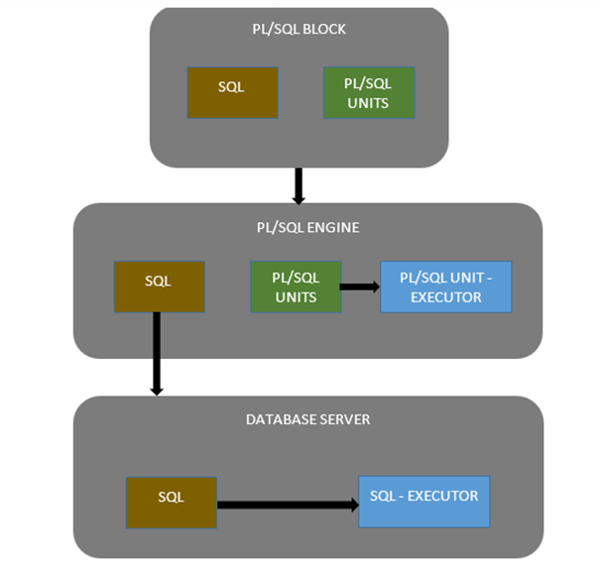

Slide 4
Blocks
Types Of Block
Anonymous Block
Named Block

Slide 5
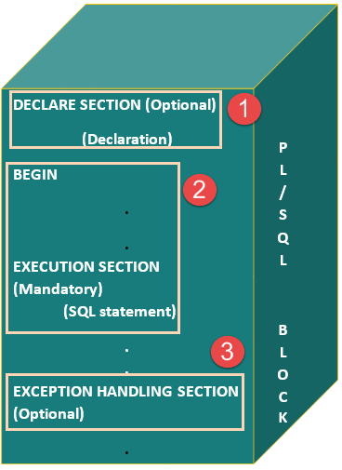

Slide 6
DECLARE
message varchar2(20):= 'Hello, World!';
BEGIN
dbms_output.put_line(message);
END;
/

Slide 7
Variables and Constants
Variable
Bind Variable
Constant

Slide 8
DATA TYPES
Scalar Types
(Number, Varchar, boolean
Number, date etc..
Composite type
Record type
Table type
Reference Type
%type
%rowtype

Slide 9
DataTypes
Simple /Scalar DataTypes
Varchar(10)
BINARY_INTEGER
Number(8,2)
Date:=sysdate+7;
Boolean
Constant
Reference DataTypes
%TYPE attribute
%ROWTYPE

Slide 10
Syntaxes
V_description varchar(20);
V_sal number(5) not null:=1000;
variable v_bind varach(10);
V_camcode varchar(5) constant:=‘aba’;
V_comm not null default 0;
V_sal employee.salary%TYPE;
nRecord employee%ROWTYPE;

Slide 11
Data Types:
Composite
Record Data Type
Type types_name is record(fied decl..)
Ex:
DECLARE
TYPE DeptRec IS RECORD (
DEPT_id department.deptno%type,
Deptname varchar(15))

Slide 12
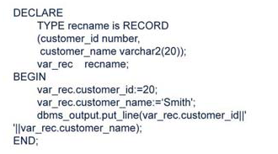

Slide 13
Example 1
DECLARE
v_salary NUMBER(8);
BEGIN
select salary into v_salary from employee where empno=899;
END;

Slide 14
Example 2
DECLARE
v_salary NUMBER(8);
BEGIN
select salary into v_salary from employee where empno=899;
DBMS_OUTPUT.PUT_LINE(v_salary);
END;

Slide 15
Example 3
SET SERVEROUTPUT ON;
DECLARE
v_salary NUMBER(8);
BEGIN
select salary into v_salary from employee where empno=899;
DBMS_OUTPUT.PUT_LINE(v_salary);
END;

Slide 16
Example 4
SET SERVEROUTPUT ON;
DECLARE
v_salary employee.salary%TYPE;
BEGIN
select salary into v_salary from employee where empno=899;
DBMS_OUTPUT.PUT_LINE(v_salary);
END;

Slide 17
Example 5
DECLARE
v_pi CONSTANT NUMBER(7,6) :=3.141592;
BEGIN
DBMS_OUTPUT.PUT_LINE(v_pi);
END;

Slide 18
Example 5
DECLARE
v_pi CONSTANT NUMBER(7,6) DEFAULT 3.141592;
BEGIN
DBMS_OUTPUT.PUT_LINE(v_pi);
END;

Slide 19
Bind Variable
VARIABLE v_bind1 VARCHAR2(12);
EXEC :v_bind1:=‘Anish’;
BEGIN
:v_bind1:=‘Amrutha’;
END;
/
Begin
DBMS_OUTPUT.put_Line(:v_bind);
End;
/

Slide 20
Bind Variable
VARIABLE v_bind1 VARCHAR2(12);
EXEC :v_bind1:=‘Anish’;
BEGIN
DBMS_OUTPUT.PUT_LINE(:v_bind1);
:v_bind1:=‘Amrutha’;
END;
/
PRINT :v_bind1;

Slide 21
Declare
nRecord employee%ROWTYPE
BEGIN
select * into nrecord from employee
where empno=988;
update employee set salary=
salary+90000 where empno=988;
END;
/

Slide 22
Control Statements
Conditional CS
Looping

Slide 23
Conditional
IF-THEN-END IF
IF-THEN-ELSE-END IF
IF-THEN-ELSIF-END IF

Slide 24

IF

Slide 25
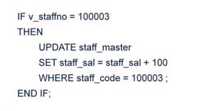

Slide 26
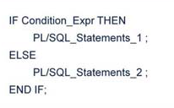

Slide 27
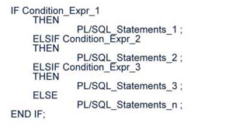

Slide 28
DECLARE
D VARCHAR2(3): = TO_CHAR(SYSDATE, ‘DY’)
BEGIN
IF D= ‘SAT’ THEN
DBMS_OUTPUT.PUT_LINE(‘ENJOY YOUR WEEKEND’);
ELSIF D= ‘SUN’ THEN
DBMS_OUTPUT.PUT_LINE(‘ENJOY YOUR WEEKEND’);
ELSE
DBMS_OUTPUT.PUT_LINE(‘HAVE A NICE DAY’);
END IF;
END;

Slide 29
case
DECLARE
grade char(1) := 'A';
BEGIN
CASE grade
when 'A' then dbms_output.put_line('Excellent');
when 'B' then dbms_output.put_line('Very good');
when 'C' then dbms_output.put_line('Well done');
when 'D' then dbms_output.put_line('You passed'); when 'F' then dbms_output.put_line('Better try again');
else dbms_output.put_line('No such grade'); END CASE;
END; /

Slide 30
Looping
Simple loop
LOOP End LOOP
While Loop
While condition LOOP
END LOOP
For Loop
For loop_counter IN lowerlimit….upper_limit LOOP
END LOOP;

Slide 31
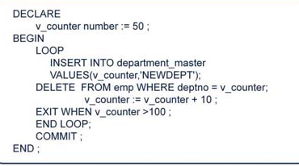

Slide 32
DECLARE
ctr number := 1;
BEGIN
WHILE ctr <= 10
LOOP
dbms_output.put_line(ctr);
ctr := ctr+1;
END LOOP;
END;
/

Slide 33
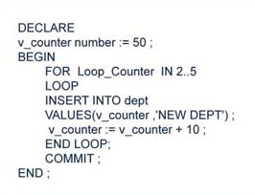

Slide 34
Cursors
• ORACLE allocates memory on the Oracle server to process SQL statements. It
is called as “context area”. Context area stores information like number of rows
processed, the set of rows returned by a query, etc.
• A Cursor is a “handle” or “pointer” to the context area. Using this cursor the
PL/SQL program can control the context area, and thereby access the
information stored in it.

Slide 35
Cursors
Implicit
Explicit

Slide 36
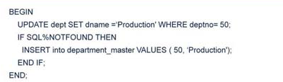
Implicit Cursor

Slide 37
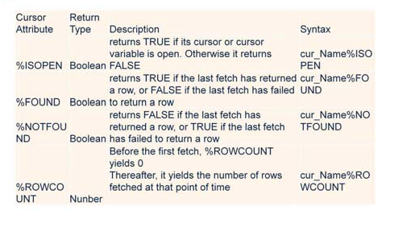

Slide 38
Explicit
Declaring the cursor for initializing the memory
Opening the cursor for allocating the memory
Fetching the cursor for retrieving the data
Closing the cursor to release the allocated memory

Slide 39
Explicit
CURSOR c_employee IS SELECT eid, ename FROM employee;
OPEN c_employee ;
FETCH c_employee INTO c_eid, c_ename;
CLOSE c_employee ;

Slide 40
DECLARE
V_Salary emp.sal%TYPE;
V_Empno emp.empno%TYPE;
CURSOR C_Empsal IS
SELECT empno, sal FROM emp WHERE sal
<2500;
BEGIN
IF NOT C_Empsal%ISOPEN THEN
OPEN C_Empsal ;
END IF ;
LOOP
FETCH C_Empsal INTO V_Empno,V_Salary;
EXIT WHEN C_Empsal %NOTFOUND ;
--Exit out of block when no rows
UPDATE emp SET sal = 1.1 * V_Salary
WHERE empno = V_Empno;
END LOOP ;
CLOSE C_Empsal ;
COMMIT ;
END;
/

Slide 41
Procedure
The subprograms are compiled and stored in the Oracle database as “stored
programs”, and can be invoked whenever required. As the subprograms are
stored in a compiled form, when called they only need to be executed. Hence
this arrangement saves time needed for compilation.
• When a client executes a procedure or function, the processing is done in the
server. This reduces the network traffic.

Slide 42
Procedures
• Subprograms provide the following advantages:
They allow you to write a PL/SQL program that meets our need.
They allow you to break the program into manageable modules.
They provide reusability and maintainability for the code.

Slide 43
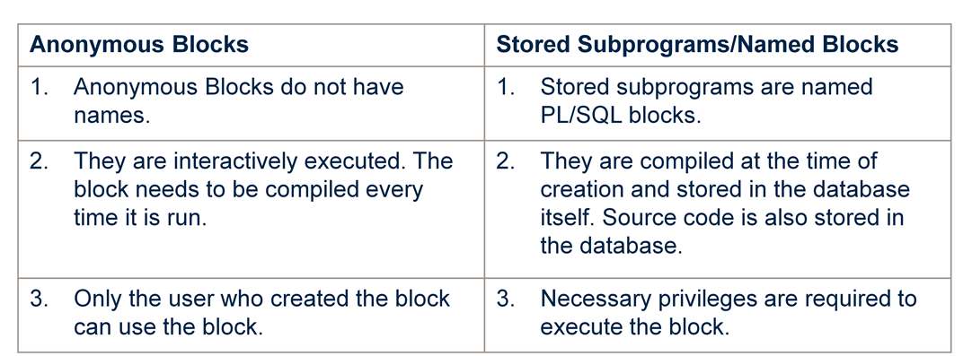

Slide 44
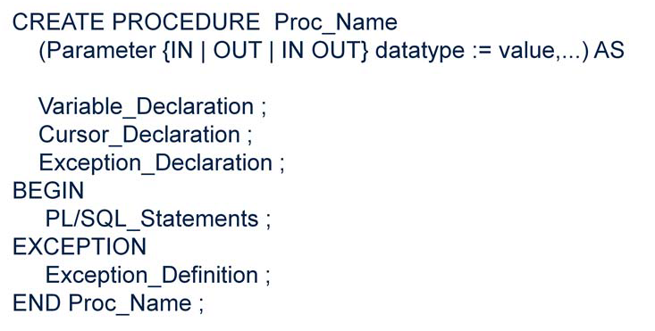

Slide 45
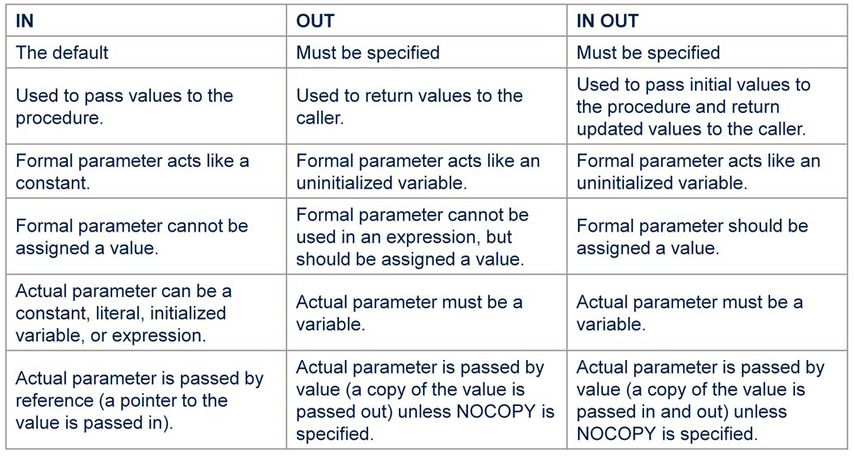

Slide 46
Functions
CREATE OR REPLACE FUNCTION welcome_msgJune ( p_name IN VARCHAR2) RETURN VARCHAR2
IS
BEGIN
RETURN ('Welcome '|| p_name);
END;
/

Slide 47
DECLARE
lv_msg VARCHAR2(250);
BEGIN
lv_msg := welcome_msg_func ('Shwetha');
dbms_output.put_line(lv_msg);
END;
SELECT welcome_msg_func('Shwetha') FROM DUAL;

