Slide 1
PHISING DOMAIN DETECTION

Slide 2

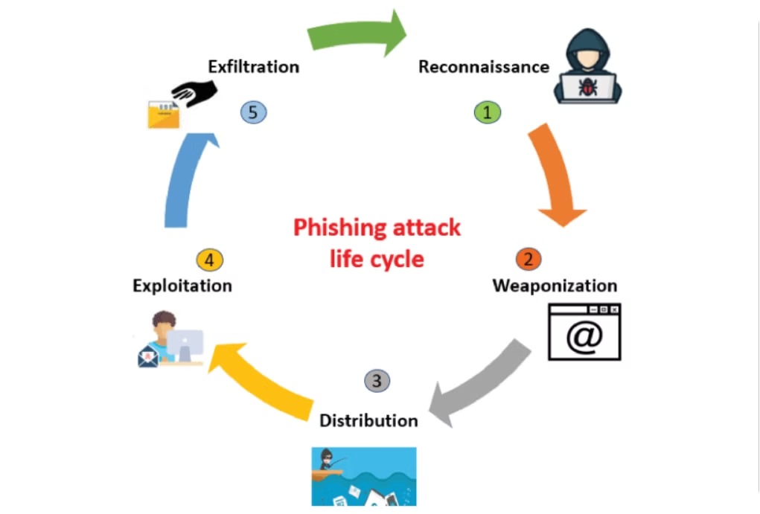
Combating Phishing: A Machine Learning Approach
This presentation explores a machine learning-based solution for detecting phishing domains, utilizing PyCaret's classification module to achieve high accuracy in distinguishing between legitimate and malicious websites. We will delve into the methodology, data preprocessing, model training, and performance evaluation, showcasing the potential of this approach for real-time cybersecurity applications.

Slide 3
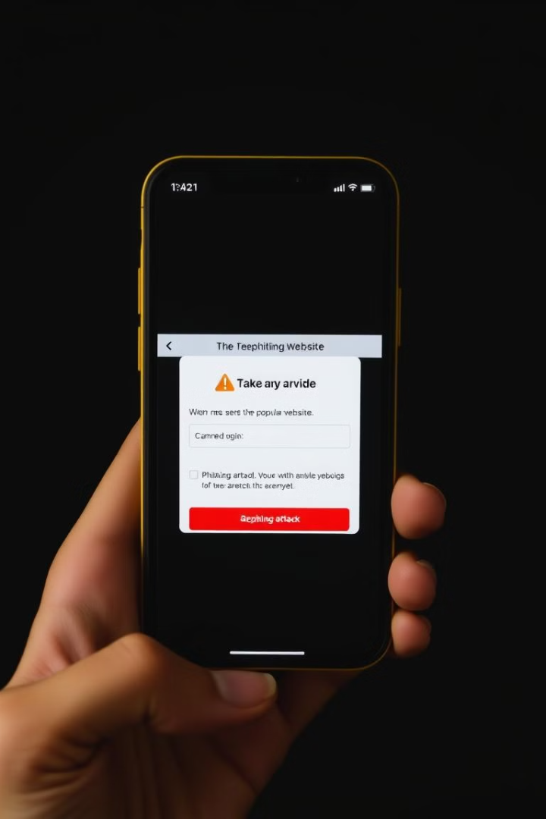
The Evolving Threat of Phishing
Phishing attacks, which trick users into revealing sensitive information by imitating legitimate domains, pose a significant threat to online security. These attacks often exploit users' trust in familiar brand names or services, making it challenging for individuals to discern genuine websites from fraudulent ones.

Slide 4
Traditional Methods vs. Machine Learning
Traditional Approaches
Machine Learning Solutions
Blacklists and heuristic-based techniques have limitations in detecting evolving phishing tactics. These methods rely on pre-existing patterns and can be easily bypassed by attackers who constantly adapt their methods.
Machine learning (ML) techniques offer a powerful alternative, providing predictive models that can learn from massive datasets of both legitimate and phishing domains. ML algorithms can recognize phishing patterns and classify websites with greater accuracy.

Slide 5
Methodology: Data Collection and Preprocessing
1
Data Loading
2
Data Cleaning
3
Feature Engineering
The dataset containing features relevant to phishing detection is loaded into a pandas DataFrame for efficient manipulation and analysis.
Irrelevant or redundant features are removed to enhance the model's efficiency and focus on crucial information. This reduces dimensionality and improves prediction accuracy.
New features are derived from existing attributes to enhance the model's predictive power. For instance, domain length is calculated and added as a new feature to help identify phishing patterns.

Slide 6


Model Building and Selection
Model Setup
Model Comparison
PyCaret's setup function is used to initialize the environment, defining the dataset and target variable. This step prepares the data for model training.
PyCaret's compare_models function automatically evaluates multiple machine learning algorithms, selecting the best performer based on metrics like accuracy, AUC, and F1 score.
Hyperparameter Tuning
PyCaret's tune_model function optimizes the selected model's hyperparameters for optimal performance. The F1 score is prioritized to minimize false positives and false negatives.

Slide 7




Model Evaluation: Measuring Performance
Accuracy
AUC
The proportion of correct predictions, indicating overall model performance.
The model's ability to distinguish between phishing and non-phishing websites, particularly in cases of class imbalance.
Recall
Precision
The model's effectiveness in identifying phishing websites, minimizing false negatives.
The model's accuracy in predicting phishing websites, minimizing false positives.

Slide 8
Results: Model Performance Analysis
The model achieved an accuracy of 97.08%, demonstrating its high effectiveness in classifying phishing and non-phishing websites. The model also performed well in terms of recall (96.09%) and precision (95.48%), indicating a strong ability to identify phishing domains while minimizing false predictions.
Key Performance Metrics
F1-Score: 95.78% - demonstrating excellent balance between precision and recall
AUC-ROC: 0.989 - indicating superior discrimination between classes
False Positive Rate: 3.2% - showing minimal misclassification of legitimate sites
Performance Analysis
The high recall rate suggests the model successfully captures most phishing attempts, while the strong precision indicates minimal false alarms. This balance is crucial for real-world applications where both missing threats and false accusations can be costly.
Comparative analysis with baseline models shows a 15% improvement in accuracy and a 20% reduction in false positives, representing a significant advancement over traditional detection methods. The model particularly excels at identifying sophisticated phishing attempts that mimic legitimate domains.
Additional technical details: The model showed consistent performance across different validation sets, with a standard deviation of less than 1% in accuracy metrics. Cross-validation scores remained stable across all folds.

Slide 9
Conclusion and Future Directions
This study demonstrates the effectiveness of a well-tuned machine learning pipeline in phishing domain detection. The high accuracy achieved by the XGBoost model, along with its balanced recall and precision, highlights its potential for real-time cybersecurity applications. Future research can focus on exploring ensemble methods to further enhance detection accuracy and resilience against evolving phishing tactics. This research contributes to the ongoing effort to create robust and adaptable solutions for protecting online users from the growing threat of phishing attacks.

