Slide 1
WINE QUALITY PREDICTION USING MACHINE LEARNING
SWETHA R
au21CB59
KGiSL INSTITUTE OF TECHNOLOGY
3/21/2024 Annual Review

Slide 2
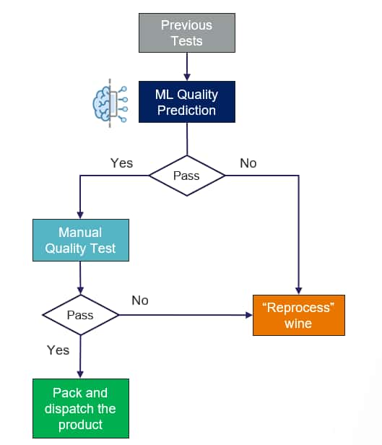
WINE QUALITY PREDICTION USING MACHINE LEARNING
3/21/2024 Annual Review

Slide 3


AGENDA
PROBLEM STATEMENT
PROJECT OVERVIEW
WHO ARE THE END USERS?
SOLUTION
WOW IN THE SOLUTION
MODEL
RESULT
3/21/2024 Annual Review

Slide 4

PROBLEM STATEMENT
The wine industry uses sensory evaluation to obtain the quality of wines, which is highly subjective and time-consuming. Machine learning enables an automated and more efficient solution to address this problem by building a predictive regression model using several physicochemical properties of wines. The goal of this work is to develop a sound machine-learning model that would provide valid predictions of wine quality based on their chemical properties.
3/21/2024 Annual Review

Slide 5

PROJECT OVERVIEW
Foster an AI model to foresee wine quality given physicochemical properties, meaning to robotize and upgrade the quality evaluation process in the wine business.
Use an extensive dataset containing data about different physicochemical properties of wines by comparing quality appraisals to prepare and assess the AI model.
By breaking down the dataset and applying AI methods, the venture looks to convey a strong prescient model equipped for giving exact and objective evaluations of wine quality, subsequently further developing effectiveness and dynamics in wine creation.
The venture includes information preprocessing to clean and set up the dataset for investigation. This incorporates dealing with missing qualities, anomaly identification, and element scaling. Included determination methods are utilized to recognize the most important traits that are firmly associated with wine quality. Moreover, the included design might be used to make new instructive highlights from the current dataset.
3/21/2024 Annual Review

Slide 6

WHO ARE THE END USERS?
1. Winemakers
2. Wine Quality Control Teams
3. Wine Distributors and Retailers
4. Wine Consumers
5. Wine Researchers and Enthusiasts
6. Wine Critics and Sommeliers
3/21/2024 Annual Review

Slide 7

SOLUTION AND PROPOSITION
AI Model Turn of events: Foster a powerful AI model prepared to do precisely foresee wine quality in light of physicochemical properties. This includes information preprocessing, highlight choice, model preparation, and assessment utilizing different calculations.
Information Reconciliation and Investigation: Coordinate an extensive dataset containing data about the physicochemical properties of wines close by quality evaluations. Examine the dataset to recognize examples and relationships that add to wine quality.
Productivity and Computerization: Our answer smoothes out the wine quality appraisal process via mechanizing the assessment of physicochemical properties. This saves time and assets while guaranteeing steady and objective quality evaluations across bunches.
Precision and Prescient Experiences: By utilizing advanced AI methods, our answer conveys profoundly exact expectations of wine quality. This permits winemakers to pursue informed choices given prescient experiences, prompting streamlined creation processes and improved item quality.
Esteem Option Across the Store Network: From wineries advancing their creation cycles to wholesalers organizing their item contributions and customers pursuing informed buying choices, our answer adds esteem to different phases of the wine store network. This exhaustive methodology upgrades general effectiveness, quality, and fulfillment throughout the business.
3/21/2024 Annual Review

Slide 8

THE WOW IN YOUR SOLUTION
1. Automation of Quality Assessment
2. Data-Driven Decision Making
3. Enhanced Predictive Accuracy
4. Scalability and Deployment
5. Value Addition Across the Supply Chain
6. Potential for Cross-Industry Applications
3/21/2024 Annual Review

Slide 9
MODELLING
1) Linear Regression:
Linear regression is a simple yet effective method for predicting wine quality. It assumes a linear relationship between the input features and the target variable (wine quality).
2) Random Forest Regression:
Random Forest is an ensemble learning method that consists of multiple decision trees. It's robust, handles non-linear relationships well, and can capture complex interactions between features.
3) Gradient Boosting Regression:
Gradient Boosting is another ensemble method that builds trees sequentially, where each tree corrects the errors of the previous one. It's powerful for regression tasks and often yields high accuracy.

Slide 10
MODELLING
4) Support Vector Regression (SVR):
SVR is a regression variant of support vector machines (SVMs). It works by mapping input features into a higher-dimensional space and finding the hyperplane that best fits the data while maximizing the margin. SVR is effective for small to medium-sized datasets and can handle non-linear relationships using kernel functions.
5) Neural Networks:
Deep learning models, particularly neural networks, can be used for wine quality prediction. Multi-layer perceptrons (MLPs) or more advanced architectures like convolutional neural networks (CNNs) or recurrent neural networks (RNNs) can be applied depending on the nature of the data and the complexity of the problem.
3/21/2024 Annual Review

Slide 11
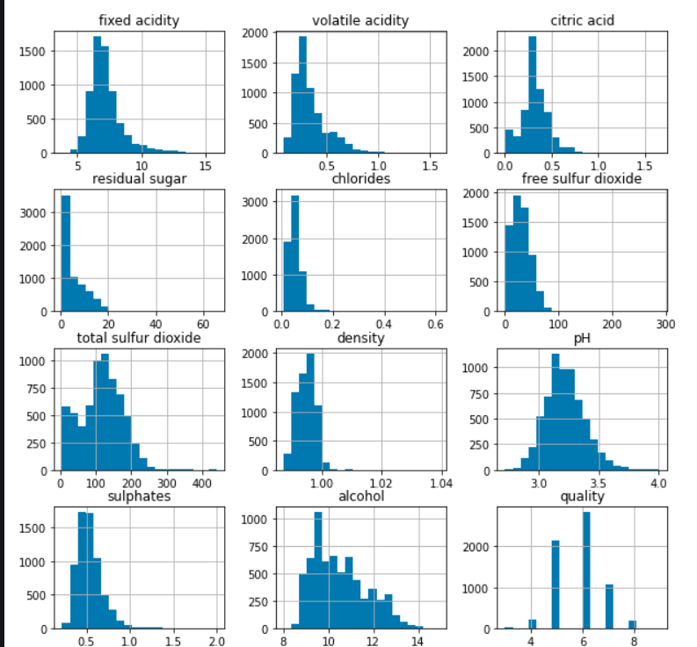
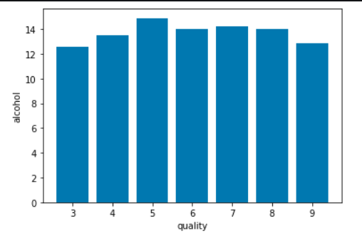
RESULTS
https://drive.google.com/drive/folders/1AwsmEaWcpmqhb_ySCR0Fi7IClzuv-j7C
3/21/2024 Annual Review

