Slide 1



Resume
孫宏宇 Sun Hongyu
ソン コウウ
2022.12 - present Huawei(China), Embedded Engineer
2020.9 - 2022.9 Tokyo Institute of Technology, Master
2014.9 - 2018.7 Northeastern University(China), Bachelor

Slide 2
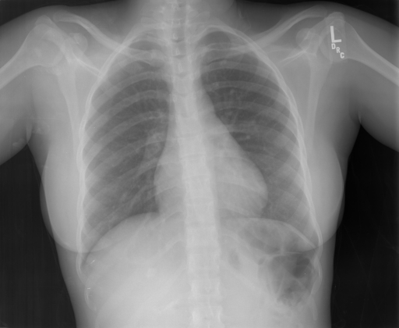
Task defination
Report：
Model
the lungs are clear bilaterally . specifically no evidence of focal consolidation pneumothorax or pleural effusion . cardio mediastinal silhouette is unremarkable . visualized osseous structures of the thorax are without acute abnormality .
Significance
Medical images play a crucial role in the clinical practice of medical diagnosis. However, analyzing graphs and generating diagnosis reports can be time-consuming for radiologists. Therefore, there is a strong desire to generate diagnosis reports based on medical images to reduce the workload of radiologists and promote automation in the medical field.

Slide 3
Motivation of Mesh Memory Transformer
1.Compared to the captioning of nature images, which demands an extensive understanding of real-world causality, prior medical knowledge can be encapsulated in a matrix of feature representations and stored in memory matrices.
2. Compare with the general encoder-decoder transformer, decoder aggreagte the information only from the last layer of the encoder which causes the loss of multi-level semantic information. Mid and low-level represen-tations, such as shape and context features, play a crucial role in disease diagnosis.

Slide 4
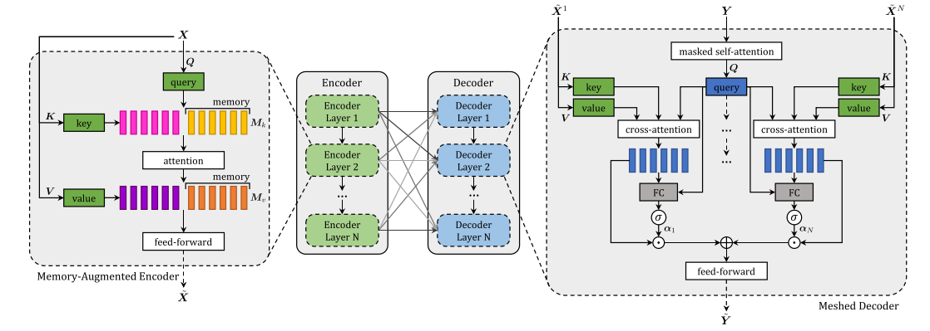
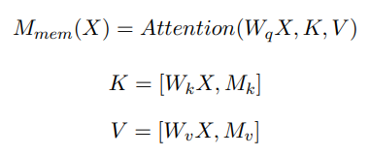


Model Structure of Mesh Memory Transformer

Slide 5
Detailed setting of Model
Optimizer: Adam
Params：
VE_Lr: | 1e-4 | ED_Lr: | 5e-4 | weight decay | 5e-5 | β₁ | 0.9 | β₂ | 0.99
Batch size：16
Loss: MSE
Initilization: xarvier
Visual Extractor：densenet121
Model set：
dimension of token：512
feedforward dimension：2048
Evaluation Indicator：BLEU-n, ROUGE-L

Slide 6
DataSet Statistics
DataSet | IU X-RAY¹
 | TRAIN | VAL | TEST
# of Image | 5.2K | 0.7K | 1.5K
# of Report | 2.8K | 0.4K | 0.8K
# of Patient | 2.8K | 0.4K | 0.8K
AVG.LEN. | 37.6 | 36.8 | 33.6
¹https://openi.nlm.nih.gov/

Slide 7
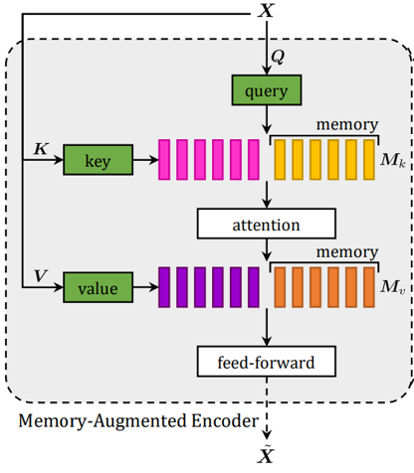
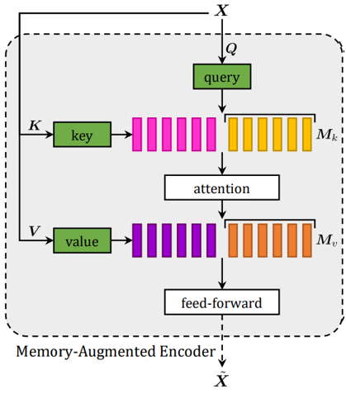
Improvement
Mk linear map
memory
Mv linear map
Original encoder layer
Improved encoder layer

Slide 8
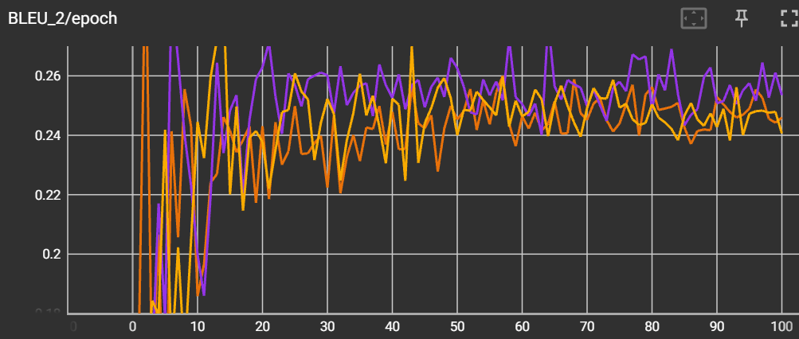
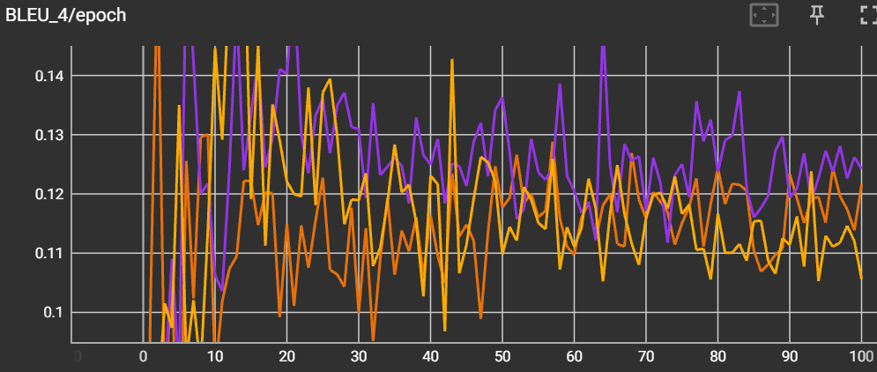
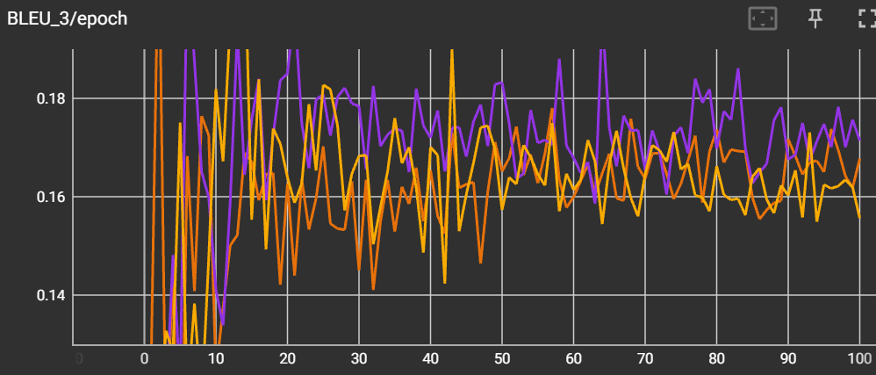
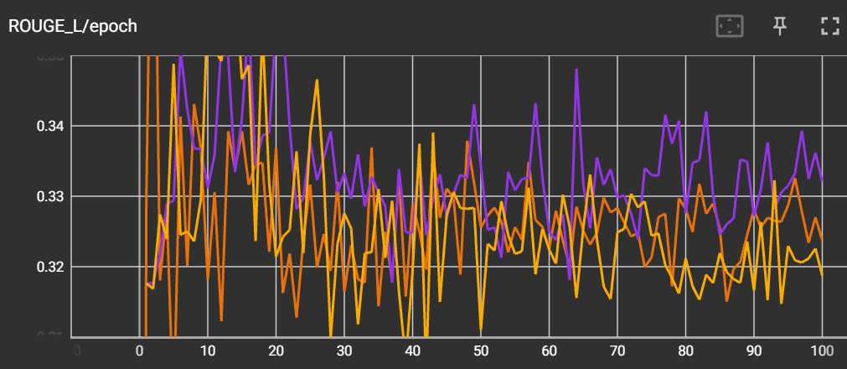
Reproduced Model
Experiment Result
Improved Model
Target Model
Hypothesis Testing result:
 | Reproduced and target | Improved and target
BLEU-2 | 0.5722 | 0.0016
BLEU-3 | 0.3261 | 4.906e-6
BLEU-4 | 0.0852 | 2.083e-10
ROUGE-L | 0.6618 | 5.842e-7

Slide 9
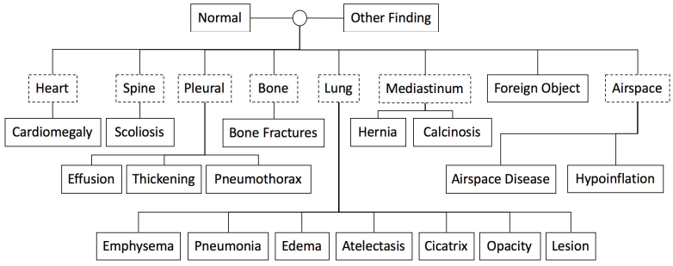
Motivation
1. Compared with traditional image captioning task, the relative positions of organs such as the lung and heart remain relatively fixed. Consequently, it is logical to focus on feature alignment within localized areas.
2. Based on clinical studies, it has been established that 20 kinds of diagnosis listed below(inside the solid line box) can be detected in X-Ray images. Therefore, it is crucial to highlight the model's capacity for identifying correlations between these diseases and image patches to generate highly accurate diagnostic reports.
Organs:
Diseases:

Slide 10
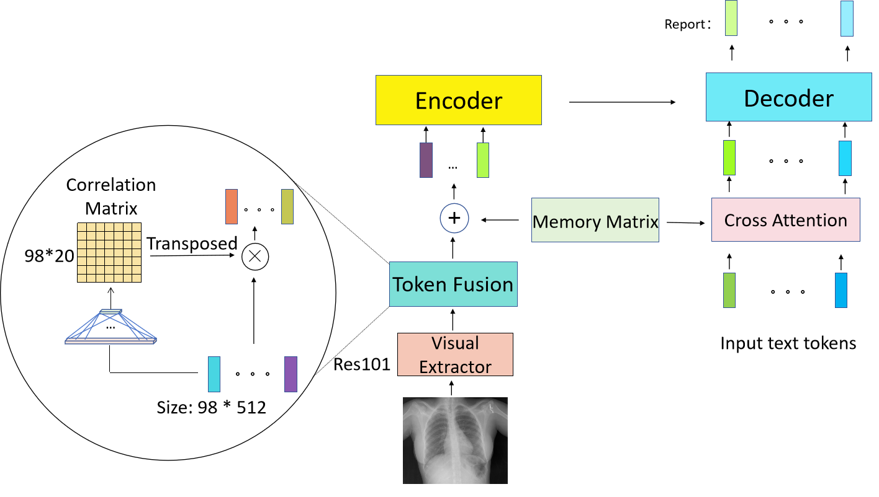
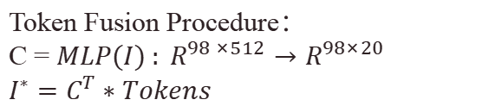
Proposed Model
Token Fusion Procedure：
C = $MLP(I) : R^{98 ×512}→R^{98×20}$
$$I^{∗}=C^{T}∗Tokens$$

Slide 11









Proposed Model
Asymmetric cross memory：
$$T_{1}（1∗512）$$
Text token:
Linear Map
$$Q_{T_{1}}$$
$$K_{M}$$
$$V_{M}$$
Topk
Decoder
...
...
...
...
+
$$T_{1}^{∗}$$
32
Linear Map
Linear Map
Memory matrix:
...
...
Size：$2040 ∗ 512$
$$=\frac{SUM(M_{1}, M_{2},...,M_{k}) }{k}$$
$$F_{1}$$
Encoder
Image tokens:
+
$$I_{1}$$
$$I_{1}^{∗}$$
Notes:
Taking one token each from the encoder side and the decoder side as examples to explain the asymmetric usage of the memory matrix

Slide 12
Reference
[1] Jing B, Xie P, Xing E. On the automatic generation of medical imaging reports[J]. arXiv preprint arXiv:1711.08195, 2017.
[2] Zhang Y, Wang X, Xu Z, et al. When radiology report generation meets knowledge graph[C]//Proceedings of the AAAI Conference on Artificial Intelligence. 2020, 34(07): 12910-12917.
[3] Gay, S.; Olazagasti, J.; Higginbotham, J.; Gupta, A.; Wurm, A.; and Nguyen, J. 2013. Introduction to chest radiology. In https://www.meded.virginia.edu/courses/rad/cxr/index.html.
[4] Chen Z, Song Y, Chang T H, et al. Generating radiology reports via memory-driven transformer[J]. arXiv preprint arXiv:2010.16056, 2020.
[5] Rücklé A, Eger S, Peyrard M, et al. Concatenated power mean word embeddings as universal cross-lingual sentence representations[J]. arXiv preprint arXiv:1803.01400, 2018.
[6] Jing B, Xie P, Xing E. On the automatic generation of medical imaging reports[J]. arXiv preprint arXiv:1711.08195, 2017.
[7] Lin T Y, Dollár P, Girshick R, et al. Feature pyramid networks for object detection[C]//Proceedings of the IEEE conference on computer vision and pattern recognition. 2017: 2117-2125.
[8] Dosovitskiy A, Beyer L, Kolesnikov A, et al. An image is worth 16x16 words: Transformers for image recognition at scale[J]. arXiv preprint arXiv:2010.11929, 2020.
[9] Lin T, Wang Y, Liu X, et al. A survey of transformers[J]. AI Open, 2022.
[10] He K, Zhang X, Ren S, et al. Deep residual learning for image recognition[C]//Proceedings of the IEEE conference on computer vision and pattern recognition. 2016: 770-778.

