Slide 2
Generate an initial population of feature subsets
Reduce dimensionality using T-SNE
Calculate quality by comparing nearest neighbor label
Use the top quality half
Calculate fitness of the feature subsets by quality
Keep top 30%, cross them and mutate them
Best Features Selected

Slide 3
Input Database
Selection of Features
Run t-SNE
Optimization Engine (GA)
Calculate Fitness Function
Select Best Model

Slide 4
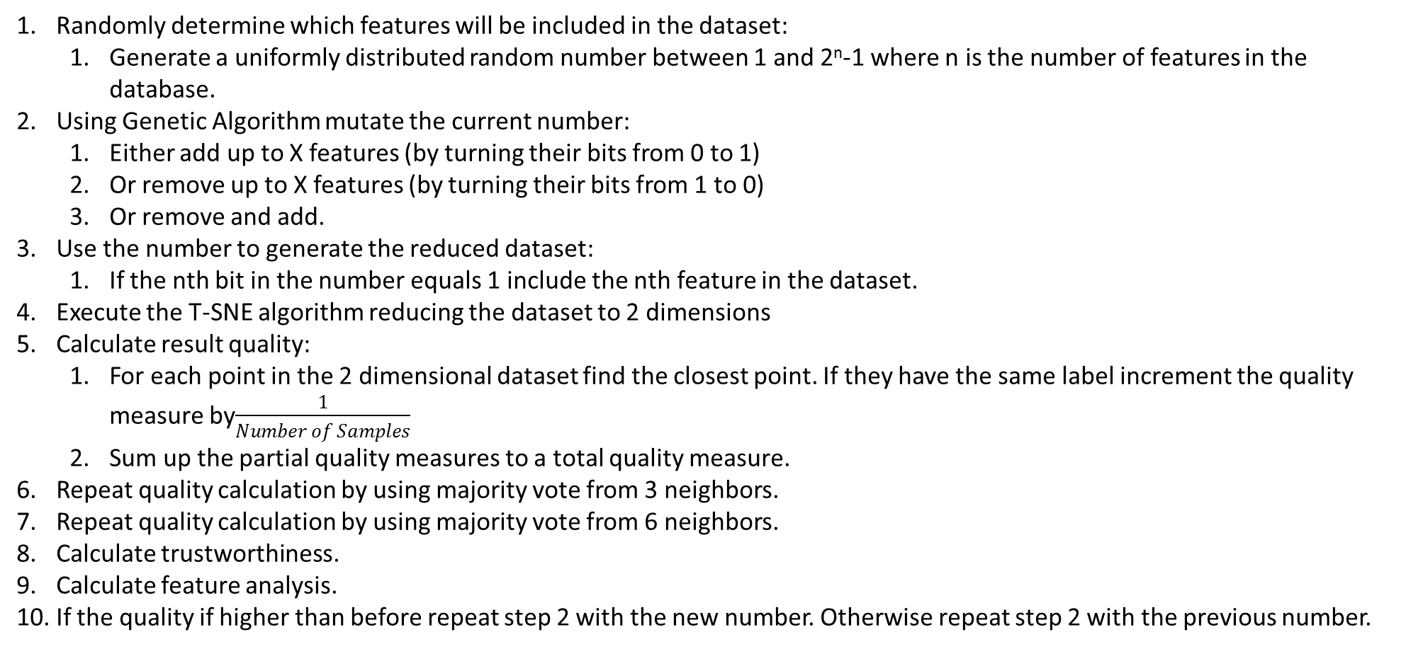
Randomly determine which features will be included in the dataset:
Generate a uniformly distributed random number between 1 and 2^{n}-1 where n is the number of features in the database.
Using Genetic Algorithm mutate the current number:
Either add up to X features (by turning their bits from 0 to 1)
Or remove up to X features (by turning their bits from 1 to 0)
Or remove and add.
Use the number to generate the reduced dataset:
If the nth bit in the number equals 1 include the nth feature in the dataset.
Execute the T-SNE algorithm reducing the dataset to 2 dimensions
Calculate result quality:
For each point in the 2 dimensional dataset find the closest point. If they have the same label increment the quality measure by$\frac{1}{Number of Samples}$
Sum up the partial quality measures to a total quality measure.
Repeat quality calculation by using majority vote from 3 neighbors.
Repeat quality calculation by using majority vote from 6 neighbors.
Calculate trustworthiness.
Calculate feature analysis.
If the quality if higher than before repeat step 2 with the new number. Otherwise repeat step 2 with the previous number.

Slide 5
Algorithm
Input: DS – Dataset, L – Labels
Output: FSS – Feature sub set – DS* - Dimensionally reduced Dataset
Initialization: Generate an initial population of feature subsets.
Fitness assignment: Perform dimensionality reduction using T-SNE on each feature subset FSS_{it} and use the percentage of data points with the nearest neighbor having the same label as fitness.
Termination: if fitness ≥ threshold or if #iterations exceeded maximum set DS* to the FSS_{t*} with the highest fitness score.
Mating selection: Perform selection with replacement in order to fill the mating pool with new feature subsets.
Variation: Apply recombination and mutation operators to the mating pool and set FSS_{t+1} to the resulting population.
Increment generation counter (t=t+1) and go to Step 2.

