Slide 1

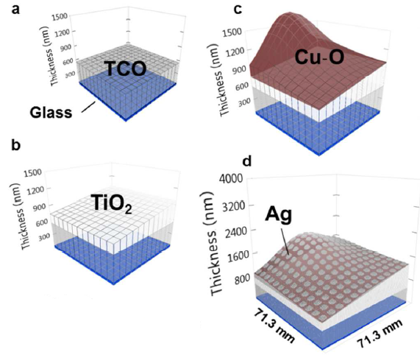
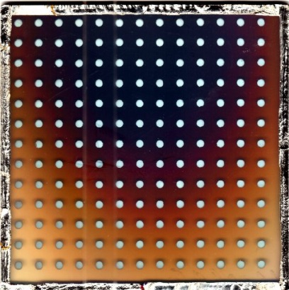
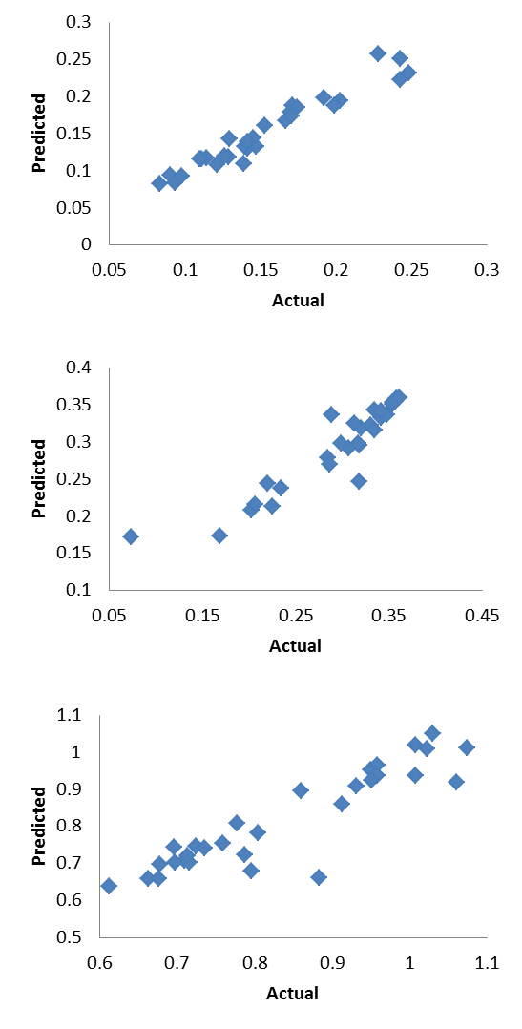
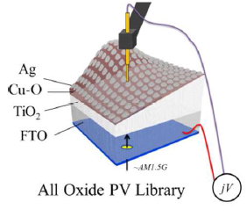
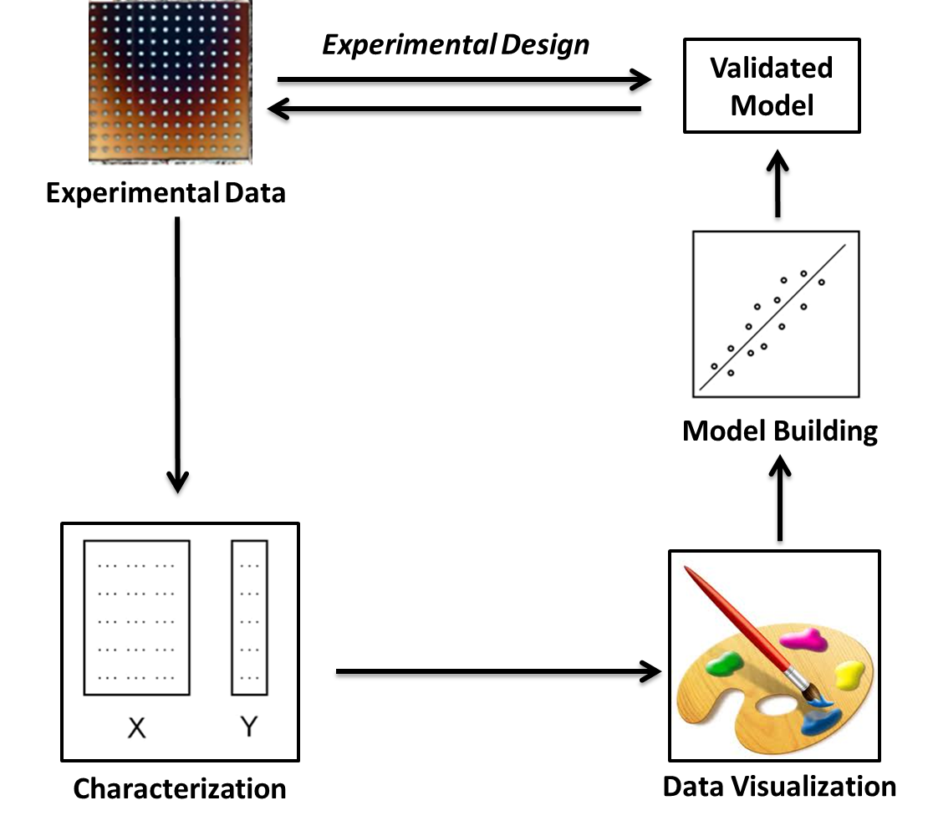
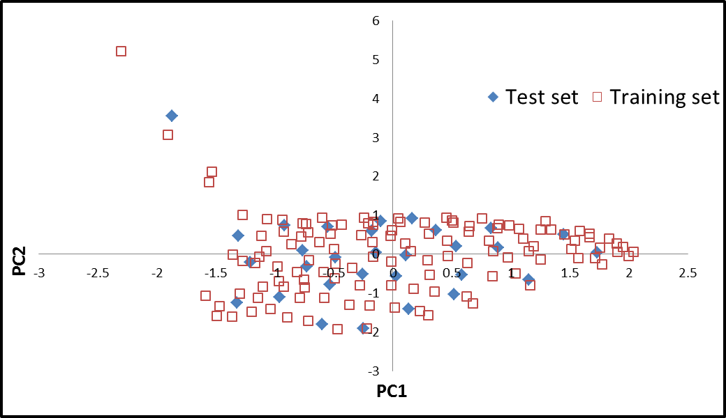
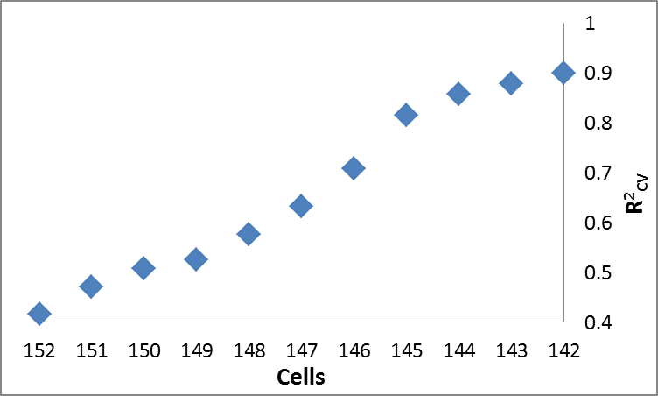
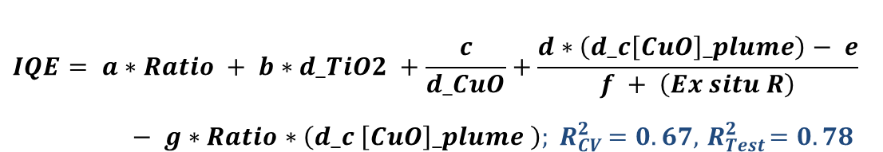
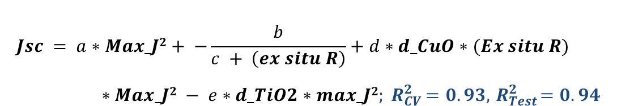
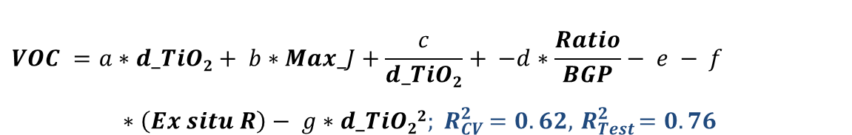
Data Mining and Machine Learning Tools for Combinatorial Material Science of All-Oxide Photovoltaic Cells
Abraham Yosipof,* Assaf Y. Anderson, Hannah Noa Barad, Sven Rühle, Arie Zaban and Hanoch Senderowitz
Department of Chemistry, Center for Nanotechnology & Advanced Materials, Bar Ilan University, 52900 Ramat Gan, Israel
*e-mail address: avi.yosipof@gmail.com
ABSTRACT
Recently a new field in photovoltaics (PV) is emerging focusing on solar cells that are entirely based on metal oxide (MO) semiconductors. All-Oxide based photovoltaics have the potential for extremely low cost solar cells, provided they can show an order of magnitude improvement in their power conversion efficiencies. The development of such cells could benefit from combining combinatorial material sciences of compounds with data mining and machine learning tools to analyze and rationalize the empirical results and for the design of new compounds.
Here we describe what we believe to be the first reported application of data mining and machine learning techniques in the field of photovoltaics. To establish the tools in this new field, we focused on a library of 169 solar cells of TiO₂/CuO. Each cell was characterized by 7 independent variables (i.e., descriptors) and by 3 dependent variables (photovoltaic parameters). Following characterization, cells were divided into training and test sets using a newly developed representativeness function. Individual models were derived for all independent variables with various techniques leading to good models with R²_{CV} and R²_{Test} typically > 0.8. For the open circuit photovoltage (VOC), no models could be derived presumably due to the presence of outliers. Ten outliers were removed using an in-house developed outlier removal algorithm and the remaining compounds were re-subjected to the model building procedures yielding this time reliable models. In summary we have demonstrated the usefulness of data mining and machine learning tools in the field of photovoltaics.
Experimental Data
Solar cells library of TiO₂/CuO
library
(a) Transparent conducting oxide (TCO)
coated glass
(b) Sprayed TiO₂ layer
(c) Pulsed Laser Deposition (PLD) of Cu–O
(d) Round Ag back contacts sputtered
on top of the Cu–O layer
Model Building and Validation
k-Nearest Neighbors optimization models
Genetic Programing models
Experimental Data collection
$$Jsc = a∗Max_J2+ −\frac{b}{c + \left(ex situ R\right)}+d∗d_CuO∗(Ex situ R)∗Max_J2 − e∗d_TiO2∗max_J2{; R}_{CV}^{2}=0.93, { R}_{Test}^{2}=0.94$$
$$VOC =a∗d_TiO2+ b∗Max_J+\frac{c}{d_TiO2}+ −d∗\frac{Ratio}{BGP}− e − f∗\left(Ex situ R\right)− g∗d_TiO22{; R}_{CV}^{2}=0.62, { R}_{Test}^{2}=0.76$$
$$IQE= a∗Ratio + b∗d_TiO2 +\frac{c}{d_CuO}+\frac{d∗\left(d_c\left[CuO\right]_plume\right)− e}{f + \left(Ex situ R\right)}− g∗Ratio∗\left(d_c \left[CuO\right]_plume \right){; R}_{CV}^{2}=0.67, { R}_{Test}^{2}=0.78$$
Library Characterization
Dependent variable Y: Photovoltaic parameters
Jsc: The short circuit photocurrent
VOC: The open circuit photovoltage
IQE: The internal quantum efficiency
Independent variable X: Cells characterization
d_ TiO₂: The thickness of the TiO₂ layer
d_ CuO: The thickness of the CuO layer
Ratio: The thickness ratio between the two layers
d_c [CuO]_plume: The distance of the cell from the center of the CuO depositing plume
BGP: The band gap of the CuO
Ex situ R : The resistance of the CuO
Max_J: The maximum calculated photocurrent
Workflow
Model Building: Spilt Data
Representativeness optimization algorithm to split the data for Training set and Validation test set.
Input: Cells and descriptors
Randomly select a subset of Cells
Calculate distances between dataset and subset
Minimize Representativeness function subset through MC
f(distance between dataset & subset)
Select most representative subset
Data Visualization
Principal Components Analysis (PCA)
Reduce dimensions for visualization
Deduct outliers
Model Building: kNN optimization based outlier removal
For VOC no model was obtained for the entire library
Outliers removed using a new kNN-based algorithm
The improvement of the VOC model in each cycle
Dataset
Run kNN optimization to obtain the best model
For each cell, calculate the improvement in R²_{cv} upon its removal from the dataset
Calculated Internal Quantum Efficiency (IQE) as a function of cell position
Remove that cell which provides the largest increase in R²_{cv} upon its removal from the dataset
Calculated Internal Quantum Efficiency (IQE) as a function of cell position
Stopping criteria: model with R²_{cv} >0.9

