Slide 1

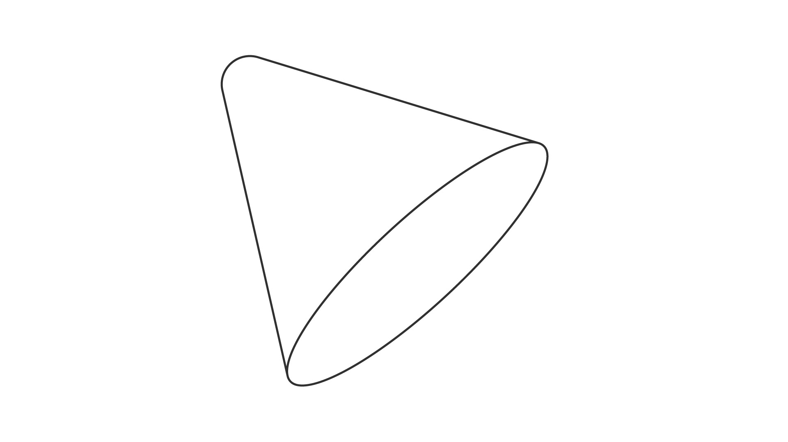
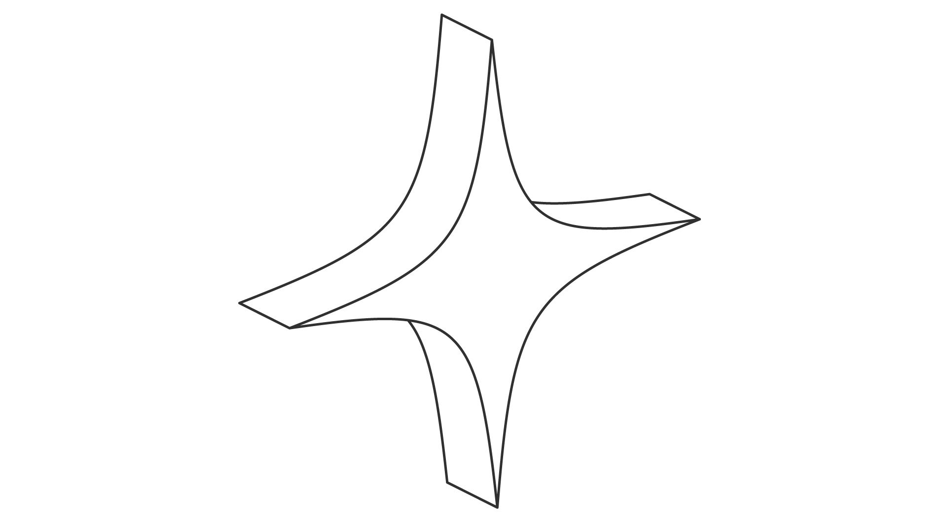
GROUP 1
PROJECT: ToDo List System
Subject: Requirements Engineering
Class: CMU-SE 214 AEIS

Slide 2
Member:
LECTURERS:
Nguyễn Trung Thuận (Mentor)
Đào Phước Long (Leader) - 29219054593
Phạm Bảo Đạt – 29216250704
Nguyễn Nam- 29219034776
Trần Thanh Hiếu- 29219065013
Phạm Quang Vũ- 28211352230

Slide 3
Work Assignments:
No. | Title | Start Date | End Date | Assignee
1 | Introduction | 23/6/24 | 11/10/24
2 | Overall Descriptions
 | Product Perspective | 23/6/24 | 11/10/24
 | Product Features | 23/6/24
 | User Class and Characteristics | 23/6/24
 | Operating Environment | 23/6/24 | 11/10/24
 | Design and Implement Constraints | 23/6/24
 | Assumption Dependencies | 23/6/24
3 | System Features | 23/6/24 | 11/10/24
4 | External Interface Requirements | 23/6/24 | 11/10/24
5 | Non Functional Requirements | 23/6/24 | 11/10/24
6 | Conclusion | 23/6/24 | 11/10/24
7 | Figma Prototype | 23/6/24 | 11/10/24
8 | Slide | 23/6/24 | 11/10/24

Slide 4
Work Completion Percentage:
Member | Percentage of work | Percentage of completion
Long | 25% | 100%
Đạt | 20% | 100%
Nam | 23% | 100%
Hiếu | 22% | 100%
Vũ | 10% | 100%

Slide 5

Table of contents
01
02
03
04
Project Overview
Main Feature
Communication & Tools
Demo by Figma

Slide 6
01
Project Overview

Slide 7
Introduction
The ToDo List System helps manage tasks efficiently for students, workers, and businesses. It allows users to easily create, organize, and track tasks, set priorities, and deadlines. With flexible customization, this system improves productivity, optimizes time management, and supports tasks ranging from simple to complex.

Slide 8
Purpose
The purpose of the ToDo List System is to provide a comprehensive, user-friendly platform that helps students, workers, and businesses efficiently manage their tasks and responsibilities. This system is designed to enhance productivity by enabling users to organize their to-do lists, set priorities, and track deadlines effectively. By simplifying task management, the system aims to reduce the stress of handling multiple tasks and improve time management skills, ultimately contributing to the successful achievement of personal, academic, and professional goals.

Slide 9
Project Scope
The ToDo List System project focuses on the design and development of a task management platform tailored for students, workers, and businesses. The key features of the system include:
Task Creation and Management.
Prioritization and Categorization
Deadline Tracking
Progress Monitoring
User-Friendly Interface
Customization
Collaboration Features

Slide 10
Technologies Used
Application for User:
Cross-Platform app using Flutter Framework.
Should perform well on Mobile. Web app could have some limitation.
For API system:
API:
Framework: .NET Core API.
All of API system are deploy on Linux server.

Slide 11
Budget & Time Constraints
Category | Detailed |  | Description
Start Date | 23/06/2024 |  | --
End Date | Estimate | 6/2024 | --
 | Real | --
Duration | Estimate | 90 | 3 months
 | Real | -- | --
Work time | 4 |  | Hours per day
Total effort | Estimate | 2160 | Work time * Duration * 6 (Team members)
 | Real | --
Labor cost | Estimate | 4320$ | Pay per hour: 2$

Slide 12
02
Main Feature

Slide 13
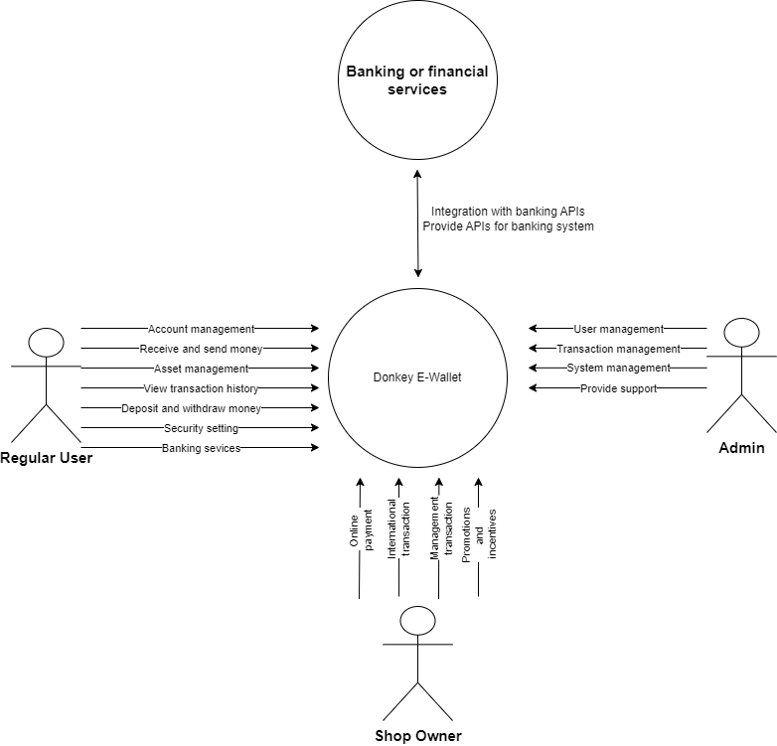
System Context Diagram

Slide 14
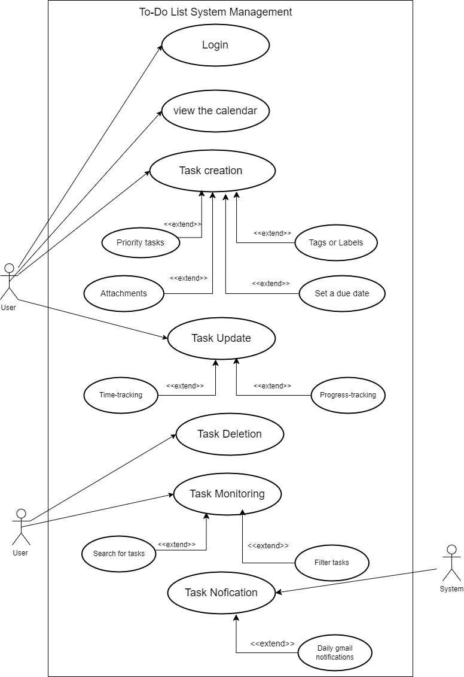
System Usecase Diagram

Slide 15
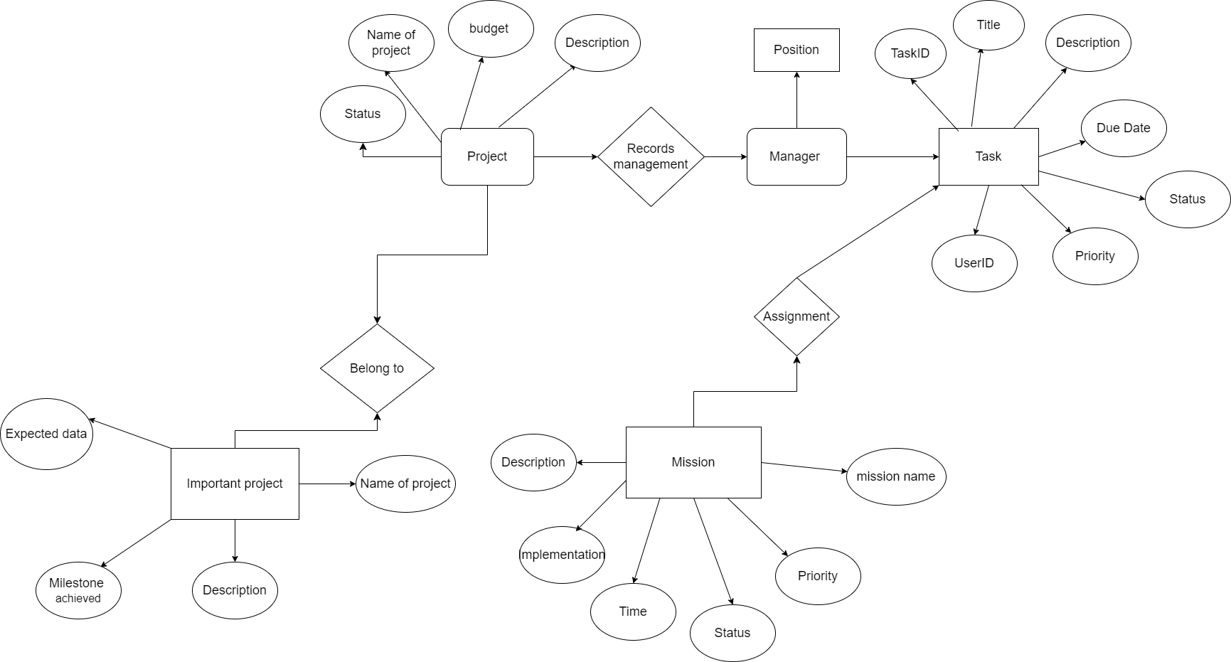
III. Entity Relationship Model

Slide 16
IV. Functional Requirement
User Management
Task Management
Task View and Filter
Collaboration
Analystics

Slide 17
V. Non-Functional Requirement
Performance
Security
Usability
Scalability
Availability

Slide 18
03
Communications & Tools

Slide 19


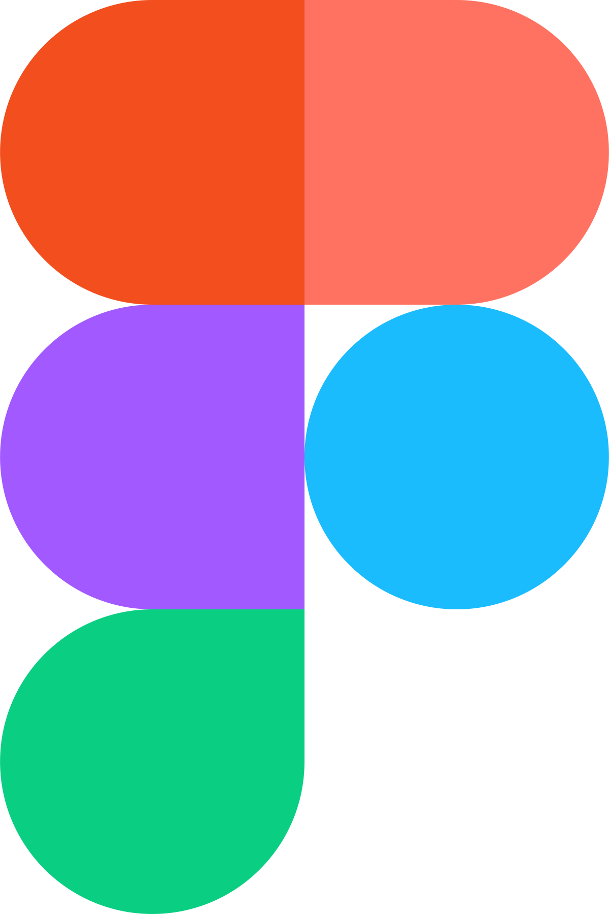
Messenger
Zoom
Figma

Slide 20
04
Demo by Figma

Slide 21
https://www.figma.com/design/EnXMFk9B0ln48xZKG3Z8Z5/StarConnect?node-id=0-1&t=j0s8jzoJbkdMti1C-1

Slide 22

Thanks for listening

