Slide 1
Remote User Authentication in Digital Libraries
Claven Ke
Library of National Chiao-Tung University
claven@lib.nctu.edu.tw

Slide 2
Introduction
Libraries subscribe to e-resources
Content providers require access be limited to our users
  Authentication is the process in which a user 's claim to an identity is checked.
Various means to authenticate
  IP Control
    Our users cannot access e-resources when they are at home
  Username/Password
    A user need a separate username/password for each e-resource

Slide 3
Remote User Authentication
Remote user authentication is a kind of authentication that enables our users to identify themselves for using e-resources when they are off-campus.
Approaches
  Direct Dial-in
  Referer URL Authentication
  Authenticated Proxy-server

Slide 4
Direct Dial-in
Schools play a role of ISP
  Maintain modem service
  Users will be assigned a campus IP when they dial in
Advantages
  No remote user authentication problems for the Library or Database vendors
Disadvantages
  Expensive
  Does not help users
    With a LAN connection (HiNet, SeedNet, APOL, ET…)
    With a cable modem or DSL (HiNet, SeedNet, APOL, ET…)
    For whom campus is a long distance phone call

Slide 5
Referrer URL
Also called Referring or Referral URL
Steps for referrer URL authentication
  A controlled-access web page registered with e-resource venders
    Users must have a valid username/password to enter the page
  Vendor allows access if user selects database URL from that page
    Library has to register the page to each vendor
    Vendor has to support HTTP environment variable HTTP_REFERER
  When a user clicks a database URL from that page, a request with HTTP_REFERER (=URL of that controlled-access page) is sent to vendor

Slide 6
Referrer URL (Cont.)
Advantages
  Easy to set up
    No additional software
    Authentication is done by the web server
    No additional hardware
  Simple user training issues
    No client-side setup involved
    No browser version issues
    Just train them to login
Disadvantages
  Not very flexible
    Can’t bookmark
    Difficult to link from multiple pages
    Multiple database URLs from vendor
  Vendor may not support Referrer URLs
  Vendor may not support multiple Referrer URLs
  Not scale well

Slide 7
Referrer URL (Cont.)
Choose Referrer URL Authentication if:
  Small number of resources (<50)
  Little need for linking to resources on other web pages
  Users or staff are not motivated to handle proxy configuration issues
  Summary: Referrer URL is easy for users but is not very flexible for the institution and does not scale well

Slide 8
Proxy Servers
Perform web retrievals on behalf of a web browser
Most often used to speed up Internet access and reduce bandwidth by caching frequently used pages
Libraries use proxy servers to make off-campus web clients look like on-campus ones
Authenticated users are allowed to relay requests through our IP address space

Slide 9
Proxy Servers (Cont.)
Advantages
  Can place database links anywhere
  A single URL from the database vendor
  Proxy servers scale better
Disadvantages
  Problems with auto-configuration proxy
  Problems with multiple proxy servers
  Problems with firewalls
  All traffic goes through proxy server (single point of failure)
  User has to manually configure and un-configure settings

Slide 10
NCTU Experiences

Slide 11
Basic Idea
Use Squid proxy server
  Support authentication plug-ins. Plug-ins available for:
    Windows NT user database
    LDAP, MySQL, NCSA, NIS, Unix password files
    Or write your own in Perl, PHP, C, etc.
  Relevant lines from Squid.conf:
    acl ourusers proxy_auth REQUIRED
    http_access allow ourusers
    authenticate_program /usr/local/squid/bin/auth.exe
The auth.exe program connects with library automation system to check username/password
If user passes the authentication checking, he can access Internet via the proxy server

Slide 12
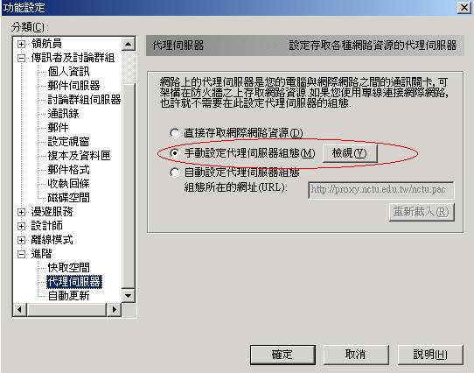
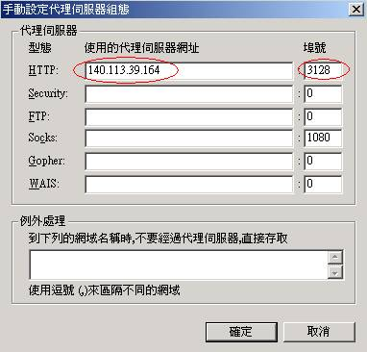
User has to setup proxy in browser…

Slide 13
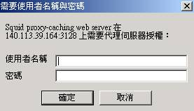


Authentication Process
Library Automation
System

Slide 14
Preliminary Statistics
NCTU starts the service from March 2001
  Inform information providers of this service
Total user: 2327; valid user: about 1000
Connect to more than 500 sites
Average connection: 1387
Average bytes retrieved: 10,992,005
Average connection time: 3729 sec.

Slide 15
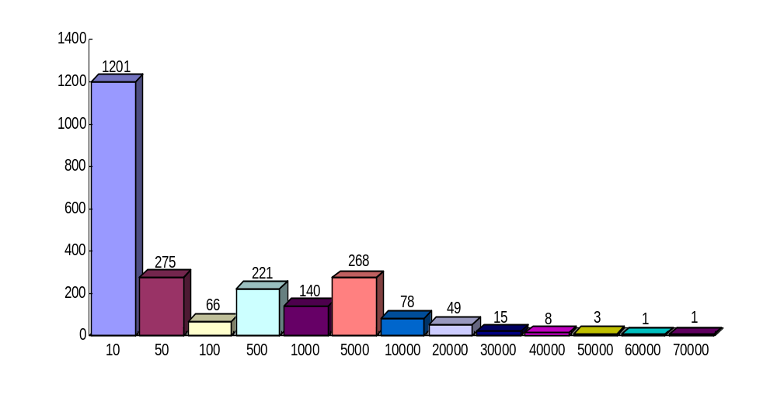
Preliminary Statistics (Cont.)
Number of Users
Connection Times

Slide 16
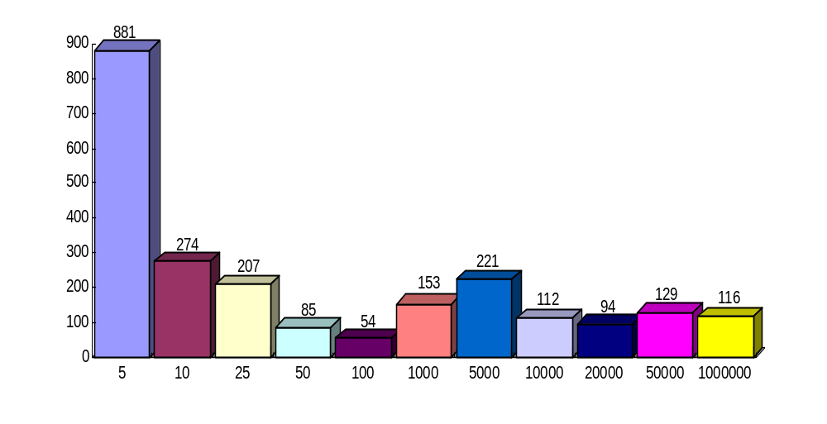
Preliminary Statistics (Cont.)
Number of Users
Kbytes Download

Slide 17
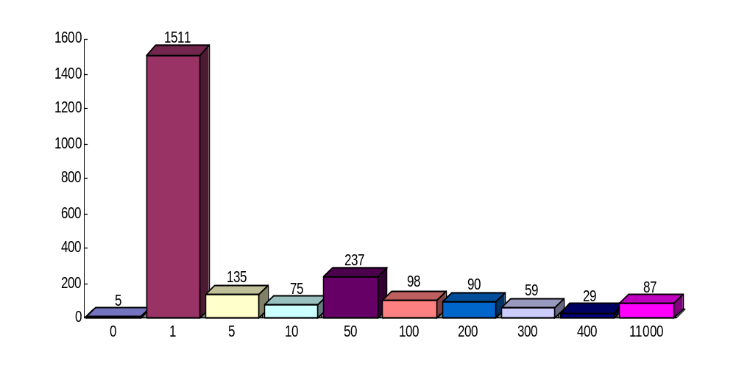
Preliminary Statistics (Cont.)
Number of Users
Connection Minutes

Slide 18
Preliminary Statistics (Cont.)
Site Ranking
  1 IEEE
  5 SDOS
  8 Proquest
  11 ISI
  13 NCL (National Central Library)
  18 AIP
  21 SwetsNet
  28 ACS
  33 ACM
  36 Springer-Verlag
  41 OVID
  45 ACM
Site Ranking
  51 CSA
  68 CatchWord
  72 EI
  84 EBSCO
  99 Academic Press IDEAL
  112 SFI ANJES
  114 IOP
  130 Delphion Patent
  131 Wiley
  180 Optics InfoBase
  186 American Mathematical Society

Slide 19
Make A Plan…
What user data do you want to use?
Where is this user data?
What software does this system use?
Who will develop this system for you?

Slide 20
Make A Plan… (Cont.)
What user data do you want to use?
  Network username and password
  Student ID number
  Library patron barcode number
  Passwords, PINs, SSN, Phone number
Where is your user data?
  Campus registration system
  Network OS user database
  Library automation system
  E-mail user database

Slide 21
Make A Plan… (Cont.)
What software does this system use?
  Database: Oracle, MS SQL, Sybase,…
  Programming language: PHP, ASP, Perl, UNIX Shell…
  Integrated into library automation system or separated
    Is password in the library automation system encrypted?
      Yes: you need an API from vendor to decrypt the password
      No: You can use SQL directly to query the database
Who will develop this system for you?
  Campus MIS
  Library Automation Vendor
  Database Vendor
  Commercial solutions

Slide 22
Who will develop this system for you?
Campus MIS
  Campus-wide authentication project?
    Remote access?
    Library needs?
  Ask for anything we have discussed so far
  Tell them This Is Important To The Library And To The School
Library Automation Vendor
  Some support remote authentication
  Some systems can use scripts
Advantages
  For some libraries this is their only user database
  Integration with other services provided to users
Disadvantages
  Tied to your ILS vendor
  ILS vendor may not support
  Not all of your databases may be supported by your vendor

Slide 23
Who will develop this system for you? (Cont.)
Database Vendor Authentication
  Provide them a list of user IDs
  Patron barcode begins with …
  Institutional username and password for each product
Advantages
  Easy to implement
Disadvantages
  Lack of consistency
Commercial Products
  EZProxy
  Obvia
  Efixa

Slide 24
Recommendation
Find out what other libraries are doing
Test web browsers and operating systems
  Netscape and IE have different setting
  IE has different setting for dial-up and LAN (ADSL, cable modem)
Need Programmer to develop and maintain
Provide web page support for your users
  http://digilib.nctu.edu.tw/proxy.htm
Train library staff on support
Provide a assistant channel
  http://140.113.39.189/ref

Slide 25
References
Most contents of this presentation are from http://library.smc.edu/rua.htm
More references about remote user authentication are at http://library.smc.edu/rpa.htm

