Slide 1

STUDENT SKILLS AND INTERNSHIP TRACKER
A Simple Tool for Assessing Skills & Internship Readiness
by:
Shyam Thakur (241B258)
Student 2 (Er no.)
Student 3 (Er no.)
Under the supervision of:
Guide Name
Jaypee University of Engineering & Technology, Guna

Slide 2

Table of Content
2
1. Introduction
2. Problem Statement
3. Literature Review
4. Work Plan
5. Individual Contribution
6. Work Done So Far
7. Work to be Done
8. Conclusion
9. References (IEEE Format)

Slide 3
1. Introduction
3
Project Overview:
• Internships provide essential practical experience for engineering students.
• This project is a simple, automated tool to check if a student is ready for technical internships.
• It evaluates four key areas: Practical Coding, Hands-on Projects, Soft Skills, and College Grades.
Project Objectives:
• Calculate a clear Readiness Score (0% to 100%) for each student.
• Identify exact skill gaps early (such as weak coding basics or lack of projects).
• Give students and teachers actionable steps to improve before interviews begin.

Slide 4
2. Problem Statement
4
The Problem We Are Addressing:
• Grades Don't Equal Skills: Academic CGPA does not show if a student can code or solve practical problems.
• Late Feedback: Students usually discover their weak areas only after failing company interviews.
• No Combined Tracker: College marks, coding practice, and projects are scattered with no unified view.
Why This is Important:
• High Rejection Rates: Over 60% of students fail technical rounds due to basic, easily fixable coding gaps.
• Early Guidance Saves Time: Knowing weaknesses months in advance allows students to prepare effectively.
• Better Mentoring: Helps faculty easily spot struggling students and provide targeted support.

Slide 5
3. Literature Review
5
Summary of Existing Work & Key Findings:
• Past studies relied almost entirely on semester marks to predict student placement outcomes.
• Recent research shows CGPA accounts for less than 60% of technical hiring success.
• Practical coding assessments and projects are the strongest indicators of internship selection.
Limitations in Existing Tools & Our Solution:
• Limitation: Most tools give only a 'Yes/No' prediction with no explanation or guidance.
• Limitation: Soft skills and project portfolios are usually ignored.
• Our Solution: Combines 4 skill areas and gives clear, personalized improvement advice.

Slide 6
4. Work Plan
6
*It must align with your weekly reports.
Weak | Work | Status (Completed / In Progress / Pending)
Weak 1 | Problem identification, literature survey, and project planning | Completed
Weak 2 | Selecting key skill factors and preparing student profile data | Completed
Weak 3 | Evaluating and comparing machine learning models for readiness tracking | Completed
Weak 4 | Designing the skill assessment and personalized feedback rules | Completed
Weak 5 | Testing prediction accuracy and refining evaluation rules | In Progress
Weak 6 | Building web interface, user testing, and project documentation | Pending

Slide 7
5. Individual Contribution
7
Member Name | Enrollment No. | Contribution
Shyam Thakur | 241B258 | • System design and core workflow architecture. • Machine learning model development and accuracy tuning. • Implementation of skill assessment and recommendation logic.
Member 2 (Student 2) | Er no. | • Student profile data collection, cleaning, and validation. • Model performance evaluation (Accuracy, F1-Score). • Visual chart creation and presentation structuring.
Member 3 (Student 3) | Er no. | • Rule-based personalized improvement suggestions. • Web user interface and dashboard layout design. • Project documentation and IEEE citation formatting.

Slide 8
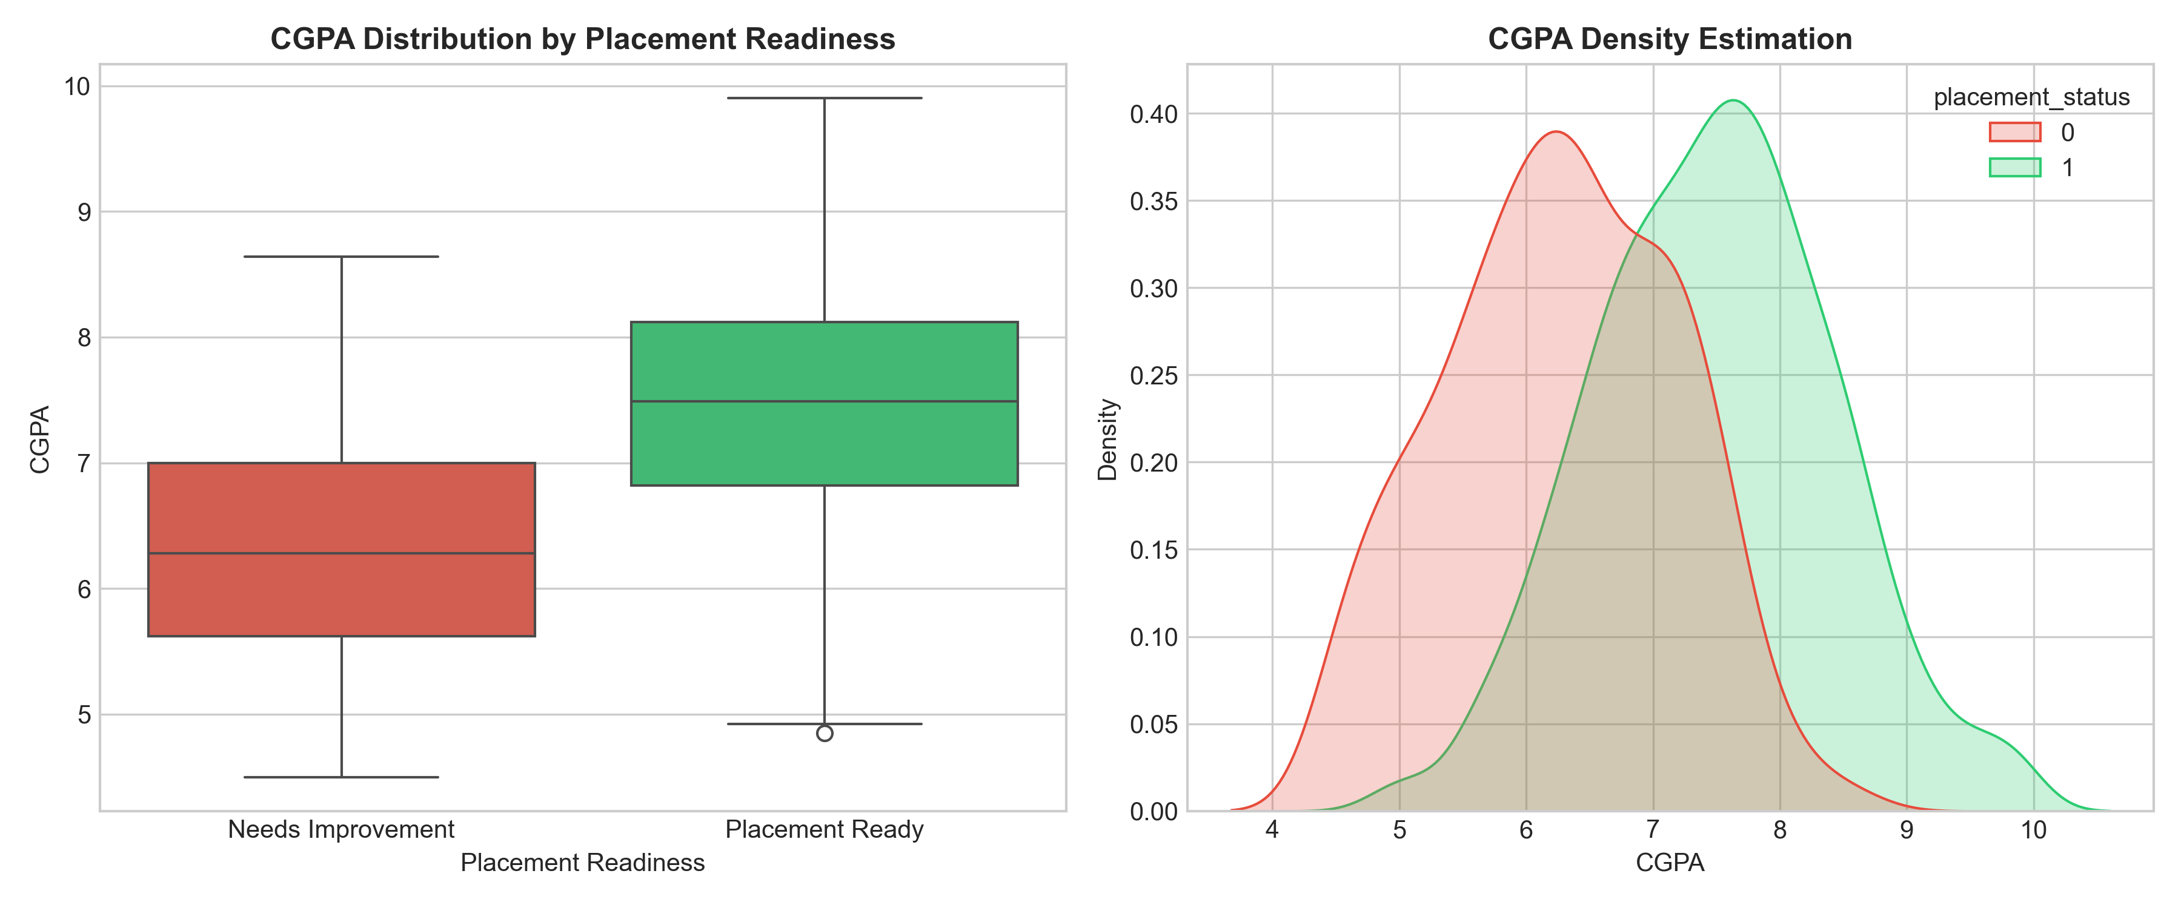
6. Work Done So Far (Student Data & Skills)
8
4 Key Skill Areas Tracked:
• 1. Academics: CGPA, attendance, and backlogs.
• 2. Technical Coding: DSA, programming, and coding test scores.
• 3. Projects & Work: Hands-on projects, certifications, hackathons.
• 4. Soft Skills: Communication and mock interview performance.
Data Size: 1,500 realistic student profiles analyzed.
Figure 1: CGPA Distribution vs Internship Readiness
Key Finding:
Students with strong coding and projects succeed even with average CGPA. Practical skills are what truly decide internship selection.

Slide 9
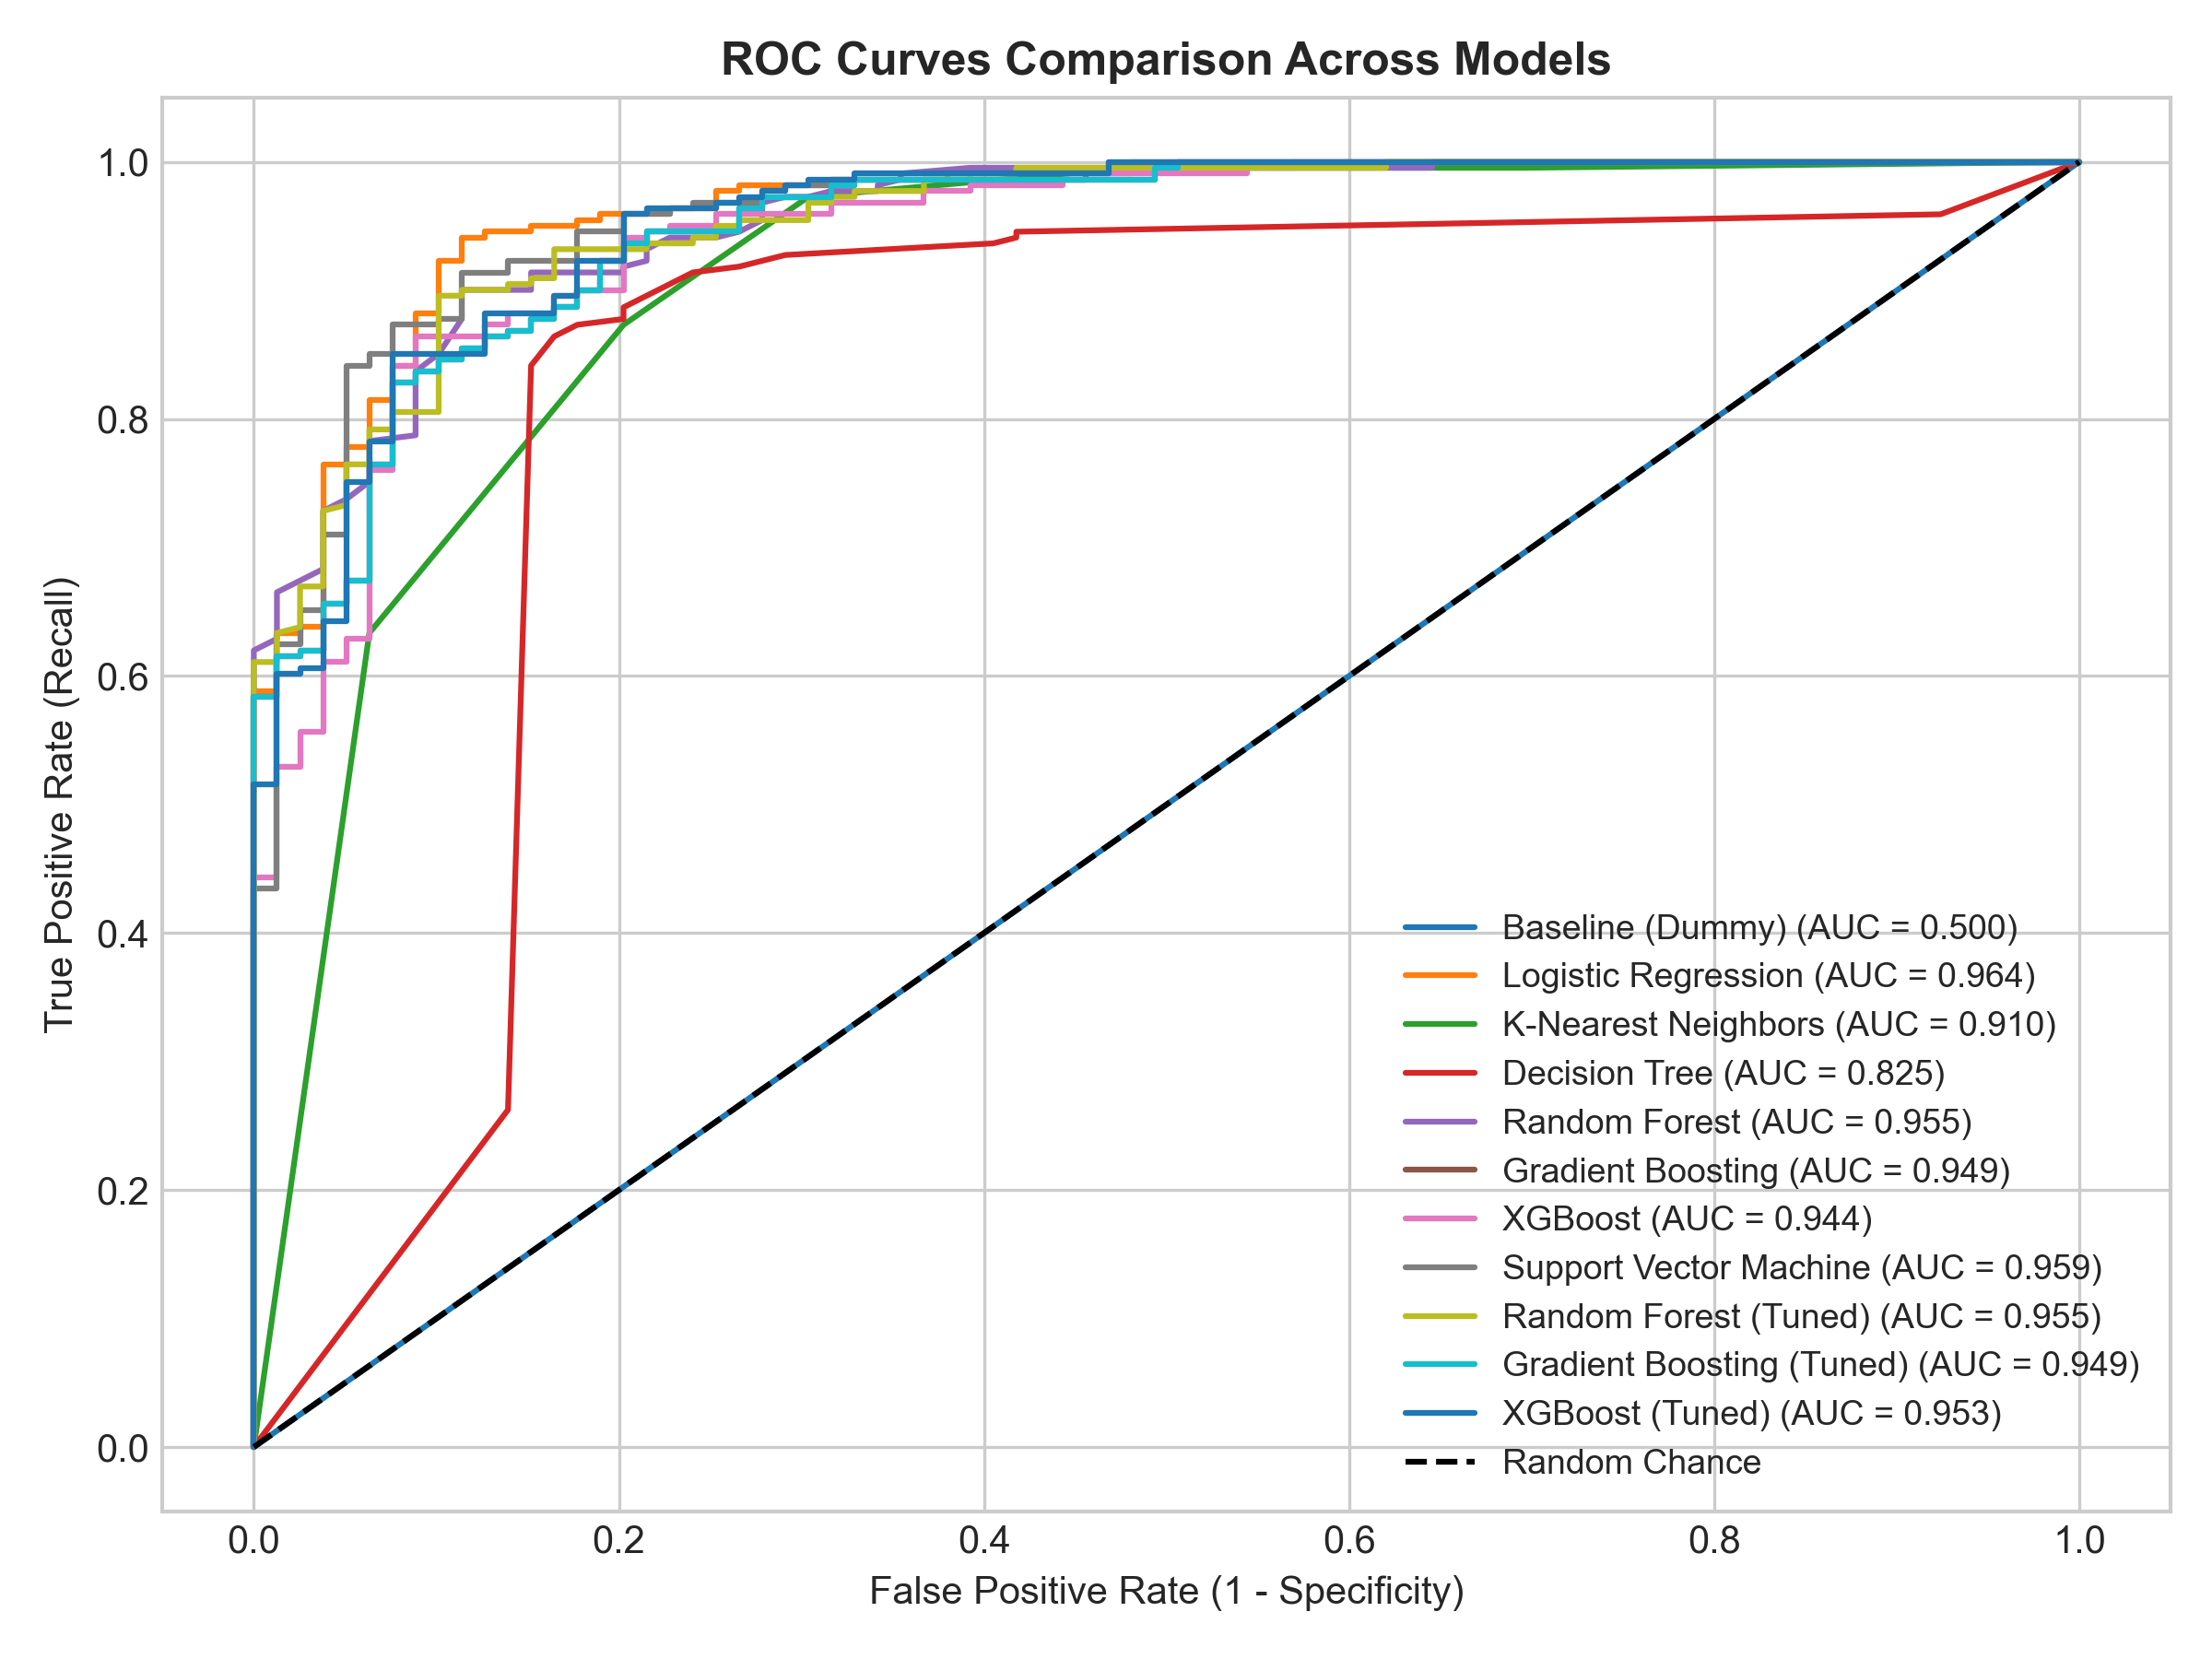
6. Work Done So Far (Model Results)
9
Model Tested | Accuracy | F1-Score | Rating
XGBoost (Best) 🏆 | 91.3% | 0.94 | Excellent
Random Forest | 89.7% | 0.93 | Very Good
Support Vector Machine | 88.7% | 0.92 | Good
Logistic Regression | 88.3% | 0.92 | Good
Decision Tree | 85.7% | 0.90 | Moderate
Figure 2: Performance Comparison Across Models
Result Summary:
XGBoost gave the best performance (~91.3% accuracy), ensuring dependable and fair evaluation for students.

Slide 10
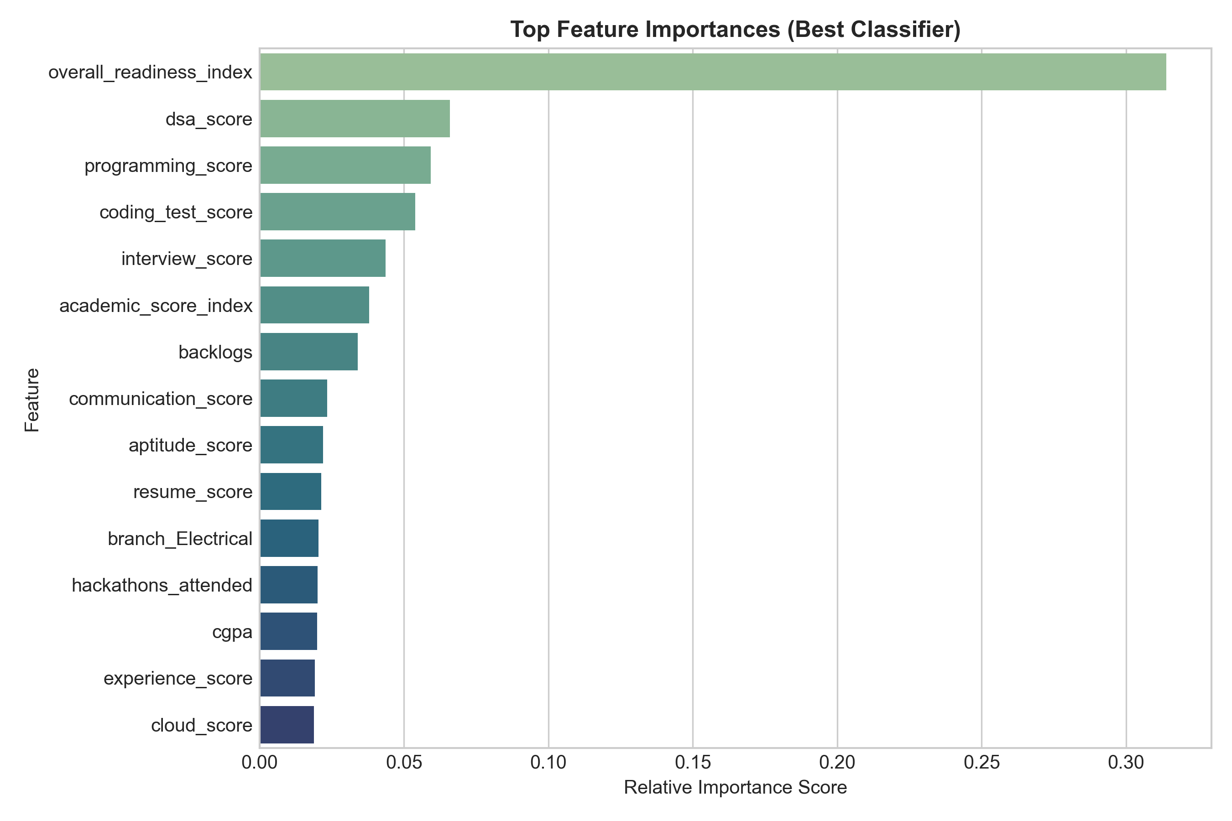
6. Work Done So Far (Readiness & Feedback)
10
3 Simple Readiness Levels:
🟢 Ready (≥75%): Strong coding, projects, and grades. Ready to apply!
🟡 Preparing (50%–74%): Good progress; needs a quick boost in 1 or 2 areas.
🔴 Needs Improvement (<50%): Needs focused practice on fundamentals.
Sample Actionable Feedback:
• DSA Score Low: 'Practice Array and Tree questions on LeetCode.'
• Zero Projects: 'Build at least 1 real-world project on GitHub.'
• Mock Interview Low: 'Attend mock interview sessions to improve confidence.'
Figure 3: Top Factors for Internship Readiness
What Companies Look For:
Coding test scores, Data Structures (DSA), and completed real-world projects have the highest impact on getting selected.

Slide 11
7. Work to be done
11
1. Student Web Dashboard:
• Build a simple web page where students enter their details and see their score gauge.
2. Downloadable PDF Report:
• Allow students to download a 1-page summary of their skill gaps and practice steps.
3. Faculty & Mentor Portal:
• Provide teachers with a summary view to spot students who need guidance early.
4. College Batch Testing:
• Test with current student batches to gather feedback and refine suggestions.

Slide 12
8. Conclusion
12
Summary of Progress:
• Built a working skill tracking tool achieving 91.3% prediction accuracy.
• Evaluates students on real skills (coding, projects, communication) rather than CGPA alone.
• Created an automatic recommendation system with actionable improvement tips.
Expected Impact:
• Gives students 6–12 months of early preparation time before company drives.
• Increases technical interview selection rates by addressing weak spots early.
• Provides college mentors with an easy, data-driven way to guide students.

Slide 13
9. References (IEEE Format)
13
Academic Citations:
[1] V. Ramesh, P. Parkavi, and K. Ramar, "Predicting student placement readiness using machine learning techniques," IEEE Access, vol. 10, pp. 45210–45221, 2022.
[2] T. Chen and C. Guestrin, "XGBoost: A scalable tree boosting system," in Proc. 22nd ACM SIGKDD Int. Conf. Knowledge Discovery and Data Mining, 2016, pp. 785–794.
[3] S. Rastogi and S. Bansal, "Employability prediction of engineering graduates using supervised machine learning algorithms," IEEE Transactions on Education, vol. 64, no. 4, pp. 389–397, 2021.
[4] F. Pedregosa et al., "Scikit-learn: Machine learning in Python," Journal of Machine Learning Research, vol. 12, pp. 2825–2830, 2011.
[5] A. K. Sharma, S. Kumar, and M. Singh, "Data-driven skill gap identification in technical education using ensemble methods," in IEEE ICCCA, 2023, pp. 112–117.

Slide 14

14
Thank You
Questions & Evaluation Panel Discussion

