Slide 1
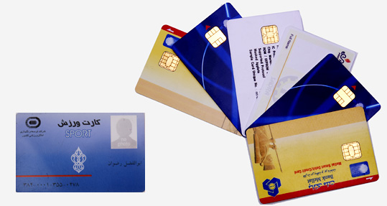
SMART CARDS

Slide 2
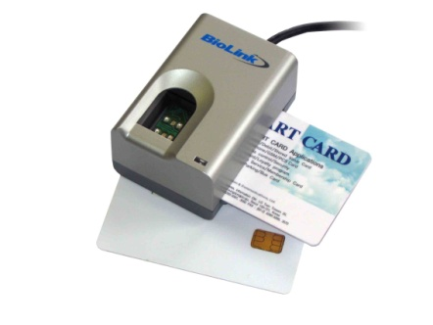
What is a Smart Card?
Plastic Card.
Microchip loaded with data.
Uses - telephone calling, electronic card payment.
Can be refreshed for further use.
Smart Cards can be used with a Smart-Card Reader attachment to a personal computer to authenticate a user.

Slide 3
History of Smart Cards
Smart Card has its origin in 1970s by inventors from Germany, Japan and France.
Until mid 80s most of the work on Smart Cards was at the research and development level.
First mass use was for payment in French payphones.
The manufacturers of Smart Cards are Gemplus, IBM, Siemens,Telesec and many more.

Slide 4
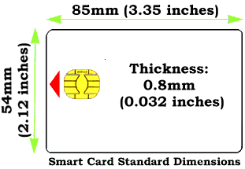
Standard Dimension of a Smart Card

Slide 5
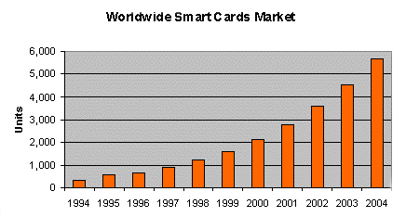
The current world population of Smart Cards is nearly 3 billion.

Slide 6
How the Smart Card works ?
A smart card does not work alone. It needs a smart card reader to function. The card contains an embedded memory chip contained in a contact pad. Once the contact pad is removed from the card, it is no longer smart.
In the card reader, the contact pad comes in contact with the reader and carries out the processing. Thus it helps you in transactions via POS (point of sale) or another medium to carry out transactions.

Slide 7
What is SMART about the Smart Card ??
Smart Cards are capable of not just storing data but also have processing power.
They have larger storage capacity when compared to magnetic swipe cards.
The data stored can be protected against unauthorized access and tampering.
They are appropriate for secure and convenient data storage.

Slide 8
Types of Smart Cards
Based on the way the smart card interacts with the Reader, smart cards are of two types
Contact Smart Cards: These require insertion into the Card reader.
Contact less Smart Cards: These require close proximity of the reader.

Slide 9
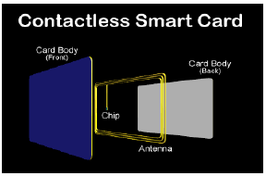
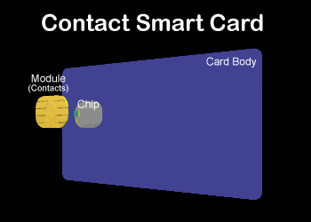
This card consists of an IC Chip
and an antenna coil embedded
into it.
These cards are mainly used
when transactions must be
processed quickly.
The contact smart card consists
of small contact plate on the
face, which is ½’’ in Diameter.
The transmission of data takes
place when this contact plate
comes in contact with the
connector of the reader.

Slide 10
Examples:
1. Contact Smart Cards: This is the most common smart cards in use. ATM cards, most credit cards, SIM cards etc fall into this category.
2. Contactless Smart Cards :
=>Visa Contactless (formerly payWave) – Visa.
=>QuickPass – UnionPay.
=>RuPay Contactless - RuPay.

Slide 11
Applications of Smart Cards
In Banks: They are used as credit/debit bank cards
Medical applications: they can be used as Health insurance card or Medical File Access Card.
In Transportation Services: for urban parking, Airline Application and Electronic Toll Collection.
used as identification cards

Slide 12
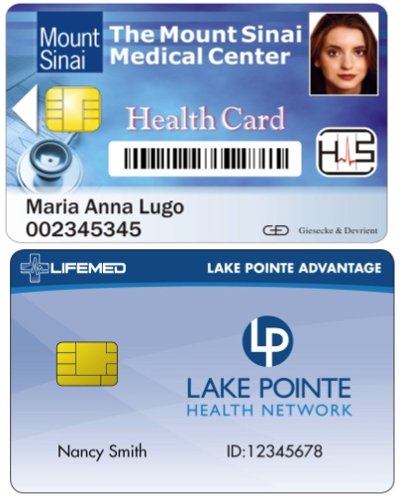
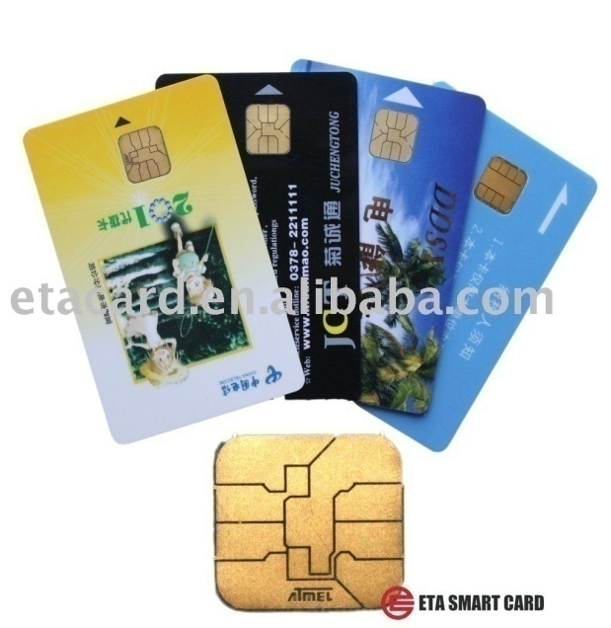
Why Smart Cards
Increased security,
Potential user mobility,
Sequential access to one machine by
multiple users..

Slide 13
Advantages of Smart Cards:
High levels of security.
Larger memory.
Prevents fraud.
Reliability.
Information Security.
Privacy.
Ease of use.
Reduced cost for operators and users.

Slide 14
Disadvantages Of Smart Cards
Smart cards are small and light-weighted. They are maybe lost or forgotten in case of any use.
The biggest problem facing smart cards is their level of security. For example, If you are using a payment card.
Lack of technology to support users.
Fees applied with the use of a card.

Slide 15
THANK YOU….

