Slide 1

ENPM667
Project 01
Playing Atari With Deep Reinforcement Learning
Sai Surya Sriramoju, UID: 119224113
Shyamsundar Prabhakar Indra, UID: 119360842

Slide 2
Abstract:
Combines a Deep Learning model - Convolutional Neural Network with the Reinforcement Learning algorithm called ‘Q-Learning’.
Successfully learns the control policies directly from high dimensional sensory input such as pixels without any prior feature knowledge.
A CNN (Convolutional Neural Network) is trained with a variant of Q-learning.
The input is a raw pixel and the output is a value function estimating the summation of future rewards.
The algorithm has been applied on seven Atari 2600 games with same architecture.
Performed better than the previous six approaches during 2013 and played better than a human expert on three games.

Slide 3
Reinforcement Learning:
Reinforcement learning (RL) is a machine learning training method based on rewarding desired behaviors and/or punishing undesired ones.
An RL agent is able to perceive and interpret its environment, take actions and learn through trial and error.
It is about an agent learning the optimal behavior in an environment to obtain maximum reward throughout its lifespan in an episode.
General RL algorithms can be divided into two categories - model based and non-model based. The former tries to model the environment itself to solve the problem whereas the latter tries to solve the RL task directly by using samples obtained from the environment.

Slide 4

Reinforcement Learning -> General flow:
Any RL algorithm consists of 5 important components : Environment, Agent, State, Action, and Reward. An agent interacts with the environment at a state ‘s_t’ by performing an action ‘a’, getting a reward ‘r’ (which could be positive or negative in nature), and hence transforming the environment to state ‘s_t+1’
Source

Slide 5
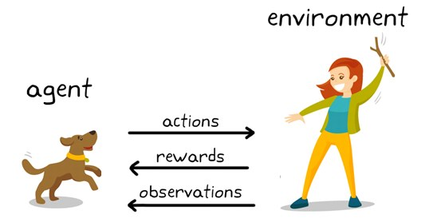
A simple example to understand RL better:
RL can be thought of analogous to a dog being taken to a park for the first time, where the owner can be thought of as the 'environment', and the dog as the 'agent'. The owner plays fetch with the dog, which the dog is initially clueless about. Slowly it learns to perform the initial ‘action’ of fetching the stick, & eventually learns to actually return it to the owner. During this phase, the owner keeps 'rewarding' the dog with a treat every time it manages to successfully fetch the stick, which 'reinforces' its behavior.
Source

Slide 6
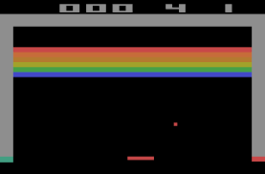
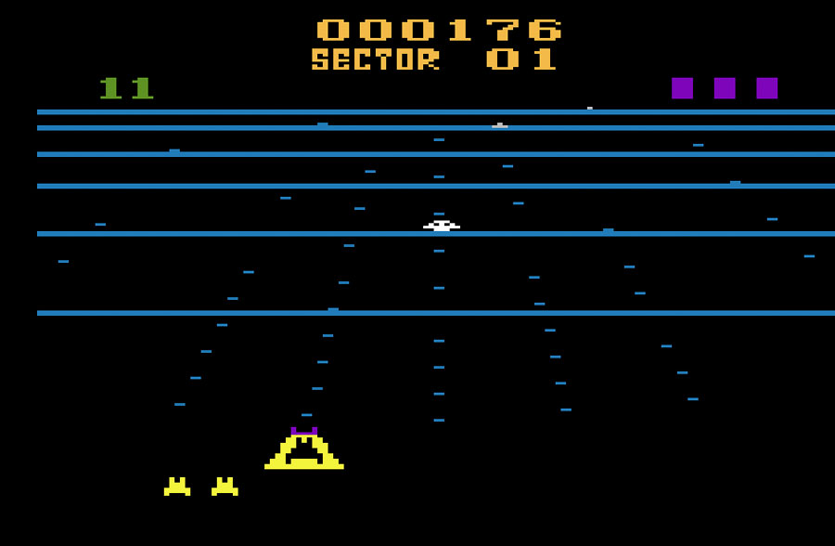
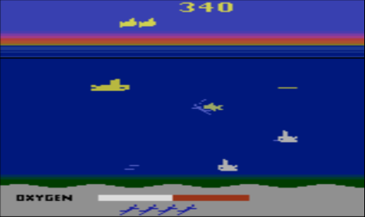
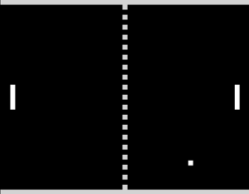
Environment: Atari 2600
The paper tests its DQN algorithm in 7 of the Atari 2600 games.
It trains a model in such a way that a single agent can play all the seven games.
No game specific information is provided.
No hand designed features.
Same network architecture and hyper-parameters.

Slide 7
Deep Learning:
Deep Learning is one of the important underlying tools of this paper’s algorithm. Background knowledge in certain topics pertaining to Deep Learning is important to understand the paper’s implementation.
Perceptron: It is the smallest unit of a neural network. It takes the input along with the weights and an added bias, which is then passed to a non-linear activating function to finally give an output.
Deep Neural Networks(DNN): A collection of perceptrons is called as neural network. They have more than two layers, first layer is an input layer and last layer is called as output layer, the layers in between are called as hidden layers.
Convolutional Neural Networks(CNN): The CNNs are a special type of neural networks which uses weighted filter kernels to operate over images and pixels.

Slide 8

Q-Learning:
Q-Learning is a model-free Reinforcement learning algorithm that computes the maximum cumulative reward possible for the agent after taking an action ‘a’ from a given state in the environment.
Q-Learning is the fundamental concept upon which the DQN algorithm proposed by this paper has been built.
Q function is an action-value function that gives cumulative future rewards upon following a policy pi after observing a state (sequence) s and taking an action 'a' at that state.
Now we define an 'optimal Q function' - Q* as the Q function which gives the maximum possible reward by following the optimal policy pi*, after taking an action a_i at state s_t where i belongs to A, the action space of a specific game.

Slide 9
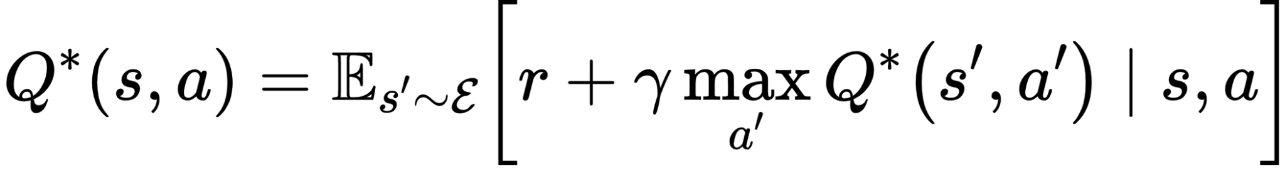
Q-Learning: (contd.)
The optimum Q function obeys an important identity called the Bellman equation, the details of which aren't in the scope of this paper.
It enables us to formulate the optimum Q function in the form of a recursive equation. This is based on the intuition that the optimal Q function at the next state s_t+1 is given by Q*(s_t+1, a_t+1). With this idea Q*, after a simple manipulation can be expressed as an recursive series.
In simpler words it can be demonstrated as the optimum Q function output at a state s_t upon taking an action a_t can be written as a sum of the reward r as a result of action a_t and the optimum Q value at the state s_t+1. Such value iteration algorithms converge to the optimal action-value function, Q_i → Q* as i → infinity.

Slide 10
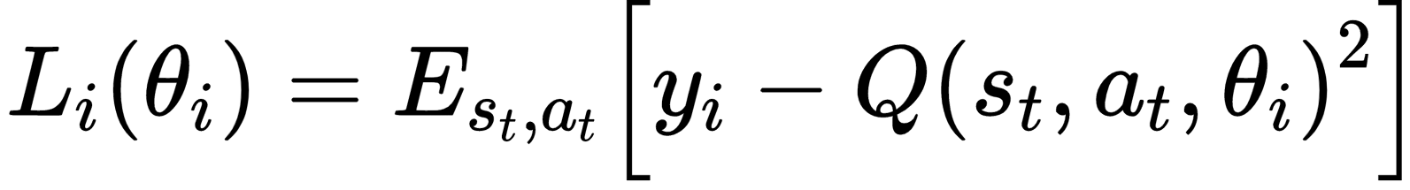
Q-Learning: (contd.)
The previous approach is however very basic and is totally impractical, because the Q function is estimated separately for each sequence, without any generalization.
Instead, it is a common practice to use a function approximator to estimate the action-value function, Q(s, a;theta ) ~ Q* (s, a). The paper uses a non-linear neural network function approximator to achieve the same. Such a non-linear function approximator neural network with weights theta is referred to as a Q-network. A Q-network can be trained by minimizing a sequence of loss functions L_i(theta_i) that changes at each iteration i
It is to be noted that both the truth labels and the observation outputs come from the same Q network (which is the CNN in the paper’s case). This idea is used to find the error function, computer its gradient, backpropagate, and optimize the weights of the CNN iteratively. This is the basic idea behind Deep Q Learning.

Slide 11
Deep Q Learning:
Three components make up the backbone for the DQN algorithm proposed in the paper:
Experience Replay - The agent's previous experiences at each time-step get stored, e_t = (s_t, a_t, r_t, s_t+1), where s_t is the state at time t, a_t is the action taken at that state, r_t is reward obtained by the agent for taking action a_t at the state s_t, s_t+1 is the state reached by the agent upon taking action a_t. This is stored in a data set D = e_1, e_2, e_3 ..., e_n, across different episodes into a replay memory, from which the agent can sample out experiences for training.
Epsilon Greedy Policy - The agent generates a random number n between 0 and 1 and decides whether to infer over the state-action pair sampled from the experience replay or take a random action a_r in the given state, according to whether n is greater or lesser than epsilon respectively. Epsilon can be a fixed number between 0 and 1 or it can be a variable number (a linearly decaying epsilon value used in the paper's algorithm)
Convolutional Neural Network (CNN) - It is a simple two hidden layer CNN proposed by the paper’s algorithm. This CNN essentially acts as the Q network, which takes state(s) as the input in the form of raw frames and makes a prediction for the Q values corresponding to every action ‘a’ belonging to the action space ‘A’ for the input state.

Slide 12
Training the Deep Q Network:
Let’s take that the agent samples out experience e_i from the experience replay memory. The Q network takes the state s_t from the experience e_i as input and outputs the Q value for every possible action in the action space A for that state. It picks the Q value for the action corresponding to state s_i from the experience replay and executes the action to receive a reward r. Let's call the Q value for this action q_1.
The Q network also runs inference with s_t+1 as the input, to find all the Q values for the action space at state s_t+1, and chooses the best Q value in this action space, and let's call this q_2.
Ideally, a perfect Q network, which is the Optimal Q function, would have q_1 = q_2 + r, but this won’t be the case since we are trying to make a network learn and approximate to the closest possible optimal Q function.
Hence the difference between these two is the error function e = q_1 - (q_2 +r). The network uses this error function to backpropagate the errors iteratively, and optimally update the weights of the network.
One can intuitively observe that in contrast to the fixed targets in a supervised learning problem, the targets here come from the Q network being trained itself. In other words, the Q network generates training labels alongside training its own self as well.

Slide 13
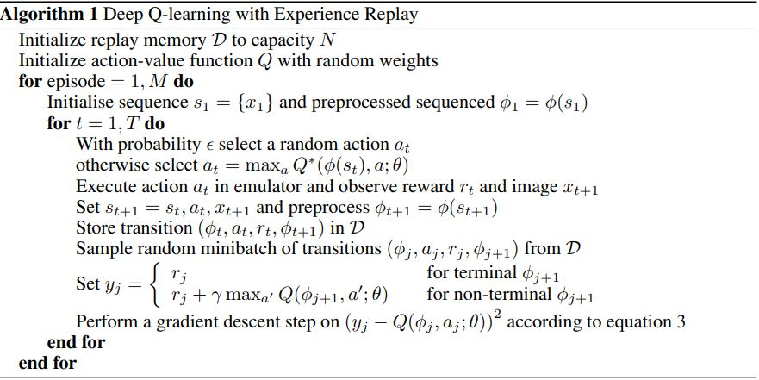
Deep Q-Learning Algorithm Overview:

Slide 14
Advantages of Experience Replay in DQN:
Firstly the Q network gets a varied range of data which is always important for a DL network not to overfit.
Secondly, learning directly from consecutive samples is very inefficient due to the strong correlations between the samples. Randomizing these samples in the form of an experience replay breaks these correlations and therefore reduces the variance of the updates.
Third, when learning on-policy, the current parameters determine the next data sample on which the parameters are trained. For example, if the maximizing action is to move left then the training samples will be dominated by samples from the left-hand side; if the maximizing action then switches to the right then the training distribution will also switch. It is easy to see how unwanted feedback loops may arise and the parameters could get stuck in a poor local minimum, or even diverge catastrophically.
Experience replay also ensures that the behavior distribution is averaged over many of its previous states, smoothing out the learning.

Slide 15
Advantages of Epsilon Greedy Policy in DQN:
Unlike supervised learning (for example image classification), in reinforcement learning there is no unseen, held-out data set available for the test phase. This means the algorithm is tested on the very same setup that it has been trained on.
Especially since the preprocessed input contains a history of previously encountered states, the concern is that, instead of generalizing to the underlying gameplay, the agent just memorizes optimal trajectories for that specific game and replays them during the testing phase, and overfits to a specific scenario.
Epsilon Greedy Policy prevents this from happening by letting the agent explore instead of following the greedy policy to just maximize the rewards. This helps in adding new experiences to the experience replay, and hence preventing overfitting.

Slide 16
Preprocessing of Environment states:
The Atari game frames which are 210 × 160 pixel images with a 128 color palette, can be computationally demanding. So, instead of working with them directly, every single raw frame is preprocessed by first converting to grey-scale format and down-sampling it to a 110×84 image. The final input representation is obtained by cropping an 84 × 84 region of the image that roughly captures the playing area. The final cropping stage is only required because we use the GPU implementation of 2D convolutions, which expects square inputs. For the experiments in this paper, this preprocessing is applied to the to the last 4 frames of history and they’re stacked to produce the input to the Q-network.

Slide 17
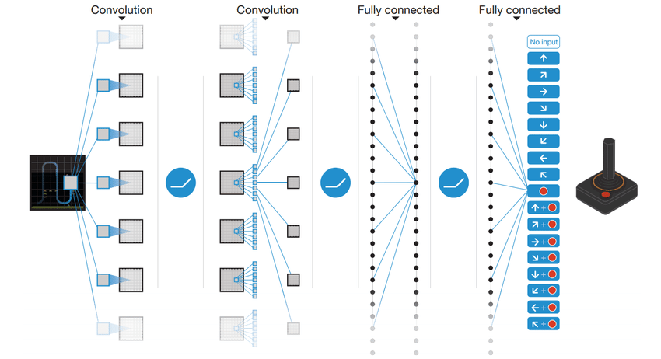
DQN Architecture:
There are several possible ways of parameterizing the Q function using a neural network. Since Q maps history action pairs to scalar estimates of their Q value, the history, and the action have been used as inputs to the neural network by some previous approaches. The main drawback of this type of architecture is that a separate forward pass is required to compute the Q-value of each action, resulting in a cost that scales linearly with the number of actions. The paper instead uses an architecture that takes only a state as the input and has a separate output unit for each possible action. The outputs correspond to the predicted Q-values of the individual action for the input state. The main advantage of this type of architecture is the ability to compute Q-values for all possible actions in a given state with only a single forward pass through the network.
The input to the neural network is 84 × 84 × 4 images produced by preprocessing. The first hidden layer convolves 16 8 × 8 filters with stride 4 with the input image and applies a rectifier non-linearity. The second hidden layer convolves 32 4 × 4 filters with stride 2, again followed by a rectifier non-linearity. The final hidden layer is fully-connected and consists of 256 rectifier units. The output layer is a fully connected linear layer with a single output for each valid action. The number of valid actions varied between 4 and 18 on the 7 games played by the paper's model.
Source

Slide 18
Experiments:
The paper tested the DQN on seven of the popular ATARI games – Beam Rider, Breakout, Enduro, Pong, Q*bert, Seaquest, Space Invaders.
The same network architecture, learning algorithm, and hyperparameters settings were used across all seven games, which shows its robustness to adapt to different environments without any tuning.
The evaluation of the agents was done on real and unmodified games. However, during the training phase, the rewards were clipped to [-1,0,1]. i.e., all positive rewards were put to 1, 0 rewards unchanged, and negative rewards were put to -1. Clipping the rewards in this manner limits the scale of the error derivatives and makes it easier to use the same learning rate across multiple games.
However, at the same time, it could affect the performance of the DQN agent since it cannot differentiate between rewards of different magnitudes.
RMSProp algorithm (Backpropagation using Root Mean Squared Error for optimization) with mini-batches of size 32 was used for training the DQN using backpropagation.
The behavior policy during training was epsilon-greedy with epsilon decreasing linearly from 1 to 0.1 over the first million frames and fixed at 0.1 thereafter. The paper trained the agent for a total of 10 million frames and used a replay memory of one million most recent frames.
Following previous approaches to playing Atari games, the paper also used a simple frame-skipping technique. More precisely, the agent sees and selects actions on every kth frame instead of every frame, and its last action is repeated on skipped frames. This technique allows the agent to play roughly k times more games without significantly increasing the runtime.
We tried to implement the paper’s DQN algorithm on our own. However, owing to time and computational constraints, we were able to train the model for only 3 of the games, namely Breakout, Seaquest, and Space Invaders. We trained for 10 million time steps, the same as the paper's model, however, we were able to train the models with an experience replay memory of only 50000 frames as opposed to the paper's million frames, since it was a severe bottleneck on the GPU.

Slide 19
Results:
Each of Breakout, Seaquest and Space Invader were trained for a total of 10 million time steps. The training for each game took around 1.5 - 2 days on an NVIDIA GTX 1060 GPU depending on the game. The video results of the RL agent playing after 1000 episodes of training and after 10 million steps of training can be found below. One will be able to notice how the RL agent learns various unique behaviors with more and more steps of training.
BREAKOUT
After 1000 ep: link
After 10 mil steps: link
SEAQUEST
After 1000 ep: link
After 10 mil steps: link
SPACE INVADERS
After 1000 ep: link
After 10 mil steps: link

Slide 20
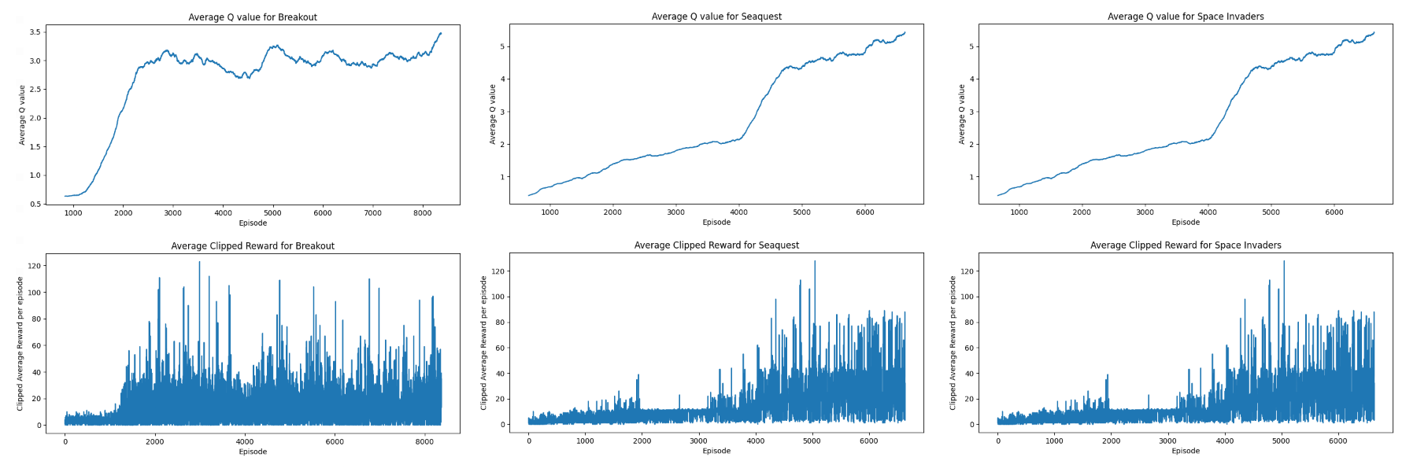
Training Statistics:

Slide 21
Training Statistics: (contd.)
By comparing it to the training and validation sets, one may quickly monitor a model's progress during training in supervised learning. However, it might be difficult to appropriately assess an agent's training progress in Deep Q Learning since there’s no obvious metric to measure.
The paper periodically computes the average reward throughout the training. Since even tiny changes in the network weights can result in significant changes in the distribution of the states, the average total reward metric frequently exhibits high levels of noise.
Because of the noise in the averaged reward graphs, it can make one think that the learning algorithm is not progressing steadily.
Hence a more reliable metric for evaluation is the policy's estimated action-value Q function, which gives an estimate of the amount of discounted reward the agent can receive by adhering to its policy from any given state.
Prior to training, a random strategy was executed to generate a fixed set of states, and then the average of the maximum predicted Q for these states was plotted. As one can see in the upper plots in the previous slide, average maximum Q value climbs much more smoothly than the average total reward received by the agent, which is very similar to the paper's graphs.

Slide 22
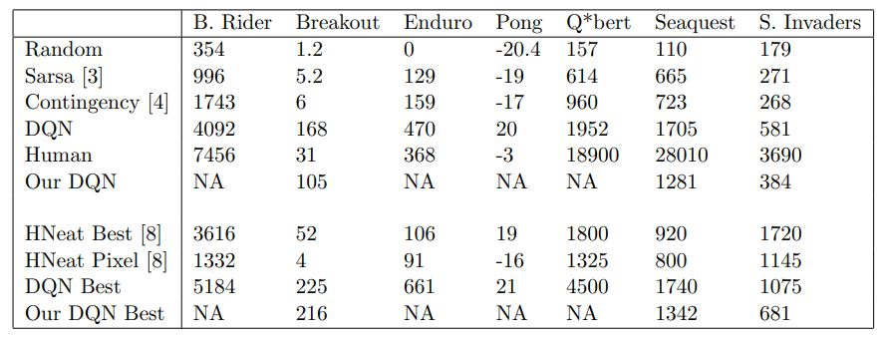
Evaluation:
The results of DQN were compared in the paper, with the best-performing methods from the RL literature during that time.
Almost all of these methods implicitly or explicitly incorporated hand-engineered features to train RL models.
In contrast, the DQN approach from the paper only receives the raw RGB screenshots as input and learns to detect objects and evaluate the environment on its own.
The paper goes on to show that in spite of not using any specialized feature inputs in any of the games, the max evaluation results (row 9), as well as the average results (row 4) achieve better performance than any other RL algorithm except for Space Invaders.
Finally, it is remarkable that DQN achieves better performance than even an expert human player on Breakout, Enduro, and Pong and it achieves close to human performance on Beam Rider.
The games Q*bert, Seaquest, and Space Invaders, on which the DQN implementation is far behind from human performance, are more challenging because they require the network to find a strategy that extends over long time scales.
Rows 6 and 10 show the average and maximum rewards respectively, from our implementation of the DQN algorithm across three games - Breakout, Seaquest, and Space Invaders. In spite of putting up good scores when compared to the best RL algorithms of that time, it isn't as good as the paper's implementation of DQN.
The only difference between our implementation and the paper's implementation is the much smaller experience replay size, which is 1 million frames vs 50000 frames.
This speaks volumes about how the experience replay formulation was the backbone of the algorithm's excellent results when compared to other best RL implementations of its time, in spite of using a very shallow network of just two hidden layers, when compared to 50+ layered networks in 2022.
This also supports the reason behind the agent not performing in games like Q*bert, Seaquest, and Space Invaders, as well as a human player, since it was bottlenecked by experience replay size since the network had to train with strategies spanning long time scales.

Slide 23
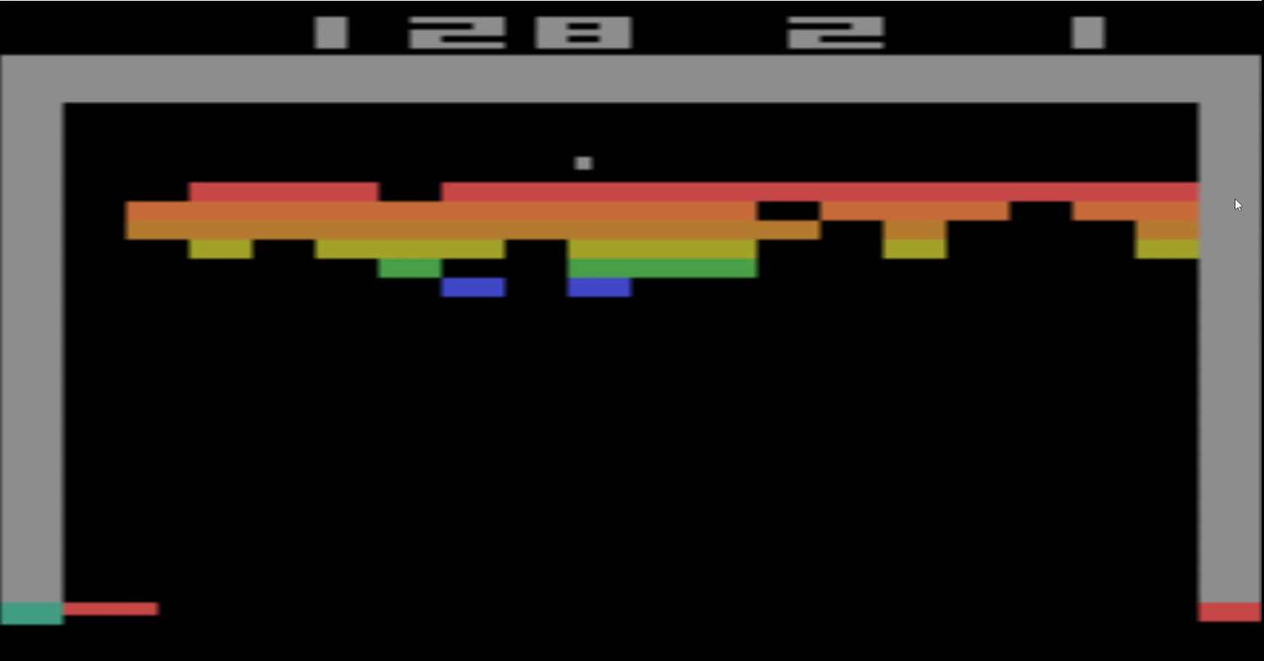
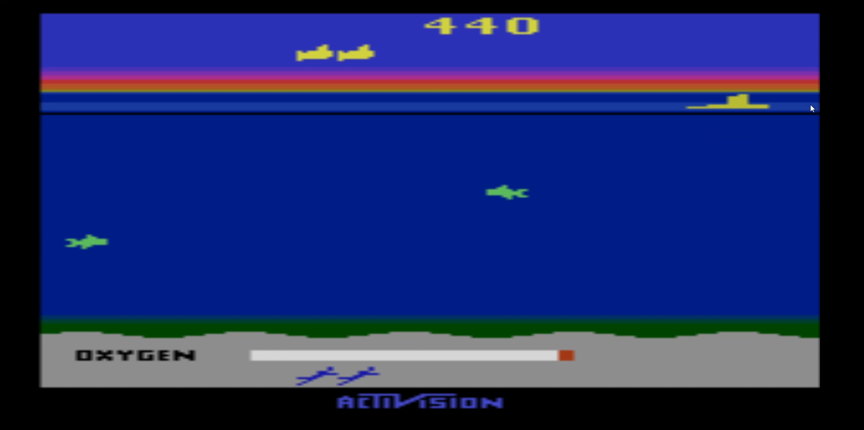
Some quirky results:
It was quite fascinating to observe how in spite of not being able to consistently perform as well as the paper's DQN implementation (lower average reward), our trained DQN agent was able to explore and find the most optimum policy to play Breakout, by making a tunnel in the bricks as shown in the below figure, which helps it in achieving a max reward per episode closer to the paper's DQN implementation. This can actually be attributed to the epsilon-greedy policy, which allowed the exploration of the agent and enabled it to find quirky strategies like tunneling.
One more interesting observation that we would bring to light to the reader is how the DQN agent learned in the Seaquest game to actually shoot down fish to earn rewards and come to the surface to replenish oxygen as shown below so that it can extend the duration of the episode and potentially earn more rewards. However owing to the smaller experience replay memory, it ends up being close to clueless after replenishing oxygen and ends up crashing into an enemy.

Slide 24
Future Works and Conclusion :
The paper was a groundbreaking research material during its time of publication in 2013, which unanimously took over the other RL implementations of its time which needed much more involved handcrafted features to solve RL problems. It came up with the novel idea of combining a simple 2-hidden-layer CNN with a Q-learning algorithm to solve complicated RL problems, along with using an experience replay buffer which proved to be the backbone of its success. Now we are here in 2022, and yet the field of RL and its problems, unlike many Supervised Learning problems are far from being solved. After DeepMind's paper in 2013, which set the pace for RL research in the coming years, there have been several implementations of Deep RL, building up the concepts introduced in the 2013 paper.
Reinforcement Learning problems, as mentioned before, are far from being solved and the plethora of sophisticated formulations which come up these days are quite overwhelming to put it simply. We believe that RL has a huge role to play in the future, starting from simple household robots which can autonomously navigate a new house to a complicated autonomous driving vehicle that will revolutionize the way the world works. RL according to us, is the truest form of Artificial Intelligence, which can provide end-to-end autonomy, and the prospects of the same in the future make us very excited to look forward to it. We are very glad that we got the opportunity to explain, review and implement the classic DeepMind RL paper from 2013 which is at the forefront of all future research in RL.

Slide 25
Thank You!

