Slide 1
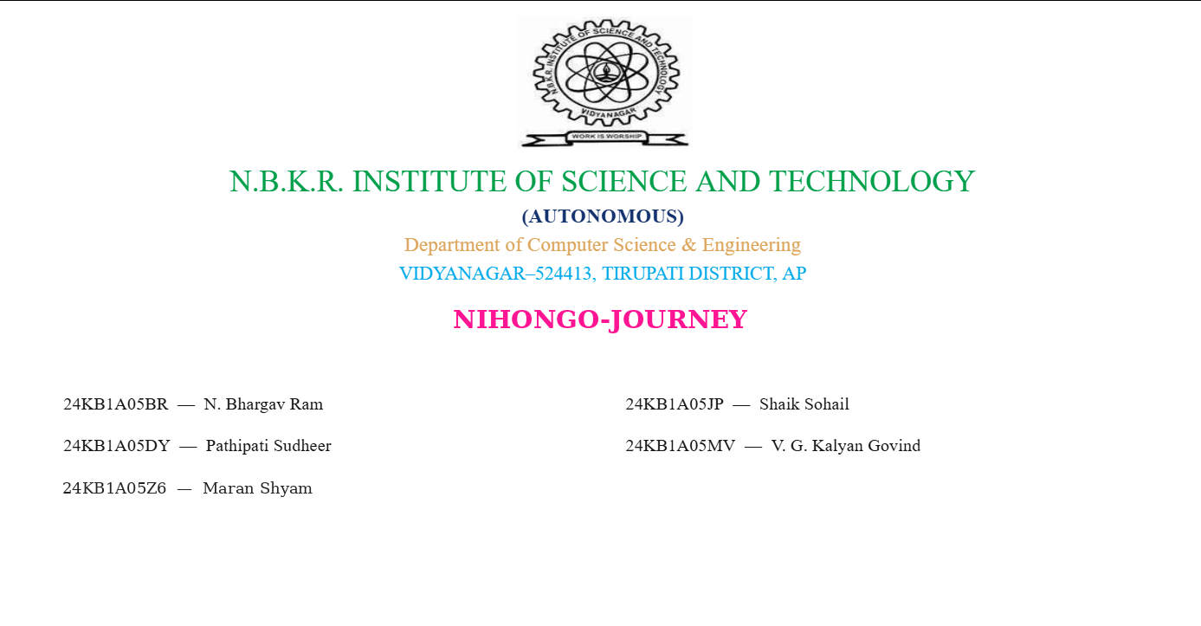

Slide 2
01 / INTRODUCTION
NIHONGO JOURNEY
Nihongo Journey: Project Overview
A website centered on Japanese language learning.
Project idea
Learning journey
Web access
Provide an online starting point for people interested in learning Japanese.
Present the experience through a dedicated website and organized navigation.
The project is deployed online and can be opened through a browser.
CORE CONCEPT
Make Japanese learning approachable, organized, and easy to begin.
Based on the public repository and live deployment.

Slide 3
02 / PROBLEM
NIHONGO JOURNEY
Problem Statement
A clear starting point can help learners approach Japanese study.
Getting started
Finding structure
Staying engaged
Japanese writing systems and unfamiliar language patterns may feel challenging to beginners.
Learners benefit when content and website sections are easy to navigate.
A dedicated web experience makes it convenient to revisit learning resources.
PROJECT GOAL
Present Japanese-learning content through a single, accessible web experience.

Slide 4
03 / FEATURES & MODULES
NIHONGO JOURNEY
Main Website Areas
High-level overview; confirm specific learning features on the deployed site.
Landing page
Navigation
Learning theme
Introduces Nihongo Journey and points users into the site.
Helps users move between the available pages and sections.
The project is focused on Japanese-language learning.
React interface
Page routing
Interface icons
Uses React to build the web user interface.
React Router is listed in the project dependencies.
Lucide React is included as an icon library.
Detailed lessons, account features, or saved progress are not claimed unless verified in the source.

Slide 5
04 / TECHNOLOGY
NIHONGO JOURNEY
Technology Stack
Identified from the repository's package.json.
React
Vite
Tailwind CSS
Builds the component-based user interface.
Provides frontend development and production build tooling.
Styling framework; its Vite plugin is listed.
React Router
Lucide React
Vercel
Supports client-side page navigation.
Icon library included as a dependency.
The project is deployed at a Vercel URL.
The repository lists React, React DOM, Vite, Tailwind CSS, React Router, and Lucide React. This deck does not assume a separate database or backend.

Slide 6
05 / REFERENCES & CONCLUSION
NIHONGO JOURNEY
References & Conclusion
Project source and live deployment.
SOURCE CODE
LIVE WEBSITE
GitHub repository
https://github.com/Shyam00070/nihongo-journey
Review src/, server/, package.json, and README.md.
https://nihongo-journey-psi.vercel.app/
Open the deployed site to explore the current interface.
References
Nihongo Journey presents a Japanese-learning theme through a browser-based experience built with modern frontend tools.
THANK YOU • QUESTIONS & SUGGESTIONS

Slide 7
CONCLUSION
NIHONGO JOURNEY
• Nihongo Journey offers a beginner-friendly way to explore Japanese language learning.
• Organized learning sections help users access lessons and practice in one place.
• The project demonstrates a clear learning experience built with modern web technologies.
• Future improvements can include quizzes, progress tracking, and additional learning resources.
PROJECT PRESENTATION

