Slide 1
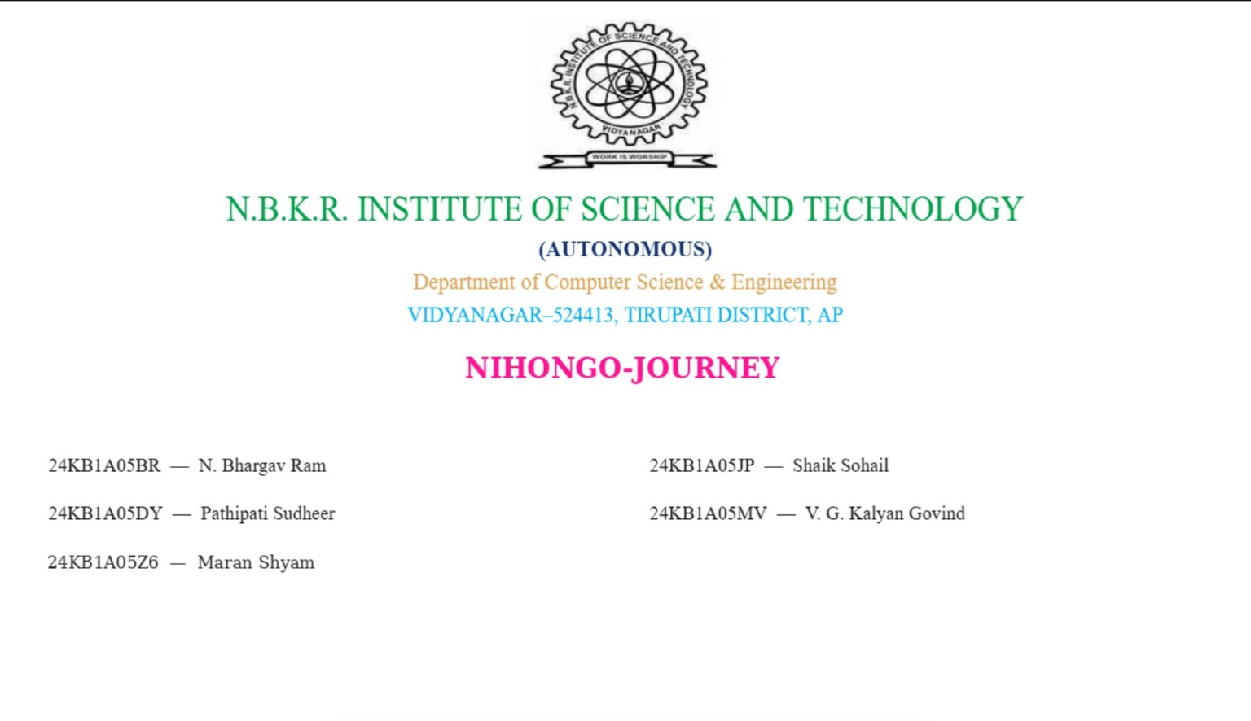
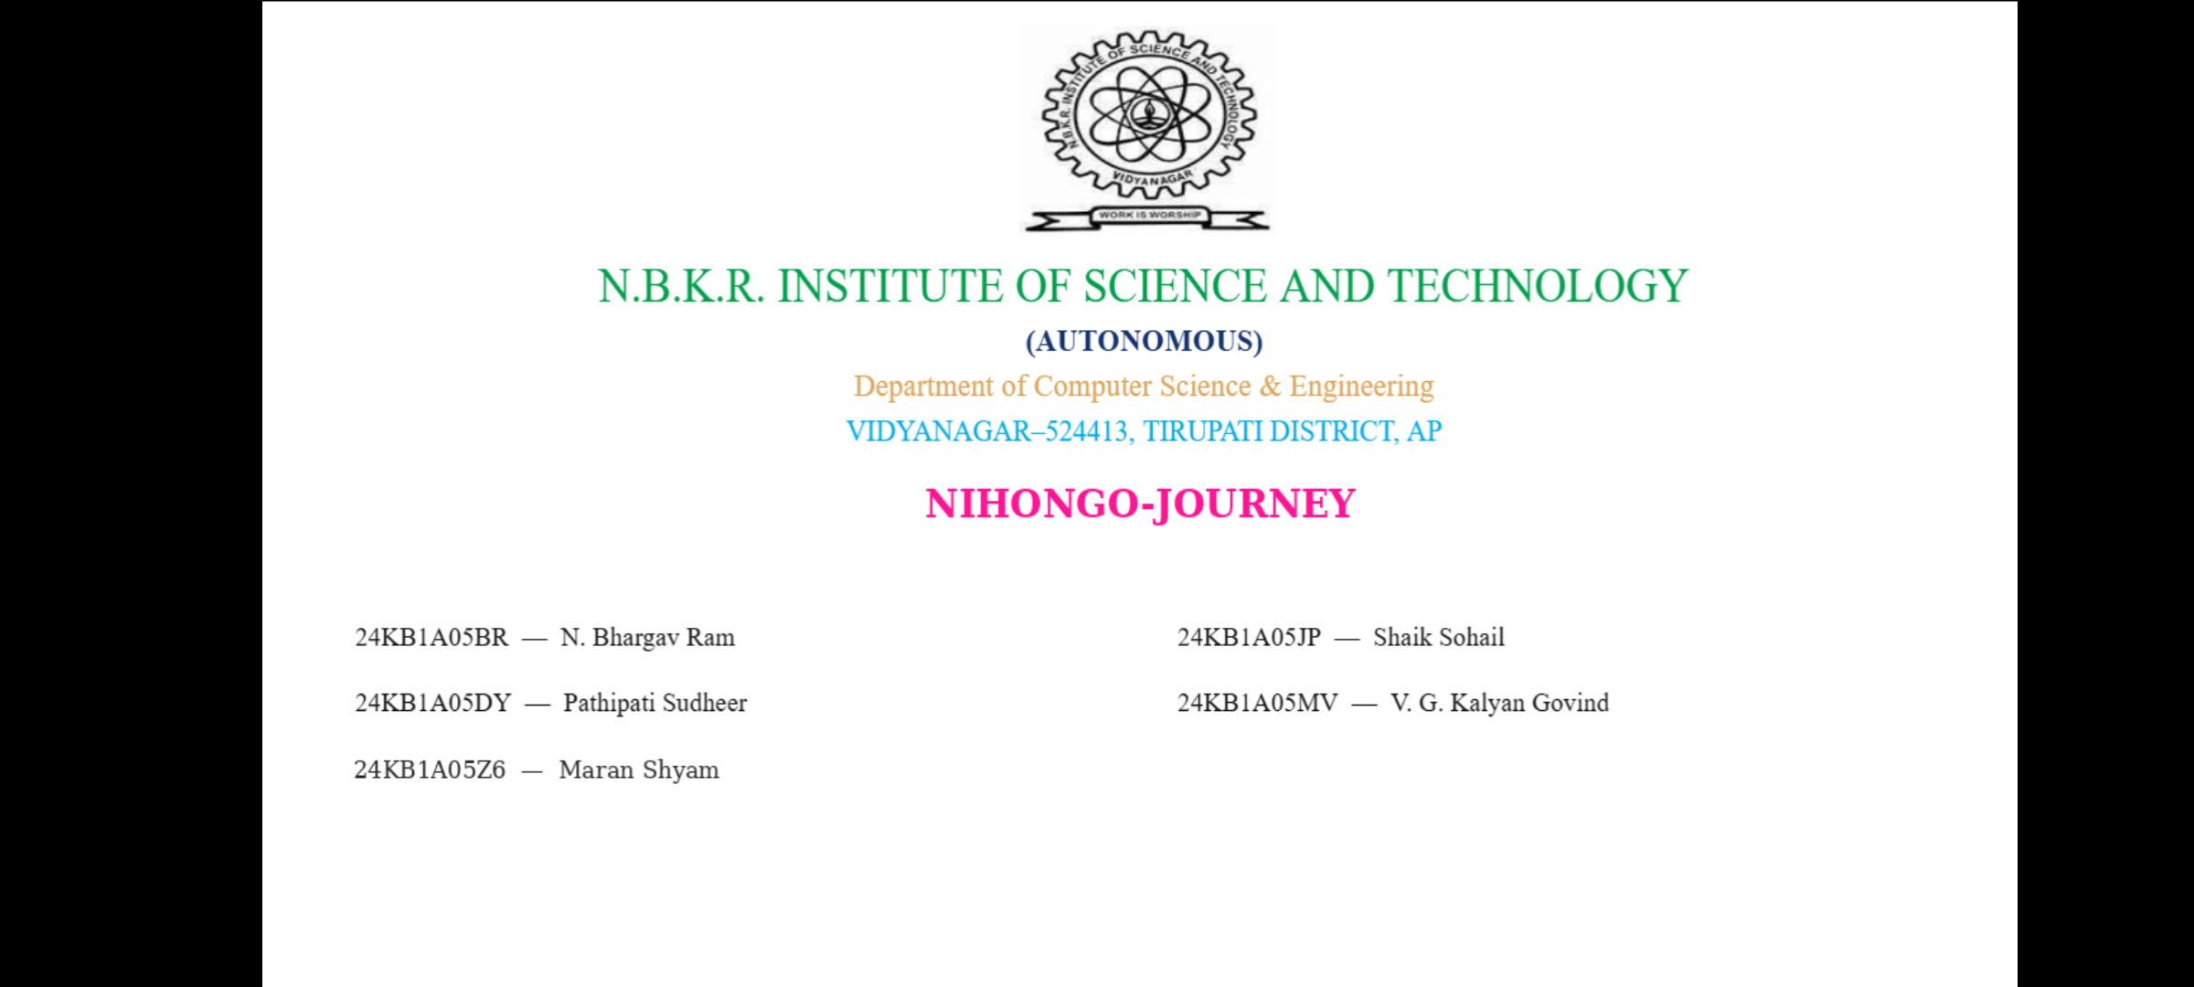

Slide 2
01 / OVERVIEW
What is Nihongo Journey?
A single place to study core Japanese language topics in a structured way.
The idea
LEARN
Learning Japanese can feel fragmented when learners use separate resources for different topics.
PRACTISE
Nihongo Journey brings grammar, vocabulary and kanji together under JLPT-based levels, starting with N5 and expanding to N4 and N3.
PROGRESS
NIHONGO JOURNEY • PROJECT PRESENTATION
02

Slide 3
02 / MOTIVATION
The problem
Learners often need to switch between multiple resources to cover the basics.
01
02
03
Scattered resources
Unclear learning path
Limited progress
visibility
Grammar, vocabulary and kanji
are studied in separate places.
Beginners may not know what
to study next or how topics connect.
It can be difficult to see what is
completed and what needs revision.
Project goal: make foundational Japanese study more organised and accessible.
NIHONGO JOURNEY • PROJECT PRESENTATION

Slide 4
03 / PROPOSED SOLUTION
One connected learning experience
Organise content by proficiency level and learning category.
N5
Beginner foundations
N4
Elementary expansion
N3
Lower-intermediate growth
Grammar • Vocabulary • Kanji
Grammar • Vocabulary • Kanji
Grammar • Vocabulary • Kanji
A consistent structure helps learners move from one level to the next.
NIHONGO JOURNEY • PROJECT PRESENTATION
04

Slide 5
04 / FEATURES
Core learning sections
The current platform focuses on the building blocks of Japanese.
あ
文
漢
Vocabulary
Grammar
Kanji
Learn words with readings
and meanings.
Study patterns and
example sentences.
Explore characters,
readings and meanings.
Content is grouped by JLPT level: N5, N4 and N3.
NIHONGO JOURNEY • PROJECT PRESENTATION
05

Slide 6
05 / TECHNOLOGY
Technology stack
A JavaScript-based full-stack architecture.
FRONTEND
React + Vite
User interface and client-side interactions
STYLING
Tailwind CSS
Responsive layout and visual design
BACKEND
Node.js + Express
REST API and server-side routes
DATABASE
MongoDB Atlas
Store structured Japanese learning content
NIHONGO JOURNEY • PROJECT PRESENTATION
06

Slide 7
06 / ARCHITECTURE
How the application works
The frontend requests learning content from the backend API.
Request
API call
Query
USER
FRONTEND
BACKEND
DATABASE
Learner
React + Vite
Express API
MongoDB
Response data flows back to the frontend and is displayed to the learner.
NIHONGO JOURNEY • PROJECT PRESENTATION
07

Slide 8
07 / DEMONSTRATION
Live project demo
Open the deployed application and walk through the main learning flow.
LIVE APPLICATION
Demo flow
• Open the homepage
• Choose a JLPT level
• Explore grammar or vocabulary
• Show how content is loaded
nihongo-journey-psi.vercel.app
Frontend deployment
Tip: test the deployed site before presenting and keep a backup screenshot.
NIHONGO JOURNEY • PROJECT PRESENTATION
08

Slide 9
08 / DEVELOPMENT
Challenges and learning
Building and deploying the project involved both frontend and backend problem-solving.
01
API integration
02
Database connection
Connecting React components to Express endpoints.
Configuring MongoDB Atlas and environment variables.
03
Deployment
04
Debugging
Deploying the frontend and backend separately.
Resolving incorrect paths, API URLs and build errors.
Key takeaway: debugging and deployment are important parts of real-world development.
NIHONGO JOURNEY • PROJECT PRESENTATION
09

Slide 10
09 / NEXT STEPS
Future enhancements
The next phase is to make learning more interactive and personalised.
Planned improvements
ありがとう
• User accounts and individual learning progress
• Quizzes and practice exercises
• Revision tools and spaced repetition
• More JLPT levels and richer learning content
• Video-based learning and real-world Japanese
Thank you!
Questions?
Nihongo Journey — making Japanese learning a clearer journey.
NIHONGO JOURNEY • PROJECT PRESENTATION
10

