Slide 1
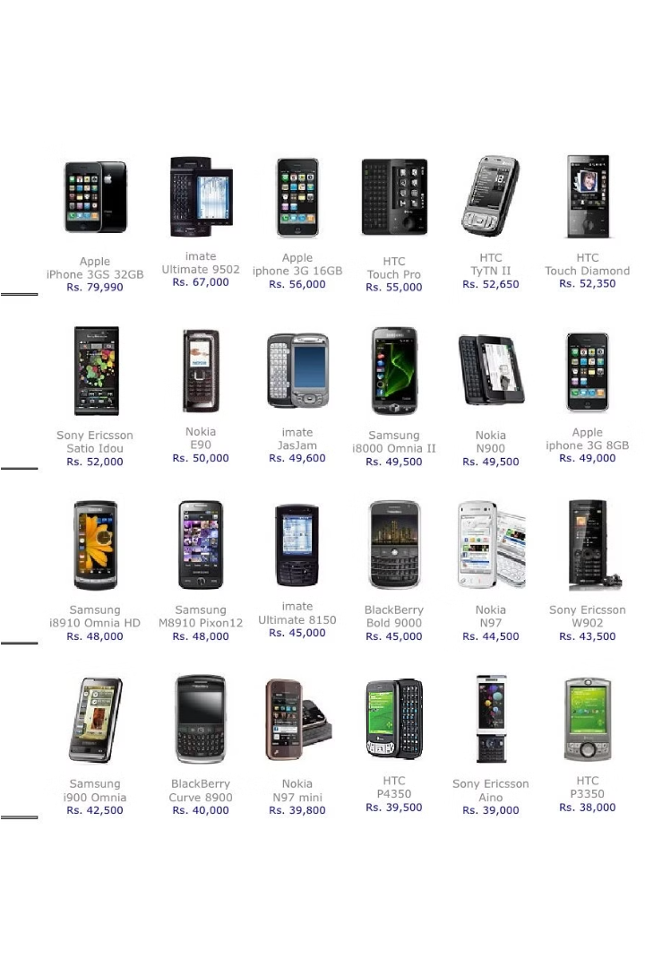

Mobile Price Classification with Logistic Regression
Explore the power of logistic regression in classifying mobile phone prices. Uncover hidden patterns and make informed pricing decisions for your mobile business.

Slide 2

Introduction to Mobile Pricing
Market Dynamics
Value Proposition
The mobile phone market is highly competitive, with numerous brands and models vying for consumer attention. Pricing strategies play a crucial role in a device's success.
Consumers consider various factors when selecting a mobile phone, including features, performance, and perceived value. Pricing must align with the phone's capabilities and target audience.
Segmentation
Mobile phone prices range from affordable entry-level devices to premium flagship models. Understanding market segmentation is key to developing effective pricing strategies.

Slide 3

Data Preprocessing and Feature Engineering
Identify and handle missing values in the dataset using appropriate techniques like imputation or dropping rows.
Encode categorical variables using techniques like one-hot encoding or label encoding to prepare them for the machine learning model.
Engineer new features from the existing data that may provide additional insights and improve the model's predictive power.

Slide 4

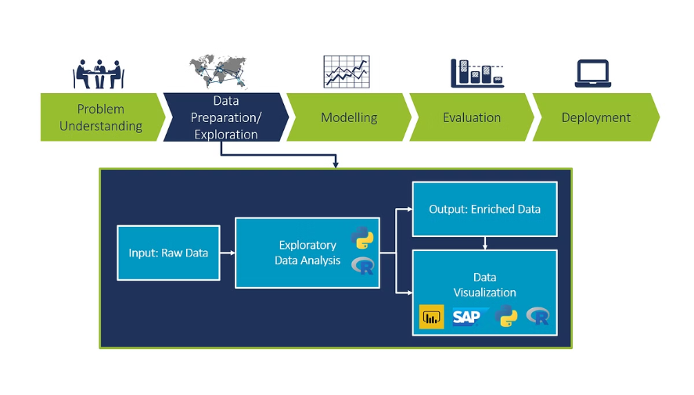
Exploratory Data Analysis (EDA)
In this phase, we delve deep into the dataset, uncovering insights and patterns that will guide our model development. We analyze the distribution of product prices, identify key features influencing pricing, and explore relationships between variables to inform our feature engineering efforts.

Slide 5
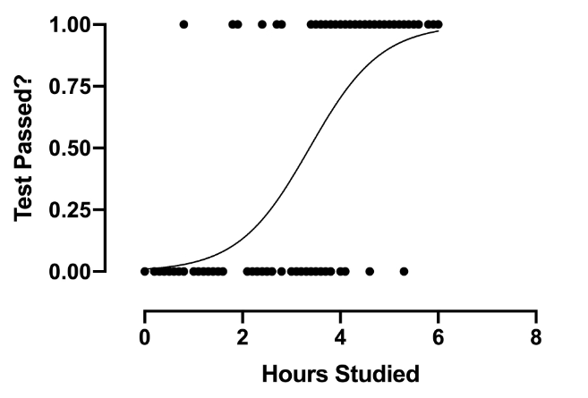
Logistic Regression Model
Logistic regression is a powerful machine learning algorithm widely used for binary classification tasks. It models the probability of a binary outcome as a function of one or more predictor variables.
The logistic regression model learns the relationship between the input features and the target variable, enabling accurate predictions of mobile phone price categories.

Slide 6
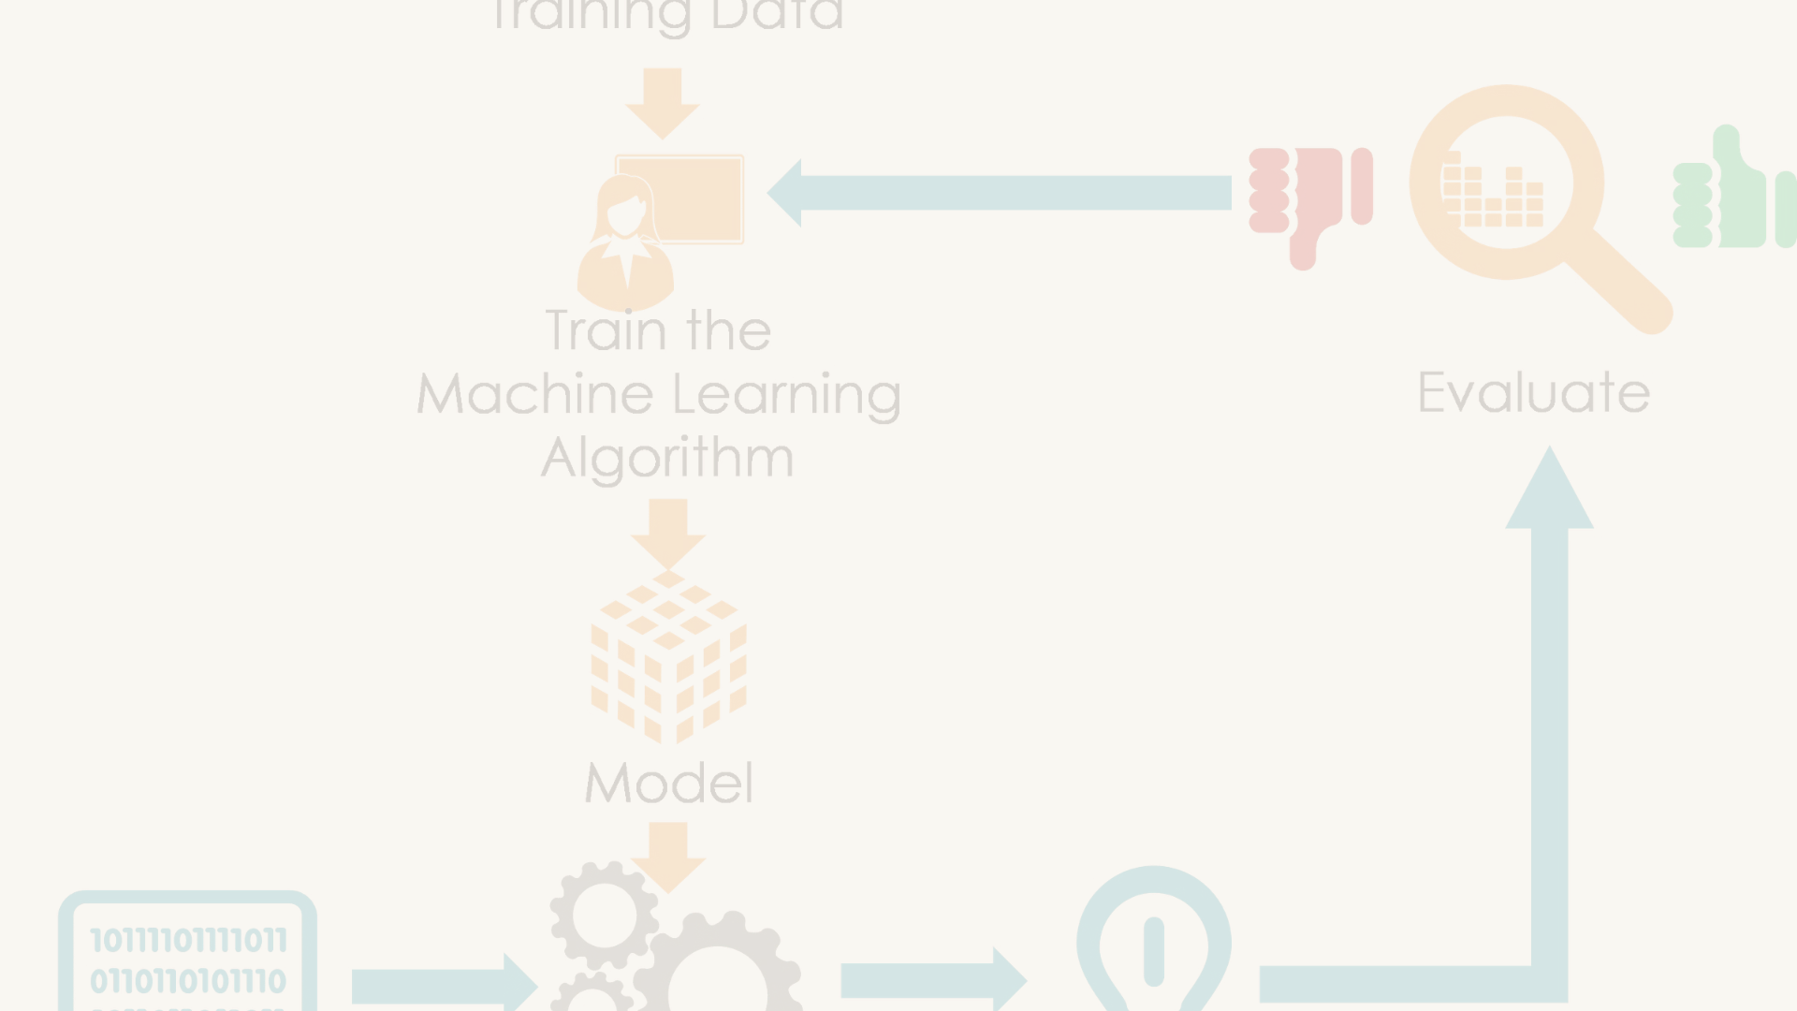



Model Training and Evaluation
Splitting the Data
Training the Logistic Regression Model
Evaluating Model Performance
Divide the dataset into training and testing sets to evaluate the model's performance on unseen data.
Fit the logistic regression model to the training data, allowing it to learn the patterns and relationships in the features.
Assess the model's accuracy, precision, recall, and F1-score on the testing set to understand its predictive capabilities.

Slide 7
Hyperparameter Tuning
1
Identifying Key Hyperparameters
2
Grid Search Cross-Validation
Systematically evaluate different combinations of hyperparameter values using a grid search approach to find the optimal configuration.
Determine the most influential hyperparameters for your logistic regression model, such as the regularization strength, learning rate, and number of iterations.
3
Randomized Search Optimization
4
Bayesian Optimization
Use a more sophisticated approach like Bayesian optimization to intelligently guide the hyperparameter search and converge on the best settings.
Explore the hyperparameter space more efficiently by randomly sampling combinations, which can be more effective than exhaustive grid search.

Slide 8




Handling Imbalanced Datasets
Class Imbalance
Resampling Techniques
Algorithmic Approaches
Evaluation Metrics
Many real-world datasets have an unequal distribution of classes, leading to biased models. Addressing this is crucial for accurate predictions.
Methods like oversampling the minority class or undersampling the majority class can help balance the dataset and improve model performance.
Some algorithms, like Cost-Sensitive Learning, are designed to handle imbalanced data by assigning higher weights to the minority class.
For imbalanced datasets, accuracy may not be the best metric. F1-score, precision, and recall can provide more meaningful insights.

Slide 9

Deployment and Real-world Application
Model Deployment
1
Once the logistic regression model is finalized, it can be deployed as a web service or integrated into a mobile app to classify the prices of new mobile devices in real-time.
2
User Interface
The deployed model can be accessed through a user-friendly interface, allowing customers to input the specifications of a mobile device and receive an immediate price classification.
Ongoing Monitoring
3
Regular monitoring and updating of the model are crucial to ensure its continued accuracy and relevance as new mobile devices are released and market trends evolve.

Slide 10


Conclusion and Future Considerations
In this presentation, we have explored the power of logistic regression in classifying mobile phone prices. By meticulously preprocessing the data, engineering informative features, and training a robust model, we have demonstrated the potential of this approach to unlock valuable insights in the mobile pricing landscape.
As we look to the future, there are several exciting avenues to further enhance this model. Incorporating additional data sources, such as market trends and consumer preferences, could refine the predictions and unlock deeper understanding. Exploring advanced hyperparameter tuning techniques could also optimize the model's performance, ensuring it remains at the forefront of the industry.

