Slide 1
Keylogger and security
CAPSTONE PROJECT
Presented By:
Shyam Kumar M - College of Engineering Guindy, Anna University- Department of Information Science and Technology

Slide 2
OUTLINE
Problem Statement
Proposed System/Solution
System Development Approach
Algorithm & Deployment
Result (Output Image)
Conclusion
Future Scope
References

Slide 3
Problem Statement
In our modern era dominated by digital advancements, the pervasive threat of cybersecurity breaches continues to escalate, with one particularly insidious danger being the rampant spread of keyloggers. These stealthy software entities operate covertly, clandestinely monitoring and logging every keystroke made on a user's device without their awareness or consent. This clandestine behavior poses a significant hazard to both individuals and businesses alike, as it enables the surreptitious capture of sensitive data including passwords, financial information, and other confidential details. The ramifications of such breaches extend far beyond mere inconvenience, encompassing the specters of identity theft, financial ruin, and profound violations of personal privacy.

Slide 4
Proposed Solution
Error Handling: Implement try-except blocks around file operations to catch and handle exceptions gracefully. Provide informative error messages to users in case of file operation failures or keylogging errors.
Modularization: Divide the code into smaller functions, each responsible for a specific task such as initializing keylogger, logging keystrokes, handling file operations, etc. Use modular design to improve code readability and maintainability.
File Writing Optimization: Keep log files open during the keylogging process to reduce overhead associated with opening and closing files repeatedly. Utilize buffered writing techniques to improve file writing performance.
JSON Usage: Correct syntax errors in the JSON file generation function to ensure proper formatting of log data. Validate JSON output to ensure compliance with standards.
User Interface: Enhance UI with clear and user-friendly messages to provide feedback on keylogging status, error handling, and other operations. Include descriptive prompts and instructions to guide users through the keylogging process.

Slide 5
GUI Improvements: Implement features such as log file location selection within the graphical user interface to offer flexibility to users. Allow users to customize keylogging settings such as log file format, logging duration, etc., through the GUI.
Keylogging Features: Integrate options for filtering keystrokes based on specific criteria such as application name, window title, or keystroke type. Provide customization options to users for configuring which keystrokes to log and which to exclude.
Security: Include privacy warnings and disclaimers to inform users about the potential risks associated with keylogging. Ensure that the keylogger is used ethically and legally, with appropriate consent from users where required.
Compatibility Testing: Test the keylogger on various operating systems (e.g., Windows, macOS, Linux) to ensure compatibility and functionality across different platforms. Address any platform-specific issues or dependencies to ensure a seamless user experience.
Documentation: Add inline comments and documentation to explain the purpose and functionality of each function and module. Include usage examples, configuration options, and troubleshooting tips to assist users in understanding and utilizing the keylogger effectively.

Slide 6
System Approach – WATERFALL MODEL
Analysis:
Understand requirements and review existing code.
Identify potential vulnerabilities and areas for improvement
Design:
Define clear objectives for enhancing security and usability.
Plan architectural changes to mitigate vulnerabilities
Implementation:
Refactor code, optimize file operations.
Testing:
Perform compatibility and functionality testing.
Deployment:
Package code, provide clear instructions.
Maintenance:
Monitor feedback, address issues, and update code.

Slide 7
Algorithm & Deployment
Algorithm:
Initialization:
Initialize variables to store pressed keys, hold status, and key sequence.
Key Press Event:
Record pressed keys with "Pressed" label.
If key held, record with "Held" label.
Key Release Event:
Record pressed keys with "Pressed" label, if held, record with "Held" label, and generate JSON file..
Start Keylogger Function:
Initialize keyboard listener, update UI, and manage button states.
Stop Keylogger Function:
Stop keyboard listener, Update UI to indicate status.
Manage button states.

Slide 8
Algorithm & Deployment
Deployment:
Packaging:
Bundle application and dependencies.
Include configuration files and documentation.
Distribution:
Distribute via website, repositories, or physical media.
Installation:
Provide clear installation instructions.
Ensure compatibility across platforms.
Configuration:
Allow user customization of settings.
Security Considerations:
Implement measures to protect against unauthorized access.

Slide 9
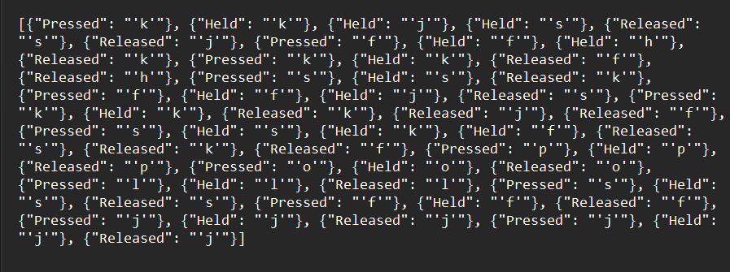

Result
Key_log.json
Key_log.txt

Slide 10
Conclusion
As the landscape of technology evolves, the role of keyloggers remains both significant and contentious. While they offer potential benefits in cybersecurity and parental control, their capacity to infringe upon privacy and security raises ethical concerns. As we navigate the complexities of the future, striking a delicate balance becomes paramount. It is imperative to advocate for ethical use, ensuring that keyloggers are employed only for legitimate purposes with clear user consent. Moreover, robust security measures must be implemented to safeguard captured data from unauthorized access. Transparency regarding monitoring practices involving keyloggers is essential to maintain trust and uphold ethical standards. As public awareness about keyloggers continues to grow, so too will the scrutiny surrounding their ethical considerations and potential misuse. Thus, it is incumbent upon stakeholders to remain vigilant, adapt to evolving regulations, and prioritize ethical conduct in the utilization of keyloggers.

Slide 11
Future scope
Increased Demand:
Potential for growth in cybersecurity and parental control.
Technological Advancements:
Malware developers may create more sophisticated keyloggers.
Keyloggers might be integrated into hardware for stealth.
Cloud-based logging could pose new privacy challenges.
Legal and Ethical Concerns:
Stricter privacy regulations may limit keylogger use.
Emphasis on transparency and user consent will rise.
Future Outlook:
Balance needed between utility and ethical user protection.
Public awareness about keyloggers is likely to increase.
Regulations around keylogger use may become stricter.

Slide 12
References
C. Silver, "Keylogging and User Privacy," Association for Computing Machinery, 2013.
K. C. Yang, "An Improved Keylogging Detection and Prevention System," IEEE Xplore, 2017. [Online].
M. Deshmukh, "Detecting Keylogger Attacks Using Machine Learning Techniques," International Journal of Advanced Research in Computer Science, 2017.
G. Kaspersky, "How to Protect Yourself Against Keyloggers," Kaspersky, 2021.
A. Carvey, "Forensic Analysis of Keystroke Dynamics," SANS Institute, 2005. [Online].

Slide 13
THANK YOU

