Slide 1
Group-62
Topic-Property Finder Application
2130-Pranav Vispute
2115-PANCHVISHE SHYAM SIDDESHWAR

Slide 2
Objective
Non Commercial property for Rent
Sell Non Commercial
Buy Property

Slide 3
Feature
Buy
Non Commercial –Flat(1BHK,2BHK,3BHK,4BHK), Bungalow,
Villa, Plots
Rent
Non Commercial –Flat(1BHK,2BHK,3BHK,4BHK), Bungalow,
Villa, Plots
Sell
Non Commercial –Flat(1BHK,2BHK,3BHK,4BHK), Bungalow,
Villa, Plots

Slide 4
Technologies
Backend : Spring Boot
Database : MySQL
User Interface Design : React js
Web Browser : Mozilla, Google Chrome,

Slide 5
Module
home module
Login /Signup module
category module-Buy,Sell,Rent
Property Search Module
Property upload Module-Sell
Property Details By Card

Slide 6
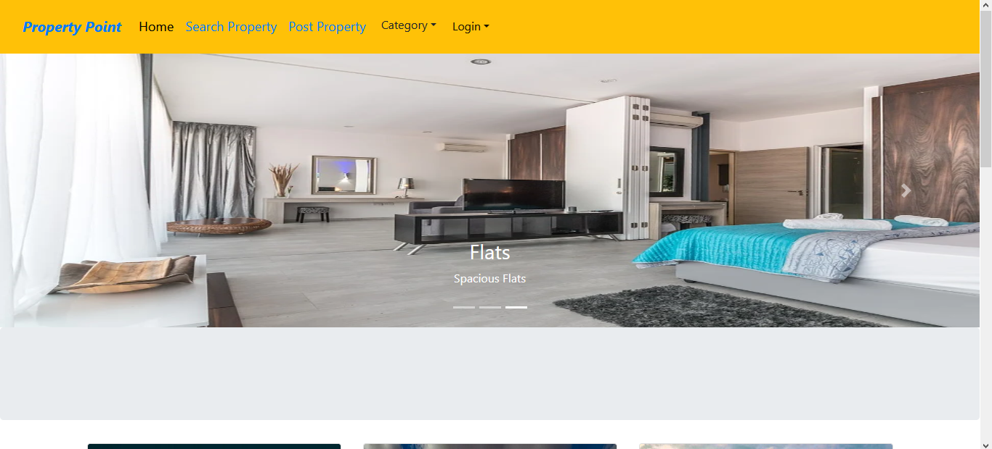
Home page

Slide 7
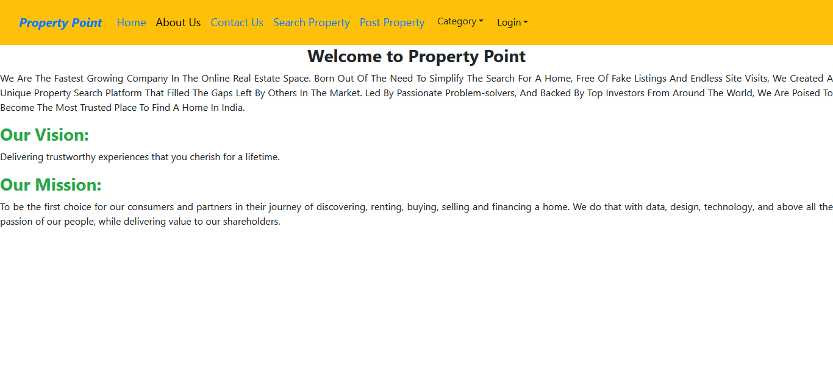
About Us

Slide 8
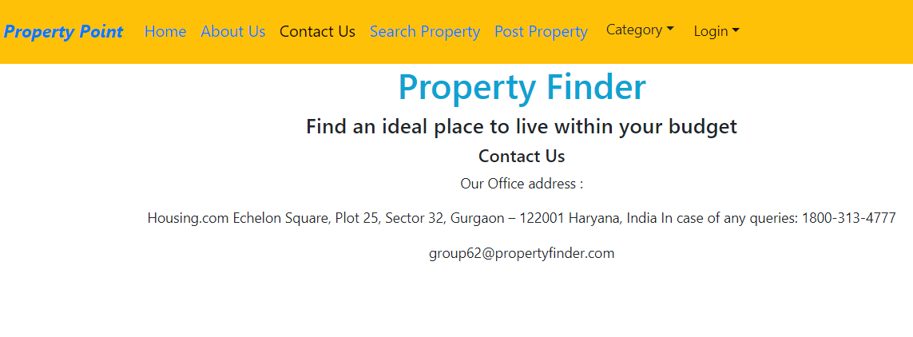
Contact us

Slide 9
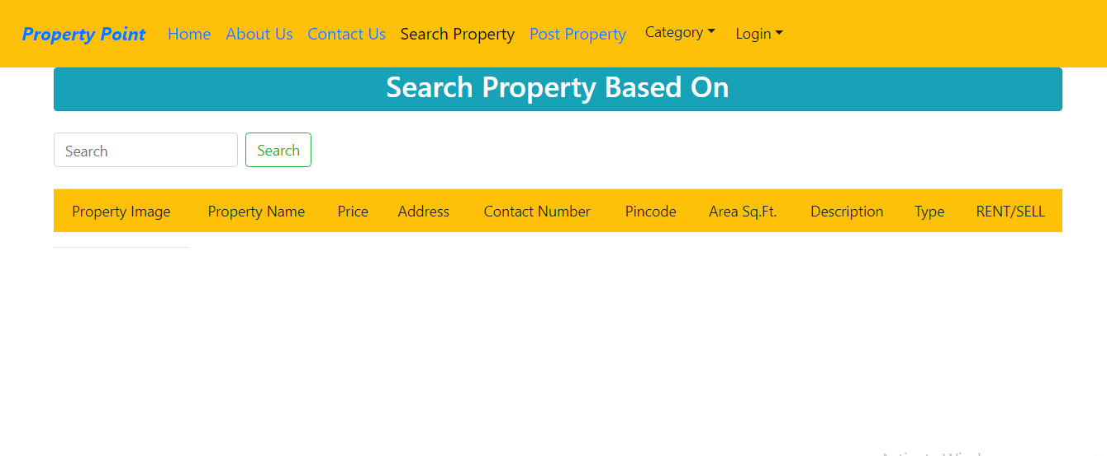
Search Property

Slide 10
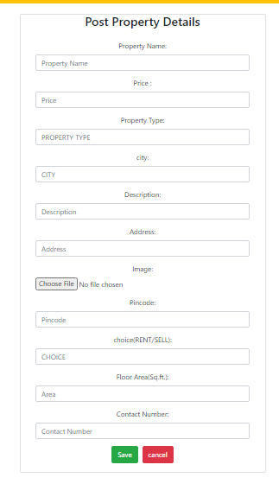
Post Property

Slide 11
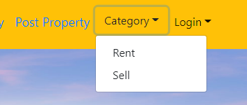
Sort By Rent And Sell

Slide 12
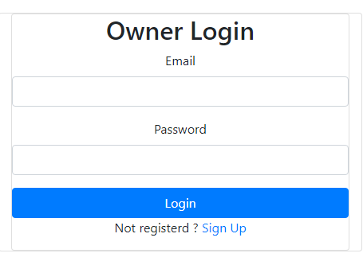
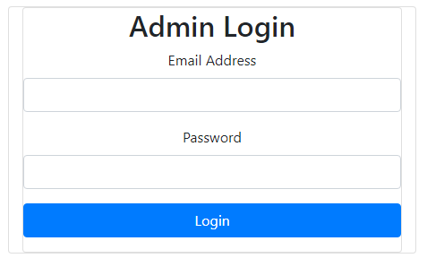
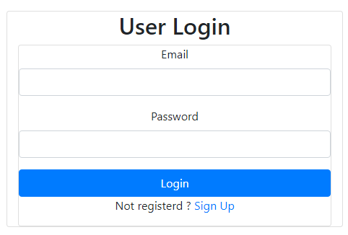
Login

Slide 13
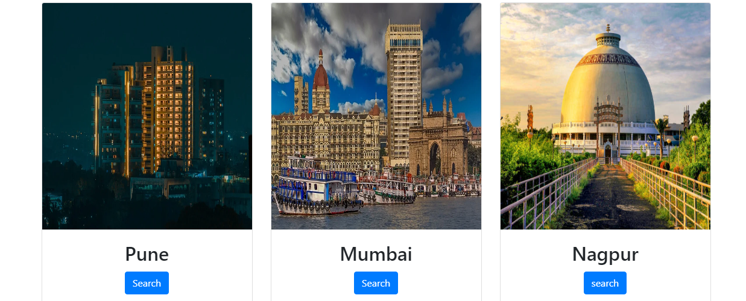
City Card to Property

Slide 14
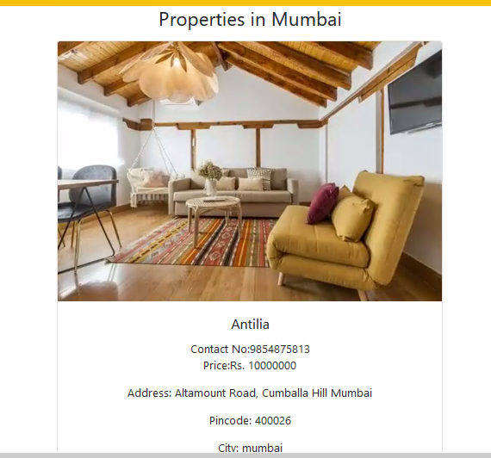
Display Property

Slide 15
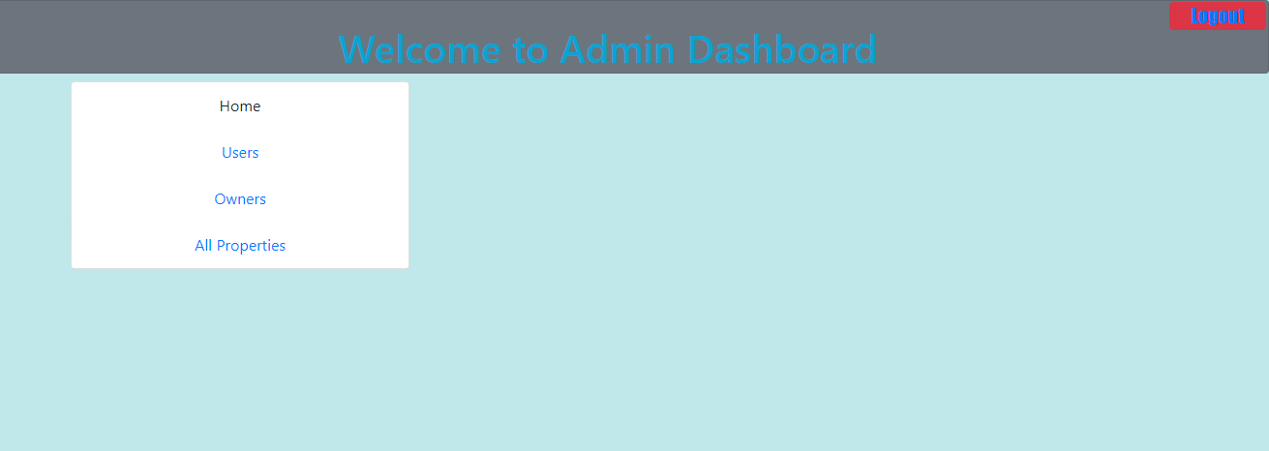
Admin Dashboard

Slide 16
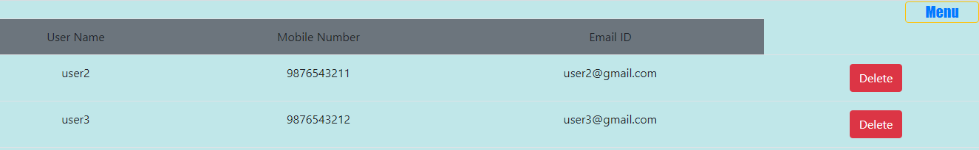
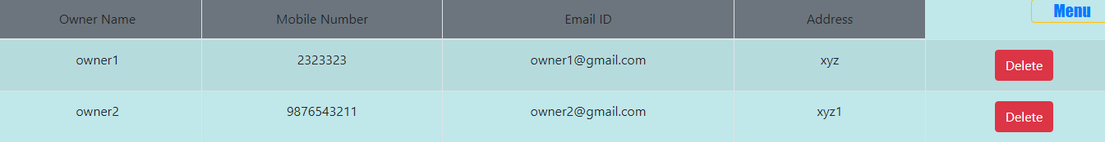
List Of User And owner in Admin Dashboard

Slide 17
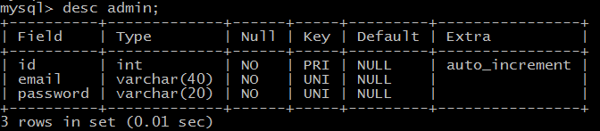
Admin Table

Slide 18
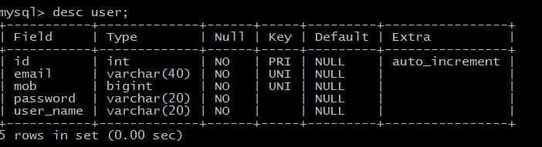
User Table

Slide 19
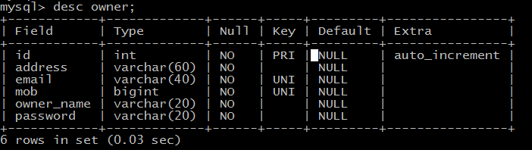
Owner Table

Slide 20
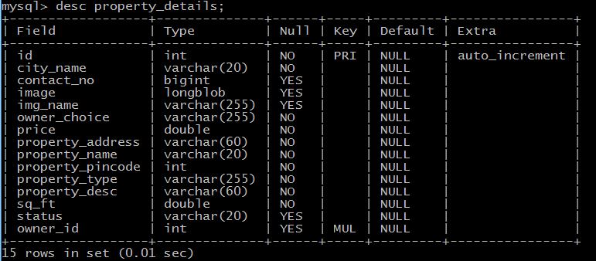
Property Details Table

Slide 21
FUTURE ENHANCEMENTS:
This application avoids the manual work and the problems concern with it. It is an easy way to obtain the information regarding the various property information
Well we have worked hard in order an improved website better than the existing one’s regarding the information about the various activities. Still ,we found out that the project can be done in a better way. Primarily, when we request information about a particular property it just shows the detail of property available. So, after getting the information we can get contact with owner of property and they discuss.
The next enhancement that we can add the commercial property and PG system for students These are the two enhancements that we could think of at present. And we can add the security guard for the security purpose

Slide 22


