Slide 1
Superstore Sales Dashboard
Power BI Dashboard with KPIs, Time-Series, and Interactivity

Slide 2
Project Overview
This Power BI dashboard provides insightful visualizations using the Superstore Sales dataset. It highlights key performance indicators (KPIs) such as Total Sales, Cost, and Year-over-Year Sales Growth. The dashboard supports interactive filtering through slicers and includes a time-series analysis to monitor trends over time.

Slide 3
Preparing the Sales/Financial Dataset
Order Date: Date when the sale occurred.
Sales: Amount of sales generated.
Profit: Profit made from the sale.
Region: Region of the sale.
Category/Product: Product category or individual products sold.
Customer: Customer details (if available).
DataSet Link
https://www.kaggle.com/datasets/rohitsahoo/sales-forecasting/data

Slide 4
1. Choosing the Right KPIs (Key Performance Indicators)
Sales KPIs:
Total Sales: Overall revenue generated.
Total Profit: Profit after subtracting costs.
YoY Growth (Year-over-Year Growth): Compare the sales/profit of the current year to the previous year to measure growth
Other KPIs:
Sales by Region: Helps in identifying which regions are performing well.
Top-Selling Products: Understanding which products are driving the most sales.
Customer Retention Rate: Indicates how many customers are returning.

Slide 5
KPIs Created
Total Sales: SUM of Sales column
Total Cost: Created using calculated column
DAX: Cost = Sales * 0.6
Profit: Created using calculated column
DAX: Profit = Sales - Cost
YoY Sales Growth: Created using measure
DAX: Sales YoY Growth = VAR CurrentYear = CALCULATE(SUM(Sales), YEAR(Order Date))
VAR PreviousYear = CALCULATE(SUM(Sales), SAMEPERIODLASTYEAR('Order Date'))
RETURN DIVIDE(CurrentYear - PreviousYear, PreviousYear)

Slide 6
Slicers and Filters
Slicers were added for the following fields to allow interactivity:
• Region
• Segment
• Order Date (Year, Quarter, Month)
• Ship Mode
These filters allow users to explore trends and performance metrics for specific subsets of data.

Slide 7
a.Time-Series & Summary Cards
Time-Series visualizations were created using line charts and bar charts based on Order Date.
Cards were added for key metrics such as Total Sales, Total Profit, and YoY Growth for easy insights.
These cards update dynamically based on slicer inputs, providing real-time metric updates.
Navigation buttons were added to switch between the Overview Page and Detailed View.
The layout follows a clean grid structure ensuring readability and clarity of metrics.
Bar charts: Show sales by region, product category, or other segments.
Line charts: Plot sales and profit over time (e.g., monthly or yearly).

Slide 8
Dashboard Design and Navigation
b. Cards for Totals/Summary:
Total Sales: Display total sales in a card format.
Total Profit: Display total profit.
YoY Growth: Show Year-over-Year growth percentage.
c. Interactivity with Slicers/Filters:
Use slicers (filters) to allow the user to choose time periods, regions, or product categories. This will dynamically update the line charts, bar charts, and cards.
Example: Date Filter, Region Filter, Product Category Filter.
d. Navigation Menu (Optional):
Create a simple navigation menu if your dashboard has multiple views. For example:
Overview
Sales by Region
Top Products
Year-over-Year Growth

Slide 9
e. Consistent Color Theme:
Use consistent colors for charts and cards to create a cohesive design. You can use brand colors or standard color schemes (e.g., blue for sales, green for profit).
Color Contrast: Ensure that the colors are easily distinguishable and readable.
f. Additional Visualizations:
Heatmaps for regions with the highest sales.
Scatter Plots for identifying trends between sales and profit.
Pie Charts for sales distribution by product category.

Slide 10
DAX Measures Used in Dashboard
**Key DAX Measures and Calculated Columns:**
- **Total Sales** = SUM(Sales)
- **Total Cost** = SUM(Cost)
- **Profit** = [Total Sales] - [Total Cost]
- **Sales YoY Growth** =
```DAX
Sales_YoY =
VAR CurrentYear = MAX('Orders'[Year])
VAR LastYear = CurrentYear - 1
VAR CurrentSales = CALCULATE([Total Sales], 'Orders'[Year] = CurrentYear)
VAR LastYearSales = CALCULATE([Total Sales], 'Orders'[Year] = LastYear)
RETURN DIVIDE(CurrentSales - LastYearSales, LastYearSales, 0)
```
- **Avg Sales per Order** = AVERAGE(Sales)
- **Year and Month Columns** were derived using Power BI's date functions for time-series analysis.

Slide 11
Visual Interactivity & Design Elements
**Slicers and Filters:**
- Region, Segment, Order Date, and Ship Mode slicers were added.
- These enable users to filter KPIs, charts, and trends interactively.
**Design Elements:**
- Consistent color theme (Blues, Greys, White) for a professional look.
- Summary Cards with Total Sales, Profit, and Average Sales.
- Line and bar charts for YoY trend visualization.
- Navigation Buttons added to switch between overview and detailed views.

Slide 12
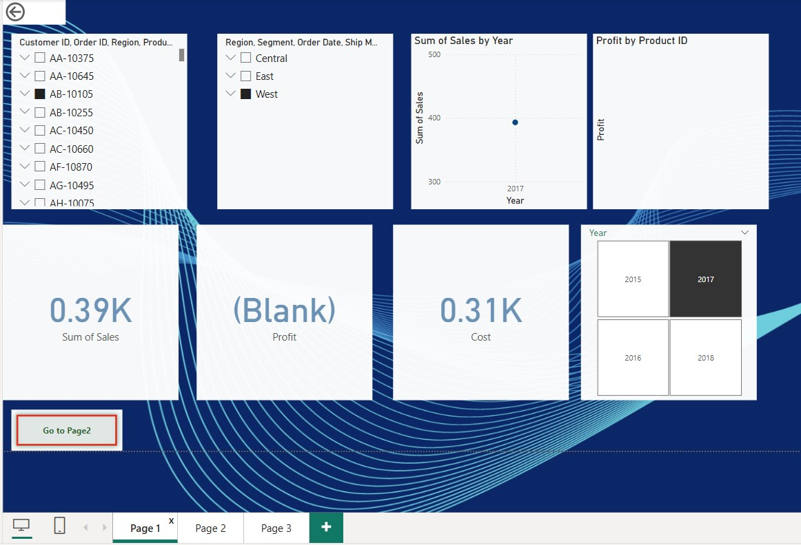

Slide 13
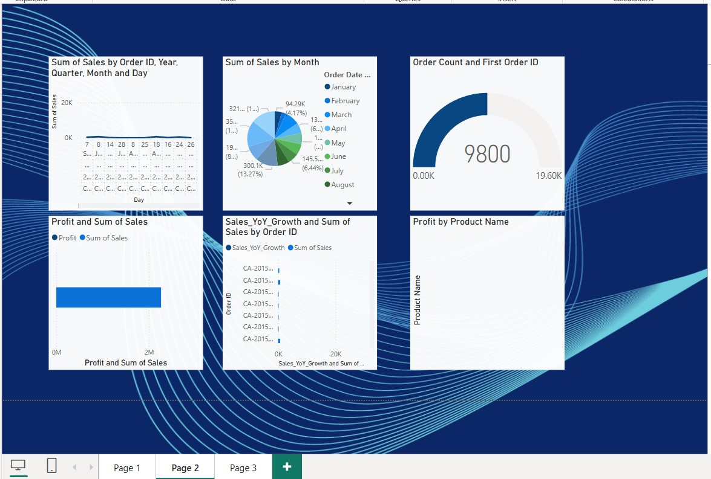

Slide 14
