Slide 1
Retail Customer Behavior & Sales Intelligence
End-to-end Data Analytics Portfolio
Python • SQL • Power BI • Excel • GitHub
Prepared by Shyam Sundar

Slide 2
Business Problem
Understand what drives retail purchase value.
Identify high-value categories, products and customer segments.
Evaluate subscriptions, discounts, shipping and payment behavior.
Convert raw data into decision-ready insights.

Slide 3
Data & Quality
3,900 records | 3,900 unique customer IDs
37 missing review ratings handled with median imputation
No duplicate rows found.
Derived features: age group, customer segment, discount flag, promo flag.

Slide 4
Python / EDA Findings
Total recorded revenue: $233,081
Average order value: $59.76
Average review rating: 3.75
Discount usage: 43.0%

Slide 5
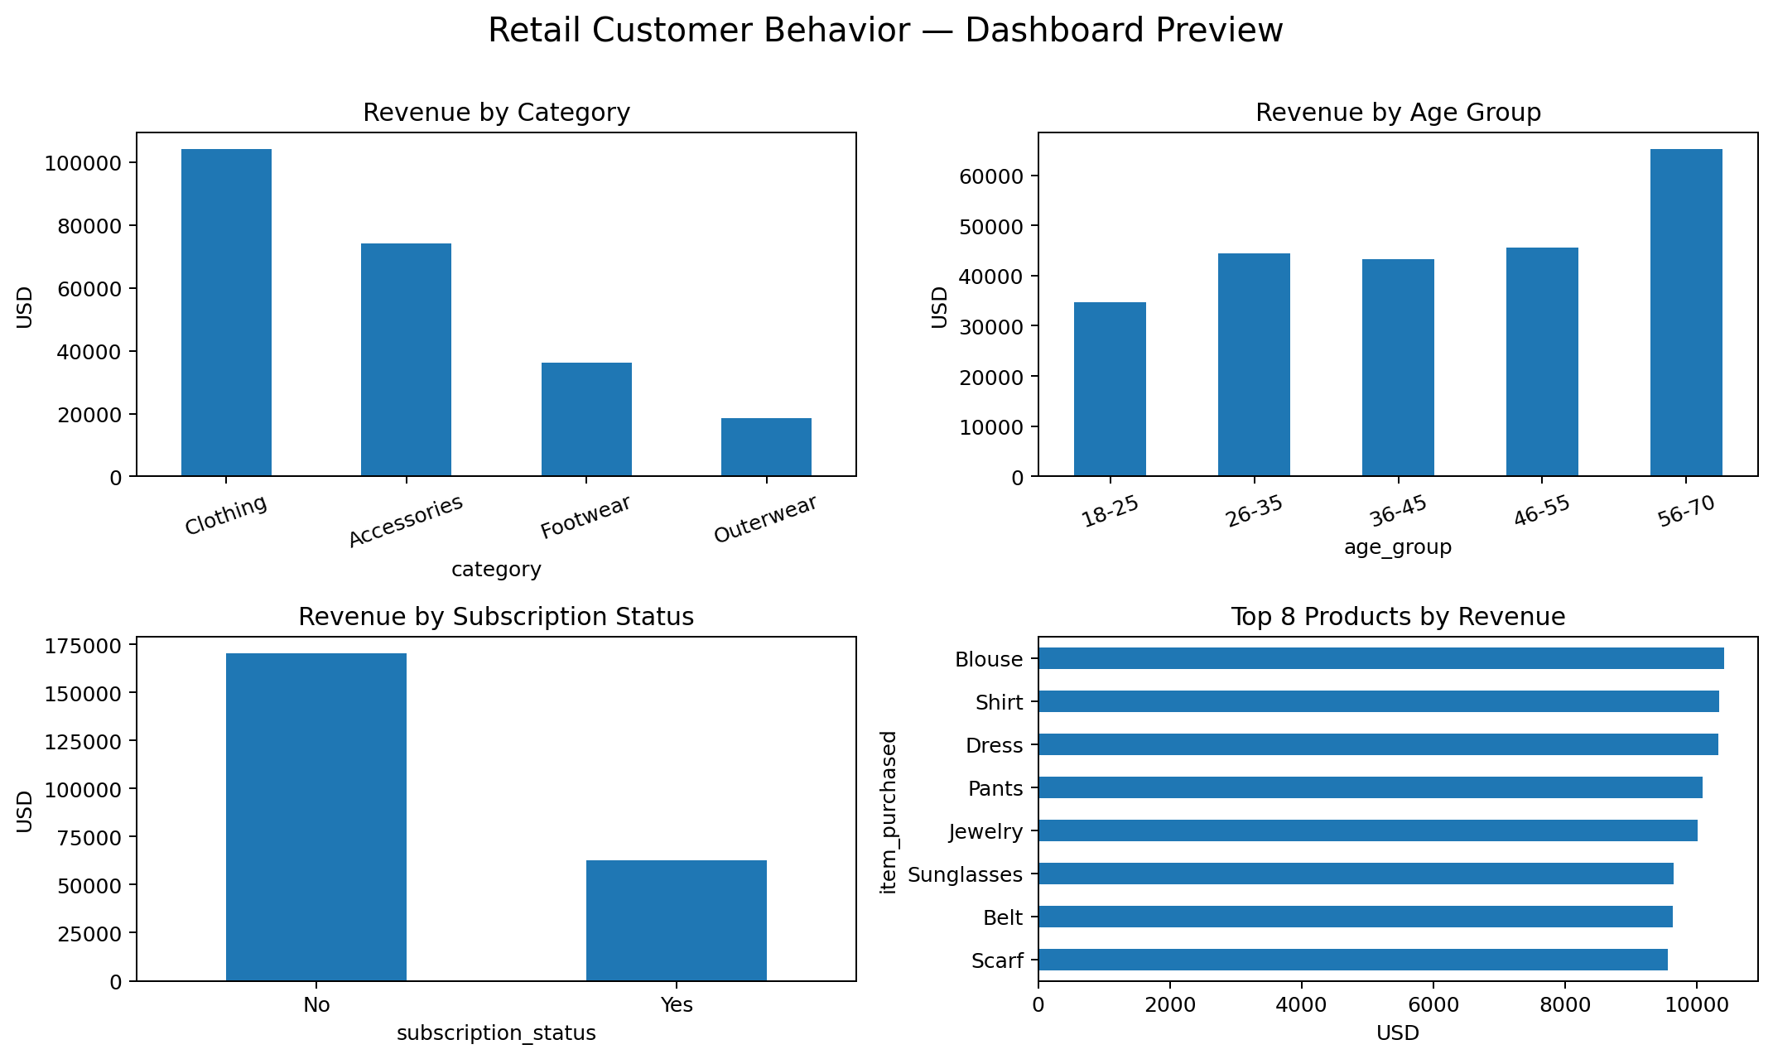
Power BI Dashboard Preview

Slide 6
SQL Analysis
Category revenue and order performance
Subscriber vs non-subscriber comparison
Discount-rate analysis by product
Customer segmentation with CASE
Top products by category using ROW_NUMBER()
Age-group revenue contribution

Slide 7
Key Business Insights
Clothing is the largest revenue category at $104,264.
The 56–70 group contributes $65,256.
Loyal customers form the largest segment under the defined purchase-history rule.
Discount usage is substantial and should be monitored for margin impact.

Slide 8
Limitations & Next Steps
No transaction date: do not claim monthly or weekly sales trends.
Future version: add validated dates, costs/margins, channels and customer acquisition data.
Potential extensions: cohort retention, CLV, RFM segmentation and promotion ROI.

Slide 9
Portfolio Deliverables
Python notebook + cleaning script
PostgreSQL SQL analysis
Power BI dashboard build guide + DAX measures + theme
Excel analysis workbook
Business problem + project report
GitHub-ready README and folder structure

