Slide 1
DATA SECURITY FOR FILE TRANSMISSION

Slide 2
INTRODUCTION
The project titled “Data Security for File Transmission ” is mainly designed for providing security during transmission of data across the network. In this the sender encrypts the data in to some form by using “Tiny Encryption Algorithm” . This algorithm has been used because it requires less memory. While encrypting the data in to some form, the key file is entered by the sender. The purpose of the key file is to provide security to the system as it is known only to the sender and the receiver.

Slide 3
Contd….
The encrypted data will embed with a video file by using the concept of steganography. So whenever the hacker tries to open the file, only video file is visible to them. Then this video file is sent to the network. The receiver will receive the video file from the network. Then the receiver will de-embed the encrypted data from the video file. The application of decryption is only done when the receiver of the data enters the proper key. Thus the data is transferred from sender to receiver in a secured manner.

Slide 4
Requirements
User Requirements
In order to use the project, the user must be acknowledged with minimum requirements such as extension file to be used, specifying proper key and contain required inputs.
Software Requirements
Operating system : Linux 4.2.1.6/windows XP
Platform : Java J2 SDK 1.5
Hardware Requirements
RAM : 512MB
Hard Disk : 40GB
Processor : Pentium D CPU 3.00GHZ
Monitor : CRT/LCD color Monitor

Slide 5
Tiny Encryption Algorithm
The Tiny Encryption Algorithm (TEA) is a cryptographic algorithm designed to minimize memory usage and maximize speed.
It is a Symmetric block cipher. TEA seems to be highly resistant to differential cryptanalysis, and achieves complete diffusion (where a one bit difference in the plaintext will cause approximately 32 bit differences in the cipher text) after only six rounds.
Time performance on a modern desktop computer or workstation is very impressive.

Slide 6
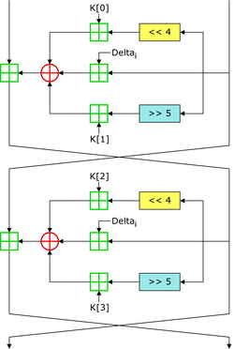
Diagrammatic Representation of TEA

Slide 7
Steganography
Steganography is an art and science of hiding information within other information. The word itself comes from Greek and means hidden writing.
In recent years cryptography become very popular science. As steganography has very close to cryptography and its applications.
Cryptography is about concealing the content of the message. Steganography goes a step further and makes the ciphertext invisible to unauthorized users.

Slide 8
Conclusion
Implementation of Tiny Encryption Algorithm with input plain text and key length of 128-bit.
Implementation of secure data transmission through network.

Slide 9
THANK YOU

