Slide 1

Department of IT
Unit no: 1
Unit title : Introduction to CNS
Cryptography and Network Security and 3161609

Slide 2
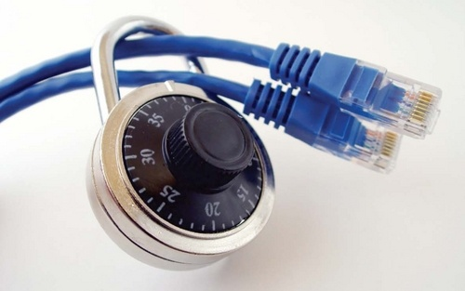
Information Security
Communication of DATA between sender and receiver over insecure
channel…..
How to transfer data securely over insecure channel???????

Slide 3
Standards Organizations
National Institute of Standards & Technology (NIST)
Internet Society (ISOC)
International Telecommunication Union Telecommunication Standardization Sector (ITU-T)
International Organization for Standardization (ISO)

Slide 4
Unit 1 Conventional Encryption
Conventional Encryption model.
Steganography
Classical Encryption

Slide 5
Background
Information Security requirements have changed in recent times traditionally provided by physical and administrative mechanisms computer use requires automated tools to protect files and other stored information use of networks and communications links requires measures to protect data during transmission

Slide 6
OSI Security Architecture
Provides the frame work for defining security attacks, mechanisms and services.
Security Attacks :
Passive attack : Unauthorized reading of message or traffic analysis
Active attack : Modification of message or files and DoS.
Security mechanism:
Process that is designed to detect, prevent , or recover from security attack.
Security services :
Includes authentication, access control , data confidentiality , data integrity , nonrepudiation , and availability

Slide 7
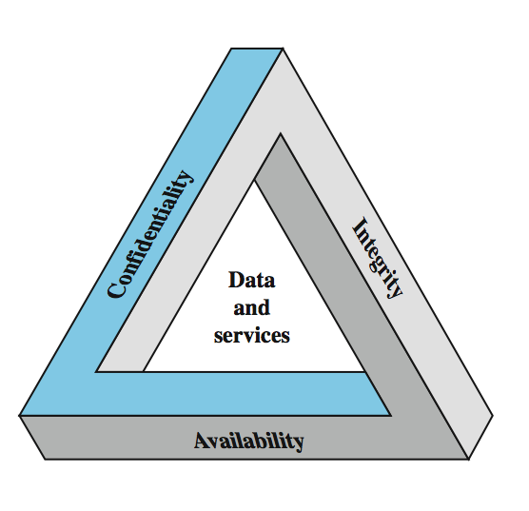
Computer Security

Slide 8
Computer Security
Definition : preserving the Confidentiality , Integrity , Availability(CIA) of information system resources.
Confidentiality :
Hiding the information from unauthorized access.
Integrity :
Preventing information from unauthorized modification.
Availability :
Easily available to authorized user

Slide 9
Computer Security
Confidentiality :
Information should remain secret , related with both storage and also transit.
Loss of confidentiality is unauthorized disclosure of information.
Integrity :
Change should be made by authorized user.
1) Preventing the modification
2) Detecting the modification
Availability :
Confidentiality and integrity should not hinder the availability

Slide 10
Examples of Security Requirements
Confidentiality – student grades
Integrity – patient information
Availability – authentication service
authenticity – admission ticket
non-repudiation – stock sell order

Slide 11
Security Requirements
Confidentiality: Preserving authorized restrictions on information access and disclosure, including means for protecting personal privacy and proprietary information. A loss of confidentiality is the unauthorized disclosure of information.
Integrity: Guarding against improper information modification or destruction, including ensuring information nonrepudiation and authenticity. A loss of integrity is the unauthorized modification or destruction of information.
Availability: Ensuring timely and reliable access to and use of information. A loss of availability is the disruption of access to or use of information or an information system.

Slide 12
Aspects of Security
Consider 3 aspects of information security:
security attack
security mechanism (control)
security service
note terms
Threat – a potential for violation of security
Vulnerability – a way by which loss can happen
Attack – an assault on system security, a deliberate attempt to evade security services.

Slide 13
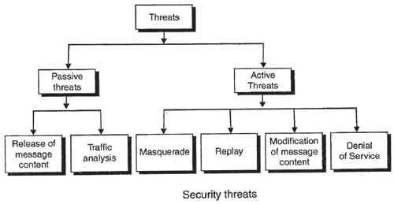
Types of Attacks

Slide 14
Classify Security Attacks as
Passive attacks –
Passive attacks are in the nature of eavesdropping on, or monitoring of, transmissions. The goal of the opponent is to obtain information that is being transmitted.
Two types of passive attacks are the release of message contents and traffic analysis
Active attacks – modification of data stream to:
masquerade of one entity as some other
replay previous messages
modify messages in transit
denial of service

Slide 15
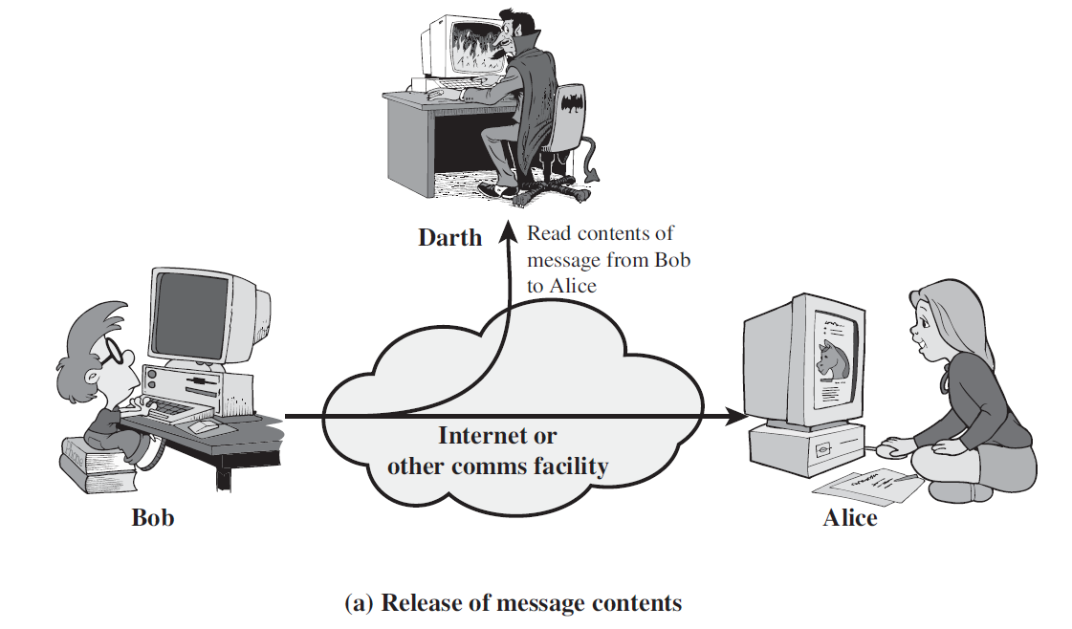
Passive Attack: release of message contents
1. Release of message content :
A telephone conversation and email and transferred file may contain sensitive or confidentiality information.
Prevent attacker from reading this content.

Slide 16
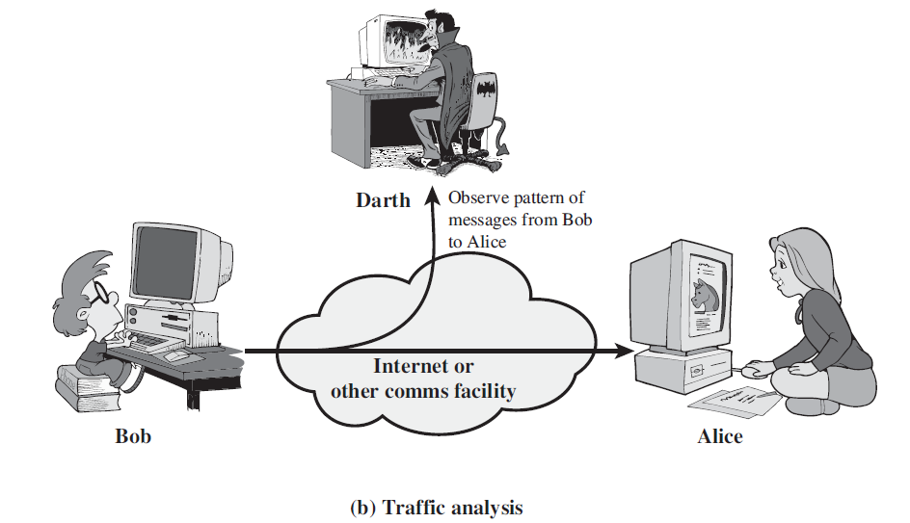
Passive Attack: Traffic Analysis
2. Traffic Analysis :
Observing Identity of sender and receiver.
Observing pattern or type of file which is transferred.

Slide 17
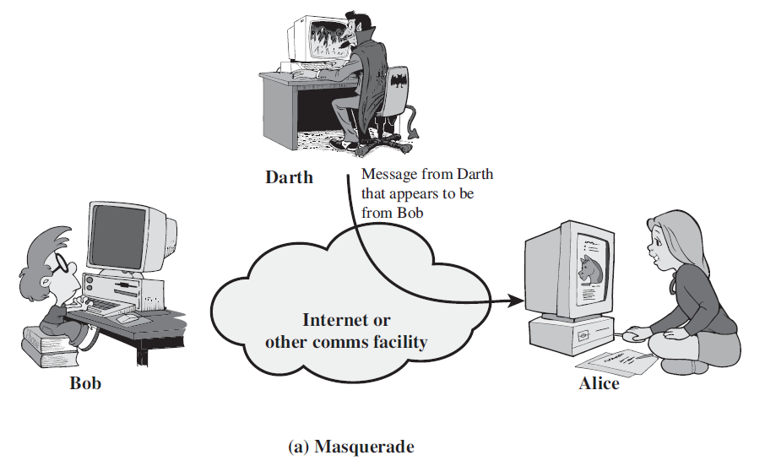
Active Attack: Masquerade
1. Masquerade : when one entity pretend as a different entity.
A masquerade attack is an attack that uses a fake identity, such as a network identity, to gain unauthorized access to personal computer information.
Stolen user id and password…

Slide 18
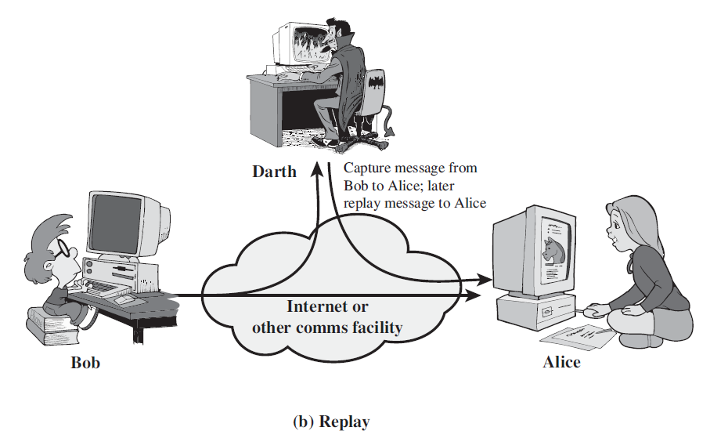
Active Attack: Replay
2. Replay : Copy a message and replay it latter to produce an unauthorized effect.

Slide 19
Active Attack: Replay and Modification of messages
3. Modification of message:
Some portion of message is altered or reordered to produce an unauthorized effect.
Ex. : Original message : “Allow john to read confidential files” is altered as “Allow brown to read confidential files”.
4. Denial of service.
Slow down with multiple request.
Prevent the normal use or management of comm. Facility.
Ex. Direct all messages to only one destination , disable the n/w or overload n/w.

Slide 20
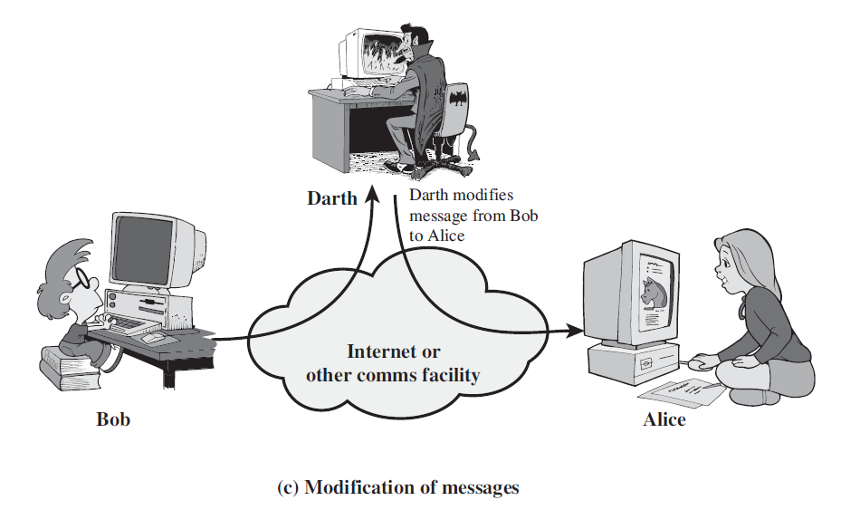
Active Attack: Modification

Slide 21
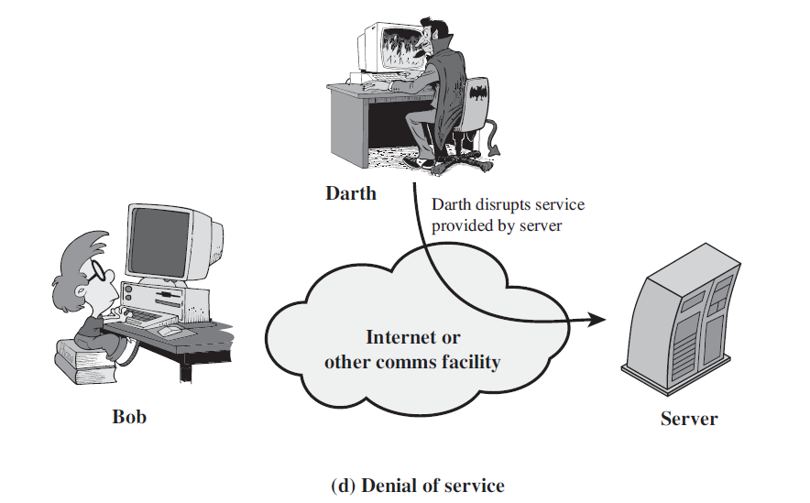
Active Attack: Denial of service

Slide 22
Active Attack: Denial of service
The denial of service prevents or inhibits the normal use or management of communications facilities. This attack may have a specific target;
For example, an entity may suppress all messages directed to a particular destination (e.g., the security audit service). Another form of service denial is the disruption of an entire network, either by disabling the network or by overloading it with messages so as to degrade performance.

Slide 23
Security Services (X.800)
Authentication : Ensure that sender or receiver is genuine.
have both peer-entity & data origin authentication
Access control : prevents authorized or unauthorized user to use of unauthorized resources.
Employee of company and project Manager can have different access control even though both are authorized user.
Data Confidentiality –protection of data from unauthorized disclosure
Data Integrity - assurance that data received is as sent by an authorized entity
Non repudiation :
Origin non-repudiation: preventing sender from denying that he has sent a message
Destination non-repudiation: preventing receiver from denying that she has received a message
Availability – resource accessible/usable

Slide 24
Security Service
Authentication : Ensure that sender or receiver is genuine.
Non repudiation :
Origin non-repudiation: preventing sender from denying that he has sent a message
Destination non-repudiation: preventing receiver from denying that she has received a message
Access control : prevents authorized or unauthorized user to use of unauthorized resources.
Employee of company and project Manager can have different access control even though both are authorized user.

Slide 25
Security mechanism… To provide security services…
1. Encipherment : Use of mathematical algorithm to transform the data that is not readily intelligible.
Example : encryption , Steganography ..
May be used for authentication , non repudiation..
2. Digital signature :
Sign digitally piece of information…
Later in details…
Ex. Hash funcation

Slide 26
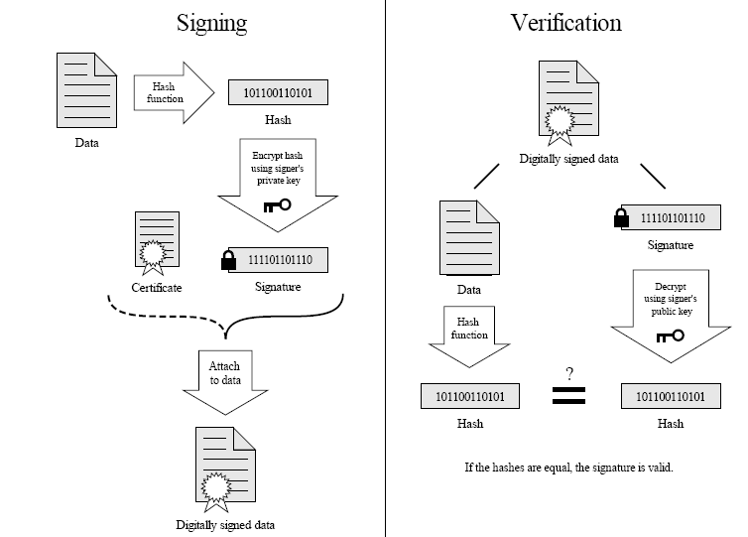
Digital Signature

Slide 27
Data integrity : A small checksum value for a massage is appended and sent to receiver.
Authentication : Mechanism intended to ensure the identity of an entity by means of information exchange.
Traffic padding : The insertion of bits into gaps in a data stream to frustrate analysis attempts.
Routing control : enables security of particular physically secure routes for certain data and allow routing changes.
Notarization : the use of trusted third party to assure certain properties of a data exchange.

Slide 28
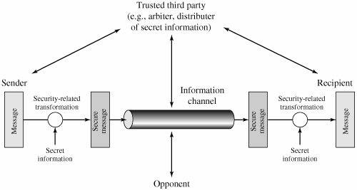
Model for n/w security

Slide 29
Classical Encryption Techniques
Topics to be covered…
Symmetric cipher mode
Substitution techniques
Transposition techniques
Rotor Machine
Steganography

Slide 30
“A cipher or cryptosystem(Can be Encryption Algorithm) is used to encrypt the plain text”.
Encryption : Plain text to cipher text
Decryption : Cipher text to plain text
KEY : used for mapping between plain text to cipher text
A symmetric key cryptosystem : Same key to encrypt as well as decrypt.
Ek(m) = c , Dk(c) = m
A public key cryptography : Use public key to encrypt but secret key to decrypt.
Epk(m) = c , Dsk(c) = m where pk is public and sk is secret key

Slide 31
Symmetric Cipher model..
A symmetric encryption key is 5 topple (p ,c ,k ,E , D).
Plain text(p) : original understandable message or data that is fed in to algorithm as input.
Cipher text(c): Random stream of not understandable data generated from plain text using key.
Secret Key(k) : Also input to encryption and decryption algorithms. independent of plain text and algorithm . Exact operation performed by algorithm will depend on key.
Encryption : Algorithm which perform various substitution and transformation on plain text.
Decryption : Essentially reverse of encryption algo.

Slide 32
Cipher or cryptographic system : a scheme or algorithm for encryption and decryption
Cryptography: science of studying ciphers
Cryptanalysis: science of studying attacks against cryptographic systems
Cryptology: cryptography + cryptanalysis

Slide 33
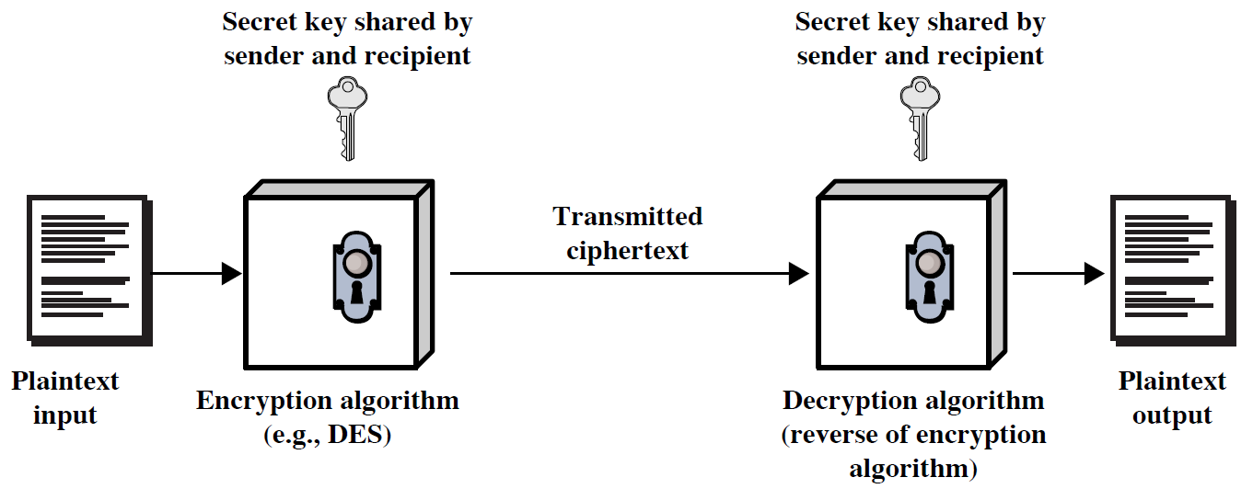
Symmetric Cipher Model

Slide 34
Symmetric Encryption
Mathematically:
Y = E_{K}(X) or Y = E(K, X)
X = D_{K}(Y) or X = D(K, Y)
X = plaintext
Y = ciphertext
K = secret key
E = encryption algorithm
D = decryption algorithm
Both E and D are known to public

Slide 35
Symmetric Encryption
The type of operation used for transforming plain text into cipher text :
Substitution , or transposition(permutation), product.
The number of key is used
Symmetric cryptosystem or Asymmetric.
The way in which the plain text is processed.
Block cipher : process one block of elements at a time.
Stream cipher : process input elements continuously.

Slide 36
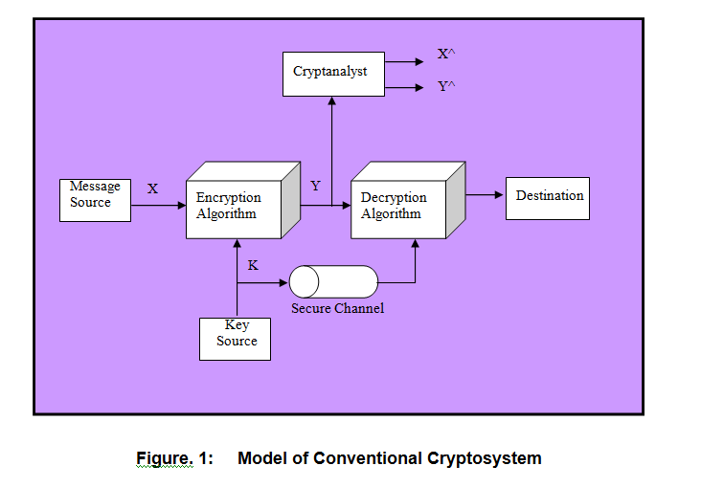
Conventional Cryptosystem

Slide 37
Cryptanalysis
Objective: to recover the plaintext of a ciphertext or, more typically, to recover the secret key.
Kerkhoff’s principle: the adversary knows all details about a cryptosystem except the secret key.
Two general approaches:
brute-force attack
non-brute-force attack (cryptanalytic attack)

Slide 38
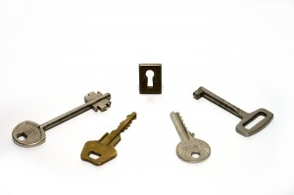
Brute-force attack
Brute-force attack:
→ The attacker tries every possible key
→ Average, half of all possible keys must be tried to achieve success.
Key Size (bits) | Number of Alternative Keys | Time required at 1 decryption/µs | Time required at 10⁶ decryptions/µs
32 | 2³² = 4.3 × 10⁹ | 2³¹ µs = 35.8 minutes | 2.15 milliseconds
56 | 2⁵⁶ = 7.2 × 10¹⁶ | 2⁵⁵ µs = 1142 years | 10.01 hours
128 | 2¹²⁸ = 3.4 × 10³⁸ | 2¹²⁷ µs = 5.4 × 10²⁴ years | 5.4 × 10¹⁸ years
168 | 2¹⁶⁸ = 3.7 × 10⁵⁰ | 2¹⁶⁷ µs = 5.9 × 10³⁶ years | 5.9 × 10³⁰ years
26 characters (permutation) | 26! = 4 × 10²⁶ | 2 × 10²⁶ µs = 6.4 × 10¹² years | 6.4 × 10⁶ years

Slide 39
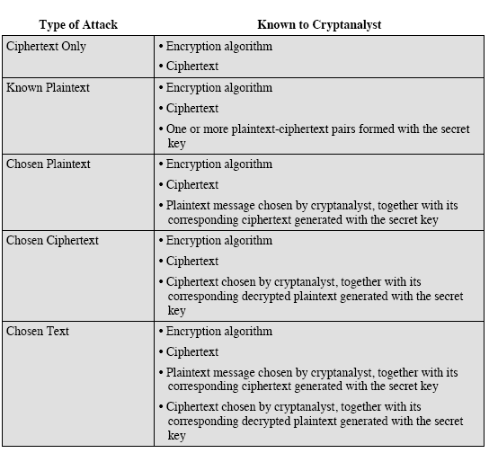
Cryptanalytic Attack
Attacks, based on the amount of information known to the cryptanalyst.

Slide 40
Unconditionally secure : cipher text does not contain enough information to convert it into plain text.
Except OTP algo , not a single encryption algorithm is unconditionally secure.
Computationally secure : If encryption algorithm. is following any of below criteria :
The cost of breaking the cipher exceeds the value of encrypted information.
The time required to break the cipher exceeds the useful lifetime of the information

Slide 41
Classical Encryption Techniques
Plaintext is viewed as a sequence of elements (e.g., bits or characters)
Substitution cipher:
replacing each element of the plaintext with another element.
Transposition (or permutation) cipher:
rearranging the order of the elements of the plaintext.
Product cipher:
using multiple stages of substitutions and transpositions

Slide 42
Substitution Techniques
Caesar cipher
Monoalphabetic cipher
Playfair cipher
Hill cipher
Polyalphabetic ciphers
OTP(One time pad)
To remember :
(Chief Minister’s Officer is learning PHP for applying replacement technique )

Slide 43
Caesar Cipher
Developed By julius ceaser.
Replacing Each letter of alphabet with the letter standing three places further down the alphabet.
Each letter is replaced by the letter three positions further down the alphabet.
Plain: a b c d e f g h i j k l m n o p q r s t u v w x y z
Cipher: D E F G H I J K L M N O P Q R S T U V W X Y Z A B C
Example : Plain Text : information security
Cipher : LQIRPDWLRQ VHFXULWB
Note : Plain text(p) is always lowercase and cipher text(C) is always upper case (only to distinguish).

Slide 44
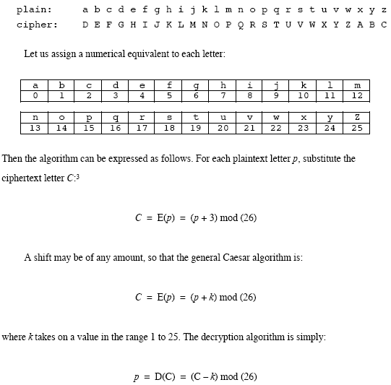
Caesar Cipher

Slide 45
Cryptanalysis Of caesar cipher
If it’s know that Ceaser cipher is used, then brute force cryptanalysis is easily performed :
Encryption algorithm and decryption algorithms are known.
Only 25 keys to try.
Language of plain text is easily recognizable.
Sol. : Compress using ZIP algo. And encrypt it.

Slide 46
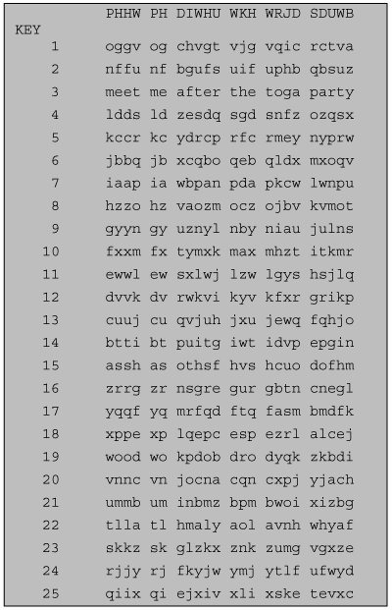

Slide 47
Something Maths…
How much possible permutation are there for letters a,b,c ???
Permutation : is a finite set of elements S is an ordered sequence of all the elements of S,with each appearing once…
abc, acb,bac,bca,cab,cba
General : n! possible permutation for set of n elements.

Slide 48
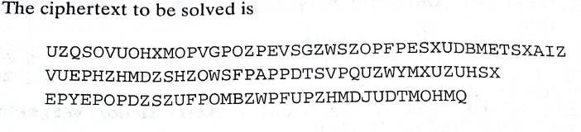
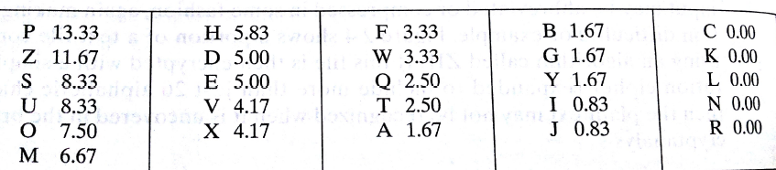
Monoalphabetic cipher
In ceaser cipher only 25 possible keys…..but here 26! = 4 * 10²⁶
With so many keys, it is secure against brute-force attacks.
But not secure against some cryptanalytic attacks.
Problem is language characteristics.
Frequencies of letter in cipher text is as follows

Slide 49
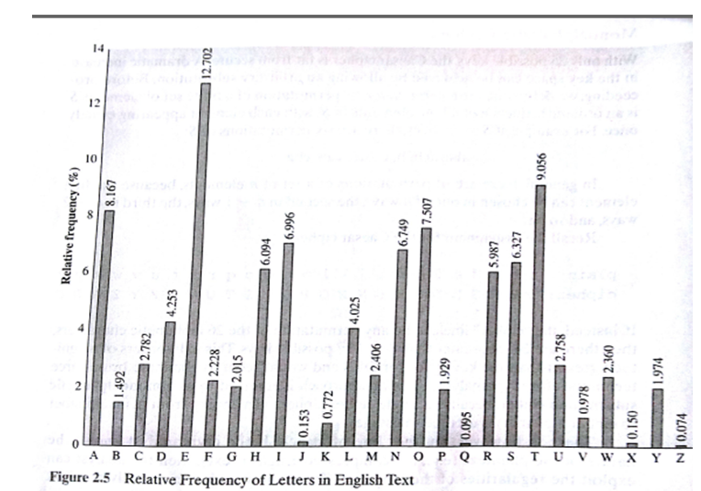
Monoalphabetic cipher

Slide 50
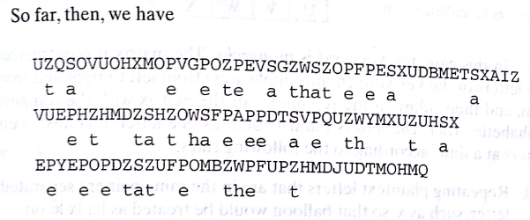
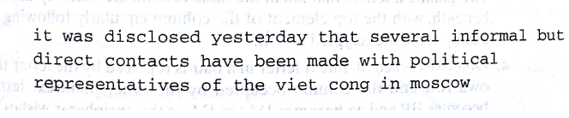
Solved cipher text :

Slide 51
Polyalphabetic Ciphers
Two types :
VIGENERE CIPHER
VERNAM CIPHER

Slide 52
Vigenère Cipher
Provides autokey system ,also called as running key cipher
Simplest polyalphabetic substitution cipher
Consider the set of all Caesar ciphers:
{ C_{a}, C_{b}, C_{c}, ..., C_{z} }
Key: e.g. security
Encrypt each letter using C_{s}, C_{e}, C_{c}, C_{u}, C_{r}, C_{i}, C_{t}, C_{y} in turn.
Repeat from start after C_{y}.
Decryption simply works in reverse.

Slide 53
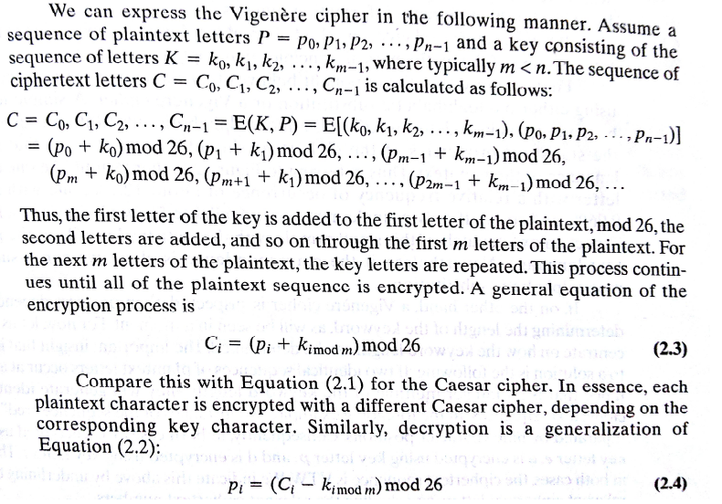
Vigenère Cipher

Slide 54
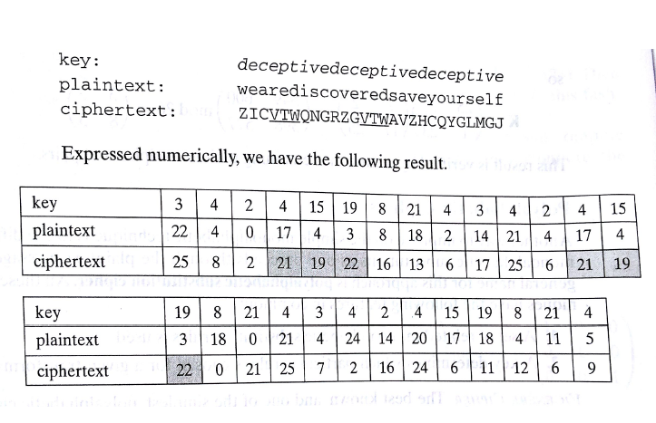
Vigenère Cipher

Slide 55
Security of Vigenère Ciphers
There are multiple (how many?) cipher text letters corresponding to each plaintext letter.
So, letter frequencies are obscured but not totally lost.
To break Vigenere cipher:
Try to guess the key length. How?
If key length is N, the cipher consists of N Caesar ciphers. Plaintext letters at positions k, N+k, 2N+k, 3N+k, etc., are encoded by the same cipher.
Attack each individual cipher as before.

Slide 56
2.Vernam Cipher
Developed by AT&T engineer , Gillbert vernam in 1918.
System works on binary data
System is
Ci = pi XOR ki
pi = ith binary digit of plaintext
ki = ith binary digit of key
Ci = ith binary digit of ciphertext
exclusive-or (XOR) operation
pi = Ci XOR ki

Slide 57
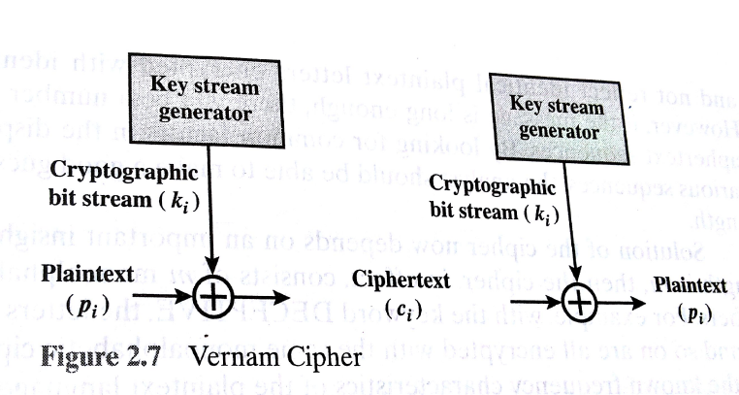
2.Vernam Cipher

Slide 58
Playfair Cipher
Not even the large number of keys in a monoalphabetic cipher provides security.
One approach to improving security is to encrypt multiple letters at a time.
The Playfair Cipher is the best known such cipher.
Invented by Charles Wheatstone in 1854, but named after his friend Baron Playfair.

Slide 59
Playfair Key Matrix
Use a 5 x 5 matrix.
Fill in letters of the key (w/o duplicates).
Fill the rest of matrix with other letters.
E.g., key = MONARCHY.
M | O | N | A | R
C | H | Y | B | D
E | F | G | I/J | K
L | P | Q | S | T
U | V | W | X | Z

Slide 60
Encrypting and Decrypting
Plaintext is encrypted two letters at a time.
If a pair is a repeated letter, insert filler like 'X’.
If both letters fall in the same row, replace each with the letter to its right (circularly).
If both letters fall in the same column, replace each with the the letter below it (circularly).
Otherwise, each letter is replaced by the letter in the same row but in the column of the other letter of the pair.

Slide 61
Security of Playfair Cipher
Equivalent to a monoalphabetic cipher with an alphabet of 26 x 26 = 676 characters.
Security is much improved over the simple monoalphabetic cipher.
Was widely used for many decades
eg. by US & British military in WW1 and early WW2
Once thought to be unbreakable.
Actually, it can be broken, because it still leaves some structure of plaintext intact.

Slide 62
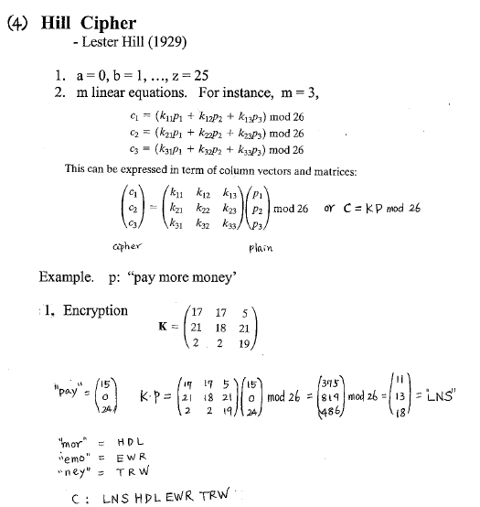
Hill Cipher

Slide 63
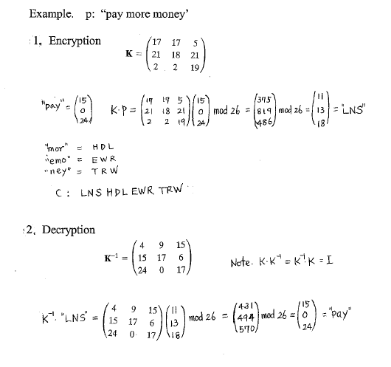
Hill Cipher

Slide 64
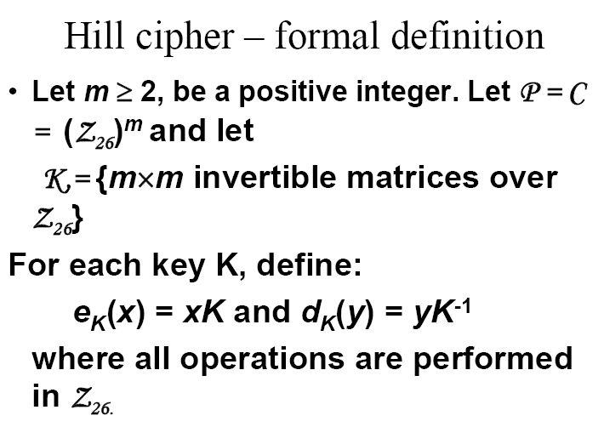
Hill Cipher

Slide 65
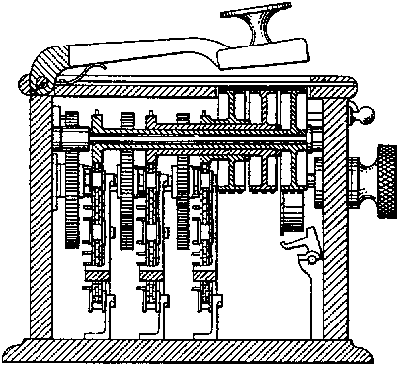

Slide 66
OTP
One-time pad.
Idea is to Choose random key.
Each new message requires new key.
For same cipher text ,based on key , multiple plain text can be generated.
One time key as long as message.
Only crypto system that is referred as a perfect secrecy

Slide 67
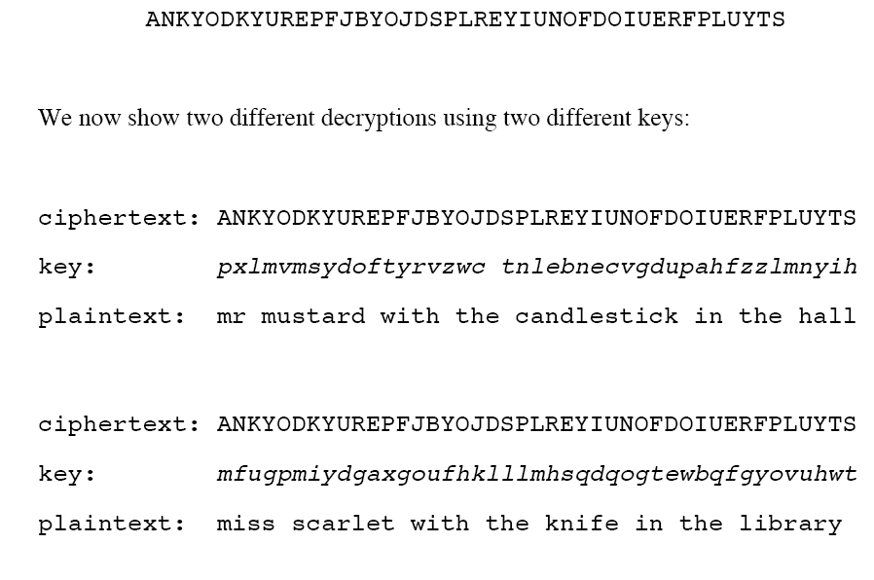
OTP

Slide 68
Transposition Technique
Rail fence cipher : plaintext is written down as a sequence of diagonals and then read off sequence of rows.
Example : encrypt “meet me after toga party” using rail fence of depth 2.
m e m a t r h t g p r y
e t e f e t e o a a t
So cipher text : MEMATRHTGPRYETEFETEOAAT

Slide 69
One stage transposition
Key: 3 4 2 1 5 6 7
Plaintext: a t t a c k p
o s t p o n e
d u n t i l t
w o a m x y z
Ciphertext:
TTNAAPTMTSUOAODWCOIXKNLYPETZ

Slide 70
2nd stage transposition
Key: 4 3 1 2 5 6 7
Input: t t n a a p t
m t s u o a o
d w c o i x k
n l y p e t z
Output: NSCYAUOPTTWLTMDNAOIEPAXTTOKZ

Slide 71
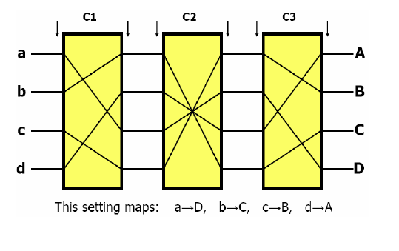
Rotor Machine
Combine Substitution and Transposition Methods
• produce ciphers that are very difficult to break
Rotor Machines in World War II: German “Enigma” and Japanese “Purple”
Used a series of rotating cylinders.
Implemented a poly alphabetic substitution cipher of period K.
With 3 cylinders, K = 26³ =17,576.
With 5 cylinders, K = 26⁵ =12 x 10⁶.

Slide 72
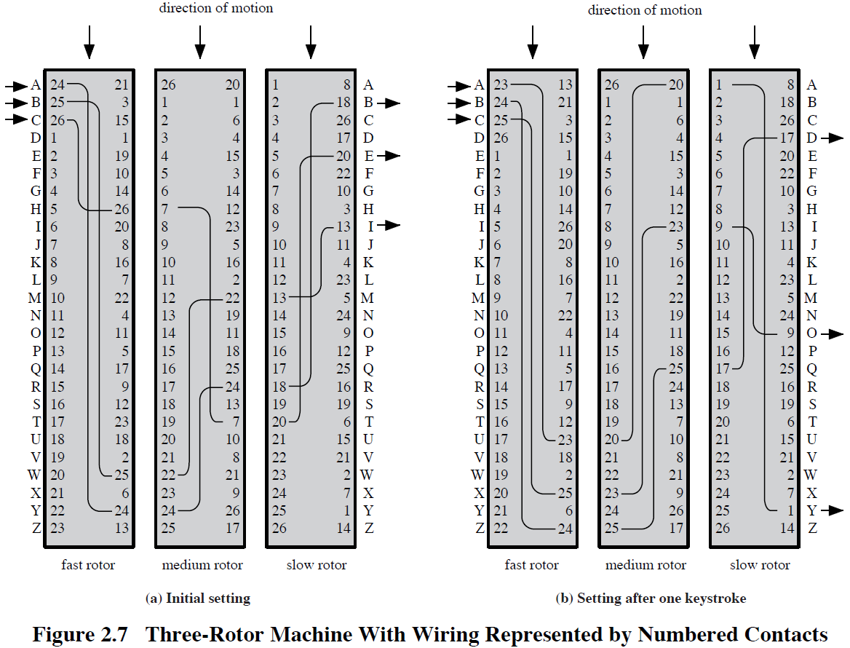
Rotor Machine

Slide 73
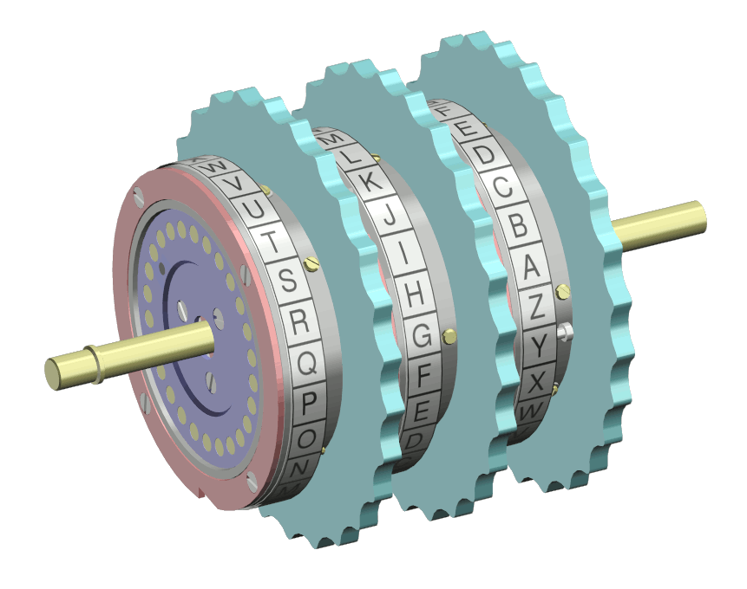
Rotor Machine

Slide 74
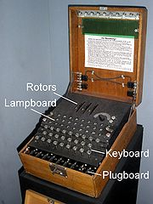
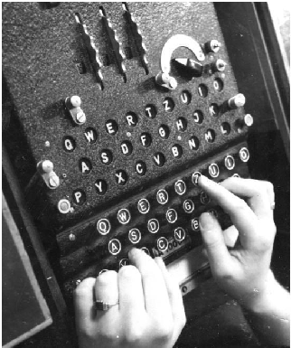
Rotor Machine

Slide 75
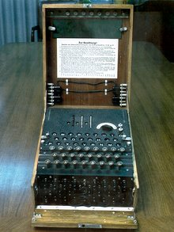
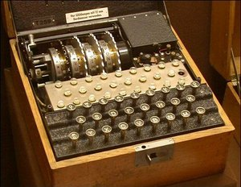
Rotor Machine -Enigma Machine
Enigma was a portable cipher machine used to encrypt and decrypt secret messages.
a family of related electro-mechanical rotor machines
Japan commercial
German military

Slide 76
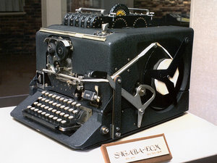
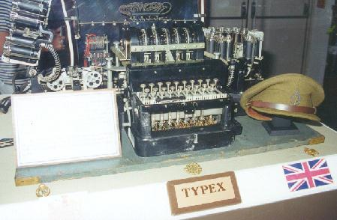
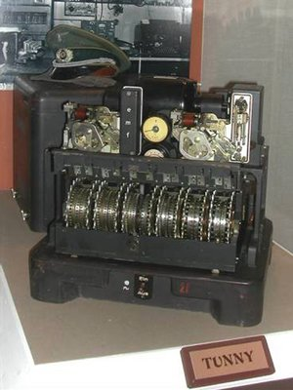
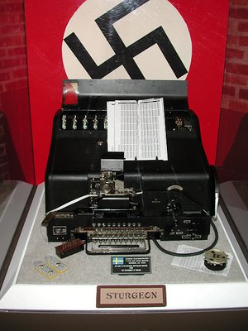
World War II Era Encryption Devices
A few here
Sigaba (United States)
Typex (Britain)
Lorenz cipher (Germany)
Geheimfernschreiber (Germany)
For more, see
http://w1tp.com/enigma/

Slide 77
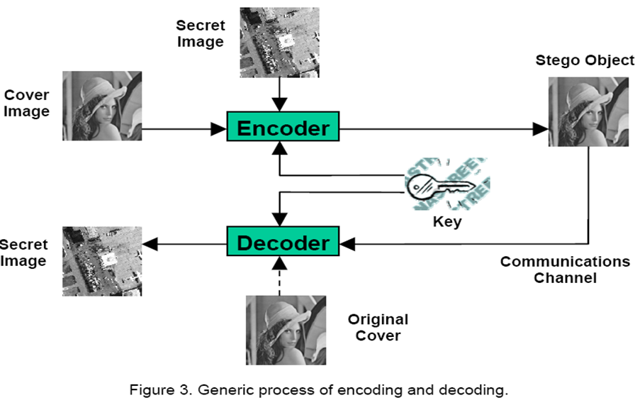
Steganography (Covered writing….)

Slide 78
Thank You!
Any Question…

