Slide 1

Department of IT
Unit no: 2
Unit title : Block Ciphers, DES, AES
Cryptography and Network Security and 3161609

Slide 2
Block Ciphers & DES - AES
Modern Block Ciphers
now look at modern block ciphers
one of the most widely used types of cryptographic algorithms
provide secrecy /authentication services
focus on DES (Data Encryption Standard)
to illustrate block cipher design principles

Slide 3

Block Ciphers & Stream Ciphers
A stream cipher : is one that encrypts the digital data stream one bit or one byte at a time
Example : Vigenere cipher or vernam cipher.
GATE : Its also called as a block cipher where size = 1.
A block cipher : Asymmetric key modern cipher that encrypts n bit block of plain text and decrypts n bits block of cipher text
PADDING :
If the message has fewer than n bits , padding must be done to make it n bits.
If message size is not multiple of n bits then it should be divided into n bits and last block should be padded.

Slide 4
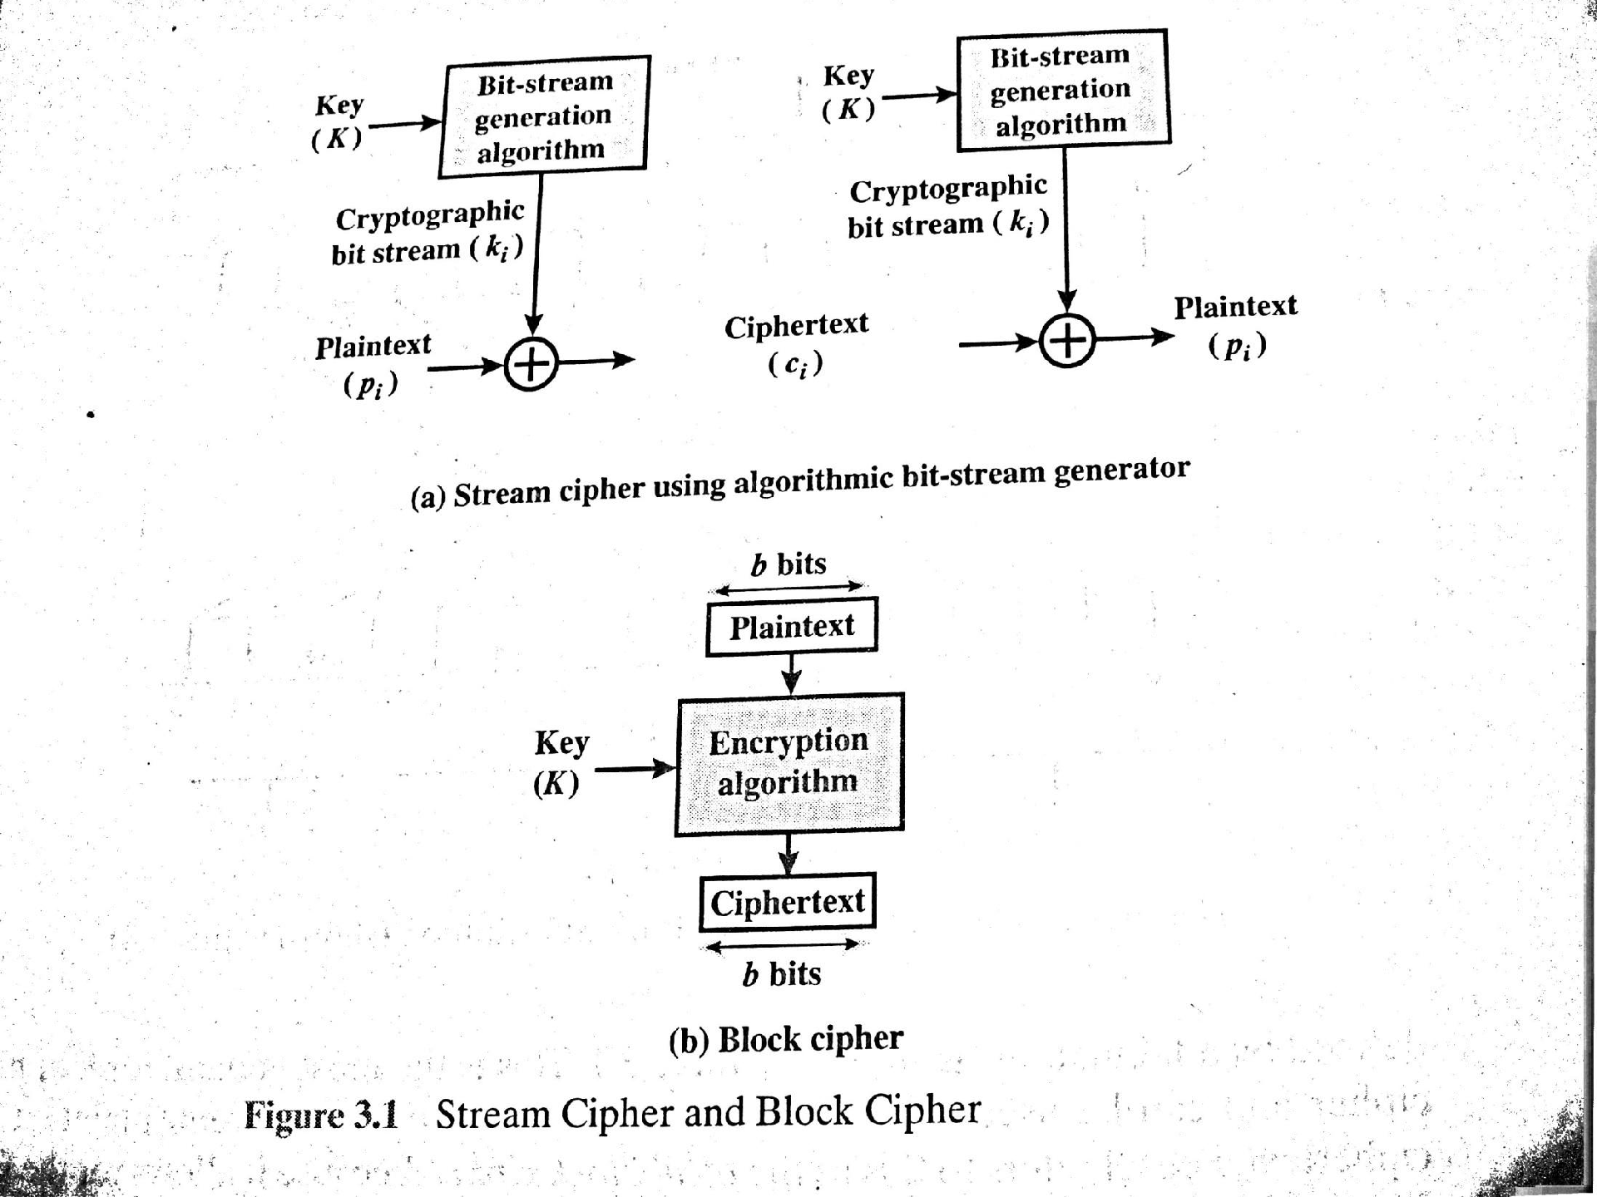
Block Ciphers & Stream Ciphers

Slide 5
Block Ciphers & Stream Ciphers
Can we model substitution as a permutation ???
Yes , n bits of input and outputs can be
represented as 2^n bit sequences , with 1’s and 0’s .

Slide 6
Block Ciphers & Stream Ciphers
Reversible mapping: which produces unique cipher text blocks .
Plain text | Cipher text
00 | 11
01 | 10
10 | 00
11 | 01
Plain text | Cipher text
00 | 11
01 | 10
10 | 01
11 | 01
a. Reversible mapping
b. Irreversible mapping

Slide 7
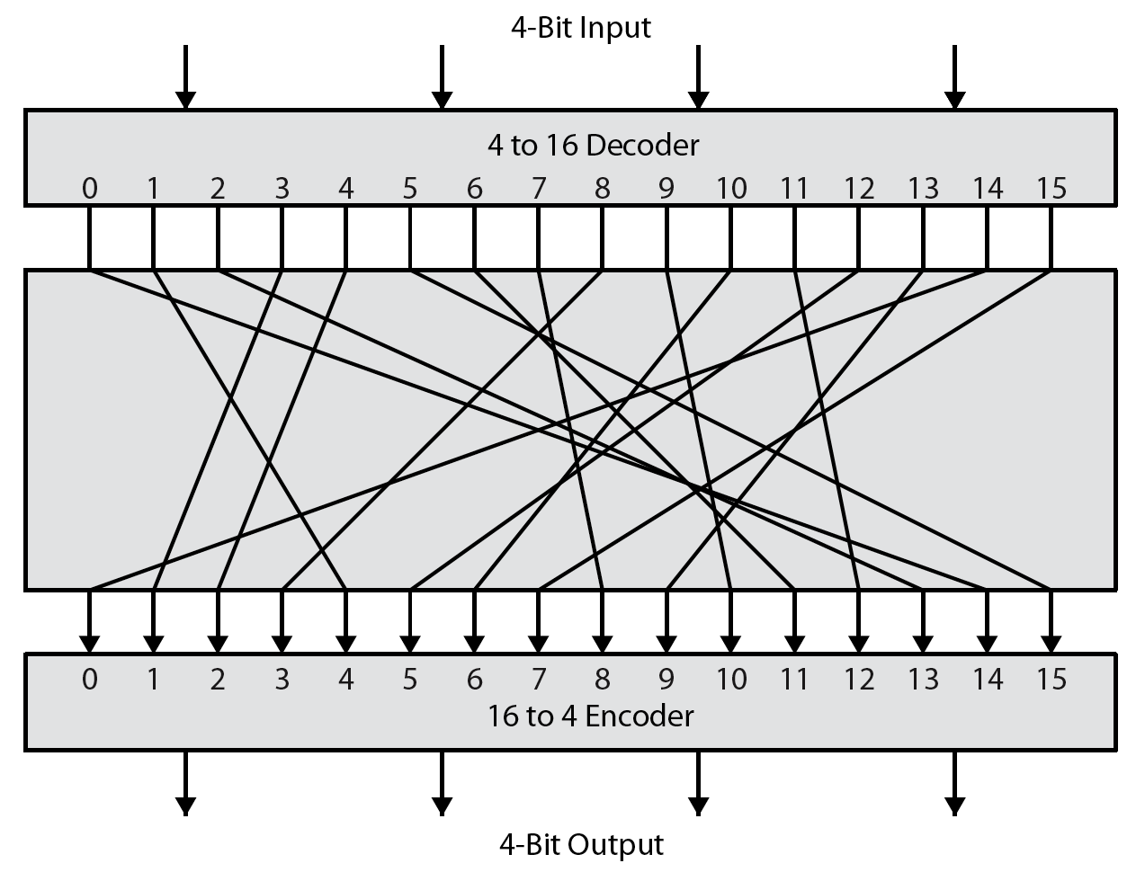
Ideal Block Cipher
Can be used to define any reversible mapping between plain text and cipher text. Feistel refers it as a ideal block cipher

Slide 8
Substitutions & Permutations
Substitutions : Each plaintext element or group of element is uniquely replaced by a corresponding cipher text elements or group of elements.
Permutation : A sequence of plain text element is replaced by a permutation of that sequence . There is no elements are added or deleted or replaced only order of the elements is changed.

Slide 9
Substitutions & Permutations
“ Based on knowledge of statistical characteristic of plain text ,
Attacker can assume the probable words of message.”………so Claude
Shannon refers a concept in which
Relationship between plain text and cipher text was hidden : called diffusion / or /
diffusion – dissipates statistical structure of plaintext over bulk of ciphertext
The mechanism of diffusion seeks to make the statistical relationship between the P.T and C.T as complex as possible in order to thwart attempts to deduce the key.
And Relation between cipher text and key was hidden : called confusion / or /
confusion – makes relationship between ciphertext and key as complex as possible
In confusion , Even if the attacker can get handle on some statistics of
C.T , the way in which the key was used to produce the that cipher text is so complex as to make it difficult to deduce the key.

Slide 10
Substitutions & Permutations
Diffusion can be achieved by repeatedly performing the some permutation : The effect is that bits from different positions in the original P.T contribute to a single bits of character in cipher text.
Confusion can be achieved by the use of complex substitution algorithm like hill cipher or Playfair cipher.

Slide 11
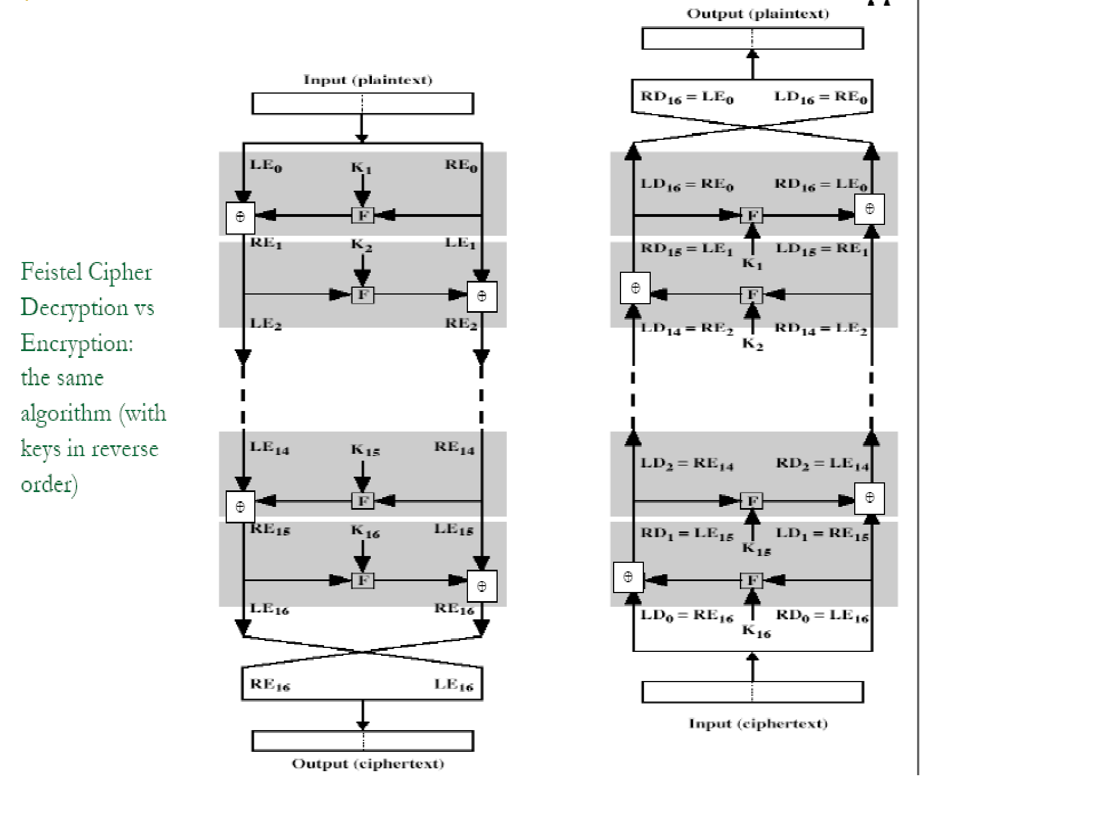
Feistel Structure

Slide 12
Data Encryption Standard (DES)
most widely used block cipher in world
adopted in 1977 by NBS (now NIST)
as FIPS PUB 46
encrypts 64-bit data using 56-bit key
has widespread use
has been considerable controversy over its security

Slide 13
DES History
IBM developed Lucifer cipher
by team led by Feistel in late 60’s
used 64-bit data blocks with 128-bit key
then redeveloped as a commercial cipher with input from National Security Agency and others.
IBM submitted their revised Lucifer which was eventually accepted as the DES

Slide 14
DES Design Controversy
although DES standard is public
was considerable controversy over design
in choice of 56-bit key (vs Lucifer 128-bit)
and because design criteria were classified
subsequent events and public analysis show in fact design was appropriate
use of DES has flourished
especially in financial applications
still standardised for legacy application use

Slide 15
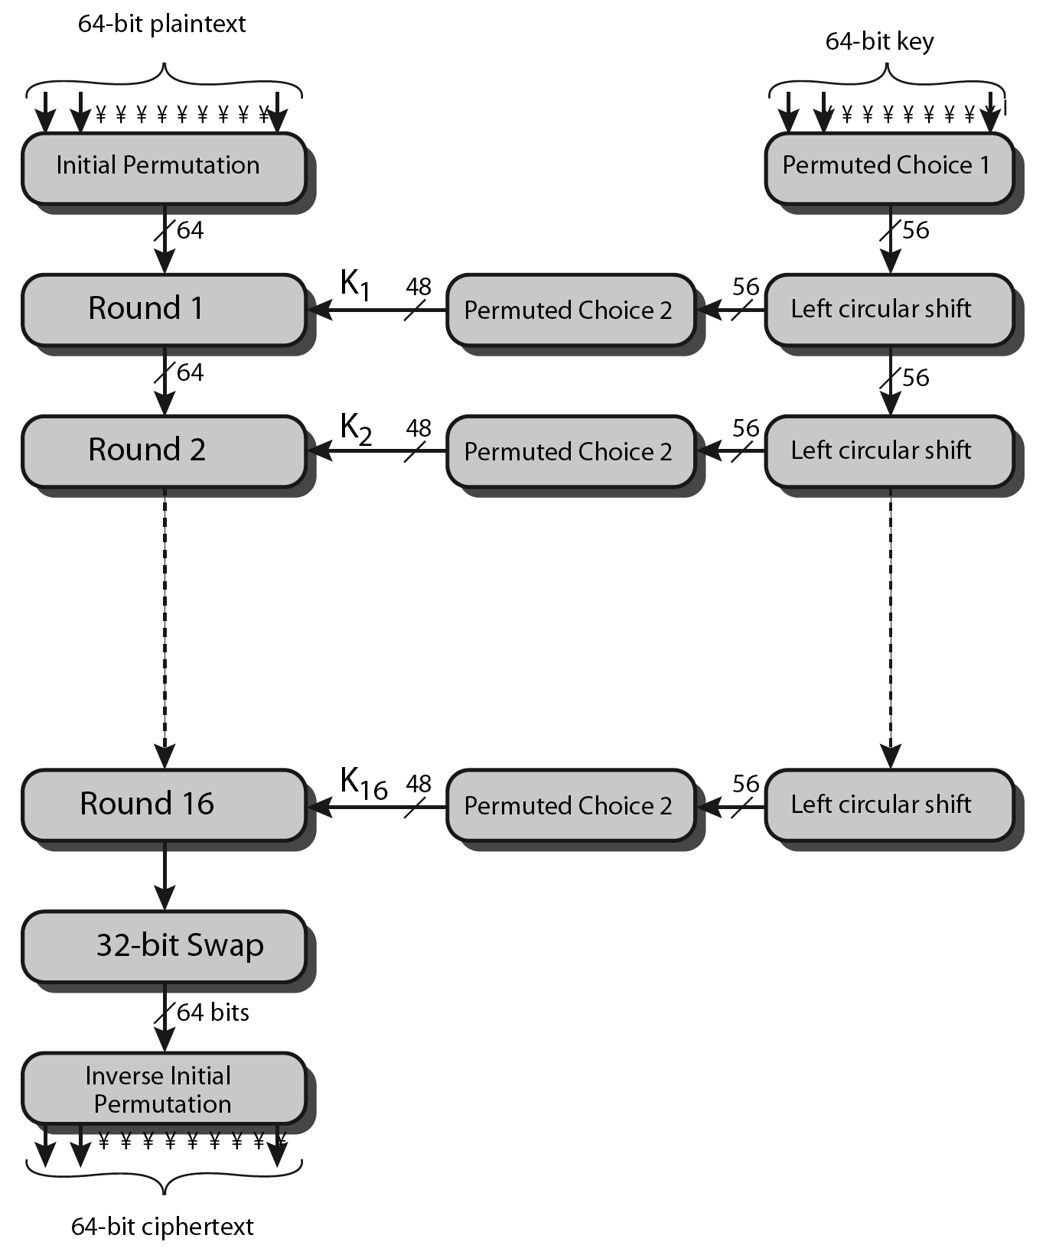
DES Encryption Overview

Slide 16
Initial Permutation IP
first step of the data computation
IP reorders the input data bits
even bits to LH half, odd bits to RH half
quite regular in structure (easy in h/w)

Slide 17
DES Round Structure
uses two 32-bit L & R halves
as for any Feistel cipher can describe as:
L_{i} = R_{i–1}
R_{i} = L_{i–1} ⊕ F(R_{i–1}, K_{i})
F takes 32-bit R half and 48-bit subkey:
expands R to 48-bits using perm E
adds to subkey using XOR
passes through 8 S-boxes to get 32-bit result
finally permutes using 32-bit perm P

Slide 18
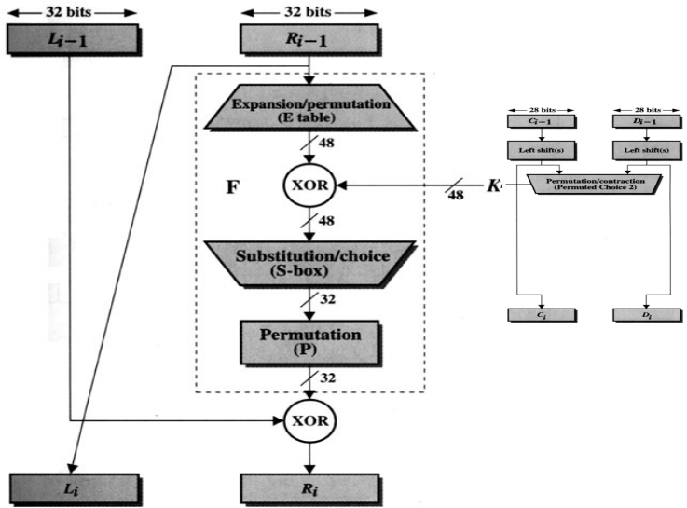
DES Round Structure

Slide 19
Encryption (Round) (cont.)
L_{i-1}
R_{i-1}
Expansion/permutation (E_table)
XOR
K_{i}
F
Substitution/choice (S-box)
Permutation (P)
XOR
L_{i}
R_{i}

Slide 20
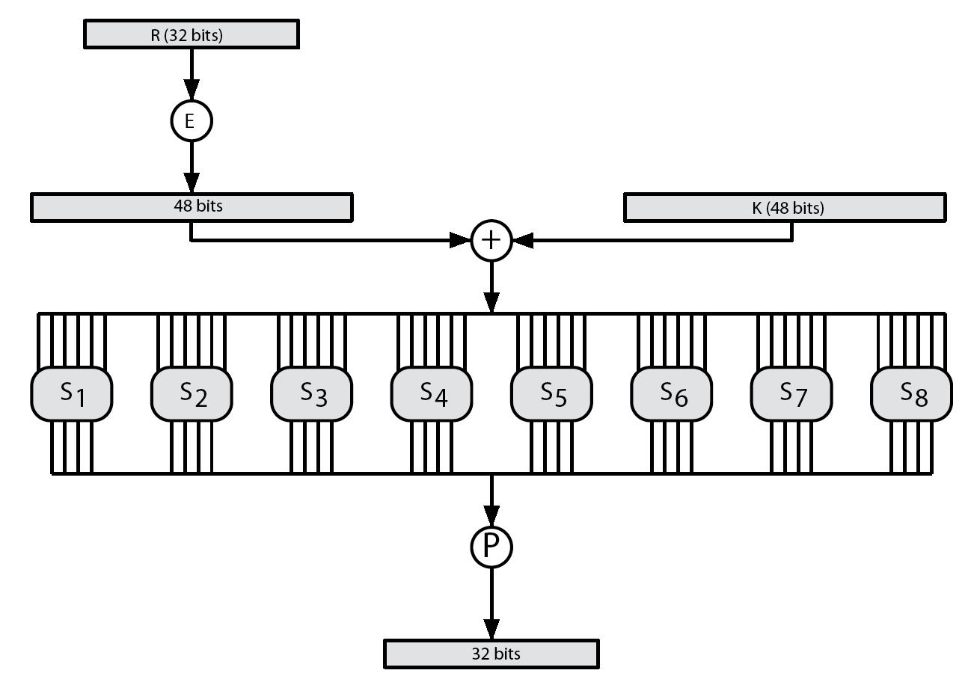
DES Round Structure

Slide 21
Substitution Boxes S
have eight S-boxes which map 6 to 4 bits
each S-box is actually 4 little 4 bit boxes
outer bits 1 & 6 (row bits) select one row of 4
inner bits 2-5 (col bits) are substituted
result is 8 lots of 4 bits, or 32 bits
row selection depends on both data & key
feature known as autoclaving (autokeying)

Slide 22
DES Key Schedule
forms subkeys used in each round
initial permutation of the key (PC1) which selects 56-bits in two 28-bit halves
16 stages consisting of:
rotating each half separately either 1 or 2 places depending on the key rotation schedule K

Slide 23
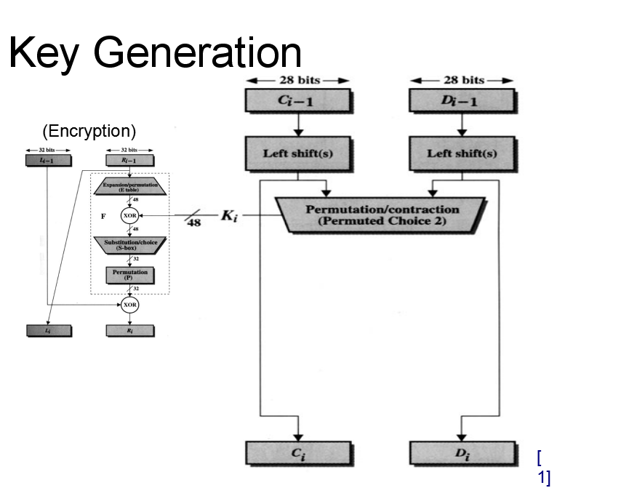
Key Generation

Slide 24
Avalanche Effect
key desirable property of encryption alg
where a change of one input or key bit results in changing approx half output bits
making attempts to “home-in” by guessing keys impossible
DES exhibits strong avalanche

Slide 25
Strength of DES – Key Size
56-bit keys have 2⁵⁶ = 7.2 x 10¹⁶ values
brute force search looks hard
recent advances have shown is possible
in 1997 on Internet in a few months
in 1998 on dedicated h/w (EFF) in a few days
in 1999 above combined in 22hrs!
still must be able to recognize plaintext
must now consider alternatives to DES

Slide 26
Strength of DES – Analytic Attacks
now have several analytic attacks on DES
these utilise some deep structure of the cipher
by gathering information about encryptions
can eventually recover some/all of the sub-key bits
if necessary then exhaustively search for the rest
generally these are statistical attacks
include
differential cryptanalysis
linear cryptanalysis
related key attacks

Slide 27
Strength of DES – Timing Attacks
attacks actual implementation of cipher
use knowledge of consequences of implementation to derive information about some/all subkey bits
specifically use fact that calculations can take varying times depending on the value of the inputs to it
particularly problematic on smartcards

Slide 28
AES – Advanced Encryption Standard
designed by Rijmen-Daemen in Belgium
has 128/192/256 bit keys, 128 bit data
an iterative rather than Feistel cipher
processes data as block of 4 columns of 4 bytes
operates on entire data block in every round
designed to have:
resistance against known attacks
speed and code compactness on many CPUs
design simplicity

Slide 29
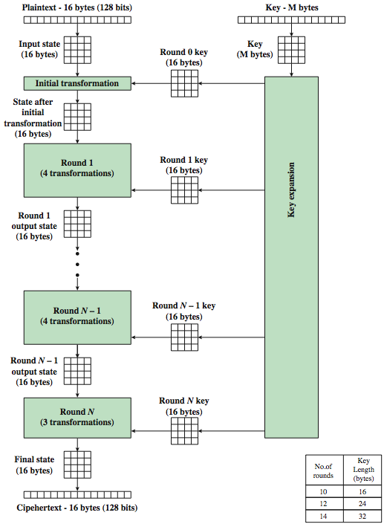
AES Encryption Process

Slide 30
AES Structure
data block of 4 columns of 4 bytes is state
key is expanded to array of words
has 10/12/14 rounds in which state undergoes:
byte substitution (1 S-box used on every byte)
shift rows (permute bytes between groups/columns)
mix columns (subs using matrix multiply of groups)
add round key (XOR state with key material)
view as alternating XOR key & scramble data bytes
initial XOR key material & incomplete last round
with fast XOR & table lookup implementation

Slide 31
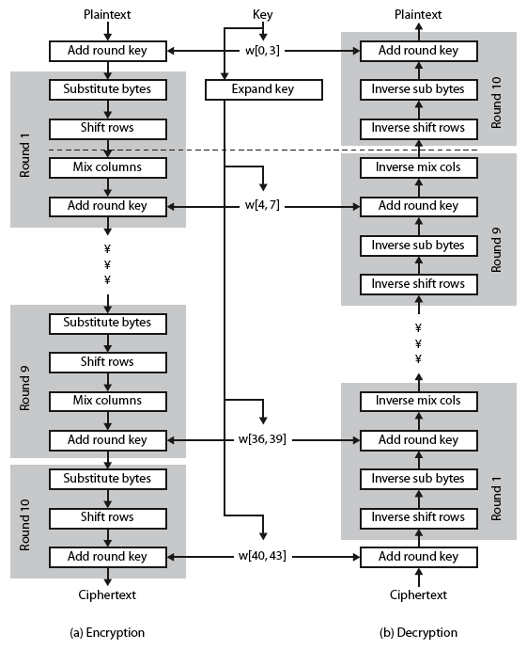
AES Structure

Slide 32
Substitute Bytes
a simple substitution of each byte
uses one table of 16x16 bytes containing a permutation of all 256 8-bit values
each byte of state is replaced by byte indexed by row (left 4-bits) & column (right 4-bits)
eg. byte {95} is replaced by byte in row 9 column 5
which has value {2A}
designed to be resistant to all known attacks

Slide 33
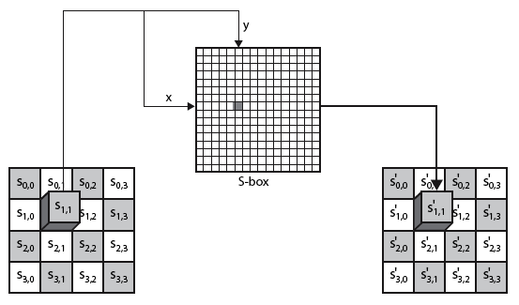
Substitute Bytes

Slide 34

Substitute Bytes Example

Slide 35
Shift Rows
a circular byte shift in each each
1st row is unchanged
2nd row does 1 byte circular shift to left
3rd row does 2 byte circular shift to left
4th row does 3 byte circular shift to left
decrypt inverts using shifts to right
since state is processed by columns, this step permutes bytes between the columns

Slide 36
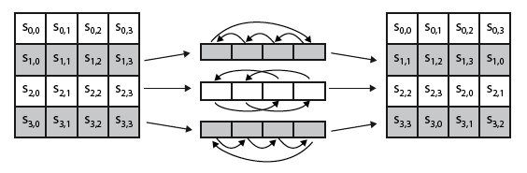

Shift Rows

Slide 37

Mix Columns
each column is processed separately
each byte is replaced by a value dependent on all 4 bytes in the column

Slide 38
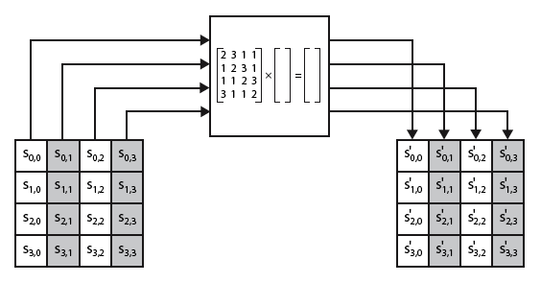
Mix Columns

Slide 39

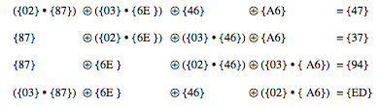
Mix Columns Example

Slide 40
Add Round Key
XOR state with 128-bits of the round key
again processed by column (though effectively a series of byte operations)
inverse for decryption identical
since XOR own inverse, with reversed keys
designed to be as simple as possible
a form of Vernam cipher on expanded key
requires other stages for complexity / security

Slide 41
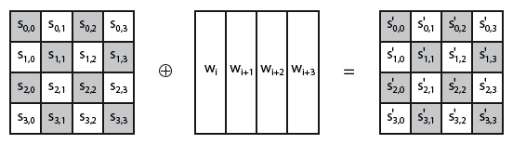
Add Round Key

Slide 42
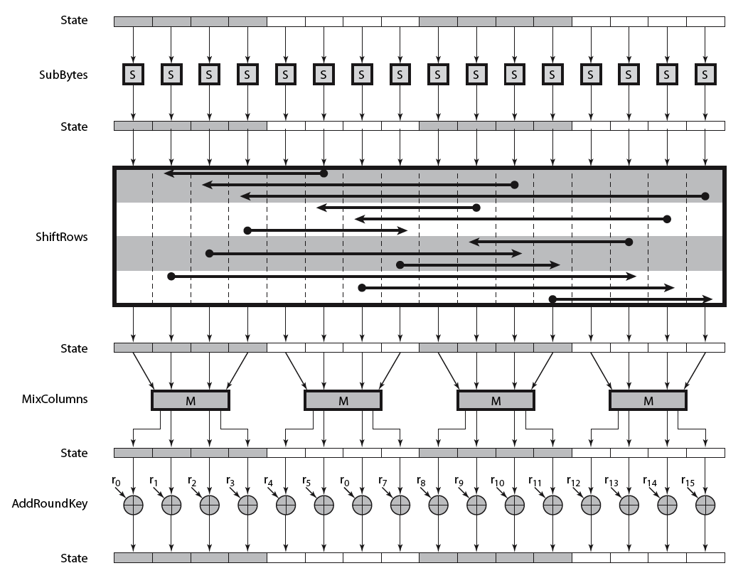
AES Round

Slide 43
AES Key Expansion
takes 128-bit (16-byte) key and expands into array of 44/52/60 32-bit words
start by copying key into first 4 words
then loop creating words that depend on values in previous & 4 places back
in 3 of 4 cases just XOR these together
1st word in 4 has rotate + S-box + XOR round constant on previous, before XOR 4th back

Slide 44
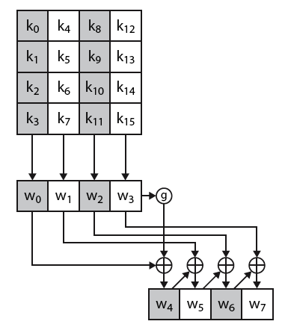
AES Key Expansion

Slide 45
Key Expansion Rationale
designed to resist known attacks
design criteria included
knowing part key insufficient to find many more
invertible transformation
fast on wide range of CPU’s
use round constants to break symmetry
diffuse key bits into round keys
enough non-linearity to hinder analysis
simplicity of description

Slide 46
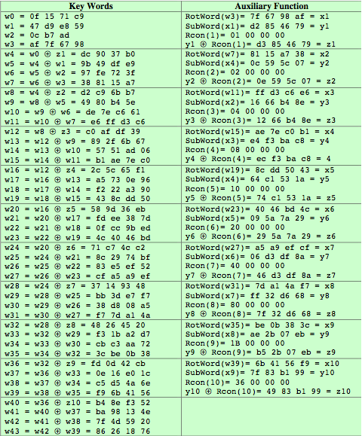
AES Example Key Expansion

Slide 47
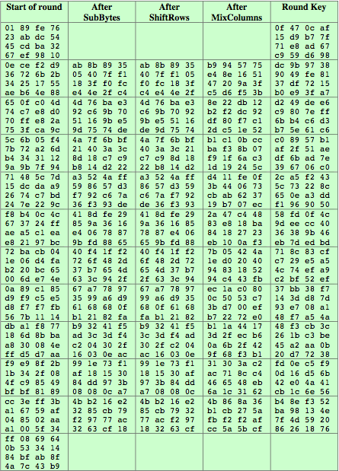
AES Encryption Example

Slide 48
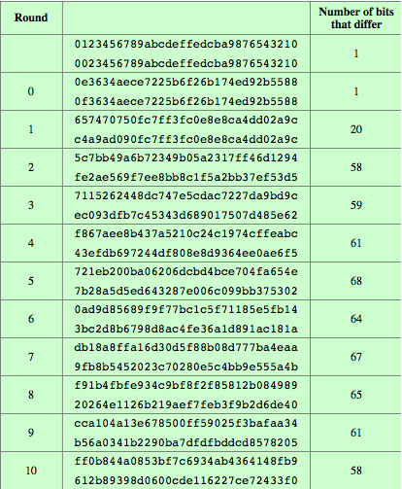
AES Example Avalanche

Slide 49
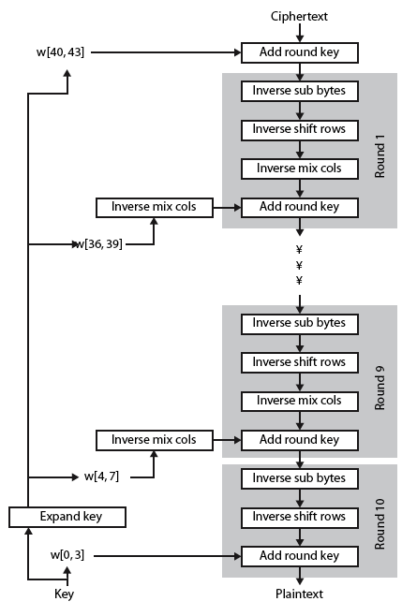
AES Decryption

Slide 50
Implementation Aspects
can efficiently implement on 8-bit CPU
byte substitution works on bytes using a table of 256 entries
shift rows is simple byte shift
add round key works on byte XOR’s

Slide 51
Implementation Aspects
can efficiently implement on 32-bit CPU
redefine steps to use 32-bit words
can precompute 4 tables of 256-words
then each column in each round can be computed using 4 table lookups + 4 XORs
at a cost of 4Kb to store tables
designers believe this very efficient implementation was a key factor in its selection as the AES cipher

Slide 52
Summary
have considered:
the AES selection process
the details of Rijndael – the AES cipher
looked at the steps in each round
the key expansion
implementation aspects

Slide 53
Thank You!
Any Question…

