Slide 1

Department of CE
Unit no: 3
Unit title : Double DES, Triple DES, Modes of Operation
Cryptography and Network Security and 3161609

Slide 2
Multiple Encryption & DES
Modern Block Ciphers
clear a replacement for DES was needed
theoretical attacks that can break it
demonstrated exhaustive key search attacks
AES is a new cipher alternative
prior to this alternative was to use multiple encryption with DES implementations
Triple-DES is the chosen form

Slide 3
Double-DES
could use 2 DES encrypts on each block
C = E_{K2}(E_{K1}(P))
issue of reduction to single stage
and have “meet-in-the-middle” attack
works whenever use a cipher twice
since X = E_{K1}(P) = D_{K2}(C)
attack by encrypting P with all keys and store
then decrypt C with keys and match X value
can show takes O(2⁵⁶) steps

Slide 4
Triple-DES with Two-Keys
hence must use 3 encryptions
would seem to need 3 distinct keys
but can use 2 keys with E-D-E sequence
C = E_{K1}(D_{K2}(E_{K1}(P)))
nb encrypt & decrypt equivalent in security
if K1=K2 then can work with single DES

Slide 5
Triple-DES with Three-Keys
although are no practical attacks on two-key Triple-DES have some indications
can use Triple-DES with Three-Keys to avoid even these
C = E_{K3}(D_{K2}(E_{K1}(P)))
has been adopted by some Internet applications, eg PGP, S/MIME

Slide 6
Modes of Operation
block ciphers encrypt fixed size blocks
eg. DES encrypts 64-bit blocks with 56-bit key
need some way to en/decrypt arbitrary amounts of data in practise
have block and stream modes

Slide 7
Electronic Codebook Book (ECB)
message is broken into independent blocks which are encrypted
each block is a value which is substituted, like a codebook, hence name
each block is encoded independently of the other blocks
uses: secure transmission of single values

Slide 8
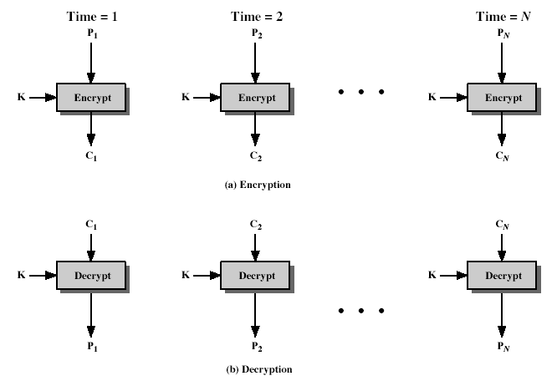
Electronic Codebook Book (ECB)

Slide 9
Advantages and Limitations of ECB
message repetitions may show in ciphertext
if aligned with message block
particularly with data such graphics
weakness is due to the encrypted message blocks being independent
main use is sending a few blocks of data

Slide 10
Cipher Block Chaining (CBC)
message is broken into blocks
linked together in encryption operation
each previous cipher blocks is chained with current plaintext block, hence name
use Initial Vector (IV) to start process
uses: bulk data encryption, authentication

Slide 11
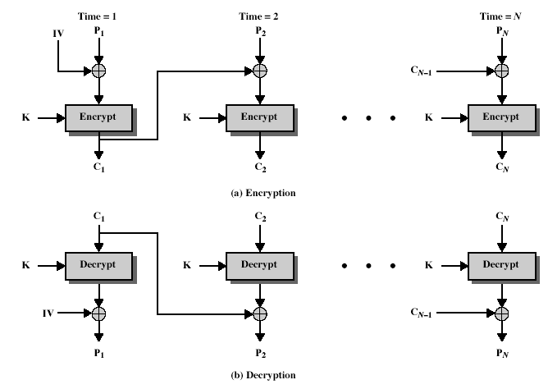
Cipher Block Chaining (CBC)

Slide 12
Cipher Block Chaining (CBC) - Message Padding
at end of message must handle a possible last short block
which is not as large as block size of cipher
pad either with known non-data value (eg nulls)
or pad last block along with count of pad size
there are other, more esoteric modes, which avoid the need for an extra block

Slide 13
Advantages and Limitations of CBC
a ciphertext block depends on all blocks before it
any change to a block affects all following ciphertext blocks
need Initialization Vector (IV)
which must be known to sender & receiver
if sent in clear, attacker can change bits of first block, and change IV to compensate
hence IV must either be a fixed value or must be sent encrypted in ECB mode before rest of message

Slide 14
Cipher FeedBack (CFB)
message is treated as a stream of bits
added to the output of the block cipher
result is feed back for next stage (hence name)
standard allows any number of bit (1,8, 64 or 128 etc) to be feed back
denoted CFB-1, CFB-8, CFB-64, CFB-128 etc
most efficient to use all bits in block (64 or 128)
uses: stream data encryption, authentication
No need of padding bits ,
P.T.= C.T.
8 stream encrypted & transmitted at a time

Slide 15
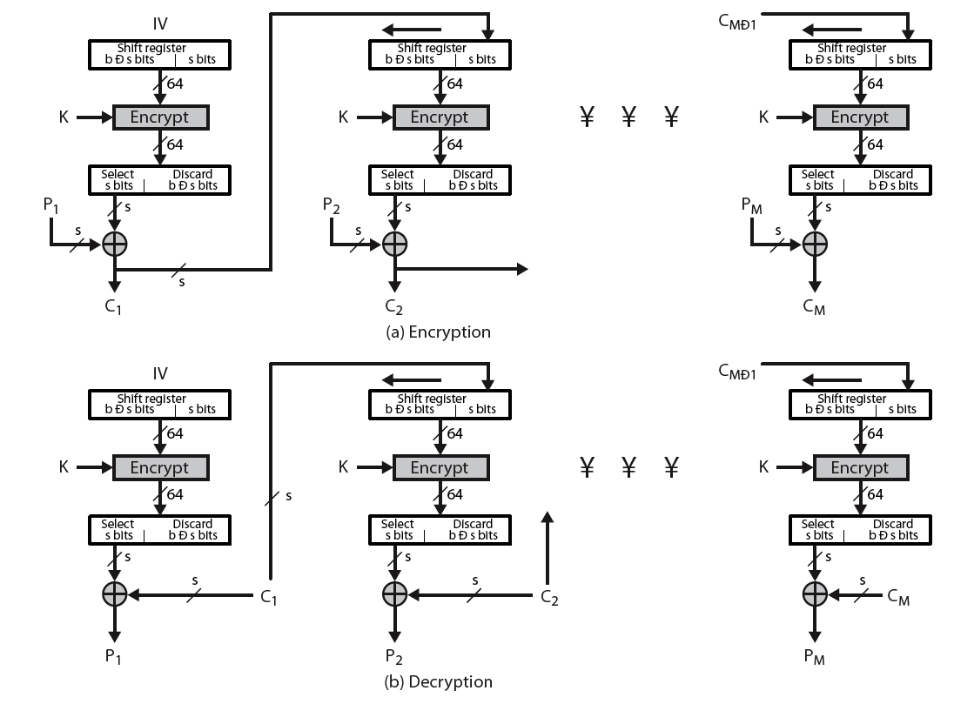
Cipher FeedBack (CFB)

Slide 16
Advantages and Limitations of CFB
appropriate when data arrives in bits/bytes
most common stream mode
limitation is need to stall while do block encryption after every n-bits
note that the block cipher is used in encryption mode at both ends
errors propogate for several blocks after the error

Slide 17
Output FeedBack (OFB)
message is treated as a stream of bits
output of cipher is added to message
output is then feed back (hence name)
feedback is independent of message
can be computed in advance
uses: stream encryption on noisy channels

Slide 18
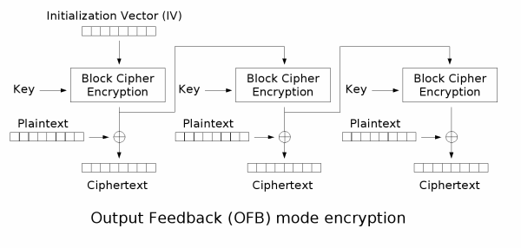
Output FeedBack (OFB)

Slide 19
Advantages and Limitations of OFB
bit errors do not propagate
more vulnerable to message stream modification
a variation of a Vernam cipher
hence must never reuse the same sequence (key+IV)

Slide 20
Counter (CTR)
a “new” mode, though proposed early on
similar to OFB but encrypts counter value rather than any feedback value
must have a different key & counter value for every plaintext block (never reused)
uses: high-speed network encryptions

Slide 21
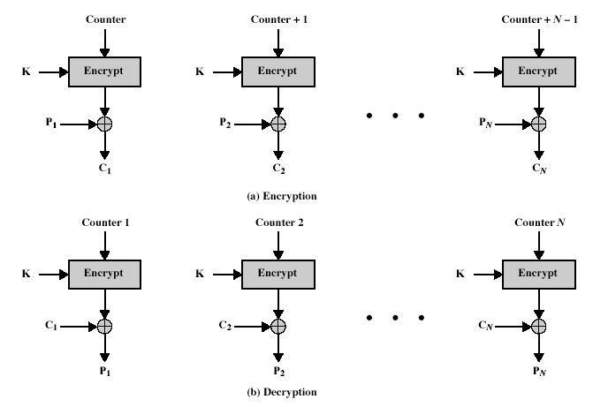
Counter (CTR)

Slide 22
Advantages and Limitations of CTR
Efficiency
can preprocess in advance of need
good for bursty high speed links
random access to encrypted data blocks
provable security (good as other modes)
but must ensure never reuse key/counter values, otherwise could break

Slide 23
Summary
Double DES
Triple-DES
Modes of Operation
ECB, CBC, CFB, OFB, CTR

Slide 24
Thank You!
Any Question…

