Slide 1

Department of CE
Unit no: 4
Unit title : Public Key Cryptography, RSA , Diffie-Hellman Key Exchange
Information and Network Security and 2170709

Slide 2
Public-Key Cryptography
Public-key cryptography is a cryptographic system that uses two separate keys, one of which is secret and the other one is public. The algorithms used for public key cryptography are based on mathematical functions.
traditional private/secret/single key cryptography uses one key
shared by both sender and receiver
if this key is disclosed communications are compromised
also is symmetric, parties are equal
hence does not protect sender from receiver forging a message & claiming is sent by sender

Slide 3
Public-Key Cryptography
uses two keys – a public & a private key
asymmetric since parties are not equal
uses clever application of number theoretic concepts to function complements rather than replaces private key crypto

Slide 4
Why Public-Key Cryptography?
developed to address two key issues:
key distribution – how to have secure communications in general without having to trust a KDC with your key
digital signatures – how to verify a message comes intact from the claimed sender
public invention due to Whitfield Diffie & Martin Hellman at Stanford Uni in 1976
known earlier in classified community

Slide 5
Public-Key Cryptography
Plaintext: This is the readable message or data that is fed into the algorithm as input.
Encryption algorithm: The encryption algorithm performs various transformations on the plaintext.
Ciphertext: This is the scrambled message produced as output. It depends on the plaintext and the key.
Decryption algorithm: This algorithm accepts the ciphertext and the matching key and produces the original plaintext.
public-key/two-key/asymmetric cryptography involves the use of two keys:
a public-key, which may be known by anybody, and can be used to encrypt messages, and verify signatures
a private-key, known only to the recipient, used to decrypt messages, and sign (create) signatures
is asymmetric because
those who encrypt messages or verify signatures cannot decrypt messages or create signatures
Any cryptosystem are designed to meet following goal
1. Secrecy (Encryption) 2. Authentication

Slide 6
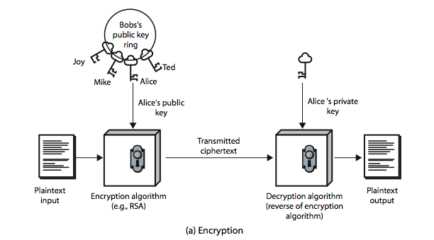
Public-Key Cryptography

Slide 7
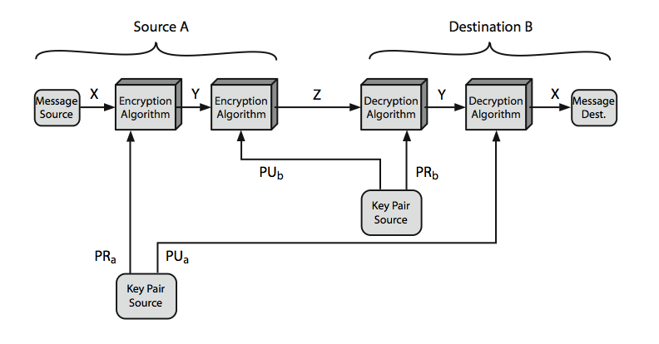
Public-Key Cryptosystems

Slide 8
Public-Key Applications
can classify uses into 3 categories:
encryption/decryption (provide secrecy)
digital signatures (provide authentication)
key exchange (of session keys)
some algorithms are suitable for all uses, others are specific to one

Slide 9
RSA
by Rivest, Shamir & Adleman of MIT in 1977
best known & widely used public-key scheme
based on exponentiation in a finite (Galois) field over integers modulo a prime
nb. exponentiation takes O((log n)³) operations (easy)
uses large integers (eg. 1024 bits)
security due to cost of factoring large numbers
nb. factorization takes O(e ^{log n log log n}) operations (hard)

Slide 10
RSA
to encrypt a message M the sender:
obtains public key of recipient PU={e,n}
computes: C = Me mod n, where 0≤M<n
to decrypt the ciphertext C the owner:
uses their private key PR={d,n}
computes: M = C^{d} mod n
note that the message M must be smaller than the modulus n (block if needed)

Slide 11
Why RSA Works
because of Euler's Theorem:
a^{ø(n)}mod n = 1 where gcd(a,n)=1
in RSA have:
n=p.q
ø(n)=(p-1)(q-1)
carefully chose e & d to be inverses mod ø(n)
hence e.d=1+k.ø(n) for some k
hence : C^{d} = M^{e.d} = M^{1+k.ø(n)} = M¹.(M^{ø(n)})^{k}
= M¹.(1)^{k} = M¹ = M mod n

Slide 12
RSA Key Setup
each user generates a public/private key pair by:
selecting two large primes at random - p, q
computing their system modulus n=p.q
note ø(n)=(p-1)(q-1)
selecting at random the encryption key e
where 1<e<ø(n), gcd(e,ø(n))=1
solve following equation to find decryption key d
e.d=1 mod ø(n) and 0≤d≤n
publish their public encryption key: PU={e,n}
keep secret private decryption key: PR={d,n}

Slide 13
RSA Example - Key Setup
Select primes: p=17 & q=11
Compute n = pq =17 x 11=187
Compute ø(n)=(p–1)(q-1)=16 x 10=160
Select e: gcd(e,160)=1; choose e=7
Determine d: de=1 mod 160 and d < 160 Value is d=23 since 23x7=161= 10x160+1
Publish public key PU={7,187}
Keep secret private key PR={23,187}

Slide 14
RSA Example - En/Decryption
sample RSA encryption/decryption is:
given message M = 88 (nb. 88<187)
encryption:
C = 88⁷ mod 187 = 11
decryption:
M = 11²³ mod 187 = 88

Slide 15
Exponentiation
can use the Square and Multiply Algorithm
a fast, efficient algorithm for exponentiation
concept is based on repeatedly squaring base
and multiplying in the ones that are needed to compute the result
look at binary representation of exponent
only takes O(log₂ n) multiples for number n
eg. 7⁵ = 7⁴.7¹ = 3.7 = 10 mod 11
eg. 3¹²⁹ = 3¹²⁸.3¹ = 5.3 = 4 mod 11

Slide 16
RSA Key Generation
users of RSA must:
determine two primes at random - p, q
select either e or d and compute the other
primes p,q must not be easily derived from modulus n=p.q
means must be sufficiently large
typically guess and use probabilistic test
exponents e, d are inverses, so use Inverse algorithm to compute the other

Slide 17
RSA Security
possible approaches to attacking RSA are:
brute force key search (infeasible given size of numbers)
mathematical attacks (based on difficulty of computing ø(n), by factoring modulus n)
timing attacks (on running of decryption)
chosen ciphertext attacks (given properties of RSA)

Slide 18
Timing Attacks
developed by Paul Kocher in mid-1990’s
exploit timing variations in operations
eg. multiplying by small vs large number
or IF's varying which instructions executed
infer operand size based on time taken
RSA exploits time taken in exponentiation
countermeasures
use constant exponentiation time
add random delays
blind values used in calculations

Slide 19
Chosen Ciphertext Attacks
RSA is vulnerable to a Chosen Ciphertext Attack (CCA)
attackers chooses ciphertexts & gets decrypted plaintext back
choose ciphertext to exploit properties of RSA to provide info to help cryptanalysis
can counter with random pad of plaintext
or use Optimal Asymmetric Encryption Padding (OASP)

Slide 20
Counter (CTR)
a “new” mode, though proposed early on
similar to OFB but encrypts counter value rather than any feedback value
must have a different key & counter value for every plaintext block (never reused)
uses: high-speed network encryptions

Slide 21
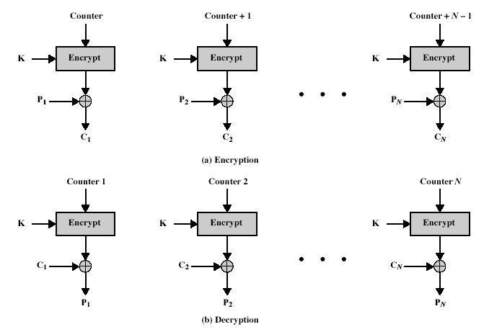
Counter (CTR)

Slide 22
Advantages and Limitations of CTR
Efficiency
can preprocess in advance of need
good for bursty high speed links
random access to encrypted data blocks
provable security (good as other modes)
but must ensure never reuse key/counter values, otherwise could break

Slide 23
Summary
Double DES
Triple-DES
Modes of Operation
ECB, CBC, CFB, OFB, CTR

Slide 24
Thank You!
Any Question…

