Slide 1

Department of CE
Unit no: 8
Unit title : Key Distibution
Cryptography and Network Security
3161609

Slide 2
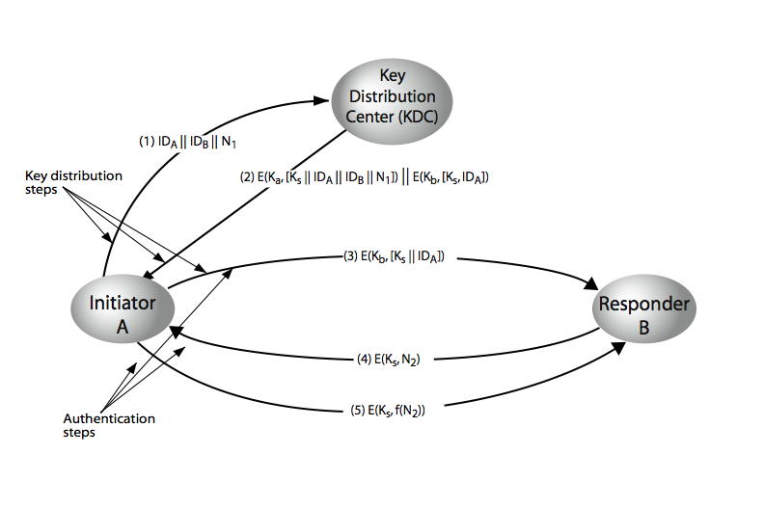
Key Distribution Scenario

Slide 3
Key Distribution Scenario

Slide 4
Thank You!
Any Question…

