Slide 1

Department of CE
Unit no: 9
Unit title : Authentication Applications: Kerberoso
Information and Network Security and 2170709
Munindra Lunagaria

Slide 2
Authentication Applications
will consider authentication functions
developed to support application-level authentication & digital signatures
will consider Kerberos – a private-key authentication service
then X.509 - a public-key directory authentication service

Slide 3
Kerberos
trusted key server system from MIT
provides centralised private-key third-party authentication in a distributed network
allows users access to services distributed through network
without needing to trust all workstations
rather all trust a central authentication server
two versions in use: 4 & 5

Slide 4
Kerberos Requirements
its first report identified requirements as:
secure
reliable
transparent
scalable
implemented using an authentication protocol based on Needham-Schroeder

Slide 5
Kerberos v4 Overview
a basic third-party authentication scheme
have an Authentication Server (AS)
users initially negotiate with AS to identify self
AS provides a non-corruptible authentication credential (ticket granting ticket TGT)
have a Ticket Granting server (TGS)
users subsequently request access to other services from TGS on basis of users TGT

Slide 6
Kerberos v4 Dialogue
obtain ticket granting ticket from AS
once per session
obtain service granting ticket from TGT
for each distinct service required
client/server exchange to obtain service
on every service request

Slide 7
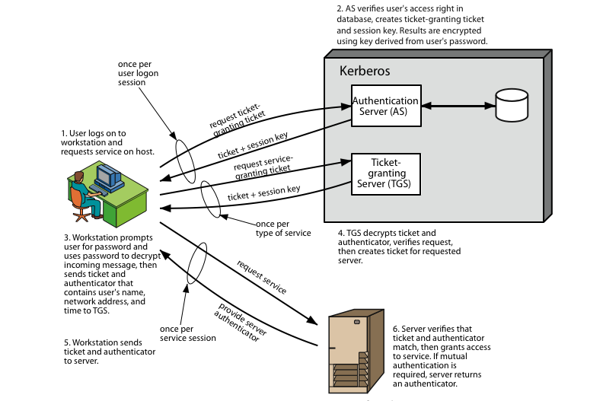
Kerberos 4 Overview

Slide 8
Kerberos Realms
a Kerberos environment consists of:
a Kerberos server
a number of clients, all registered with server
application servers, sharing keys with server
this is termed a realm
typically a single administrative domain
if have multiple realms, their Kerberos servers must share keys and trust

Slide 9
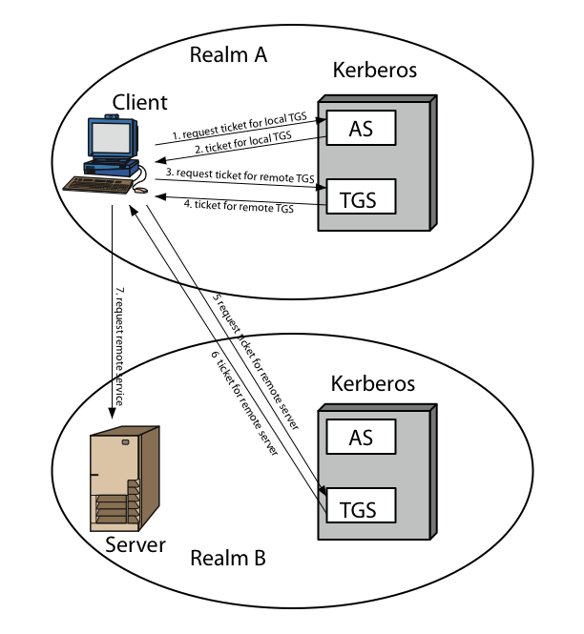
Kerberos Realms

Slide 10
Kerberos Version 5
developed in mid 1990’s
specified as Internet standard RFC 1510
provides improvements over v4
addresses environmental shortcomings
encryption alg, network protocol, byte order, ticket lifetime, authentication forwarding, interrealm auth
and technical deficiencies
double encryption, non-std mode of use, session keys, password attacks

Slide 11
X.509 Certificates
issued by a Certification Authority (CA), containing:
version (1, 2, or 3)
serial number (unique within CA) identifying certificate
signature algorithm identifier
issuer X.500 name (CA)
period of validity (from - to dates)
subject X.500 name (name of owner)
subject public-key info (algorithm, parameters, key)
issuer unique identifier
subject unique identifier
extension fields (v3)
signature (of hash of all fields in certificate)
notation CA<<A>> denotes certificate for A signed by CA

Slide 12
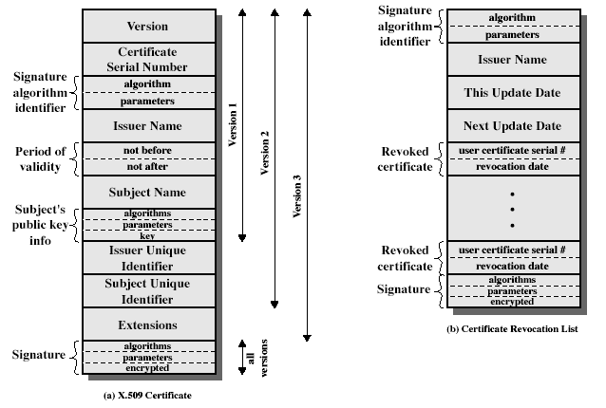
X.509 Certificates

Slide 13
Obtaining a Certificate
any user with access to the public key of the CA can verify the user public key that was certified
only the CA can modify a certificate without being detected
cannot be forged, certificates can be placed in a public directory

Slide 14
CA Hierarchy
if both users share a common CA then they are assumed to know its public key
otherwise CA's must form a hierarchy
use certificates linking members of hierarchy to validate other CA's
each CA has certificates for clients (forward) and parent (backward)
each client trusts parents certificates
enable verification of any certificate from one CA by users of all other CAs in hierarchy

Slide 15
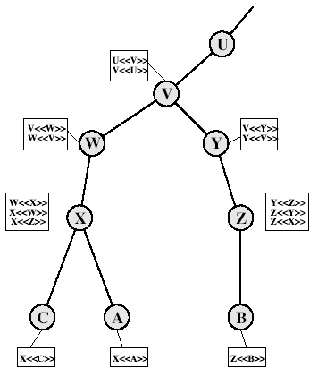
CA Hierarchy Use

Slide 16
Certificate Revocation
certificates have a period of validity
may need to revoke before expiration, eg:
user's private key is compromised
user is no longer certified by this CA
CA's certificate is compromised
CAs maintain list of revoked certificates
the Certificate Revocation List (CRL)
users should check certificates with CA’s CRL

Slide 17
Certificate Extensions
key and policy information
convey info about subject & issuer keys, plus indicators of certificate policy
certificate subject and issuer attributes
support alternative names, in alternative formats for certificate subject and/or issuer
certificate path constraints
allow constraints on use of certificates by other CA’s

Slide 18
Thank You!
Any Question…

