Slide 1
Disclaimer
It is hereby declared that the production of the said content is meant for non-commercial, scholastic and research purposes only.
We admit that some of the content or the images provided in this channel's videos may be obtained through the routine Google image searches and few of them may be under copyright protection. Such usage is completely inadvertent.
It is quite possible that we overlooked to give full scholarly credit to the Copyright Owners. We believe that the non-commercial, only-for-educational use of the material may allow the video in question fall under fair use of such content. However we honour the copyright holder's rights and the video shall be deleted from our channel in case of any such claim received by us or reported to us.

Slide 2
IPDC
Department of
Learning & Development
Integrated Personality Development Course
Module title – Facing Failures
Subject name –
IPDC
Subject code – 3150005
Topic 1 : Insignificance of Failure

Slide 3
Learning Objectives
IPDC
(Insignificance of Failure|| Module : Facing Failures)
Understand why failures are insignificant
Identify and use the six powerful techniques

Slide 4

IPDC
(Insignificance of Failure|| Module : Facing Failures)
Failure is necessary in life

Slide 5

IPDC
(Insignificance of Failure|| Module : Facing Failures)
What will happen if I fail in my life?

Slide 6

IPDC
(Insignificance of Failure|| Module : Facing Failures)
1. Don’t Personalize your failure

Slide 7
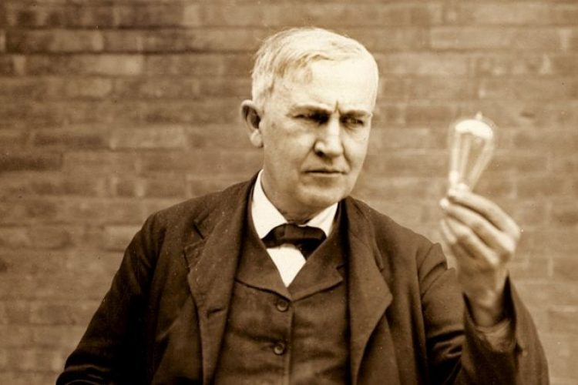

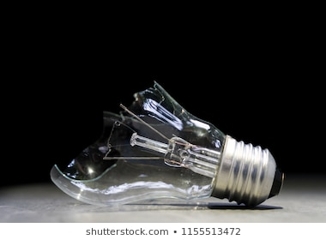


IPDC
(Insignificance of Failure|| Module : Facing Failures)
2. Keep a Learning Attitude

Slide 8






IPDC
(Insignificance of Failure|| Module : Facing Failures)
3. Don’t dwell upon your mistakes or The 24 – Hour Rule

Slide 9




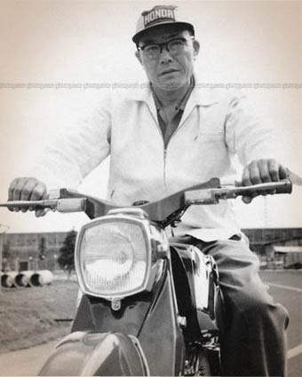
IPDC
(Insignificance of Failure|| Module : Facing Failures)
4. Don’t give the power of approval to others

Slide 10


