Slide 1
Disclaimer
It is hereby declared that the production of the said content is meant for non-commercial, scholastic and research purposes only.
We admit that some of the content or the images provided in this channel's videos may be obtained through the routine Google image searches and few of them may be under copyright protection. Such usage is completely inadvertent.
It is quite possible that we overlooked to give full scholarly credit to the Copyright Owners. We believe that the non-commercial, only-for-educational use of the material may allow the video in question fall under fair use of such content. However we honour the copyright holder's rights and the video shall be deleted from our channel in case of any such claim received by us or reported to us.

Slide 2
IPDC
Department of
Learning & Development
Integrated Personality Development Course
Module title – Facing Failures
Subject name –
IPDC
Subject code – 3150005
Topic 2 : The power of faith

Slide 3
Learning Objectives
IPDC
(The power of faith || Module : Facing Failures)
Understanding of Faith
Necessity of faith in life
Belief system and its impacts

Slide 4


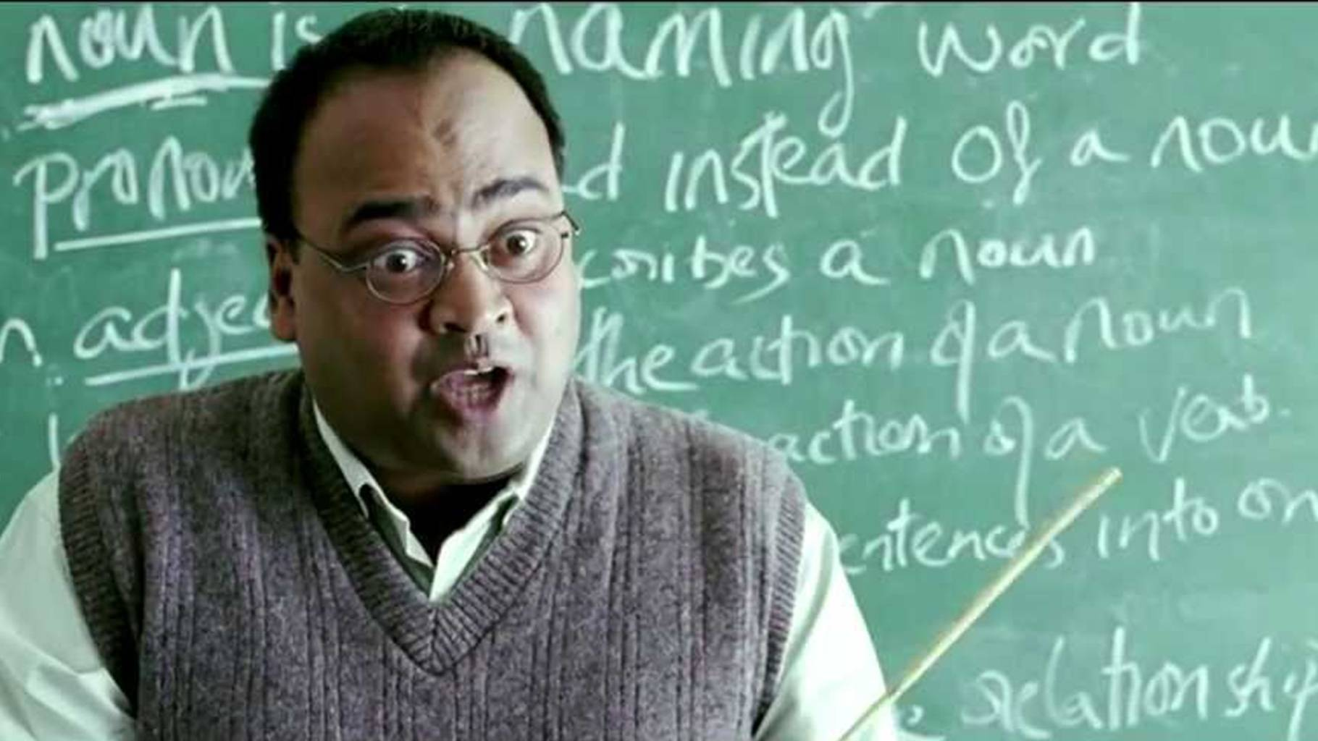

IPDC
(The power of faith || Module : Facing Failures)
The necessity of faith

Slide 5
IPDC
(The power of faith || Module : Facing Failures)
Think of something that you want to achieve. Something that you have the ability to achieve but somehow you are stopping yourself. Maybe you doubt your ability, or because you have a fear, or because you worry it is bigger than yourself.
Example: I want to be able to give presentation to other people and be able to confidently convey my message to them, but I stopped trying because I suffer from stage fright.

Slide 6
IPDC
(The power of faith || Module : Facing Failures)
Your Turn…

Slide 7
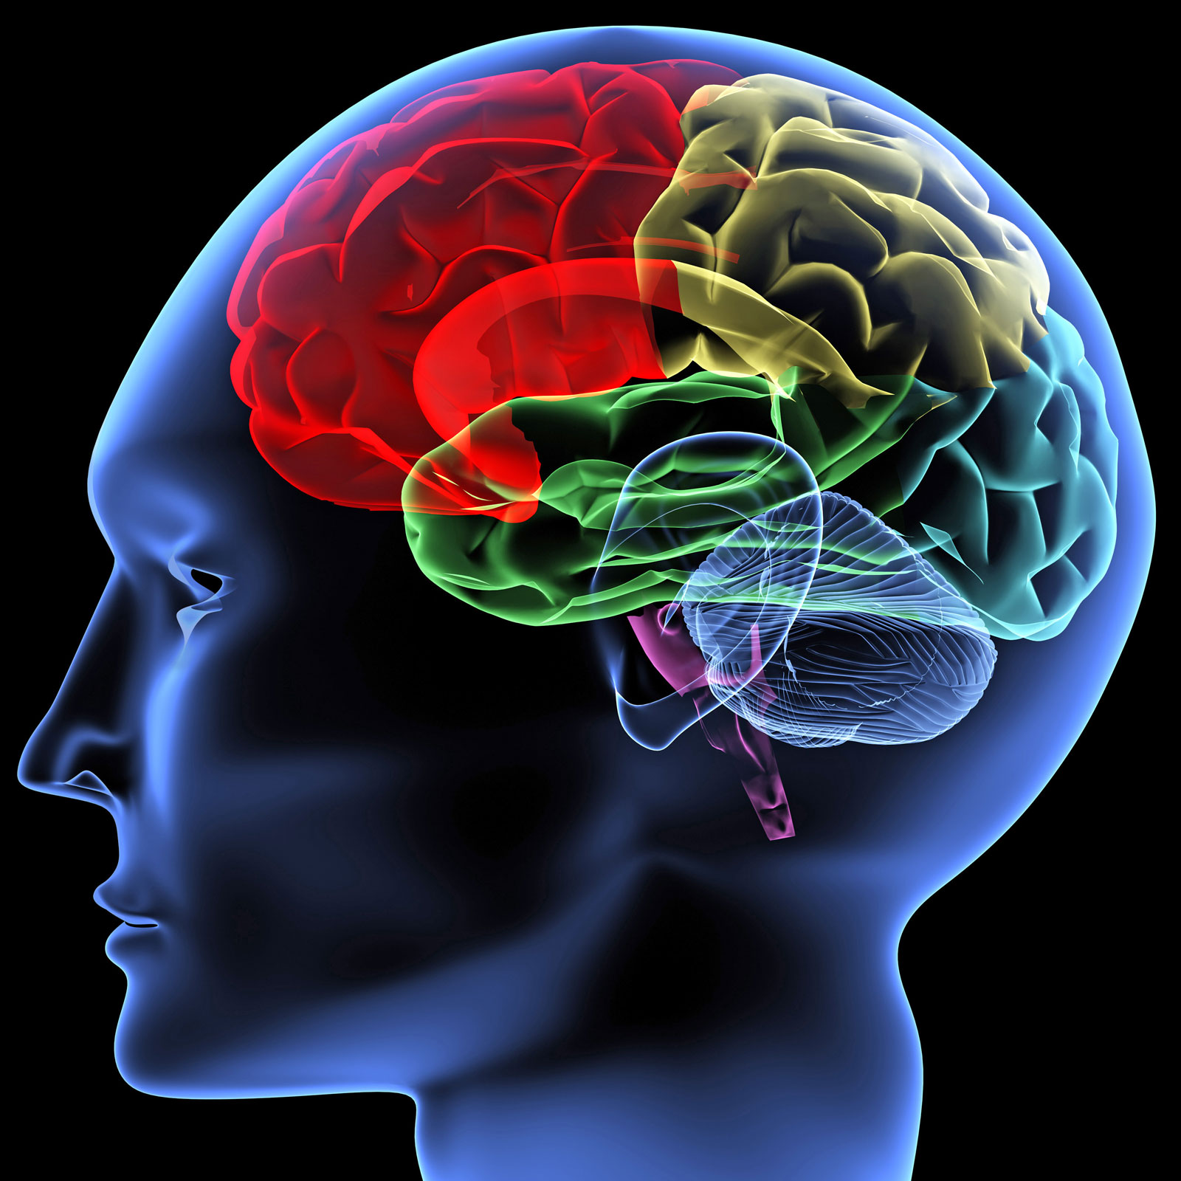
IPDC
(The power of faith || Module : Facing Failures)
We have been blessed with infinite potential and our brain
is an evidence of that.
“To be a champ, you have to
believe in yourself when no one else will”
Sugar Ray Robinson

Slide 8
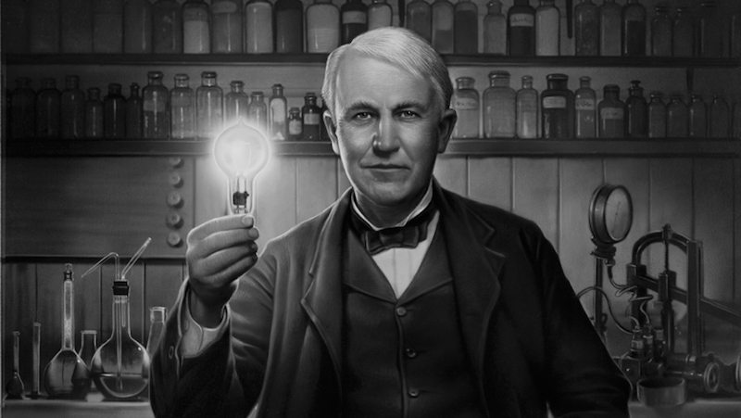
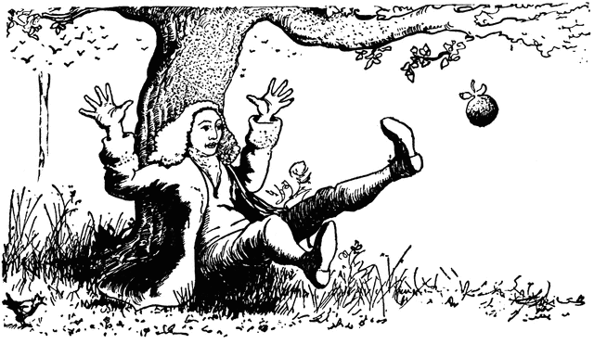
IPDC
(The power of faith || Module : Facing Failures)
10000 attempts
22 years to present gravity

Slide 9
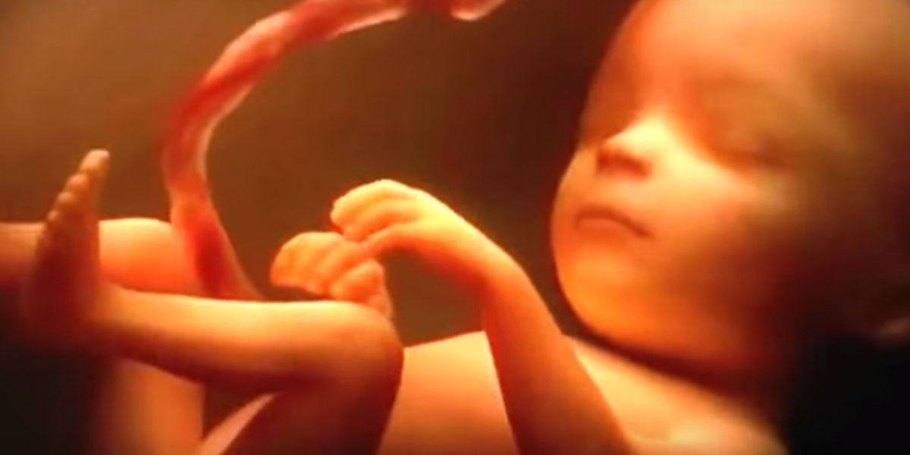
IPDC
(The power of faith || Module : Facing Failures)
Nobody knows about the future of the child- Intelligence, career, marriage, fame etc. though the child is loved by parents because of faith.

Slide 10

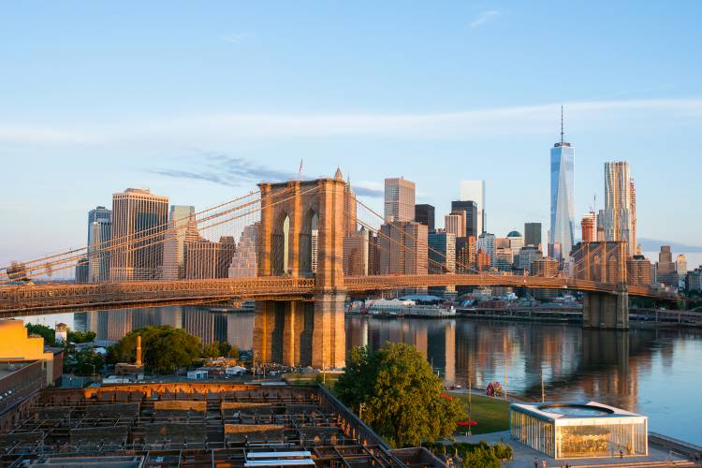
IPDC
(The power of faith || Module : Facing Failures)
Brooklyn Bridge
Thought by father, continued by son and finished by wife-in-law after multiple accidents.

Slide 11
IPDC
(The power of faith || Module : Facing Failures)
BELIEF IS STRONG ENOUGH TO GET YOU OUT OF ALL THE PITS

Slide 12

IPDC
(The power of faith || Module : Facing Failures)
Believe in yourself and you will reach great heights

Slide 13
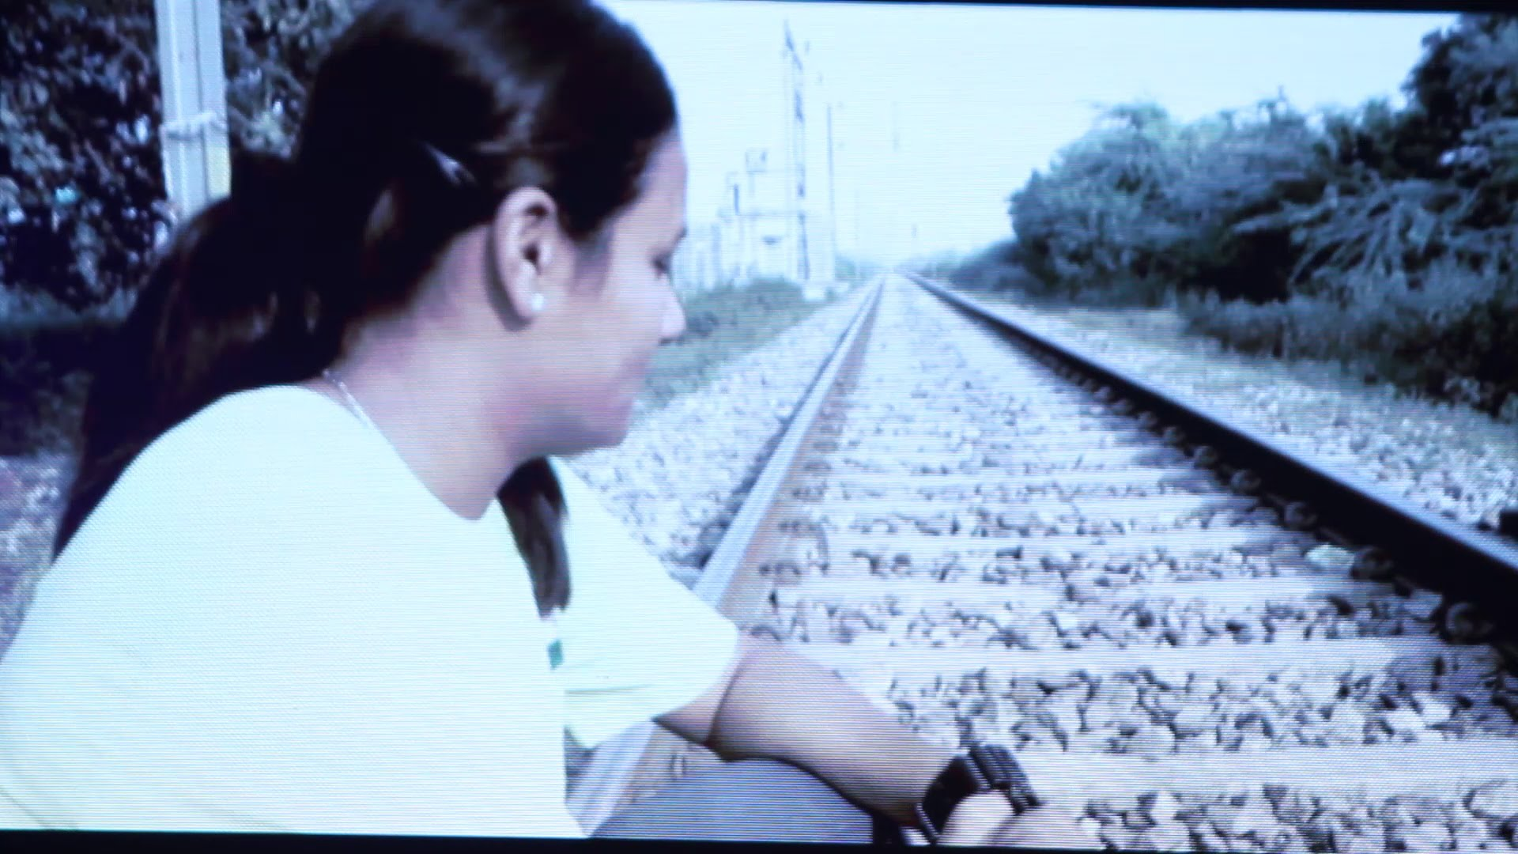
IPDC
(The power of faith || Module : Facing Failures)

Slide 14
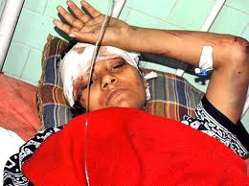
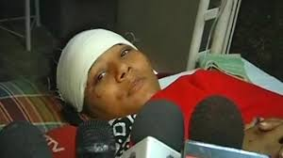
IPDC
(The power of faith || Module : Facing Failures)

Slide 15

IPDC
(The power of faith || Module : Facing Failures)

Slide 16
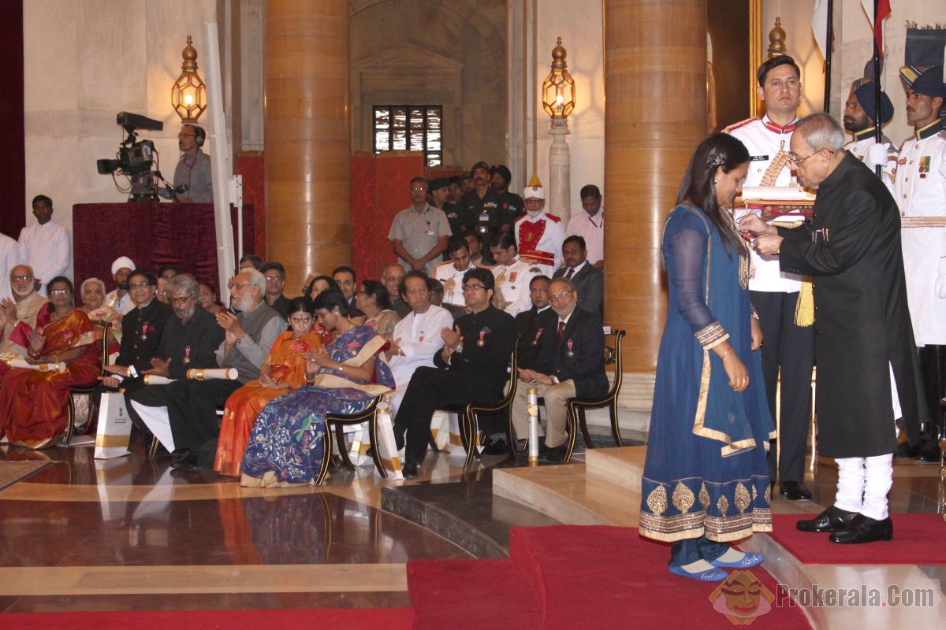

IPDC
(The power of faith || Module : Facing Failures)

Slide 17

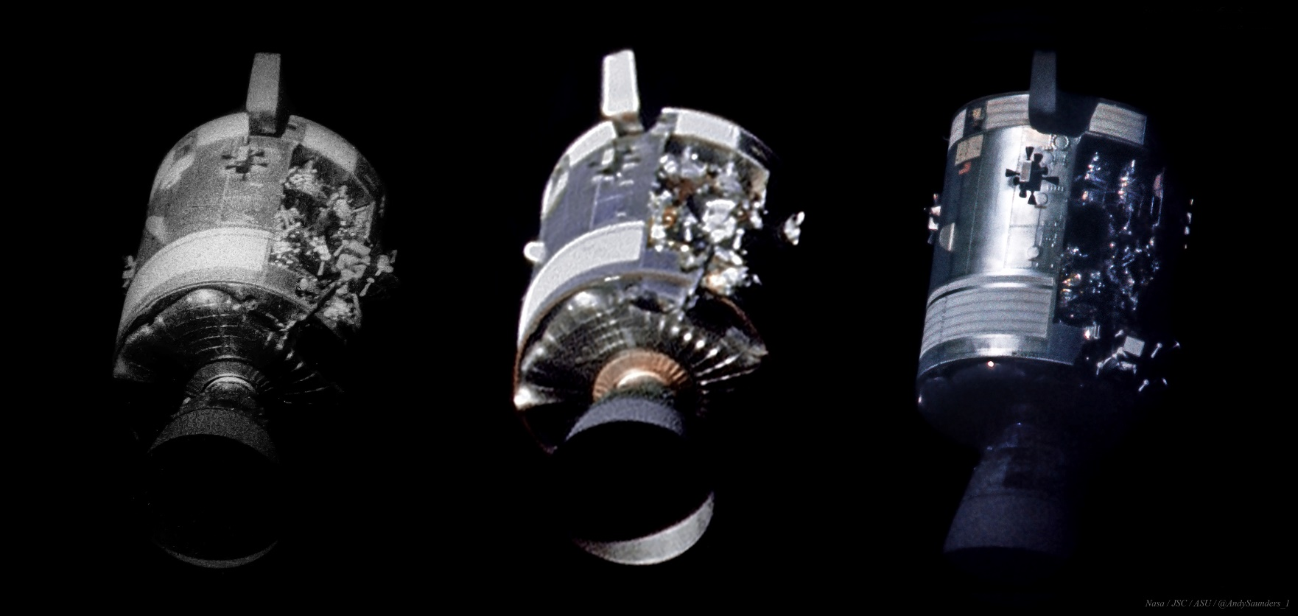
IPDC
(The power of faith || Module : Facing Failures)

Slide 18

IPDC
(The power of faith || Module : Facing Failures)
It is not necessary to be able to see or understand someone or something to have faith in it.

Slide 19


