Slide 1
Disclaimer
It is hereby declared that the production of the said content is meant for non-commercial, scholastic and research purposes only.
We admit that some of the content or the images provided in this channel's videos may be obtained through the routine Google image searches and few of them may be under copyright protection. Such usage is completely inadvertent.
It is quite possible that we overlooked to give full scholarly credit to the Copyright Owners. We believe that the non-commercial, only-for-educational use of the material may allow the video in question fall under fair use of such content. However we honour the copyright holder's rights and the video shall be deleted from our channel in case of any such claim received by us or reported to us.

Slide 2
IPDC
Department of
Learning & Development
Integrated Personality Development Course
Module title – Facing Failures
Subject name –
IPDC
Subject code – 3150005
Topic 3 : Practicing Faith

Slide 3
Learning Objectives
IPDC
(Practicing Faith || Module : Facing Failures)
Understanding the impact of practicing faith in our day to day life
Explore different ways to cultivate spiritual habits

Slide 4

IPDC
(Practicing Faith || Module : Facing Failures)
Understanding the impact of practicing faith in our day to day life

Slide 5

IPDC
(Practicing Faith || Module : Facing Failures)
Understanding the impact of practicing faith in our day to day life

Slide 6
IPDC
(Practicing Faith || Module : Facing Failures)
Explore different ways to cultivate spiritual habits
Stay Stable
Find Strength
Achieve Beyond Your Potential

Slide 7
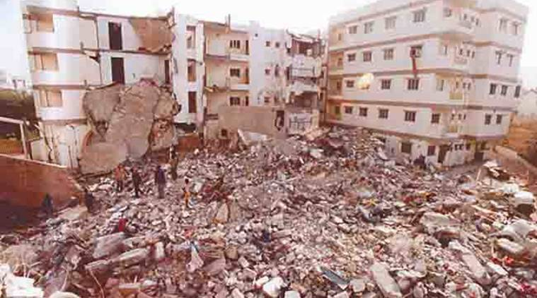
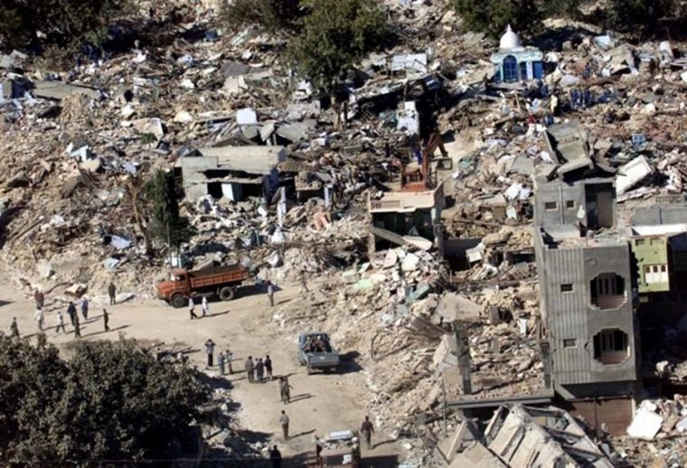
IPDC
(Practicing Faith || Module : Facing Failures)
Stay Stable
Case Study – 1 : Unshakable Stability (26th January, 2001)

Slide 8
IPDC
(Practicing Faith || Module : Facing Failures)
Stay Stable
Case Study – 1 : Unshakable Stability (26th January, 2001)
26th Jan, 2001. This was a day that shook the whole nation. It was an earthquake that only lasted for 2 minutes, but Its damage lasted for decades. It was the most devastating earthquake in the last 150 years. With a magnitude of 7.7.Mw,The earthquake left the city of Bhuj and its surrounding areas in ruins. While taking the lives of more than 20,000 people and injuring more than 150,000.
Kalpesh Bhatt was present in Bhuj during this time. He first-hand witnessed the horrors of the disaster. Amidst the chaos, he saw an elderly man sitting calmly on a pile of what looked like a collapsed building. Kalpesh Bhatt approached the elderly man who now seemed to be lost in thought. Bhatt kindly offered him some teat and asked him if anyone in his family had passed away. The man’s reply was tragic. He was sitting on everything that was once his…his 2 – storey house, his wife, his sons , his grand children…and now they were all gone.

Slide 9
IPDC
(Practicing Faith || Module : Facing Failures)
Stay Stable
Case Study – 1 : Unshakable Stability (26th January, 2001)
His reply left Bhatt saddened and speechless . Surprisingly, it was the elderly man who started to console Bhatt. “Have you read the Gita?” he asked. "I used to read it daily, believing it would come in use. Today that day has come.” He recalled a stanza from the Bhagvad Gita …For any one who is born, death is certain; everything is perishable, nothing lasts.In 5 to 10 years time, I was going to die.And after death, they would have been gone for me, and this would have been a big pile of rubble. But it is God’s wish that it is to be reversed. First , they go and then me.”
Bhatt was astounded at how this man could remain stable through such an awful time. The elderly man decided to accompany Bhatt to the food camp. He continued to stay there, to serve food to the victims and give them words of encouragement.

Slide 10
IPDC
(Practicing Faith || Module : Facing Failures)
Stay Stable
Case Study – 1 : Unshakable Stability (26th January, 2001)
Answer the following questions :
In the case study, we saw the elderly man respond to the situation with extraordinary understanding and patience. How would an average person react to the same situation that the elderly man found himself in?
2. From where did the elderly man find inspiration to deal with the difficult situation? With which understanding did he find stability?

Slide 11

IPDC
(Practicing Faith || Module : Facing Failures)
2. Find Strength
Case Study – 2 : Hold On

Slide 12
IPDC
(Practicing Faith || Module : Facing Failures)
Case Study – 2 : Hold On
2. Find Strength
Since a young age, She experienced constant miseries. Even though she was born in a grand home in India, amidst luxury. Her father’s alcohol addiction created a toxic atmosphere in the home. To avoid the fighting, she would hide in the local church. Her father’s bad financial choices caused them to lose their home. They ended up living in a very small simple house. Her mother soon faced a serious accident and suffered much pain due to burns. Even after marriage and finding a new home in America, she had to live in poverty. She had to do low-end work to care for her family. Amidst all these problems, she would find peace when talking to her brother. They would talk for hours. They successfully submitted a file for him to come to America. She was excited to soon have his company. But it was not long until bad news struck once again, her brother had died in accident.
Throughout this pain and hardship, she found something that kept her strong. After attending a spiritual assembly in 2007, she felt her faith reawakened. From then on, she tried to mentally connect to God and her guru in every task throughout the day. She would constantly remind herself that God loves me and is always with me. It was through this connection that she found hope and happiness throughout all her difficulties.

Slide 13
IPDC
(Practicing Faith || Module : Facing Failures)
2. Find Strength
Case Study – 2 : Hold On
Answer the following question :
How did Practicing Faith help this woman live a happy life?

Slide 14
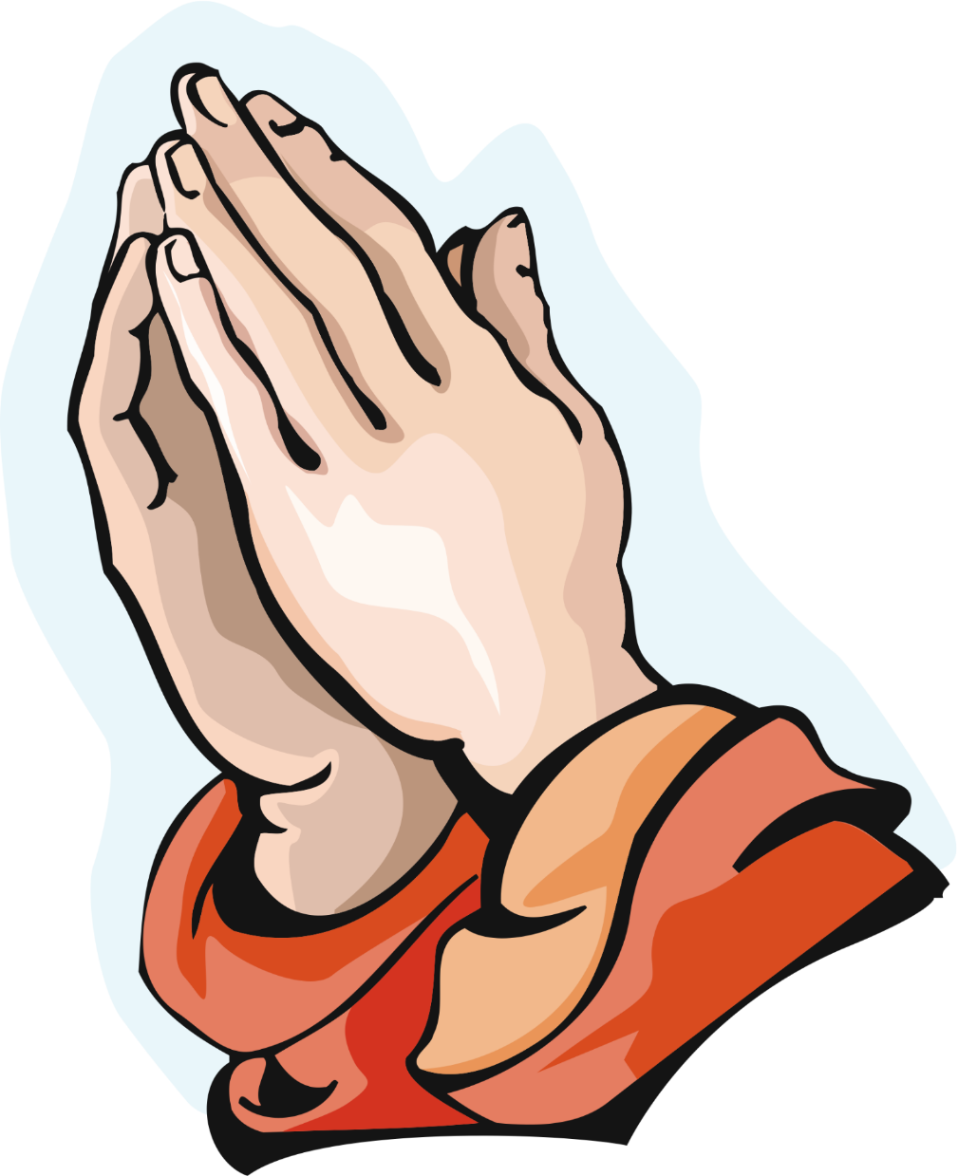

IPDC
(Practicing Faith || Module : Facing Failures)
3. Achieve Beyond Your Potential
Case Study – 3 : Prayer

Slide 15
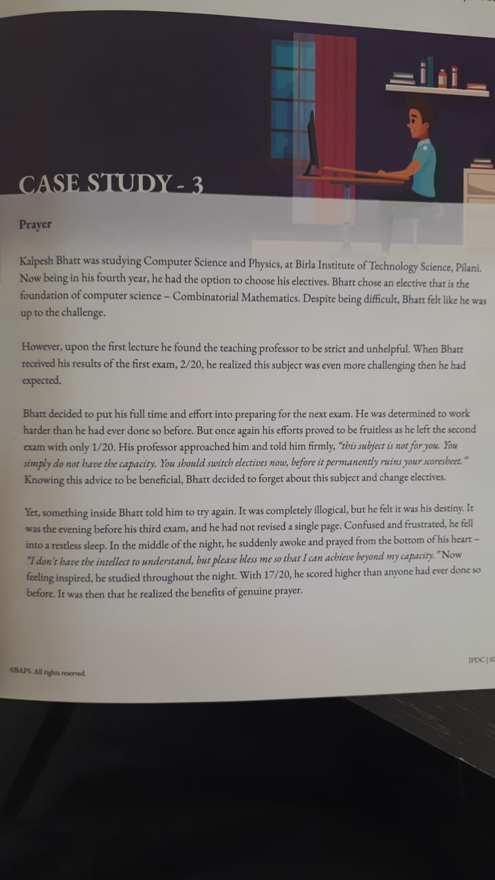
IPDC
(Practicing Faith || Module : Facing Failures)
3. Achieve Beyond Your Potential
Case Study – 3 : Prayer

Slide 16
IPDC
(Practicing Faith || Module : Facing Failures)
3. Achieve Beyond Your Potential
Case Study – 3 : Prayer

Slide 17
IPDC
(Practicing Faith || Module : Facing Failures)
3. Achieve Beyond Your Potential
Case Study – 3 : Prayer
Answer the following questions :
How do we know that Kalpesh Bhatt did not have the capacity to achieve the highest score in the exam?
2. How did prayer help him when he was feeling overwhelmed?

Slide 18
IPDC
(Practicing Faith || Module : Facing Failures)
Prayer
Write potential prayers that you could perform that you could perform throughout the day.
Wake Up | Description | Tick Here
Before leaving the house | Description | Tick Here
Before the first class begins | Description | Tick Here
Before eating lunch | Description | Tick Here
Before studying for exams | Description | Tick Here
Before Sleeping | Description | Tick Here

Slide 19


