Slide 1
What's next?
Android Developer Fundamentals
Lesson 15
This work is licensed under a Creative Commons Attribution-NonCommercial 4.0 International License

Slide 2
15.1 Prepare and Publish Your App!
This work is licensed under a Creative Commons Attribution-NonCommercial 4.0 International License

Slide 3
Contents
Prepare your app for release
Publish!

Slide 4
Steps for publishing your app
Prepare app for release
Generate signed APK
Upload to Google Play
Run alpha and beta tests
Publish to the world

Slide 5
What is an APK?
Android Application Package file → .apk file
It's like the executable
Each Android application is compiled and packaged in a single file that includes all the app's code, resources, assets, and manifest file
You need an APK to publish on Google Play

Slide 6

Share your app during development
Ways to distribute your app
Zip it up
Share the source code
Publish to github
Make an APK

Slide 7

Share with friends and family
Use alpha and beta tests to share your app with friends and family

Slide 8
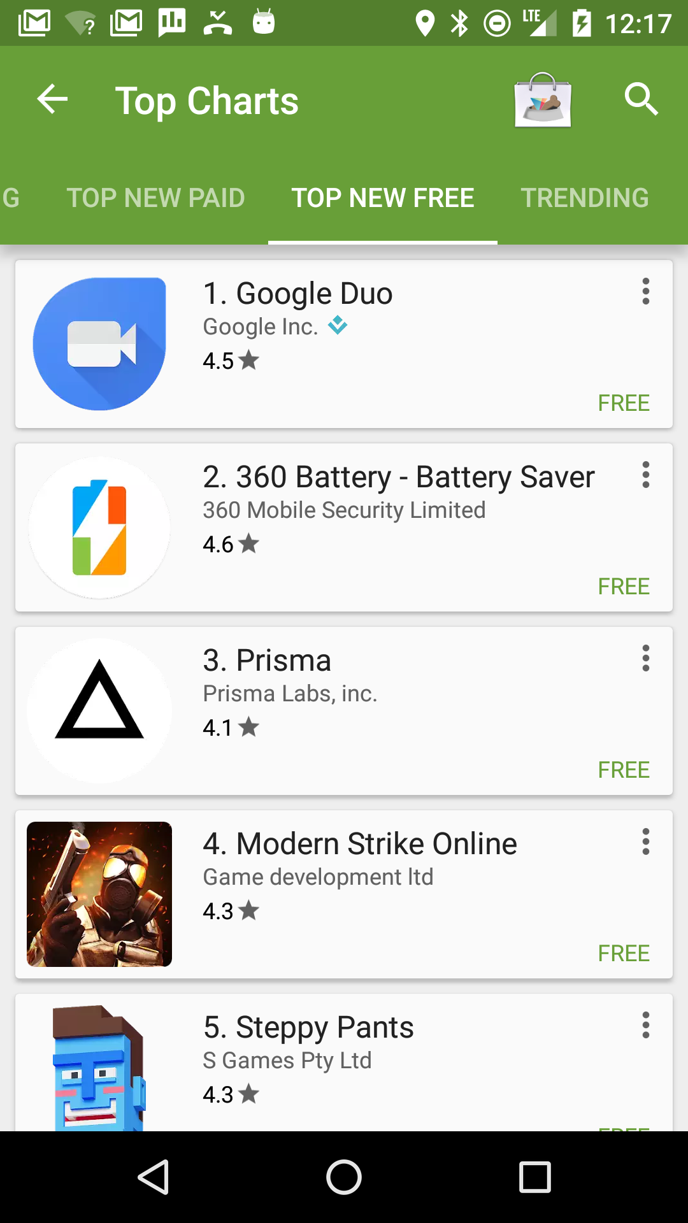
Share your production app
Publish on Google Play
Make an APK
Upload to Google Play
Run alpha and beta tests
Publish!

Slide 9
Prepare Your App for Release

Slide 10
Prepare your app for release
Test, test, test!
Add an icon
Make sure your app has the correct filters
Choose an Application ID
Specify API levels targets
Clean up your app
Generate a signed APK for release
developer.android.com/studio/publish/preparing.html

Slide 11
Test, test, test!
First, make sure your app works correctly...
Test your app on different devices and screen size
Test your app on older devices
Use support library for backwards compatibility
Test, test, test!

Slide 12

Test on devices in a data center
Test on real devices in a data center using the
Firebase Cloud Test Lab

Slide 13
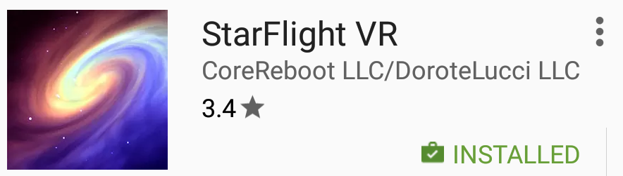
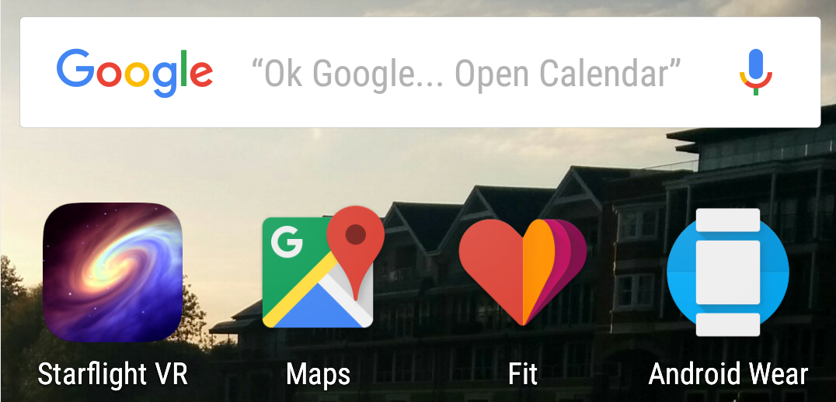
Add launcher app icon
The launcher icon appears in
Google Play
On the device
Home screen
Manage Applications
My Downloads

Slide 14
Google Play filters search results
Google Play search results only show apps that are compatible with the user's device.
If an app uses a camera, Google Play only shows the apps to devices that have a camera.
developer.android.com/google/play/filters.html

Slide 15
Types of filters
Hardware features
API level
Manifest settings such as
<supports-screens>
<uses-feature>
Countries (selected during APK upload)
developer.android.com/google/play/filters.html

Slide 16
Choose your Application ID
Application ID defines your application's identity
Must be unique across all apps from everyone!
If you change App ID and re-publish
The app becomes a different application
Users of the previous app cannot update to the new app

Slide 17
Application ID versus package name
Initial Application ID is set to the package
You can change Application ID in build.gradle independently of package name
tools.android.com/tech-docs/new-build-system/applicationid-vs-packagename
Notes:
The initial application ID when you create an app is exactly the same as the package specified in Android Manifest
Before releasing to Google Play, it's best to change it so that you have control over different editions of your app

Slide 18
Specify Application ID in build.gradle
android {
compileSdkVersion 23
buildToolsVersion "23.0.3"
defaultConfig {
applicationId "android.mydomain.com.myappid"
...
}
...
}
Initial Application ID is same as package in Android manifest

Slide 19
Set min and target API level
minSdkVersion — minimum version of the Android platform that the app runs on
targetSdkVersion — API level that the app is designed for
API levels: developer.android.com/guide/topics/manifest/uses-sdk-element.html#ApiLevels
Notes:
In some cases, targetSdkVersion allows the app to use manifest elements or behaviors defined in the target API level, rather than being restricted to using only those defined for the minimum API level.

Slide 20







Android versions
Codename |  | Version | Release Date | API Level
Honeycomb |  | 3.0 - 3.2.6 | Feb 2011 | 11 - 13
Ice Cream Sandwich |  | 4.0 - 4.0.4 | Oct 2011 | 14 - 15
Jelly Bean |  | 4.1 - 4.3.1 | July 2012 | 16 - 18
KitKat |  | 4.4 - 4.4.4 | Oct 2013 | 19 - 20
Lollipop |  | 5.0 - 5.1.1 | Nov 2014 | 21 - 22
Marshmallow |  | 6.0 - 6.0.1 | Oct 2015 | 23
Nougat |  | 7.0 | Sept 2016 | 24
There were earlier versions before Feb 2011.

Slide 21
Clean up your app
Remove logging statements
Disable debugging
Clean up your project directories
Update URLs for servers and services
Reduce APK size

Slide 22
Why does APK size matter?
The size of your APK affects:
how fast your app loads
how much memory it uses
how much power it consumes
developer.android.com/topic/performance/reduce-apk-size.html

Slide 23
Why reduce APK size?
Users might abandon "large" apps, particularly:
in areas with unreliable 2G and 3G networks
on devices that work on pay-by-the-byte plans
developer.android.com/topic/performance/reduce-apk-size.html

Slide 24
Reducing APK size
Remove unused resources
Reuse resources
Minimize resource use from libraries
Reduce native and Java code
Reduce space needs for images
developer.android.com/topic/performance/reduce-apk-size.html

Slide 25
Reduce image sizes
Reduce animation frames
Use Drawable objects
Crunch PNG files
Use lowest quality and size JPEG files that look good
Use WebP File Format
Use vector graphics
developer.android.com/topic/performance/reduce-apk-size.html

Slide 26
Clean up project folders
Clean up project folders and files
Stray or orphaned files can prevent your application from compiling and cause it to behave unpredictably
developer.android.com/studio/projects/index.html#ApplicationProjects

Slide 27
Clean up jni, lib, and src folders
src: source files for your app (.java and .aidl files) NO jar files
lib: third-party or private library files, including prebuilt shared and static libraries (such as .so files)
jni: source files associated with the Android NDK, such as .c, .cpp, .h, and .mk files

Slide 28
Clean up assets, resources, and tests
Remove unused private or proprietary data files
For example, delete unused drawable files, layout files, and values files from res/ folder
Review the assets and res/raw directories for raw asset files and static files to update or remove
Remove unused test directories

Slide 29
Generate APK

Slide 30
Generate signed APK for release
Android apps must be digitally signed before users can install them
Use Android Studio to generate and sign your APK

Slide 31
Digital certificates
A public-key certificate contains:
the public key of a public/private key pair,
other metadata identifying the owner of the key such as name and location
The owner of the certificate holds the private key.

Slide 32
Public and private key for app
When Android Studio signs the app, it creates the public certificate and the private key.
It attaches the public certificate to the APK.
You must securely store the private key in a keystore

Slide 33
Why you need to sign your app
The public-key certificate serves as as a "fingerprint" that uniquely associates the APK to you and your corresponding private key.
This helps Android ensure that any future updates to your APK are authentic and come from the original author.

Slide 34
Publish to Google Play
This work is licensed under a Creative Commons Attribution-NonCommercial 4.0 International License

Slide 35
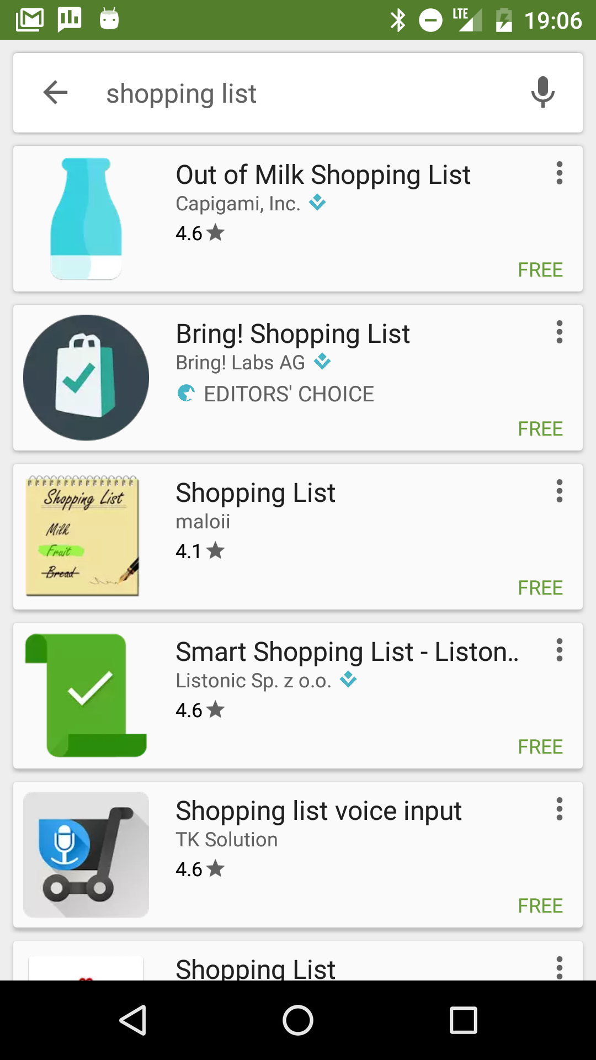

Publish your app!
Publish your Android apps on Google Play
Users can
search
download
review

Slide 36
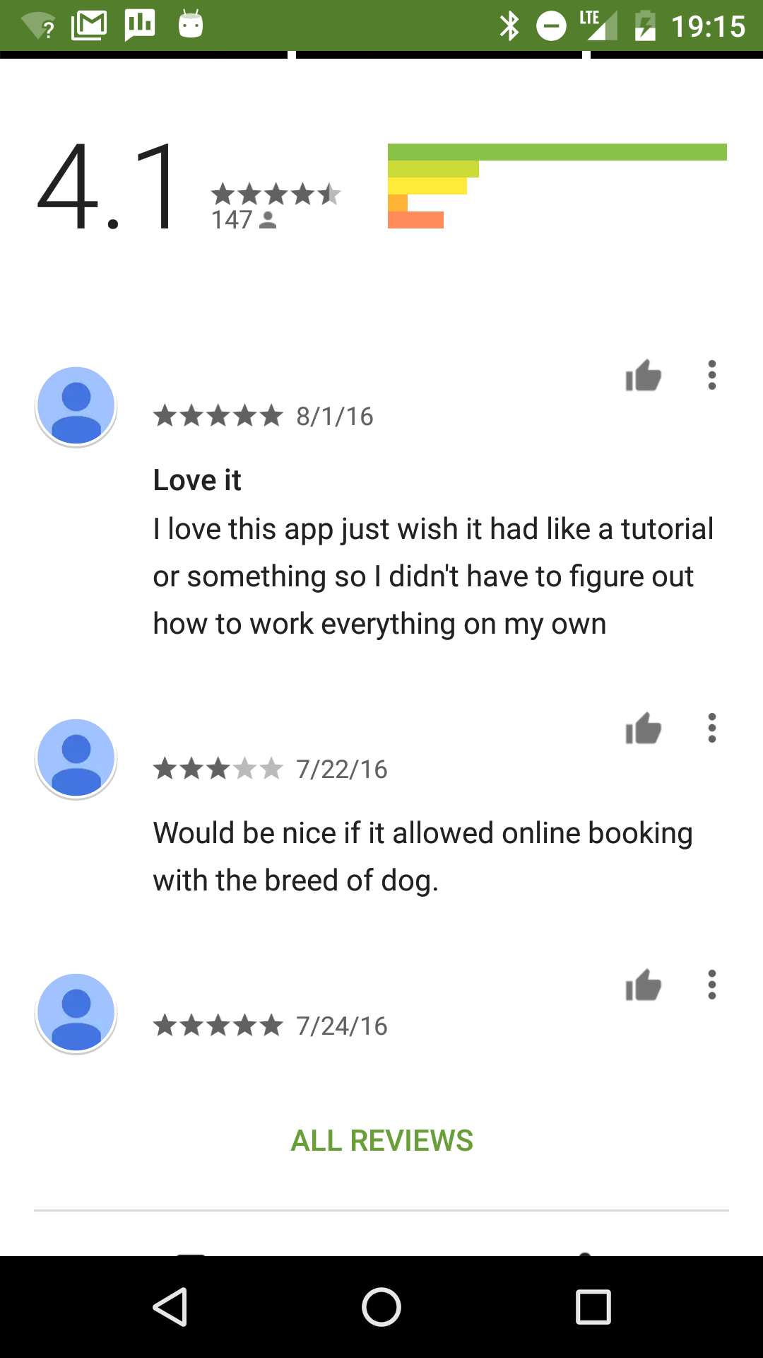
Users can review!
Make sure your app is ready before publishing to the world!
People will give you bad reviews if they are unhappy with it
The more they like it, the more they will want more features!

Slide 37
Steps to publish
Create an account on Google Play developer console
Create an entry for your app
Add the required assets and information
Run alpha and beta tests
Run pre-launch reports
Publish to the world!

Slide 38
Google Play Developer Console

Slide 39
Sign up for Google Play
Go to play.google.com/apps/publish/
Accept agreement
Pay the registration fee
Enter your details

Slide 40
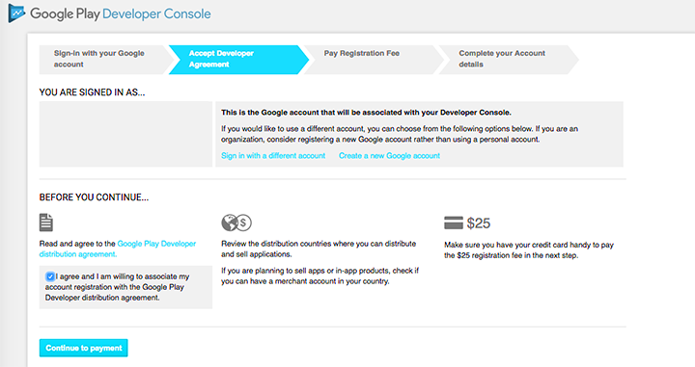
Google Play Developer Console
play.google.com/apps/publish/

Slide 41
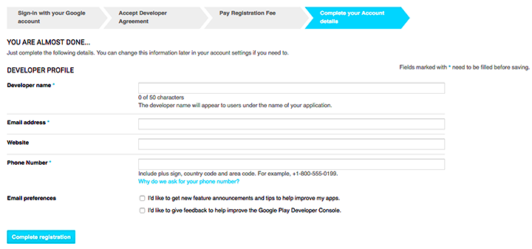
Enter your details
Name
Address
Website
Phone
Email preferences

Slide 42
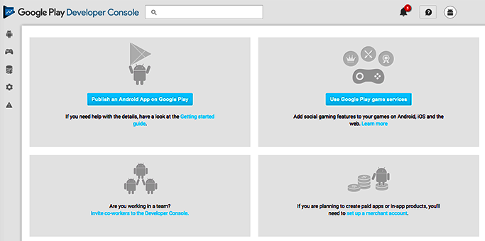
You're in!

Slide 43
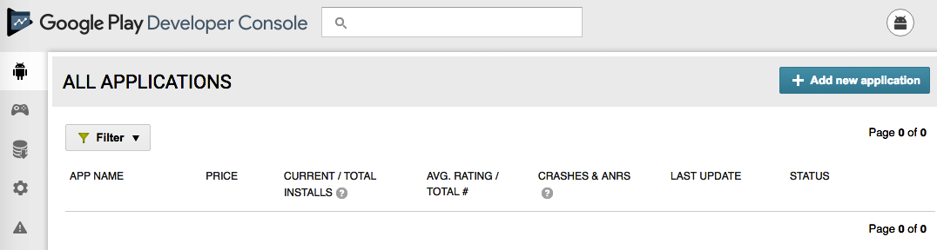
Add an application

Slide 44
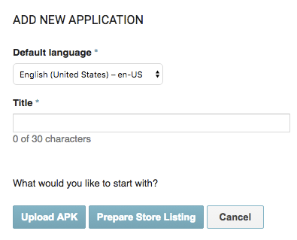
Add an application
Upload APK
or
Prepare Store Listing
To run alpha and beta tests, upload the APK

Slide 45
Alpha and Beta Tests

Slide 46
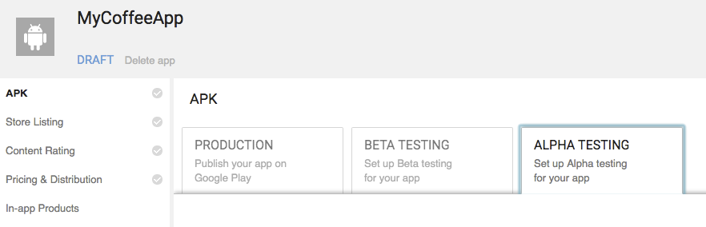
Run alpha and beta tests
Run alpha and beta tests in Google Play developer console

Slide 47
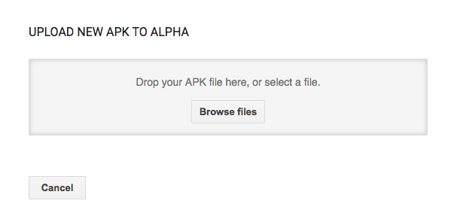
Choose file to upload

Slide 48
Why run alpha and beta tests?
Test your app before public release to help find and fix any technical or user experience issues
Get the bugs out before you release your app to the world!
Feedback from your test users does not affect your app’s public rating

Slide 49
Share with testers before publishing
Alpha test during development
Use alpha tests for early experimental versions of your app that might contain incomplete or unstable functionality
Beta test with limited number of real users
Use beta tests for apps that should be complete and stable

Slide 50
Alpha and beta tests
During alpha and beta tests
Your app is not listed in Google Play
Testers must have a link to get it
Testers cannot give reviews in Google Play

Slide 51
Closed beta
People have to be invited to join closed alpha and beta tests
Closed beta using email addresses
use lists of individual email addresses which you can add individually or upload as a .csv file
Closed beta with Google+ community or Google Group
You can move closed betas to an open beta while maintaining your existing testers

Slide 52
Open beta
Anyone with the link can join
Can scale to a larger group
You can limit max number of testers

Slide 53
Get feedback
Closed tests:
Provide a way for users to give feedback on your app, such as by email, website, or a message forum
Open tests:
Your testers can give private feedback in Google Play Store
support.google.com/googleplay/android-developer/answer/ 138230#browse_reviews

Slide 54
Get private feedback for open betas
For open tests (alpha or beta) program, you can see and reply to user feedback in the Developer Console
Alpha and beta feedback from users is only visible to you and cannot be seen in the Google Play store

Slide 55
Pre-launch Report
Test before you publish

Slide 56
Opt in for pre-launch reporting
Pre-launch reports identify crashes, display issues, and security vulnerabilities
During pre-launch check, test devices automatically launch and crawl your app for several minutes
The crawl performs basic actions every few seconds on your app, such as typing, tapping, and swiping
support.google.com/googleplay/android-developer/answer/7002270

Slide 57
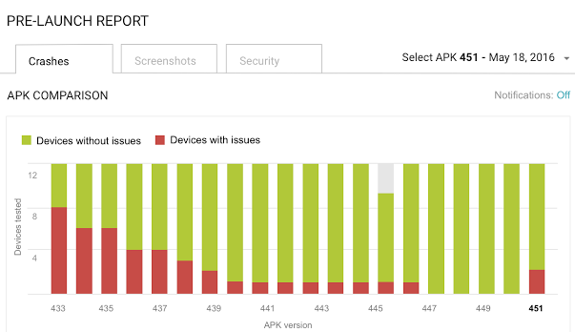
Example pre-launch report

Slide 58
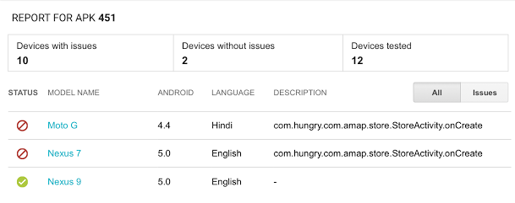
Example pre-launch report

Slide 59
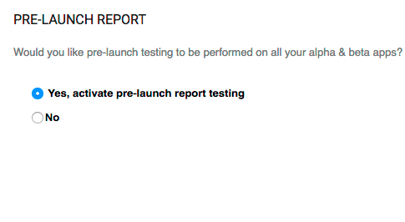
Running pre-launch reports
Opt-in to pre-launch reports in the console
Then when you upload or publish an alpha or beta APK, the pre-launch test runs automatically

Slide 60
Criteria
for
Publishing

Slide 61
Only publish high quality apps
Your app must meet core app quality requirements
Visual design and user interaction
Functionality
Performance and stability
Android users expect high-quality apps!
developer.android.com/distribute/essentials/quality/core.html

Slide 62
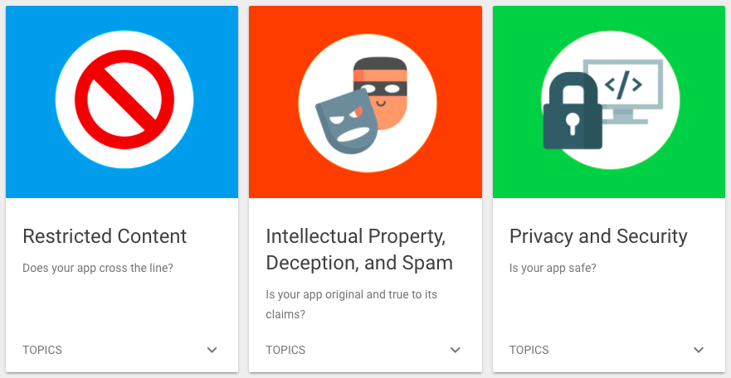
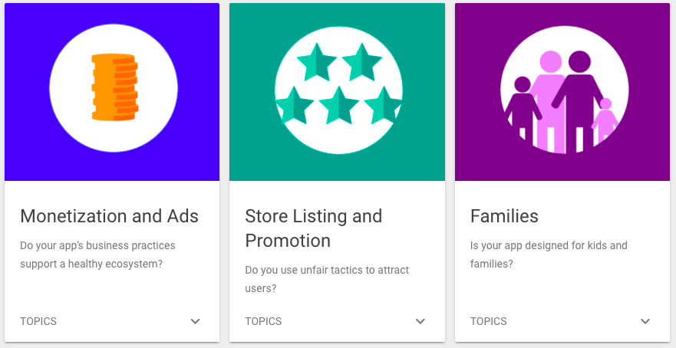
Comply with Google Play policies
Google Play policies ensure that all apps on Google Play provide a safe experience for everyone
play.google.com/about/developer-content-policy/

Slide 63
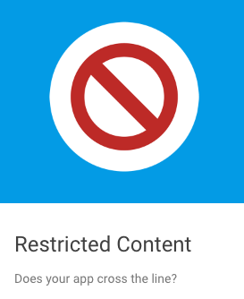
Restricted Content
Sexually Explicit Content
Child Endangerment
Violence
Bullying & Harassment
Hate Speech
Sensitive Events
Gambling
Illegal Activities
play.google.com/about/restricted-content
Notes:
If your app allows users to generate content you must provide a compliance policy so that users do not generate restrict content

Slide 64
Publish to the world!

Slide 65
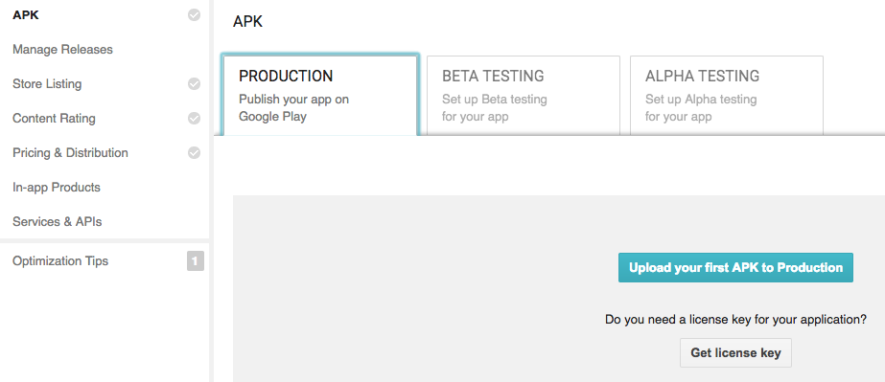
Upload your APK to Production

Slide 66

Check what's missing
add a high-res icon
add a feature graphic
add 2 non-Android TV screenshots
select a category
select a content rating
target at least one country
enter a privacy policy URL
make your app free or set a price for it
declare if your app contains ads
add a required content rating
Google Play tells you what is missing

Slide 67
Google checks your app
Automatic and manual checking
Your app can be rejected for violating any requirement
If you get rejected, fix the problem and try again

Slide 68
Learn more

Slide 69
Learn more about prepping your app
Review the launch checklist
Core app quality checklist developer.android.com/distribute/essentials/quality/core.html
Handling user data play.google.com/about/privacy-security/user-data/
Design for tablets and handsets developer.android.com/guide/practices/tablets-and-handsets.html
Min, max, and target API levels developer.android.com/guide/topics/manifest/uses-sdk-element.html

Slide 70
Learn more about prepping your app
Preparing for release https://developer.android.com/studio/publish/preparing.html
Google Play filters developer.android.com/google/play/filters.html
Reduce app size developer.android.com/topic/performance/reduce-apk-size.html
Sign your app developer.android.com/studio/publish/app-signing.html

Slide 71
Learn more about publishing your app
Google Play Developer Console:
Go to the console: play.google.com/apps/publish/
Dev guide: developer.android.com/distribute/googleplay/developer-console.html
Help center: support.google.com/googleplay/android-developer/#topic=3450769

Slide 72
Learn more about publishing your app
Get started publishing developer.android.com/distribute/googleplay/start.html
Alpha and Beta testing
Dev guide:
developer.android.com/distribute/engage/beta.html
Help center:
support.google.com/googleplay/android-developer/answer/3131213

Slide 73

What's next?
This is the end of the course!
Build great apps and publish them

Slide 74
END

