Slide 1
Simple media playback
Advanced Android Development
Lesson 13

Slide 2

13.1 Simple media playback
Play audio and video in your app

Slide 3
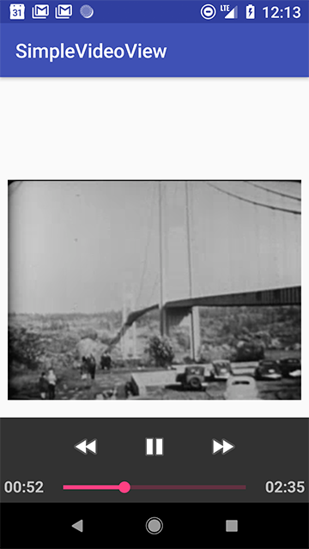
Contents
Media formats and sources
Media players and controls
Playing media with intents
Playing media with VideoView
Playing media with ExoPlayer
Android media apps architecture

Slide 4
Media formats and sources

Slide 5
Media source
The location of playable media:
Embedded in app
On external device storage (SD card)
Streamed from the internet

Slide 6
Media formats
Different media players play different formats
Sample format: encoding of media (codec)
Container format: media + metadata
Extension indicates container, for example .mp3
With audio, sample and container format are often the same thing

Slide 7
Sample Formats
Audio formats
Sample format
MP3
AAC
FLAC
PCM/WAVE
Container format
.mp3
.aac
.flac
.wav

Slide 8
Container Format
Video formats
Sample format
H.263, H.264 AVC
MPEG-4
VP8, VP9
Container format
.mp4, .3gp
.3gp
.webm, .mkv

Slide 9
Other considerations
Adaptive streaming: DASH, Smooth Streaming, HLS
Digital rights management: Widevine or PlayReady
Both are advanced topics

Slide 10
Media formats: more information
Supported Media Formats (Android platform)
Supported formats (ExoPlayer)

Slide 11
Media players and controls

Slide 12
Media players
Media source as input
Decodes and renders source as audio or video
May or may not have associated View to display video
Many different media players with different capabilities

Slide 13
Media player options
MediaPlayer—simple, limited, part of Android platform
VideoView—wrapper for MediaPlayer to display video
ExoPlayer—best choice for most media apps
YouTube Android Player API—for YouTube-hosted media
Custom player—only for very complex use cases

Slide 14
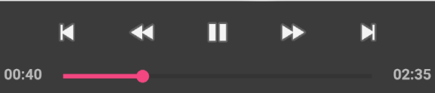
Media Controls
Media controls
Also called transport controls
Play/pause
Fast forward/rewind
Skip forward/back
Progress bar or seek bar

Slide 15
Media controls options
MediaController—simple but limited
PlayerControlView (ExoPlayer)—very customizable
Build your own controls in app layout

Slide 16
Playing media with intents

Slide 17
Playing media with intents
Use implicit intent
Intent action is Intent.ACTION_VIEW
Intent data is URI of media to play

Slide 18
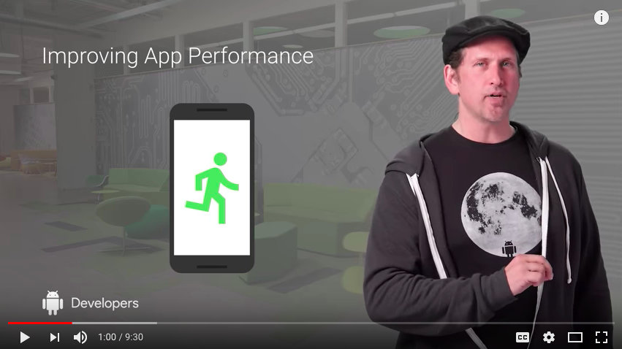
Playing media with intents
Intent mediaIntent = new Intent();
mediaIntent.setAction(Intent.ACTION_VIEW); mediaIntent.setData(Uri.parse(
"https://www.youtube.com/watch?v=LBBqTd6uOd4");
if (mediaIntent.resolveActivity(
getPackageManager()) != null) {
startActivity(mediaIntent);
}

Slide 19
Media intents: benefits and drawbacks
Benefits:
Easy to play most media
Do not need to implement players or controls
Simplest way to play YouTube video
Drawbacks:
Requires available app on device
User leaves your app to play media

Slide 20
Playing media with VideoView

Slide 21
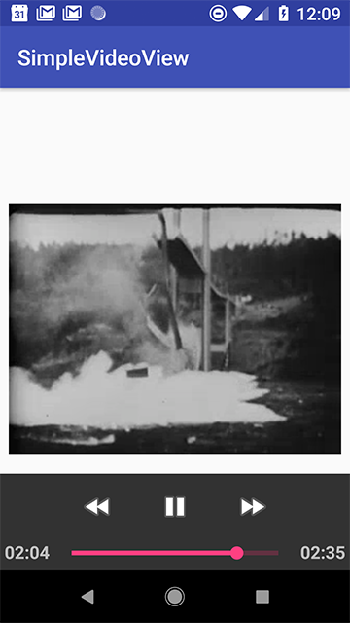
VideoView class
Easiest way to embed video in app layout
MediaPlayer (for playback) + SurfaceView (for view)
Use MediaController view for controls
Can play local media or streamed

Slide 22
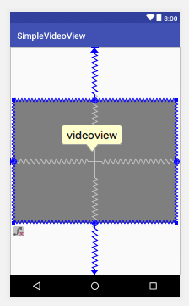
VideoView: layout
Add to XML layout like any other view
TIP: To keep the video's aspect ratio the same in different layouts, use app:layout_constraintDimensionRatio

Slide 23
VideoView layout example
<VideoView
android:id="@+id/videoview"
android:layout_width="0dp"
android:layout_height="0dp"
android:layout_margin="8dp"
app:layout_constraintDimensionRatio="4:3"
app:layout_constraintBottom_toBottomOf="parent"
app:layout_constraintEnd_toEndOf="parent"
app:layout_constraintStart_toStartOf="parent"
app:layout_constraintTop_toTopOf="parent"/>

Slide 24
VideoView and media controls
In onCreate():
Get VideoView object
Create new android.widget.MediaController
Connect controller to VideoView with setMediaController()
Connect VideoView to controller with setMediaPlayer()

Slide 25
VideoView onCreate() example
mVideoView = findViewById(R.id.videoview);
MediaController controller = new MediaController(this);
controller.setMediaPlayer(mVideoView);
mVideoView.setMediaController(controller);

Slide 26
Set media source
Use setVideoUri() with the URI of video to play
Video file embedded in app (in res/raw):
Uri videoUri = Uri.parse("android.resource://" +
getPackageName() + "/raw/" + "videofile");
mVideoView.setVideoUri(videoUri);

Slide 27
Set media source
Media in external storage
String fullPath = Environment.getExternalStorageDirectory()
+ "/" + "videofile.mp4;
File file = new File(fullPath);
Uri videoUri = Uri.fromFile(file);
mVideoView.setVideoUri(videoUri);

Slide 28
Set media source
Media streamed from internet
String mediaName = "http://myserver.com/videofile.mp4";
Uri videoUri = Uri.parse(mediaName);
mVideoView.setVideoUri(videoUri);

Slide 29
Set media source: permissions
External storage permission
<uses-permission android:name="android.permission.READ_EXTERNAL_STORAGE"/>
Internet permission
<uses-permission android:name="android.permission.INTERNET" />

Slide 30
VideoView: controlling playback
User can control playback in app with media controls
VideoView methods:
start(): start player
pause(): pause player
stopPlayback(): stop player and release media resources
seekTo(): move current playback position to this location, in milliseconds
getCurrentPosition(): get current playback position, in milliseconds

Slide 31
VideoView and app lifecycle
Create and connect media controller in onCreate()
Call setVideoUri() in onStart()
Call stopPlayback() in onStop()
Call pause() in onPause() only for SDK < 24
if (Build.VERSION.SDK_INT < Build.VERSION_CODES.N) {
mVideoView.pause();
}

Slide 32
Preserve playback position
VideoView does not preserve player position across lifecycle changes
Save playback position in instance state bundle with getCurrentPosition()
Get playback position from bundle in onCreate()
Move playback position in onStart() with seekTo()

Slide 33
VideoView event listeners
MediaPlayer listeners:
onPrepared(): media is ready to play
onCompletion(): media has finished playing
onInfo(): information or warning is available
onError(): an error has occurred
… and more

Slide 34
onPrepared() callback
Set up media:
Call setVideoUri() to start preparing media
Display "Buffering…" message or other indicator
In onPrepared():
Remove buffering message
If necessary, use seekTo() to move to stored position
Start playing

Slide 35
onPrepared() callback
mVideoView.setOnPreparedListener(new
MediaPlayer.OnPreparedListener() {
@Override
public void onPrepared(MediaPlayer mediaPlayer) {
mBufferingTextView.setVisibility(VideoView.INVISIBLE);
if (mCurrentPosition > 0) {
mVideoView.seekTo(mCurrentPosition);
}
mVideoView.start();
}
});

Slide 36
onCompletion() callback
Called when media playback is finished
Can be used to:
Alert user that playback is finished
Return playback position to beginning
Set up next item in playlist

Slide 37
onCompletion() callback
mVideoView.setOnCompletionListener(new
MediaPlayer.OnCompletionListener() {
@Override
public void onCompletion(MediaPlayer mediaPlayer) {
Toast.makeText(MainActivity.this, "Playback completed",
Toast.LENGTH_SHORT).show();
mVideoView.seekTo(1);
}
});

Slide 38
Playing media with ExoPlayer

Slide 39
ExoPlayer
Open source media player
Alternative to MediaPlayer for audio and video
Recommended starting point for most media apps
Supports more technologies than MediaPlayer
Easy to customize and extend

Slide 40
ExoPlayer: more information
ExoPlayer developer guide: https://google.github.io/ExoPlayer/
ExoPlayer GitHub project: https://github.com/google/ExoPlayer
ExoPlayer developer blog: https://medium.com/google-exoplayer

Slide 41
Android media apps architecture

Slide 42
Android media apps architecture
Helps implement best practices for complex media apps
Helps integrate your apps with the Android platform, including Android Auto and Android Wear
Enables use of hardware controls such as headset buttons
Maintains player state across multiple apps
Browser API to enable media discovery
Provides service for background music playback

Slide 43
More information
Media Apps Overview
Building a Video App
Building an Audio App

Slide 44
What's next?
Concept chapter: 13.1 Simple media playback
Practical: 13.1 Playing video with VideoView

Slide 45
END

