Slide 1

Next-Gen Banking: AI-Powered Customer Experience
Team Name : VISION
Date : 30/6/2024

Slide 2

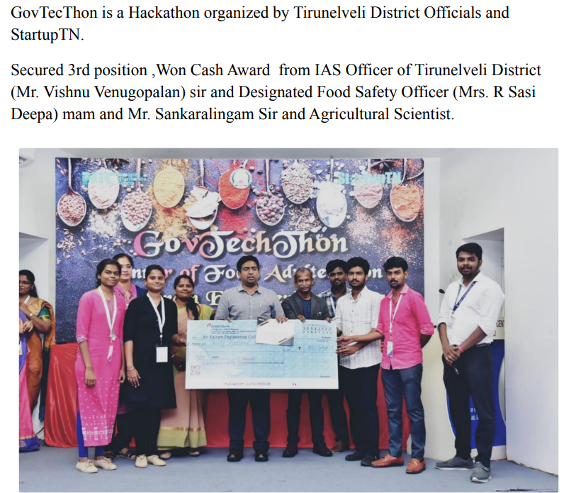

Our Team - VISION

Slide 3
Problem Statement - Customer Service
Pain-points : Customer Service
Customer Frustration: Addressing delays and inaccuracies in customer inquiry resolutions.
Operational Inefficiencies: Streamlining manual processes to reduce costs and improve efficiency.
Competitive Advantage: Establishing leadership in customer service innovation to boost loyalty and trust.

Slide 4
Pre-Requisite
Here are three alternative or competitive products addressing similar challenges:
Traditional Call Centers: Human agents cause longer wait times and inconsistent service.
Basic Chatbots: Rule-based bots lack sophisticated AI for personalization.
AI Customer Service Platforms: Competitors offer specific features but lack our comprehensive integration.

Slide 5
Development Tools
S. No | Name | Tools
1 | Development : Front-end development Back-end development Database setup Smart match algorithm | Azure Bot Service Azure Language Understanding (LUIS) Azure Machine Learning Studio Azure Databricks Azure Synapse Analytics ChatBot
2 | UI / UX Design UI Design UX Design | Open-source frameworks
3 | Verification system and Database | Azure SQL Database

Slide 6
Solution
Transforming customer service with AI-driven technologies
to deliver personalized, efficient, and proactive support
across multiple channels.
Key Features:
AI-Powered Customer Inquiry Chatbot
Personalized Recommendations and Solutions
Seamless Integration with Existing Platforms
Continuous Learning and Improvement
Voice-Activated Banking Assistant
Visual AI for Document Processing
Personalized Financial Health Dashboard and Score
Customer Journey Mapping and Analytics
Gamification of Banking Services

Slide 7
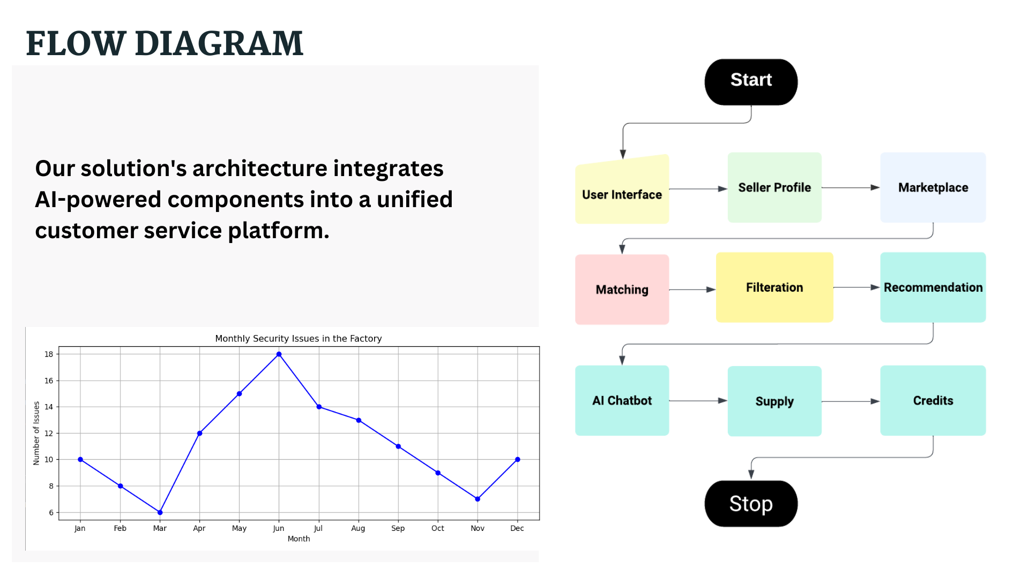

Slide 8
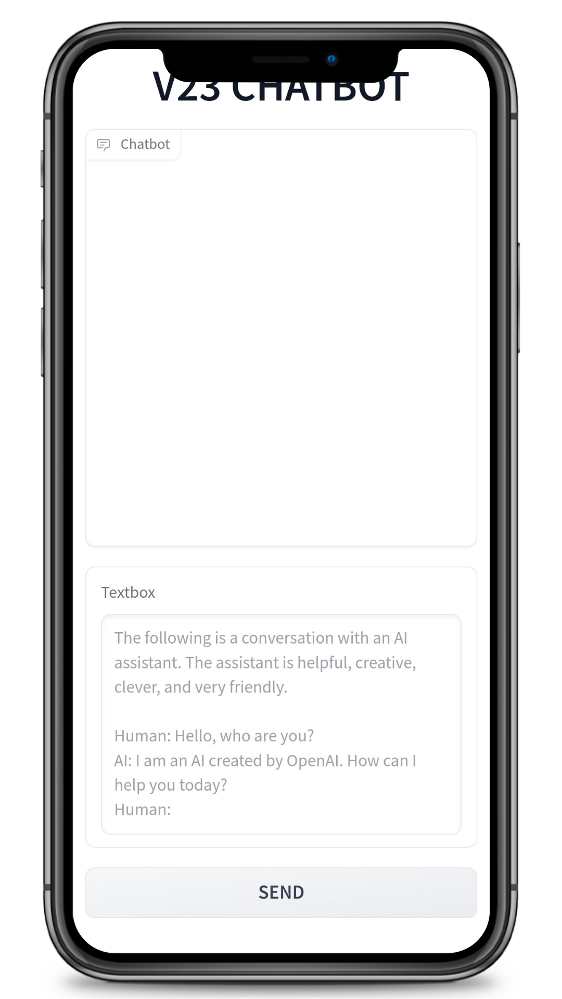
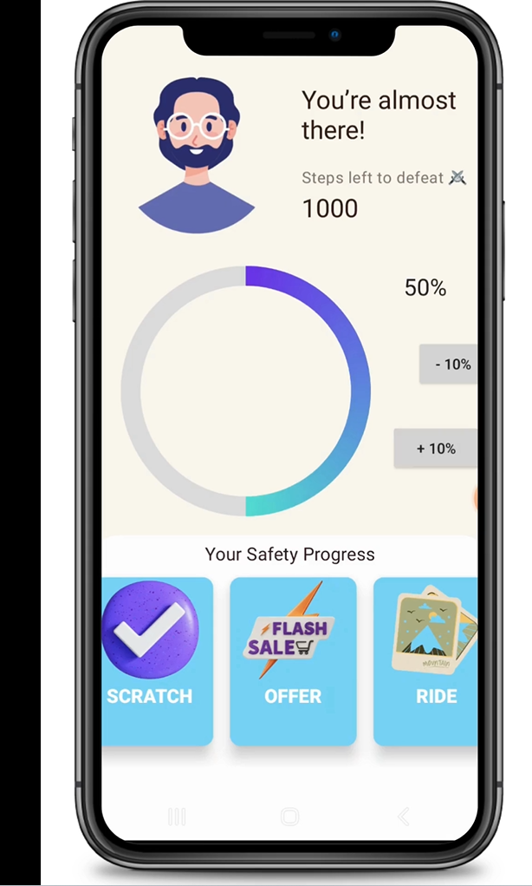
POC Screenshots

Slide 9
Feature and Differentiation
Feature | Our Solution | Direct Competitors | Indirect Competitors
AI-Powered Customer Inquiry Chatbot | Advanced AI, multilingual, 24/7 | Basic rule-based chatbots | Human agents in call centers
Personalized Recommendations and Solutions | AI-driven, dynamic content | Limited personalization, rule-based | Generic recommendations
Customer Journey Mapping and Analytics | AI-driven insights | Limited journey mapping | Manual analysis
Gamification of Banking Services | Challenges, rewards, educational games | No engagement tools | No engagement tools

Slide 10
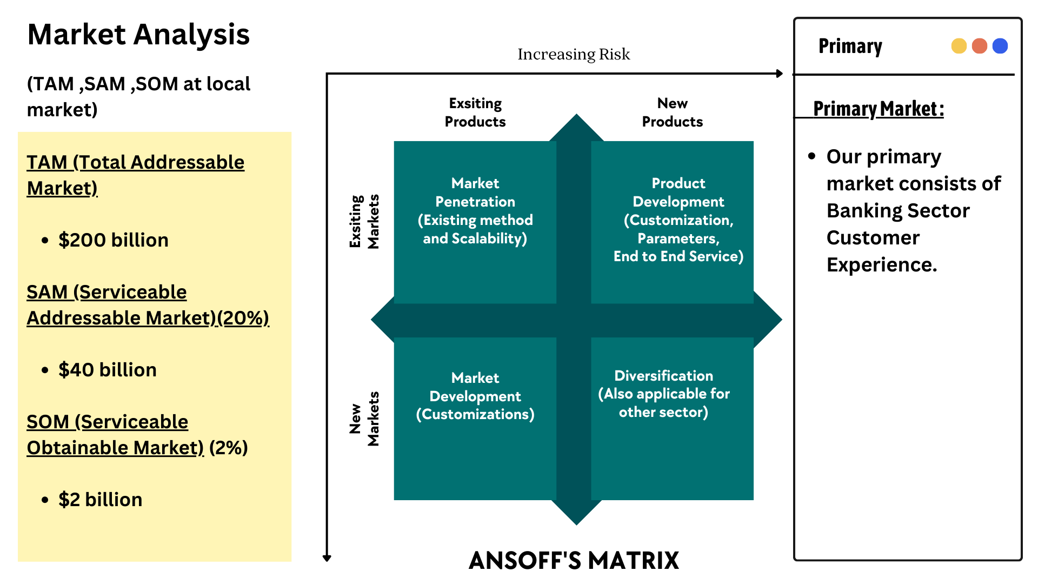

Slide 11
User Experience
Real-Time Support: Providing instant, accurate responses through an AI-powered chatbot.
Personalized Service: Offering tailored recommendations and solutions based on user data.
Financial Insights: Delivering personalized financial health dashboards and scores.
Journey Optimization: Mapping and analyzing user interactions for improved engagement.
Engagement and Learning: Incorporating gamification to make banking more engaging and educational.

Slide 12

Scalability
Our solution can be effectively scaled to accommodate growth without compromising performance by:
Cloud Infrastructure: Leveraging Azure's scalable cloud services to handle increasing workloads seamlessly.
Modular Architecture: Using a modular design that allows for easy expansion of features and services.
Automated Scaling: Implementing auto-scaling capabilities to dynamically adjust resources based on demand.

Slide 13
Ease of Deployment and Maintenance
Our solution is simple to implement and maintain on an ongoing basis by:
01
Pre-built Azure Services: Leveraging ready-to-use Azure AI and cloud services for rapid deployment.
02
Low Code Development: Using Azure's low-code tools for quick prototyping and customization.
03
Scalability and Flexibility: Allowing seamless scaling and customization to meet evolving business needs.
04

Slide 14
Security Considerations
Measures incorporated to ensure
Data Encryption: Utilizing Azure's encryption services to protect data both at rest and in transit.
Access Control: Implementing role-based access control (RBAC) and multi-factor authentication (MFA) to safeguard sensitive information.
Compliance Standards: Adhering to industry standards (e.g., GDPR, HIPAA) and leveraging Azure's compliance certifications.
Regular Audits: Conducting regular security audits and vulnerability assessments to identify and mitigate risks.

Slide 15
Product Planning
Milestones | Activities | Timeline | Deliverables
Phase 1 - Designing | Define project scope and requirements UI/UX Design | 1.5 months | Complete Structure with basic functionalities
Phase 2 - Development | Front-end Development Back-end Development Database Setup Smart Matching Algorithm Development | 2.5 months | Complete Platform
Phase 3 - Integration | Testing and Quality Assurance User Acceptance Testing (UAT) Deployment and Launch | 2 months | Testing and Feedback integration

