Slide 1
FIVETHON - WEBINAR ON PYTHON
DAY 1
INTRODUCTION TO PROBLEM SOLVING, GETTING STARTED WITH PYTHON, PYTHON FUNDAMENTALS and DATA HANDLING

Slide 2

How to solve a Python Program/Problem:
Read the problem at least three times.
Work through the problem manually.
Simplify and optimize your steps.
Write pseudocode.
Translate pseudocode into code and debug.
Simplify and optimize your code.
Debug.

Slide 3
ALGORITHM:
Algorithms are a set of instructions that are executed to get the solution to a given problem. Since algorithms are not language-specific, they can be implemented in several programming languages. No standard rules guide the writing of algorithms.
Characteristics of Algorithms:
Precision – The steps are precisely stated(defined).
Uniqueness – Results of each step are uniquely defined and only depend on the input and the result of the preceding steps.
Finiteness – The algorithm stops after a finite number of instructions are executed.
Input – The algorithm receives input.
Output – The algorithm produces output.
Generality – The algorithm applies to a set of inputs
What is Algorithm?

Slide 4
Building the Algorithm:
SEQUENCE:
Sequence means that each step of the algorithm is executed in the specific order.
DECISION:
Decision statement are used when the outcome of the process depends on some condition.
EXAMPLE:
IF X=Y
Print “Equal”
ELSE
Print “ Not Equal”

Slide 5
RECURSION:
It is technique of solving a problem by breaking it down into smaller and smaller sub-problems until you get to a small enough problem that it can be easily solved.
Recursion involves a function calling itself until a specific condition is met
Every recursive solution has two major cases.
BASE CASE:
In which the problem is simple enough to be solved directly without making any further calls to the same function .
RECURSIVE CASE:
In which first the problem at hand is divided into simpler sub-parts. Second the function calls itself but with sub-parts of the problem obtained in the first step. Third the result is obtained by combining the solution of simpler sub-parts.

Slide 6
Disadvantages of Algorithms:
1. Algorithms is Time consuming.
2. Difficult to show Branching and Looping in Algorithms.
3. Big tasks are difficult to put in Algorithms.
Advantages of Algorithms:
1. It is a step-wise representation of a solution to a given problem, which makes it easy to understand.
2. An algorithm uses a definite procedure.
3. It is not dependent on any programming language, so it is easy to understand for anyone even without programming knowledge.
4. Every step in an algorithm has its own logical sequence so it is easy to debug.
5. By using algorithm, the problem is broken down into smaller pieces or steps hence, it is easier for programmer to convert it into an actual program.

Slide 7
EXAMPLE: Algorithm to add two numbers
Step1: Start
Step2: Input first number as A
Step3: Input second number as B
Step4: Set sum = A+B
Step5: Print Sum
Step6: End

Slide 8
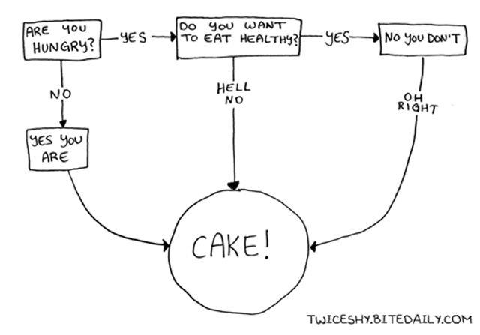
What is Flowchart ?
A flowchart is a graphical or symbolic representation of a process. It is basically used to design and document virtually complex process to help the viewers to visualize the logic of the process.

Slide 9
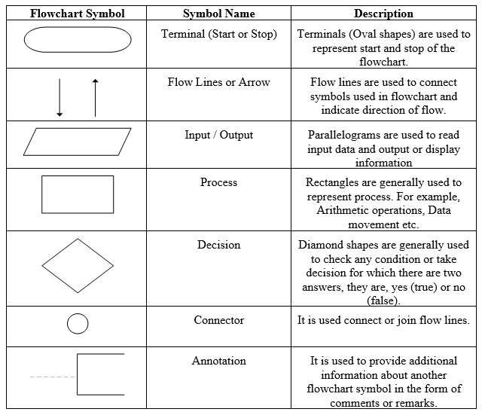

Slide 10
Guidelines for Preparing Flowchart
Standard symbols should be used while drawing flowchart.
Ensure that flowchart has START (or BEGIN) and STOP (or END).
Flowchart should be neat, clean and easy to follow. There should be no any ambiguity.
The usual direction of flowchart is from top to bottom or from left to right.
The terminal symbol, that is, START/BEGIN or STOP/END should have only one flow line.
Only one flow line should come out from process symbol.
Only one flow line should enter a decision symbol, but two or three flow-lines, one for each possible answer, can leave the decision symbol.
If the flowchart is lengthy and complex connector symbol should be used to reduce the number of flow lines.
Avoid intersection of flow lines.
Use annotation symbol to describe steps more clearly.

Slide 11
Advantages of Flowchart
Effective Communication : Flowcharts are better way of communicating the logic of the system.
Effective Analysis : Using flowchart problem can be analyzed more efficiently.
Easy Debugging and Efficient Testing : The Flowchart helps in debugging and testing process.
Efficient Coding : The flowcharts are very useful during program development phase.
Proper Documentation : Flowcharts serves as a good program documentation, which is needed for various purpose.
Efficient Program Maintenance : Maintenance of operating programs becomes easy with the help of flowchart.

Slide 12
Disadvantages of Flowchart
Complex Logic: For complicated logic, flowchart becomes complex and clumsy.
Difficulty in Modifications: If change is required in the logic then flowchart needs to be redrawn and requires a lot of time.

Slide 13
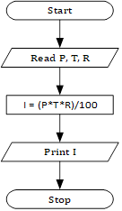
EXAMPLE: Flowchart for calculating simple interest

Slide 14
What is Pseudocode ?
Pseudocode is an informal way of programming description that does not require any strict programming language syntax or underlying technology considerations. It is used for creating an outline or a rough draft of a program. Pseudocode summarizes a program's flow, but excludes underlying details.

Slide 15
Characteristics of pseudocode are:
It uses plain english statements.
It emphasizes on the design of the computer program.
It uses structured english.
It is detailed and readable to draw an inference.
It enables the programmers to concentrate on the algorithms.

Slide 16
Advantages of pseudo-code
It is be quickly and easily converted into an actual programming language as it is similar to a programming language
It is fairly easy to understand, even for non-programmers
It does not matter if there are errors in the syntax - it is usually still obvious what is intended
changes to the design can be incorporated quite easily

Slide 17
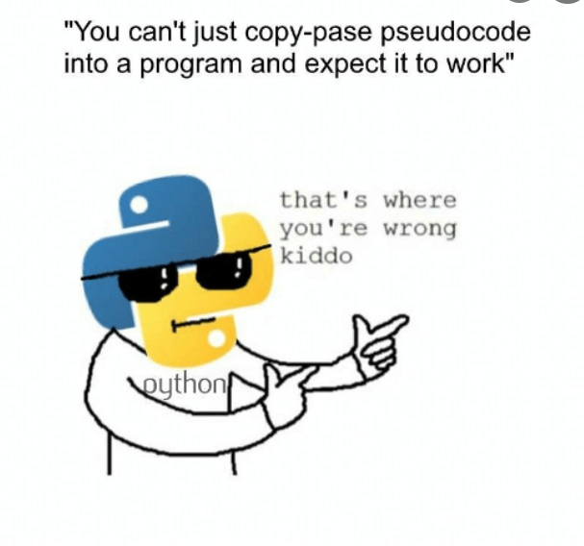
Disadvantages of pseudo-code
It is be hard to see how a program flows.
It is be time consuming to produce.

Slide 18

EXAMPLE: To make a cup of tea
Organise everything together;
Plug in kettle;
Put tea bag in cup;
Put water into kettle;
Wait for kettle to boil;
Add water to cup;
Remove tebag with spoon;
Add milk and sugar;
Serve;

Slide 19
Introduction to python:
Difference between idle and script:-
In Python, there are two options/methods for running code:
Interactive mode
Script mode

Slide 20
Interactive mode:
The interactive mode of Python is also called REPL.
REPL stands for ‘Read-Eval-Print-Loop’. It is a simple, interactive command-line shell that provides us with the result when provided with a single line Python commands.
Read: The read function accepts an input from the user and stores it into the memory.
Eval: The eval function evaluates this ‘input’ read from the memory.
Print: The print function prints the outcome from the eval function.
Loop: The loop function creates a loop and terminates itself when the program ends.
This was a brief explanation of the interactive mode: REPL.

Slide 21
To keep it simple and concise for a better understanding, the interactive mode is a command-line shell that gives immediate feedback for each statement, while running previously fed statements inside the active memory.
So once new lines are fed into the interpreter, the fed program is evaluated each partly and as a full program. Interactive mode is beneficial after you simply wish to execute basic Python commands or just wish to undertake numerous syntaxes and easy functionalities of python.

Slide 22
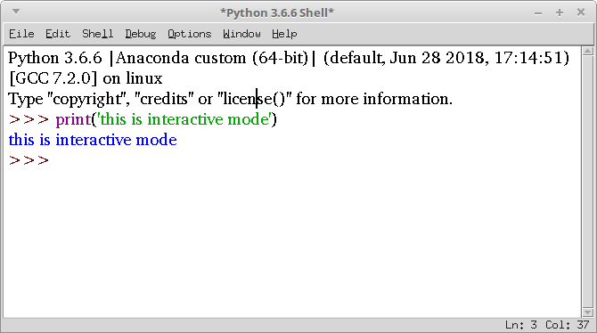
EXAMPLE: Printing interactive mode

Slide 23
Script mode:
To write long Python codes or programs having multiple files, the interactive mode is not what I would recommend using on the first hand. Script mode would be a better choice in such scenarios.
Using Script mode is quite easy, you have to write your code in a text file and save the particular file with a ‘.py’ extension. .py stands for PYTHON. You can use any available text editor.
The syntax of the programs remains the same. “IDLE” is the popular GUI based Python shell to write programs and perform all the functions mentioned above.

Slide 24
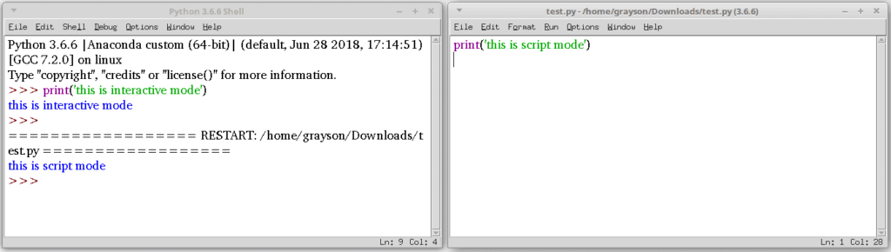
EXAMPLE: Printing Script mode

Slide 25
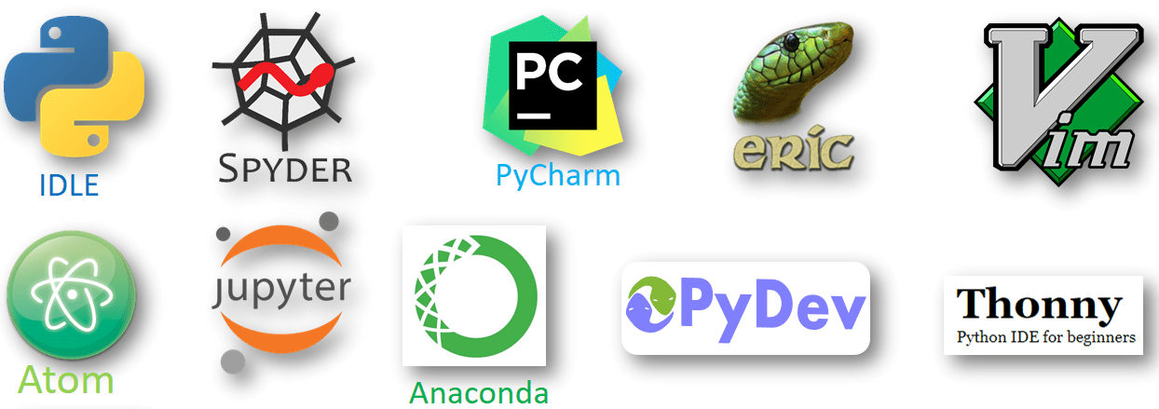
Different types of python development environment

Slide 26
What are tokens?
Python breaks each logical line into a sequence of elementary lexical components known as tokens. Each token corresponds to a substring of the logical line.
The normal token types are identifiers, keywords, operators, delimiters, and literals, as covered in the following sections. You may freely use whitespace between tokens to separate them.
Some whitespace separation is necessary between logically adjacent identifiers or keywords; otherwise, Python would parse them as a single, longer identifier.
For example, printx is a single identifier; to write the keyword print followed by the identifier x, you need to insert some whitespace (e.g., print x).

Slide 27
Python has mainly 5 types of token which are given below -:
Keywords
Identifiers
Operators
Literals
Punctuators

Slide 28
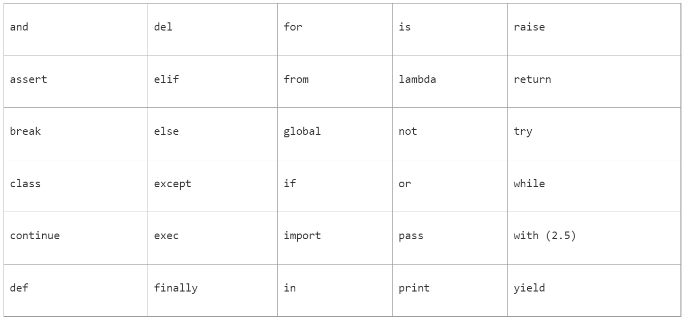
What are keywords?
Python has 36 keywords, which are identifiers that Python reserves for special syntactic uses. Keywords contain lowercase letters only. You cannot use keywords as regular identifiers. Some keywords begin simple statements or clauses of compound statements, while other keywords are operators.

Slide 29
What are identifiers?
An identifier is a name used to identify a variable, function, class, module, or other object. An identifier starts with a letter (A to Z or a to z) or an underscore (_) followed by zero or more letters, underscores, and digits (0 to 9).
Case is significant in Python: lowercase and uppercase letters are distinct. Python does not allow punctuation characters such as @, $, and % within identifiers.
Normal Python style is to start class names with an uppercase letter and all other identifiers with a lowercase letter.
The identifier _ (a single underscore) is special in interactive interpreter sessions: the interpreter binds _ to the result of the last expression statement it has evaluated interactively, if any.

Slide 30
What are operators?
Python uses non alphanumeric characters and character combinations as operators. Python recognizes the following operators, which are covered in detail in Expressions and Operators:

Slide 31
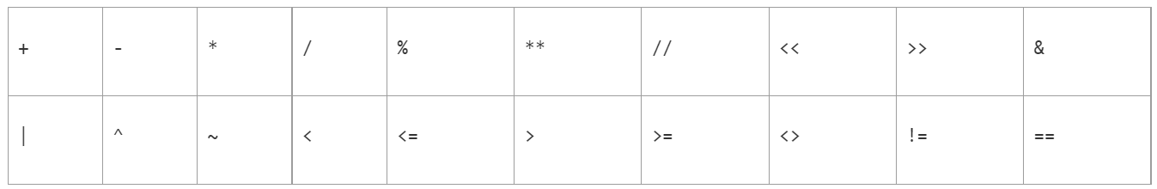
There are following types of Operators:
Arithmetic Operators : + , - , * , /
Relational Operators : < , > , <= , >= , == ,!=
Assignment Operators : += , -= , *= , /= , %=
Logical Operators : && , || ,!
Bitwise operators : & , | , ^ , << , >>
Identity Operators : is , is not

Slide 32
What is literal?
Literals like a constant (often referred to as constant - values) are data items that have a fixed value.
Literals yields an object of the given type (String, integer, Long integer, Long floating number, Complex number ) with the given value. Python allows several kinds of literals.
String Literals
Numeric Literals
Boolean Literals.

Slide 33
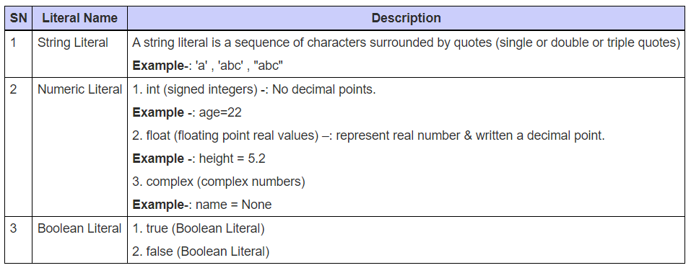

Slide 34

What is punctuators?
Punctuators is used to implement the grammar and structure of syntax.
Punctuators are symbols that are used in a programming language to organize programming sentence.
The most common punctuators of Python programming language are:-

Slide 35
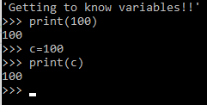
What are variables?
A variable is a name given to a memory location.
Variables are the basic units for storing data in a computer program.
The values that are assigned in a variable, can be changed, thus we call it a “variable”.

Slide 36
Creating a variable
Variables need not be declared first in python. They can be used directly.
Variables in python are case-sensitive just like other programming languages.
Variables can store values of any data-type.
For example, name = “Sam”
num = 100
Here, name is a variable of type “string” and “num” is of type “int”

Slide 37
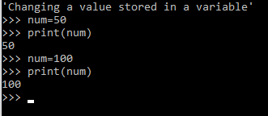
So how do variables exactly work?
The variables stored in a variable can be changed during the program execution.
A variable is only a name given to a memory location, all the operations done on that variable affects the memory location.

Slide 38
Rules for creating variables
A variable name must start with a letter or the underscore character.
A variable name cannot start with a number.
A variable name can only contain alpha-numeric characters and underscores (A-z, 0-9, and _ ).
Variable names are case-sensitive (name, Name and NAME are three different variables).
The reserved words(keywords) cannot be used naming the variable.

Slide 39
So let’s check out your understanding of variables!!
length
Yes
Length.
No
myLength
Yes
1length
No
_length
Yes

Slide 40
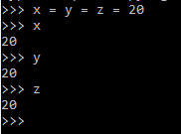
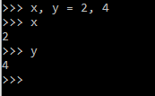
Wait! There’s more!
Assigning a single value to multiple variables:
Python allows assigning a single value to several variables simultaneously with “=” operators.
Assigning different values to multiple variables:
Python allows adding different values in a single line with “,”operators.

Slide 41



Print Input/Output
Python provides numerous built-in functions like input() and print() that are widely used for standard input and output operations respectively.
We use the print() function to output data to the standard output device (screen).
We use the input() function to take the input from the user.

Slide 42
Data Types
Data types are the classification or categorization of data items. It represents the kind of value that tells what operations can be performed on a particular data. Since everything is an object in Python programming, data types are actually classes and variables are instance (object) of these classes.
Following are the standard or built-in data type of Python:
Numeric
Sequence Type
Boolean
Set
Dictionary

Slide 43
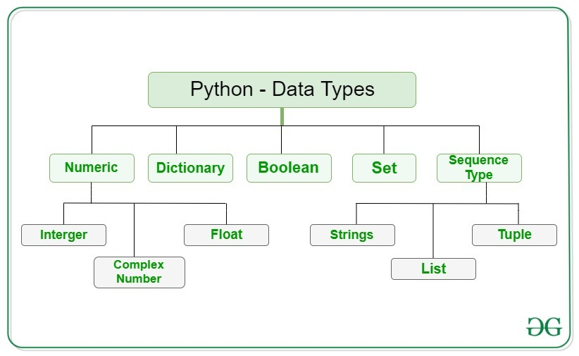

Slide 44
Numeric data type
In Python, numeric data type represents the data which has numeric value. Numeric value can be integer, floating number or even complex numbers. These values are defined as int, float and complex class in Python.
Integers – This value is represented by int class. It contains positive or negative whole numbers (without fraction or decimal). In Python there is no limit to how long an integer value can be.
Float – This value is represented by float class. It is a real number with floating point representation. It is specified by a decimal point. Optionally, the character e or E followed by a positive or negative integer may be appended to specify scientific notation.
Complex Numbers – Complex number is represented by complex class. It is specified as (real part) + (imaginary part)j. For example – 2+3j

Slide 45
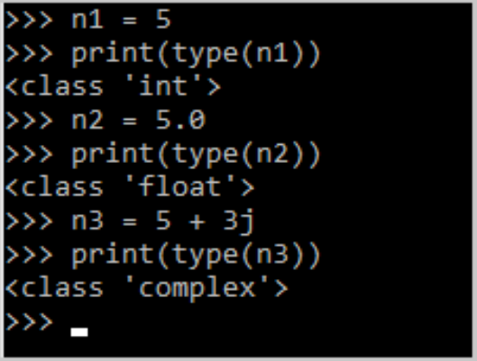
Checking the data type
The type of data type is determined using the function type().

Slide 46
Sequence Type
In Python, sequence is the ordered collection of similar or different data types. Sequences allows to store multiple values in an organized and efficient fashion. There are several sequence types in Python –
String
List
Tuple

Slide 47
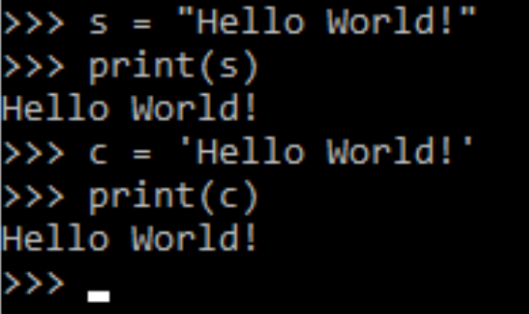
Strings
In Python, Strings are arrays of bytes representing Unicode characters. A string is a collection of one or more characters put in a single quote, double-quote or triple quote. In python there is no character data type, a character is a string of length one. It is represented by str class.

Slide 48
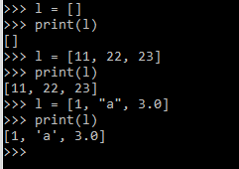
Lists
Lists are just like the arrays, declared in other languages which is an ordered collection of data. It is very flexible as the items in a list do not need to be of the same type. Lists in Python can be created by just placing the sequence inside the square brackets[].

Slide 49
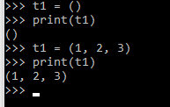
Tuples
Just like list, tuple is also an ordered collection of Python objects. The only difference between tuples and list is that tuples are immutable i.e. tuples cannot be modified after it is created. It is represented by tuple class.
In Python, tuples are created by placing a sequence of values separated by ‘comma’ with or without the use of parentheses for grouping of the data sequence. Tuples can contain any number of elements and of any datatype (like strings, integers, list, etc.).

Slide 50
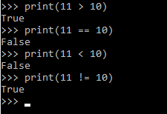
Boolean
Data type with one of the two built-in values, True or False. Boolean objects that are equal to True are truthy (true), and those equal to False are falsy (false). But non-Boolean objects can be evaluated in Boolean context as well and determined to be true or false. It is denoted by the class bool.
True and False with capital ‘T’ and ‘F’ are valid booleans otherwise python will throw an error.

Slide 51
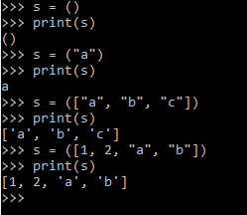
Set
In Python, Set is an unordered collection of data type that is iterable, mutable and has no duplicate elements. The order of elements in a set is undefined though it may consist of various elements.
Sets can be created by using the built-in set() function with an iterable object or a sequence by placing the sequence inside curly braces, separated by ‘comma’. Type of elements in a set need not be the same, various mixed-up data type values can also be passed to the set.

Slide 52
Dictionary
Dictionary in Python is an unordered collection of data values, used to store data values like a map, which unlike other Data Types that hold only single value as an element, Dictionary holds key:value pair. Key-value is provided in the dictionary to make it more optimized. Each key-value pair in a Dictionary is separated by a colon :, whereas each key is separated by a ‘comma’.
In Python, a Dictionary can be created by placing a sequence of elements within curly {} braces, separated by ‘comma’. Values in a dictionary can be of any datatype and can be duplicated, whereas keys can’t be repeated and must be immutable. Dictionary can also be created by the built-in function dict(). An empty dictionary can be created by just placing it to curly braces{}.

Slide 53
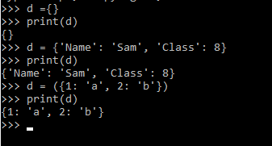
Dictionary

Slide 54
Arithmetic Operators
Arithmetic operators are used to perform mathematical operations like addition, subtraction, multiplication and division.
There are 7 arithmetic operators in Python :
Addition
Subtraction
Multiplication
Division
Modulus
Exponentiation
Floor division

Slide 55


Addition Operator : In Python, + is the addition operator. It is used to add 2 values.
Subtraction Operator : In Python, – is the subtraction operator. It is used to subtract the second value from the first value.

Slide 56


3. Multiplication Operator : In Python, * is the multiplication operator. It is used to find the product of 2 values.
4. Division Operator : In Python, / is the division operator. It is used to find the quotient when first operand is divided by the second.

Slide 57
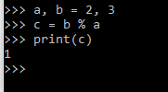

5. Modulus Operator : In Python, % is the modulus operator. It is used to find the remainder when first operand is divided by the second.
6. Exponentiation Operator : In Python, ** is the exponentiation operator. It is used to raise the first operand to power of second.

Slide 58

7. Floor division : In Python, // is used to conduct the floor division. It is used to find the floor of the quotient when first operand is divided by the second.

Slide 59
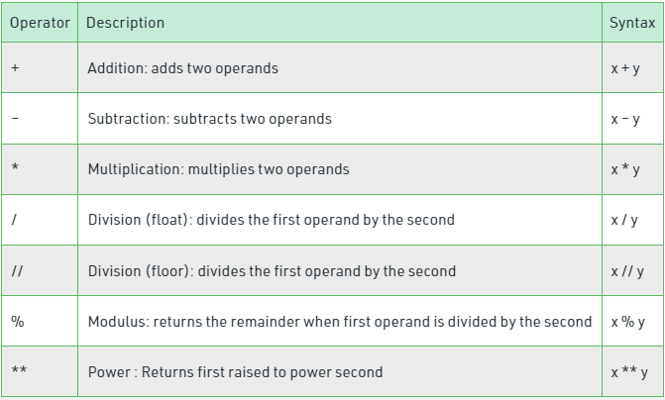

Slide 60

Let’s try some debugging!
a = ‘50’
What will be the output when we print type(a)?
It is because the value in the variable ‘a’ is given as a string. (Note the quotation marks)

Slide 61
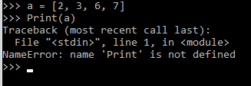

How to change the following line of code to get the desired output?
Code given:
a = [2, 6, 7, 9]
Print(a)
Remember we told you Python is case sensitive!!
The correct answer is:
a = [2, 6, 7, 9]
print(a)

Slide 62

ITS HOMEWORK TIME!!!
1.Algorithm to that prints the first 10 natural numbers
2.Write a program to convert degrees into fahrenheit

