Slide 1
FIVETHON - WEBINAR ON PYTHON
DAY 2
Flow of Control, String Manipulation, List Manipulation

Slide 2
1)SELECTION CONTROL STATEMENTS

Slide 3
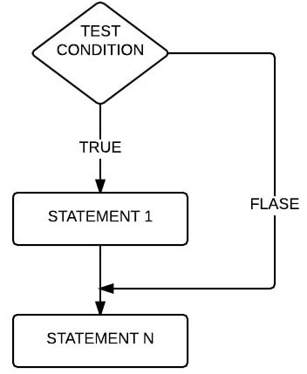
IF STATEMENT
If statements are control flow statements that help us to run a particular code, but only when a certain condition is met or satisfied. A simple if only has one condition to check.
Syntax:
if (test expression):
statement 1

Slide 4
Example:
number = int(input("Enter a number: "))
if(number%2==0):
print("EVEN")
Sample Output:
Enter a number: 22
EVEN
Enter a number: 10
EVEN

Slide 5
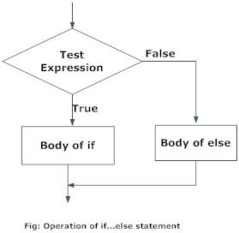
IF-ELSE STATEMENT
If-else statement is used to execute both the true part and the false part of a given condition. If the condition is true, then if block is executed and if the condition is false, the else block is executed.
Syntax:
if(test expression):
statement 1
else:
statement 2

Slide 6
Example:
age = int(input("Enter the age:"))
if(age>=18):
print("You are eligible to vote")
else:
print("You are not eligible to vote")
Sample Output:
Enter the age:15
You are not eligible to vote
Enter the age:20
You are eligible to vote

Slide 7
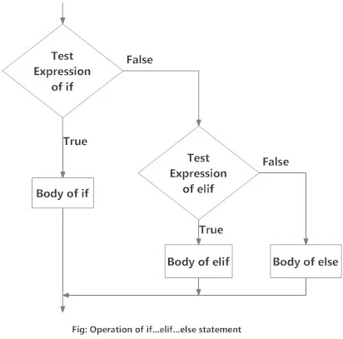
IF-ELIF-ELSE STATEMENT
if-elif-else statement is used to conditionally execute a statement or a block of statements. Conditions can be true or false, execute once when the condition is true, otherwise executes the else block.
Syntax:
if(test expression 1):
statement 1
elif(test expression n):
statement n
else:
statement

Slide 8
Example:
num=int(input("Enter any number:"))
if(num==0):
print("The value is zero")
elif(num>0):
print ("The number is positive")
else:
print ("The number is negative")
Sample Output:
Enter any number: -10
The number is negative
Enter any number: 15
The number is positive

Slide 9
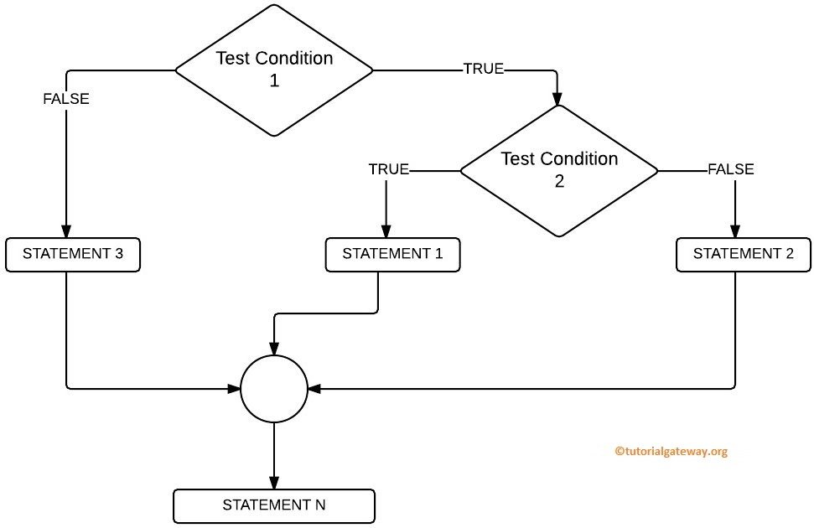
NESTED IF STATEMENT
Nested if statements are an if statement inside another if statement.
Syntax:
if (test expression 1):
if (test expression 2):
Statement 1
else:
Statement 2
else:
Statement 3

Slide 10
Example:
a=int(input("Enter a: "))
b=int(input("Enter b: "))
c=int(input("Enter c: "))
if(a>b):
if(a>c):
print("a is the biggest")
else:
print("c is the biggest")
else:
if(b>c):
print("b is the biggest")
else:
print("c is the biggest")
Sample Output:
Enter a: 21
Enter b: 14
Enter c: 7
a is the biggest
Enter a: 10
Enter b: 6
Enter c: 15
c is the biggest

Slide 11
2)ITERATIVE
CONTROL
STATEMENTS

Slide 12
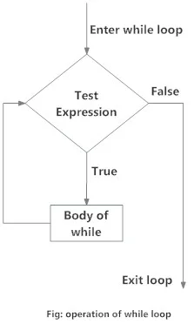
WHILE LOOP
While Loops is used to execute a block of statements repeatedly until a given condition is satisfied. And when the condition becomes false, the line immediately after the loop in the program is executed. While loop falls under the category of indefinite iteration.
Syntax:
while(condition):
statement block

Slide 13
Example:
Sample Output:
Enter the number: 10
1 2 3 4 5 6 7 8 9 10
Enter the number: 1
1
n=int(input("Enter the number:"))
i=1
while(i <= n):
print(i, end= " ")
i+=1

Slide 14
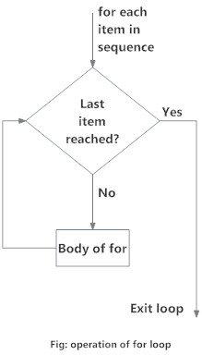
FOR LOOP
For loop is used to repeat a task until a particular condition is true. The for loop is usually known as determinate or definite loop because the programmer knows exactly how many times the loop will repeat. It is used to iterate over a sequence of objects.
Syntax:
for var in sequence:
statement block

Slide 15
range() function:
The range() is a built-in function in python that is used to iterate over a sequence of numbers. The syntax of range() is
range(start, stop, [step])
Example:
n=int(input("Enter the number:"))
for i in range(0, n, 2):
print(i, end= " ")
Sample Output:
Enter the number: 10
0 2 4 6 8 10
Enter the number: 7
0 2 4 6

Slide 16
3)SEQUENTIAL CONTROL STATEMENTS

Slide 17
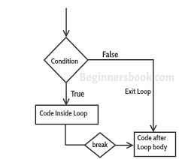
BREAK STATEMENT
Break statements Terminates the loop statement and transfers execution to the statement immediately following the loop.
Syntax:
while(condition):
if (test expression):
break
Transfer control out of the
while loop

Slide 18
Sample Output:
1
2
3
4
5
Good Bye
Example:
i=1
while(i<=10):
print(i)
if i==5:
break
i+=1
print("Good Bye")

Slide 19
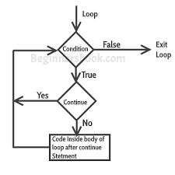
CONTINUE STATEMENT
Continue statements Causes the loop to skip the remainder of its body and immediately retest its condition prior to reiterating.
Syntax:
While(condition):
if (test expression):
continue
Transfer control to the condition
expression of the while loop

Slide 20
Sample Output:
Current Letter : P
Current Letter : y
Current Letter : t
Current Letter : o
Current Letter : n
Example:
for letter in 'Python':
if letter == 'h':
continue
print (“Current Letter :”, letter)

Slide 21
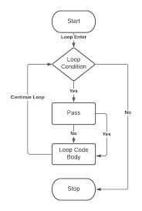
PASS STATEMENT
Pass statements in Python is used when a statement is required syntactically but you do not want any command or code to execute.
Syntax:
while(condition):
if (test expression):
pass
Null Operation

Slide 22
Sample Output:
1
2
3
4
5
6
7
8
9
10
Good Bye
Example:
i=1
while(i<=10):
print(i)
if i==5:
pass
i+=1
print("Good Bye")

Slide 23
STRING
MANIPULATION

Slide 24
STRING MANIPULATION
STRINGS
String in Python is a sequence of characters. It is a derived data type. Strings are immutable. This means that once defined, they cannot be changed.
String manipulation basically refers to the process of handling and analyzing strings. It involves various operations concerned with modification and parsing of strings to use and change its data. It offers a series of in-built functions to manipulate the contents of a string.

Slide 25
INDEXING
Indexing allows you to access individual characters in a string directly by using a numeric value. String indexing is zero-based: the first character in the string has index 0, the next is 1, and so on.
TRAVERSING A STRING
Traversing a string means accessing all the elements of the string one after the other by using the subscript. A string can be traversed using for loop or while loop.

Slide 26
Output:
message[ 0 ] = H
message[ 1 ] = E
message[ 2 ] = L
message[ 3 ] = L
message[ 4 ] = O
message[ 5 ] = !
Example:
message= "HELLO!"
index=0
for i in message:
print("message[",index, "] = ", i)
index += 1

Slide 27
CONCATENATING
The word concatenate means to join together. Python allows you to concatenation two strings using the “+” operator.
Example:
str1= "Hello "
str2= "World"
str3= str1+ str2
print("The concatenated string is : ",str3)
Output:
The concatenated string is : Hello World

Slide 28
APPENDING
Append mean to add something at the end. In Python you can add one string at the end of another string using the “+=” operator.
Example:
str = "Hello, "
name= input("\n Enter your name : ")
str += name
str += ". Welcome to python programming. "
print(str)
Output:
Enter your name : Ram
Hello, Ram. Welcome to python programming.

Slide 29
MULTIPLYING STRINGS
When you multiply a string by an integer, Python returns a new string. This new string is the original string, repeated X number of times (where X is the value of the integer).
Example:
str = "Hello "
print(str * 4)
Output:
HelloHelloHelloHello

Slide 30
STRINGS ARE IMMUTABLE
Python strings are immutable which means that once created they cannot be changed. Whenever you try to modify an existing string variable, a new string is created.
Example:
str = "Hi " #changes made here
new_str = "Bi "
print("Old string = ",str)
print("New string = ",new_str)
Output:
Old String = Hi
New String = Bi

Slide 31
STRING FORMATTING OPERATOR
This string formatting operator is one of the exciting features of python. The % operator takes a format string on the left (that has %d, %s, etc). The format operator, % allows users to construct strings, replacing parts of the string with the data stored in variables.
Syntax:
"<FORMAT> " % (<VALUES>)

Slide 32
FORMATTING SYMBOLS & PURPOSE
FORMAT SYMBOL | PURPOSE
%c | character
%d or %i | signed decimal integer
%s | string
%u | unsigned decimal integer
%o | octal integer
%x or %X | hexadecimal integer
%f | floating point number

Slide 33
BUILT-IN STRING METHODS
FUNCTION | DESCRIPTION | EXAMPLE
capitalize() | This is used to capitalize first letter of the string | str = "hello" print(str.capitalize()) Hello
center(width, fillchar) | returns a string with the original string centred to a total of width columns and filled with fillchar in columns | str = "hello" print(str.center(10, ‘*’)) **hello***
index(str, beg, end) | same as find but raises an exception if str is not found | text = "she is my best friend" print(text.index("mine",0,len(text))) ValueError: substring not found

Slide 34
rfind(str, beg, end) | same as find but starts searching from the end | str = "Is this your bag?" print(str.rfind("is",0,len(str))) 5
isalnum() | returns True if string has alphabet or a number | text = "JamesBond007" print(text.isalnum()) True
isalpha() | returns True if string has alphabet alone | text = "JamesBond007" print(text.isalpha()) False
isdigit() | returns True if string has digits alone | text = "007" print(text.isdigit()) True

Slide 35
islower() | returns True if all characters in the string are lower case | text = "JamesBond007" print(text.islower()) False
isupper() | returns True if all characters in the string are upper case | text = "HELLO" print(text.isupper()) True
len(string) | returns the length of the string | str = "Hello" print(len(str)) 5
isspace() | returns True if string contains white space | text = "hello world" print(text.isspace()) True

Slide 36
lstrip() | removes all leading whitespace in string | str = "Hello" print(str.lstrip()) Hello
rstrip() | removes all trailing whitespace in string | str = " Hello " print(str.rstrip()) Hello
strip() | removes all leading and trailing whitespace in string | str = "Hello " print(str.strip()) Hello
max(str) | removes the highest alphabetical character from the string str | str = "hello friendz" print(max(str)) z

Slide 37
min(str) | returns the lowest alphabetical character from the string str | str = "hello friendz" print(min(str)) d
swapcase() | toggles the case of every character | str = "The World Is Beautiful" print(str.swapcase()) tHE wORLD iS bEAUTIFUL
replace(old,new) | replaces all or maximum occurrences of old in string with new | str = "hellohellohello" print(str.replace("he", "Fo")) FolloFolloFollo
split(delim) | returns a list of substrings separated by the specified delimiter. if no delimiter with which the function is invoked | str = "abc,def,ghi,jkl" print(str.split(',')) ['abc', 'def', 'ghi', 'jkl']

Slide 38
SLICE OPERATION
A substring of a string is known as slice. The slice operation is used to refer to sub-parts of sequences and strings. You can take subset of a string from original string by using [] operator. Before slicing let us understand about index of strings.
Syntax for slice:
s[start:end]

Slide 39
P Y T H O N
0 1 2 3 4 5
-6 -5 -4 -3 -2 -1
INDEX
FROM
THE
START
INDEX
FROM
THE
END
Example:
str = "PYTHON"
print("str[1:5] = ",str[1:5])
print("str[:6] = ",str[:6])
print("str[1:] = ",str[1:])
print("str[:] = ",str[:])
print("str[1:10] = ",str[1:10])
Output:
str[1:5] = YTHO
str[:6] = PYTHON
str[1:] = YTHON
str[:] = PYTHON
str[1:10] = YTHON

Slide 40
ord() AND chr() FUNCTIONS
The ord() function returns the ASCII code of the character and the chr() function returns character represented by a ASCII number.
Example 1:
ch = 'R'
print(ord(ch))
Output:
82
Example 2:
print(chr(82))
Output:
R
Example 3:
print(chr(112))
Output:
p
Example 4:
print(ord('p'))
Output:
112

Slide 41
in AND not in OPERATORS
in and not in operators can be used with strings to determine whether a string is present in another string. Therefore, the in and not in operator are also known as membership operator.
Example 1:
str1 = "Welcome to the world of python!!!"
str2 = "the"
if str2 in str1:
print("Found")
else:
print("Not Found")
Output:
Found
Example 2:
str1 = "Welcome to the world of python!!!"
str2 = "mine"
if str2 in str1:
print("Found")
else:
print("Not Found")
Output:
Not Found

Slide 42
COMPARING STRINGS
OPERATOR | DESCRIPTION | EXAMPLE
== | if two strings are equal, it returns True | >>>"Abc" == "Abc" True
!= or <> | if two strings are not equal, it returns True | >>>"Abc" != "Abc" True >>>"abc" <> "Abc" True
> | if the first string is greater than the second, returns True | >>>"abc" > "Abc" True
< | if the second string is greater than the first, returns True | >>>"abc" < "abc" True
>= | first string is greater than or equal to second, returns True | >>>"abC" >= "ABC" True
<= | second string is greater than or equal to first, returns True | >>>"ABc" <= "ABc" True

Slide 43
ITERATING STRINGS
String is a sequence type(sequence of characters). You can iterate the string using for loop or while loop.
Example:
#iterate using while loop
str = "Welcome to Python"
index=0
while index < len(str):
letter = str[index]
print(letter, end=' ')
index += 1
Output:
W e l c o m e t o P y t h o n
Example:
#iterate using for loop
str = "Welcome to Python"
for i in str:
print(i, end=' ')
Output:
W e l c o m e t o P y t h o n

Slide 44
LIST
MANIPULATION

Slide 45
LIST
List in Python are ordered and have a definite count. The elements in a list are indexed according to a definite sequence and the indexing of a list is done with 0 being the first index. Each element in the list has its definite place in the list, which allows duplication of elements in the list, with each element having its own distinct place and credibility.
LIST MANIPULATION
List manipulation basically refers to the process of handling and analyzing lists. It involves various operations concerned with modification and parsing of list to use and change its data. It offers a series of in-built functions to manipulate the contents of a list.

Slide 46
ACCESS VALUES IN LIST
Lists can be sliced and concatenated. To access values in lists, square brackets are used to slice along with the index or indices to get values stored at that index.
SYNTAX :
seq=List[start : stop : step]

Slide 47
EXAMPLE :
OUTPUT:
First element in the list is 1
num_list[2:5] = [3 ,4, 5, 6]
num_list[ ::2 ] = [1 ,3 ,5 ,7 ,9]
num_list[ 1::3 ] = [2 , 5 , 9]
num_list = [1,2,3,4,5,6,7,8,9,10]
print("first element in the list is " , num_list[0])
print(" num_list[2:5] = ", num_list[2:5])
print(" num_list[ ::2 ] = ", num_list[ ::2 ])
print(" num_list[ 1::3 ] = ", num_list[ 1::3 ])

Slide 48
UPDATING VALUES IN LIST
Once created, one or more elements on a list can be easily updated using the slice operator to the left hand side of the Assignment operator. You can also append new values or remove existing values from the list using append() statement and del statement.

Slide 49
EXAMPLE:
num_list = [1,2,3,4,5,6,7,8,9,10]
num_list[5]= 100
print(" list after updation is : " ,num_list)
num_list.append(200)
print(" list after appending a value is : ", num_list)
del num_list[3]
print(" list after deleting a value is : " , num_list)
OUTPUT:
list after updating is : [1,2,3,4,5,100,7,8,9,10]
list after appending a value is : [1,2,3,4,5,100,7,8,9,10,200]
list after deleting a value is : [1,2,3,5,100,7,8,9,10,200]

Slide 50
NESTED LISTS
Nested list means list within another list. You can specify the elements in the nested list by using the set of indices. The first index specifies the starting location of the nested list and second index specifies the index of the element within the nested list.

Slide 51
OUTPUT:
List1[0] = 1
List1[1] = a
List1[2] = abc
List1[3] = [2, 3, 4, 5]
List1[4] = 8.9
EXAMPLE:
list1= [1, 'a' , "abc" , [2,3,4,5] , 8.9]
i=0
while i<(len(list1)):
print("list1[",i,"] = " ,list1[i] )
i+=1

Slide 52
ALIASING
When we assign one variable or element to the other, both of them actually point to the same variable or object in Memory. Aliasing can be useful but it can sometime produce unexpected and undesirable results.

Slide 53
EXAMPLE:
list1=[1,2,3,4,5]
list2=[1,2,3,4,5]
print(" list1==list2: " ,list1==list2)
print(" list1 is list2: " ,list1 is list2)
list1=list2
print(" list1==list2: " ,list1==list2)
print(" list1 is list2: " ,list1 is list2)
OUTPUT
list1 == list2 : True
list1 is list2 : False
list1 == list2 : True
list1 is list2 : True

Slide 54
CLONING LISTS
If you want to modify the list and also keep the copy of the original list, then you should create a separate copy of the list. This process is called as CLONING. The slice operation is used to clone a list.

Slide 55
EXAMPLE:
list1=[1,2,3,4,5,6,7,8,9,10]
list2 = list1
print(" list1 = " , list1)
print(" list2 = " , list2)
list3 = list1[2 : 6 ]
print(" list3 = " , list3)
OUTPUT:
list1 = [1,2,3,4,5,6,7,8,9,10]
list2 = [1,2,3,4,5,6,7,8,9,10]
list3 = [3,4,5,6]

Slide 56
BASIC LIST OPERATIONS
OPERATION | DESCRIPTION | EXAMPLE | OUTPUT
len | Returns length of list | len([1,2,3,4,5,6,7,8,9,10]) | 10
concatenation | Joins two list | [1,2,3,4,5]+[6,7,8,9,10] | [1,2,3,4,5,6,7,8,9,10]
repetition | Repeats element in the list | [“Hello”, ”World”]*2 | [‘Hello’,’World’,’Hello’,’World’]
in | Checks if the value is present in the list | ‘a’ in [‘a’,’e’,’i’,’o’,’u’] | True
not in | Checks if the value is not present in the list | 3 not in [0,2,4,6,8] | True
max | Returns maximum values in the list | >>>num_list=[6,3,7,0,1,2,4,9] >>>print(max(num_list)) | 9
min | Returns the minimum value in the list | >>>num_list=[6,3,7,0,1,2,4,9] >>>print(min(num_list)) | 0

Slide 57
OPERATION | DESCRIPTION | EXAMPLE | OUTPUT
sum | Adds the value in the list that has numbers | num_list = [1,2,3,4,5,6,7,8,9,10] print(“SUM=”,sum(num_list)) | SUM=55
all | Returns True if all elements of the list are true | >>>num_list=[0,1,2,3] >>>print(all(num_list)) | False
any | Returns true if any element of the list is true. if the list is empty it returns false | >>>num_list=[6,3,7,0,1,2,4,9] >>>print(any(num_list)) | True
list | Converts an iterable to a list. | >>>list1=list(“HELLO”) >>>print(list1) | [‘H’,’E’,’L’,’L’,’O’]
sorted | Returns a new sorted list. The original list is not sorted | >>>list1=[3,4,1,2,7,8] >>>list2=sorted(list1) >>>print(list2) | [1,2,3,4,7,8]

Slide 58
LIST METHODS
METHOD | DESCRIPTION | SYNTAX | EXAMPLE | OUTPUT
append() | Appends an element to the list. In insert(), if the index is 0,then element is inserted as the first element and if we write,list.insert(len(list),obj),it inserts object as the last element in the list. | list.append(obj) | num_list=[6,3,7,0,1,2,4,9] num_list.append(10) print(num_list) | [6,3,7,0,1,2,4,9,10]
count() | Counts the number of times an element appears in the list | list.count(obj) | print(num_list.count(4)) | 1
index() | Returns the lower index of obj in the list.Gives an error value if obj is not present | list.index(obj) | >>>num_list=[6,3,7,0,3,6,7,0] >>>print(num_list.index(7)) | 2

Slide 59
METHOD | DESCRIPTION | SYNTAX | EXAMPLE | OUTPUT
insert() | Inserts object at the specified index in the list. | list.index(index,obj) | >>>num_list=[6,3,7,0,3,7,6,0] >>>num_list.insert(3,100) >>>print(num_list) | [6,3,7,100,0,3,7,6,0]
pop() | Removes the element at the specified index from the list.Index is an optional parameter. If no index is specified it removes the last element. | list.pop([index]) | num_list=[6,3,7,0,1,2,4,9] print(num_list.pop()) print(num_list) | 9 [6,3,7,0,1,2,4]
remove() | Removes or deletes object from the list.Valueerror is generated if obj is not present in the list.if multiple objects exist then the first value Is deleted | List.remove() | >>>num_list=[6,3,7,0,1,2,4,9] >>>num_list.remove(0) >>>print(num_list) | [6,3,7,1,2,4,9]

Slide 60
METHOD | DESCRIPTION | SYNTAX | EXAMPLE | OUTPUT
reverse() | Reverse the elements in the list. | list.reverse() | >>>num_list=[6,3,7,0,1,2,4,9] >>>num_list.reverse() >>>print(num_list) | [9,4,2,1,7,6,3]
sort() | Sorts the element in the list. | list.sort() | >>>num_list=[6,3,7,0,1,2,4,9] >>>num_list.sort() >>>print(num_list) | [9,4,2,1,0,7,6,3]
extend() | Adds the element to a list at the end of the another list. Using + or += on a list is similar to using extend() | list1.extend(list2) | >>>num_list1=[1,2,3,4,5] >>>num_list2=[6,7,8,9,10] >>>num_list1.extend(num_list2) >>>print(num_list1) | [1,2,3,4,5,6,7,8,9,10]

Slide 61

HOMEWORK
Write a program to print the smallest of three digits?
Write a program to check whether a number is positive, if yes print “TRUE” else print “FALSE” ?

Slide 62


